Slide 1


Unit 2: Conflict and Resolution
Lesson 1: How did the First World War begin and why did Britain fight?
Notes:
Hook: Prepare an engaging hook to introduce pupils to the new unit. You could: show photographs, read a story, show a video, or something more creative.

Slide 2
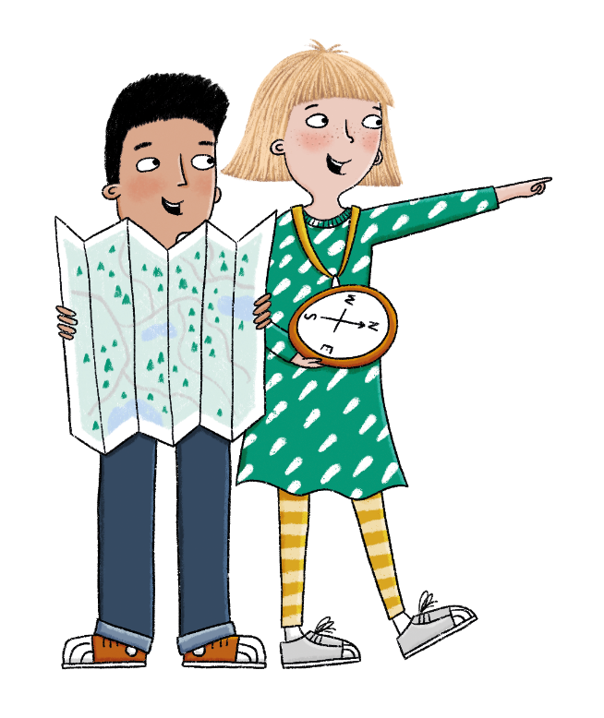
How and why did Britain fight in two world wars, and how did they change British society?
Notes:
Share the unit Enquiry question ‘How and why did Britain fight in two world wars, and how did they change British society?’ and explain that all lessons in this unit will support the pupils in answering this question at the very end. Each lesson has its own question, and they should be able to answer each of these individually too.

Slide 3


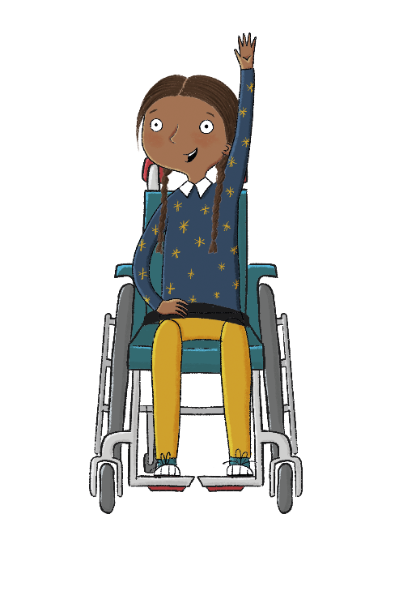
What do you know about the First and Second World Wars?
Lesson 1:
What questions do you have?
Notes:
Existing knowledge exercise: Gauge pupils’ current knowledge of the First and Second World Wars. What questions to they have at this point?

Slide 4
How did the First World War begin and why did Britain fight?
Why did a second war break out in 1939?
1
Who fought for Britain in the First World War?
How did Britain fight in the Second World War?
What was trench warfare?
What was the impact of the Second World War on Britain?
What did women do during the First World War?
How successful was Britain in rebuilding after the Second World War?
How did the First World War end and what followed?
What measures were put in place to maintain peace after the Second World War?
Notes:
Introduction: Share the learning journey. Then begin by sharing the lesson statement, key term, other key vocabulary and the key knowledge with pupils. . Discuss any key words that the pupils already know and the definitions of any new words. Before the content of the lesson begins, investigate the Timeline resource with the pupils. Show that this unit brings their study of history into far more recent times, and that some parts of this unit are still within living memory.

Slide 5

Lesson 1:
In this lesson we are learning about the causes of the
First World War.

Slide 6
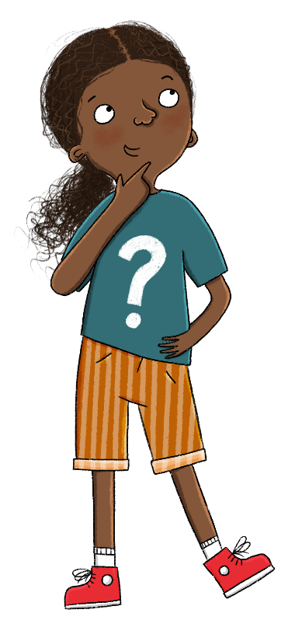
Lesson 1:
The key word for this lesson is alliance.
An alliance is an agreement between countries or political parties to work together to achieve something.

Slide 7

How did the First World War begin and why did Britain fight?
Lesson 1:
Archduke Franz Ferdinand, the Austro-Hungarian heir, was killed on 28 June 1914 in Sarajevo.
The Triple Entente was made up of the British, French, and Russian empires.
The Triple Alliance was made up of the German, Austro-Hungarian, and Italian empires.
alliance
annexed
assassinate
colonies
Empire
propaganda
Triple Alliance
Triple Entente

Slide 8
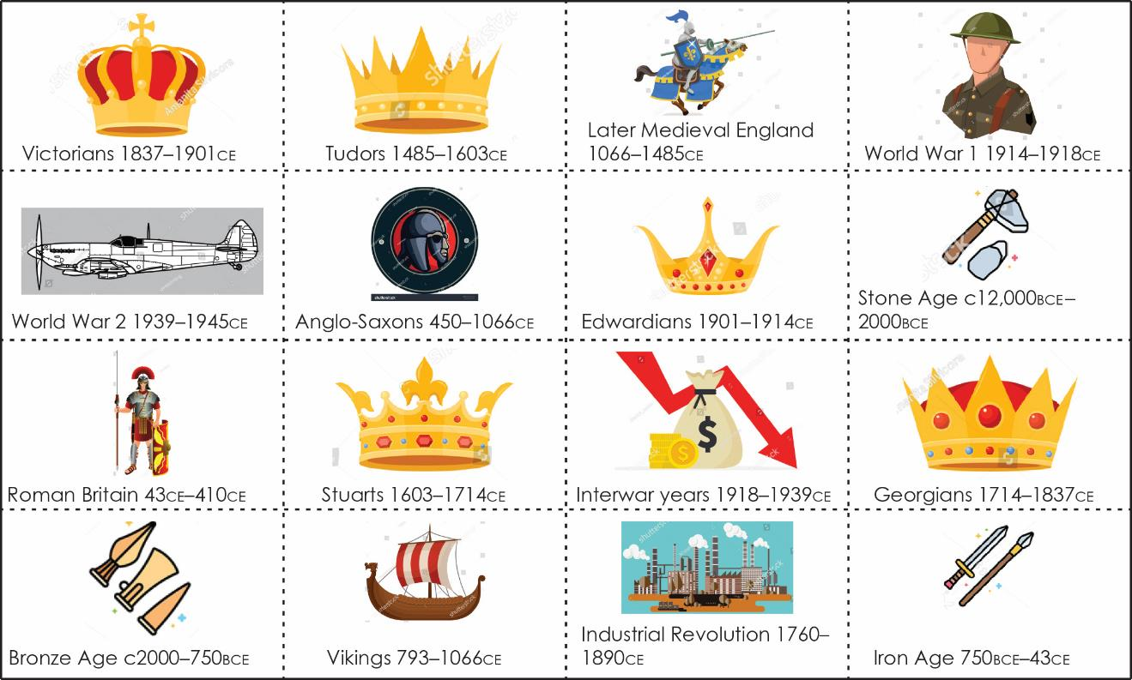
Put these cards in order to form a timeline of British History.
Lesson 1:
Notes:
Group task: Timeline activity. Remind pupils that they have learned about the ancient history of Britain (Years 3 to 5) and about its previous kings and queens (Year 2). This unit covers more modern history from 1914 onwards, specifically the First and Second World Wars and their effect on Britain. To enable pupils to track the progression of British history, they will order the events on each card from the oldest to the most recent, using Additional resource: Timeline of British History.

Slide 9

Modern history, and sources and evidence
Lesson 1:
We are living through our own period of history. Even though it is much more modern than some of the periods you have studied.
Today, we have access to much more evidence than in ancient times because there are many more ways to record and find information. For example, we can use photographs, film, audio recordings, and online material. This means there is a lot more evidence to tell us about modern history. However, it also means
the evidence can sometimes be contradictory. This can make it difficult to know the truth about what happened.
Notes:
Read: ‘Modern history, and sources and evidence’ (slides only). This should start pupils thinking about the huge number and type of sources available when studying modern history as they will be in this unit.

Slide 10


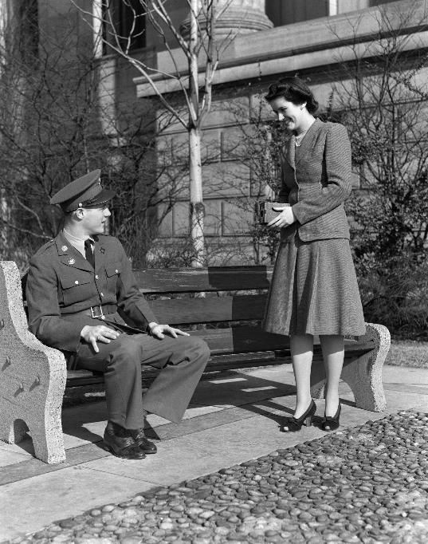
Why do we know more about modern history than the times before?
How is this useful for historians?
Lesson 1:
Notes:
Talk task: Ask pupils the questions ‘Why do we know more about British history than the times before?’ and ‘How is this useful for historians?’. Pupils should identify that there are many more ways to record historical events in the 20th century, for example photographs, film, audio, newspapers, written accounts from a large number of people, etc. This helps historians by helping them gain a fuller picture of the past.

Slide 11
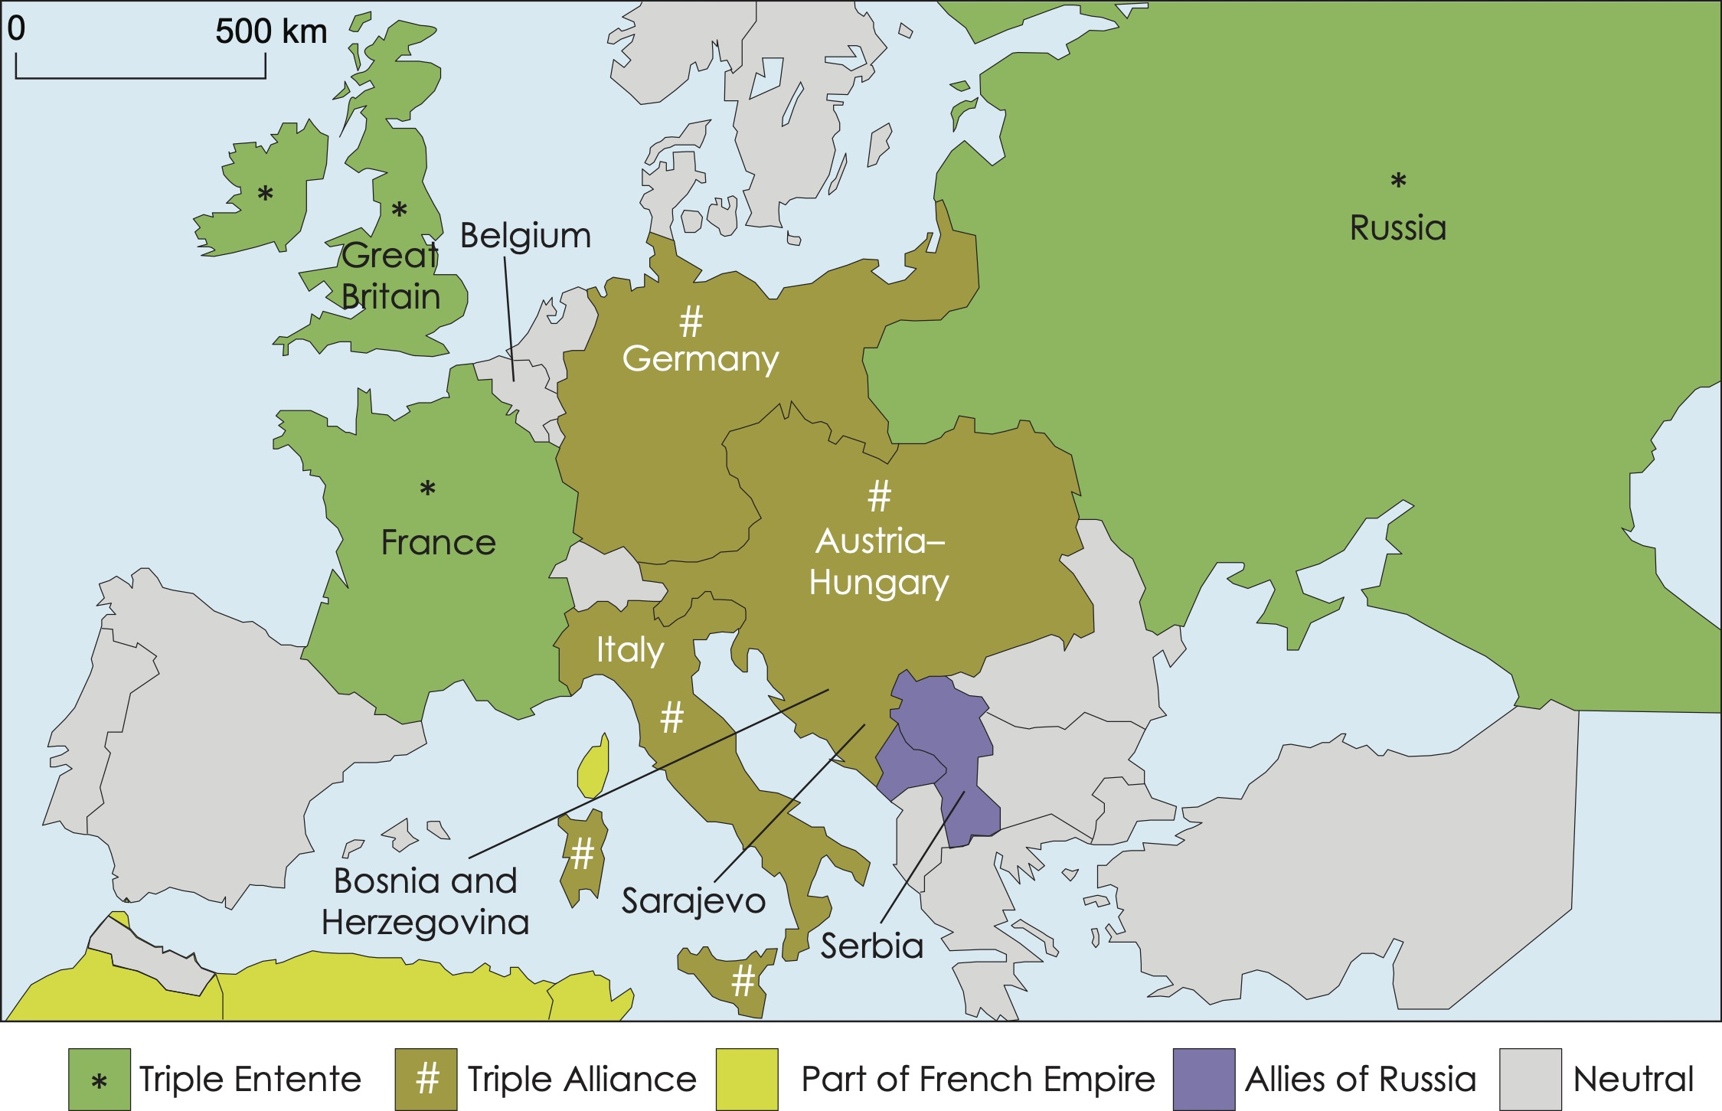
What were the alliances in Europe in 1914?
Lesson 1:
When countries are allies, their governments agree to support and help each other. If one country in an alliance is attacked, then often that country’s allies will come to its defence.
By 1914 the most powerful countries in Europe were split into two alliances. The Triple Alliance and the Triple Entente.
Notes:
Read: ‘What were the alliances in Europe in 1914?’. This text will help to introduce the events prior to the outbreak of the First World War.

Slide 12
What were the alliances in Europe in 1914?
Lesson 1:
People believed that this system helped prevent war. However, most historians believe that the alliance system was a major reason why the biggest war the world had ever seen broke out in 1914.

Slide 13
Look at the map and answer the following questions:
Lesson 1:
1. Which countries made up the Triple Entente?
2. Which countries made up the Triple Alliance?
Notes:
Retrieval: Pupils answer the retrieval questions independently. Answers are provided on the following slide.

Slide 14
Look at the map and answer the following questions:
Lesson 1:
1. Which countries made up the Triple Entente?
Britain, France, and Russia
2. Which countries made up the Triple Alliance?
Germany, Austria–Hungary, and Italy

Slide 15
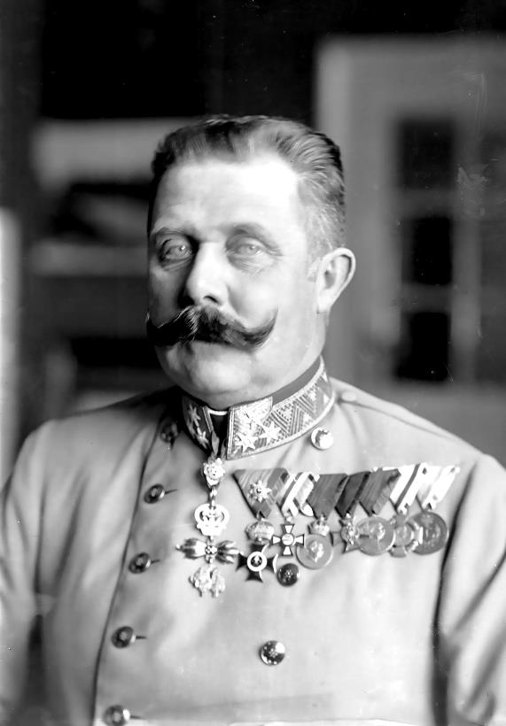
How did the killing of Archduke Franz Ferdinand lead to war?
Lesson 1:
Archduke Franz Ferdinand was the heir to the Austro-Hungarian throne. Austria–Hungary annexed Bosnia and Herzegovina in 1908. This angered some Serbians who thought that the territories should have been part of Serbia. This anger led to a plan to assassinate the Archduke.
Archduke Franz Ferdinand
Notes:
Read: ‘How did the killing of Archduke Franz Ferdinand lead to war?’. Explain who Archduke Franz Ferdinand was and how his assassination acted as a catalyst for the First World War. If necessary, remind pupils about empires by linking to previous learning, such as on the Roman Empire.

Slide 16
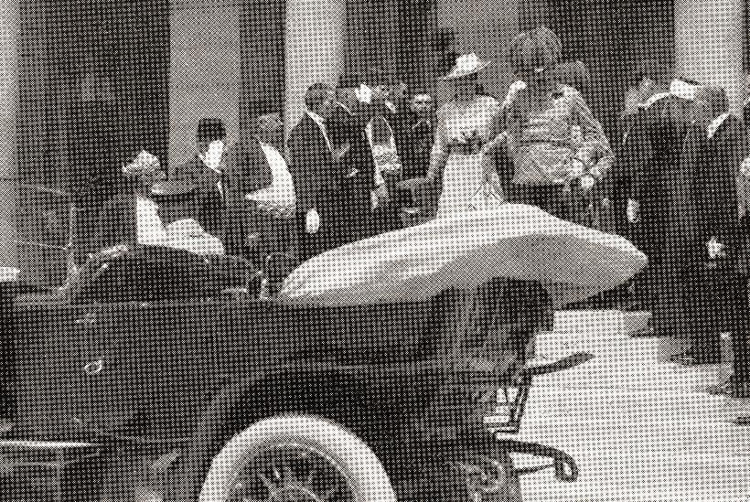
How did the killing of Archduke Franz Ferdinand lead to war?
Lesson 1:
On a visit to Sarajevo in Bosnia on 28 June 1914, Gavrilo Princip shot and killed the Archduke and his wife.
The alliances between Serbia and Russia, and Austria–Hungary and Germany sparked a chain of events that led to the outbreak of the First World War.

Slide 17
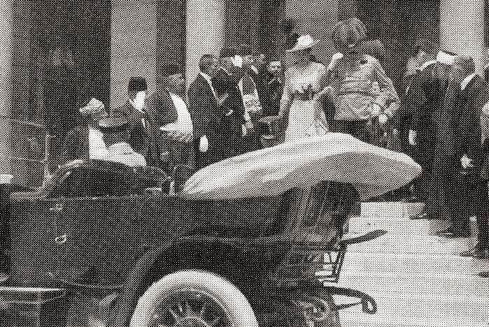
How did the killing of Archduke Franz Ferdinand lead to war?
Lesson 1:
Austria–Hungary immediately blamed the Serbian government and, because Russia supported Serbia, Austria asked Germany for support.
With Germany’s support, Austria–Hungary declared war on Serbia on 28 July 1914. Russia then declared war on Austria–Hungary to support Serbia. As a result of their alliance with Austria–Hungary, Germany declared war on Russia and then Russia’s ally, France.

Slide 18
Why did Britain declare war on Germany?
Lesson 1:
Britain’s alliance with France and Russia did not include an agreement to go to war if France or Russia were attacked, so why did Britain get involved in the war?
Germany planned to attack France through neutral Belgium. As well as being in an alliance with France and Russia, Britain had promised to defend Belgium under the Treaty of London, 1839. If Germany had gained control of Belgium, it would have been a serious threat to Britain. Germany was also growing its naval power and Britain was fearful of any challenge to its navy and the security of the British Isles. Because of these actions, shortly after Germany declared war on France, Britain declared war on Germany.
Notes:
Read: ‘Why did Britain declare war on Germany?’.

Slide 19
Read the five key causes of World War One. Add the numbers 1 to 5 to put them in chronological order, with being the first thing that happened.
Lesson 1:
Russia supported Serbia and declared war on Austria–Hungary. | Britain declared war on Germany. | Archduke Franz Ferdinand was killed. | Germany declared war on Russia and France. | Austria–Hungary, supported by Germany, declared war on Serbia.
Notes:
Group task: Read through the five key causes of the First World War and ask pupils to order them chronologically with 1 being the first thing that happened. Answers are provided on the following slide.

Slide 20
Read the five key causes of World War One. Add the numbers 1 to 5 to put them in chronological order, with 1 being the first thing that happened.
Lesson 1:
Russia supported Serbia and declared war on Austria–Hungary. | Britain declared war on Germany. | Archduke Franz Ferdinand was killed. | Germany declared war on Russia and France. | Austria–Hungary, supported by Germany, declared war on Serbia.
3 | 5 | 1 | 4 | 2

Slide 21
Do you think the shooting of Franz Ferdinand started the First World War?
Lesson 1:
Notes:
Write: Pupils answer the question ‘Do you think the shooting of Archduke Franz Ferdinand started the First World War?’, using the table to support their answers. Hopefully most pupils will grasp that the assassination may have been the immediate cause but was certainly not the only reason why war broke out on such a large scale.

Slide 22

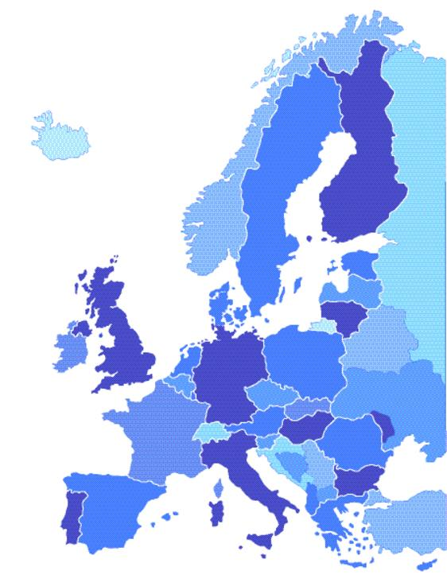

Can you find the countries Britain, Germany, France, Italy, Russia, Austria, and Hungary on the map?
Do you think today’s countries’ borders have always been that way?
Lesson 1:
Notes:
Talk task: Ask pupils the questions ‘Can you find the countries Britain, Germany, France, Italy, Russia, Austria, and Hungary on the map?’ and ‘Do you think today’s countries’ borders have always been that way?’. Pupils should identify countries on the modern-day map and discuss how country borders aren’t set in stone and change depending on empires/politics, etc.

Slide 23
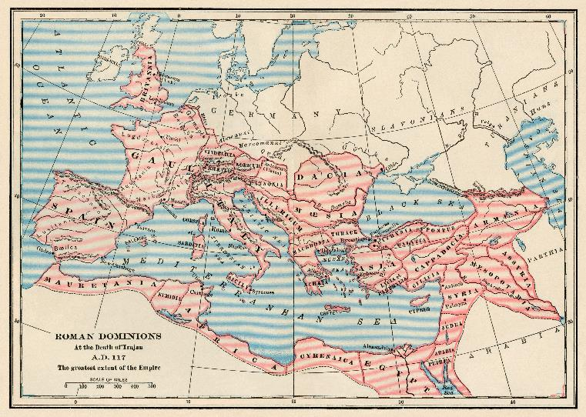
How was it a ‘world’ war?
Lesson 1:
All of the countries involved in the war each ruled an empire. Usually an empire would be a territory greater than a single kingdom. An example you may have come across before is the Roman Empire.

Slide 24

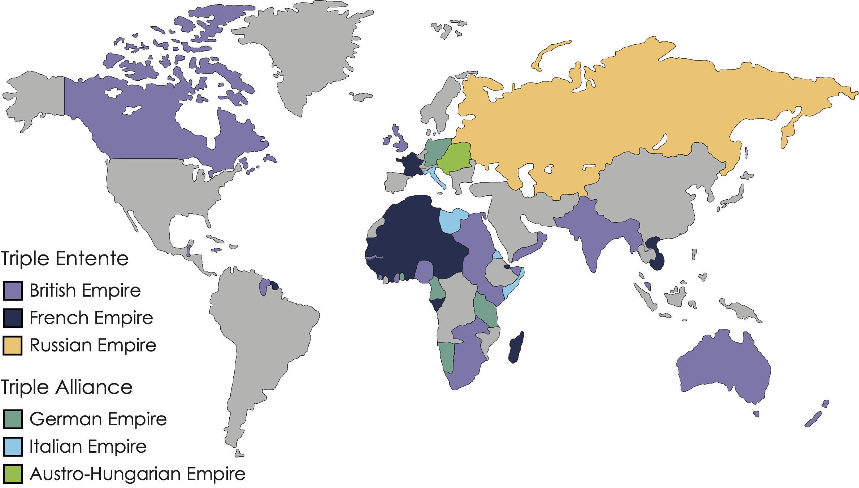
Lesson 1:
Here is a map of the world in 1914. What does this map tell us?
What countries were part of the British Empire at this time?
Notes:
Talk task: Ask pupils the questions 'Here is a map of the world in 1914. What does this map tell us?' and 'What countries were part of the British Empire at this time?'. The map shows the empires within the Triple Entente and Triple Alliance. Answers: The countries in the British Empire were Canada, Australia, New Zealand, India, British Guiana, Sierra Leone, Gold Coast, Nigeria, South Africa, Swaziland, Rhodesia, Kenya, Sudan, Egypt, Uganda, British Somaliland, Burma, Malaya, Brunei, British North Borneo, Sarawak, Papua New Guinea, and Fiji. Note that some of the country names have now been updated, but the names stated here were used at the time.

Slide 25
How was it a ‘world’ war?
Lesson 1:
The British Empire began in the 16th century. Companies such as the East India Trading Company began forming trading posts and settlements overseas. In the 17th and 18th centuries, the British Empire mainly controlled its colonies through trade. Later, the British took more direct political control.
Notes:
Read: The remainder of 'How was it a 'world' war?'. To give context to pupils, explain that the British Empire, like other empires, controlled colonies around the world and were able to get resources and people from them in times of need.

Slide 26
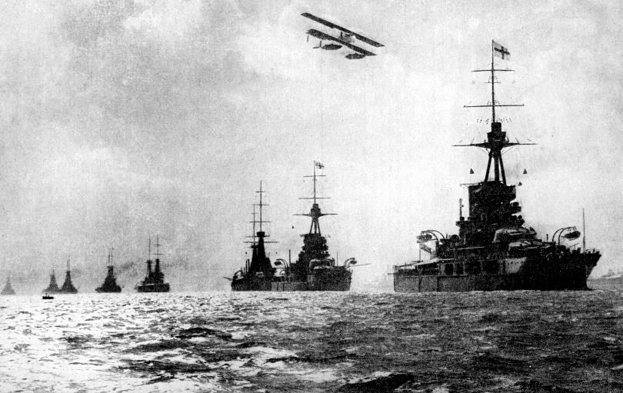
How was it a ‘world’ war?
Lesson 1:
With Britain’s entry into the war, its colonies provided military and financial help in the form of supplies (such as food) and soldiers. In 1914, Britain had the largest empire and ruled over as many as 56 colonies. The British Royal Navy was also the largest in the world.

Slide 27
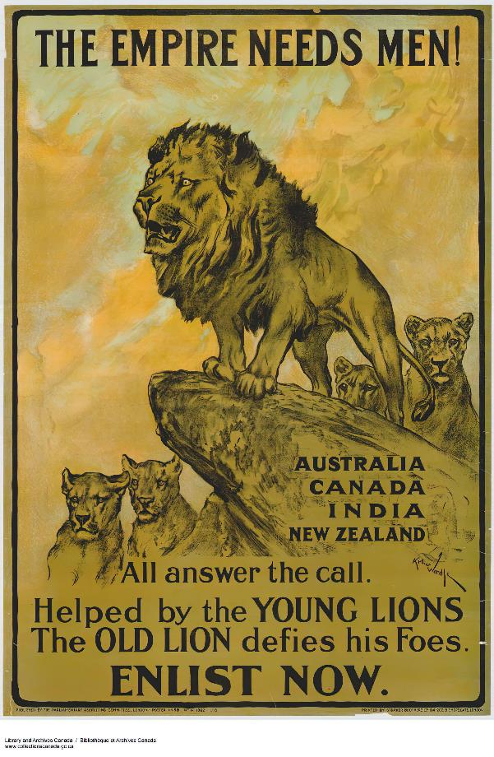
Analysing a source
Lesson 1:
Who?
Where?
What?
Why?
Notes:
Investigation: Pupils analyse a source. This propaganda poster is an example of one created specifically for people from the British Empire colonies, which aims to persuade people to join the British army. Answers are provided on the following slide. You could finish this lesson by reinforcing the causes of the First World War and explaining that we will find out about the consequences of the war in Lessons 2 to 5.

Slide 28
Analysing a source
Lesson 1:
Who?
People from the British Empire colonies.
Where?
Australia, Canada, India, and New Zealand.
What?
Enlist in the British Army.
Why?
To fight against Germany and its allies.

Slide 29
How did the First World War begin and why did Britain fight?
Lesson 1:
Notes:
Learning review: Using the slides, talk partners tell each other a response to the lesson question. Add further review questions if you wish to. Pupils should write an independent response into their Knowledge record for this lesson.

Slide 30
How did the First World War begin and why did Britain fight?
Lesson 1:
Archduke Franz Ferdinand, the Austro-Hungarian heir, was killed on 28 June 1914 in Sarajevo.
The Triple Entente was made up of the British, French, and Russian empires.
The Triple Alliance was made up of the German, Austro-Hungarian, and Italian empires.
alliance
annexed
assassinate
colonies
Empire
propaganda
Triple Alliance
Triple Entente

