Slide 1

Welcome to 5DL and 5WB!
Notes:
M

Slide 2
Meet the Team
5DL: Mr Leeming
5WB: Mr Bailey
Teaching Assistants:
Miss Sutton
Miss Cull
Mrs Walker
Notes:
N

Slide 3
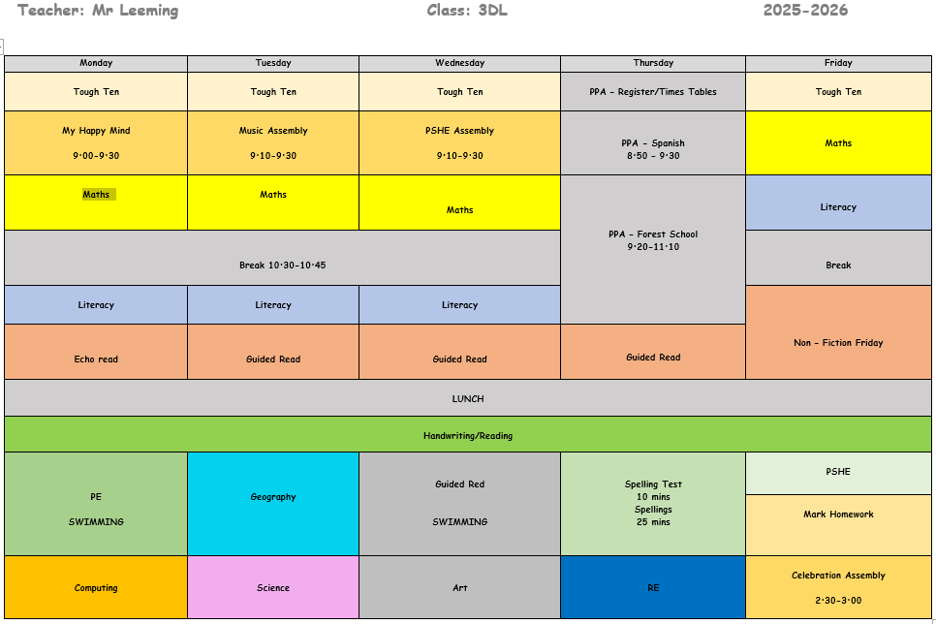
The School Day
The school day in Year 5 is very similar to Year 4. Maths, English and guided reading are taught every day.
8:40- doors open.
8:50- classroom doors will close. If you arrive after this time, you need to go through the office.
3:10- end of the day. Children leave through the stairs/hall doors.
Notes:
M

Slide 4
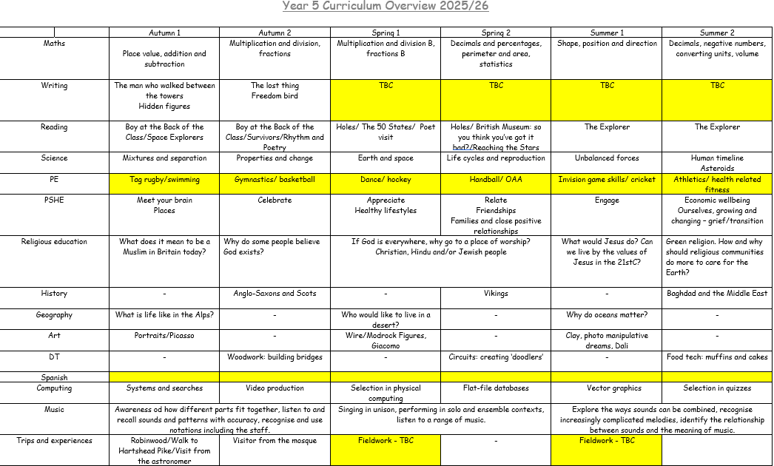
Curriculum Overview
Notes:
N

Slide 5


Homework
We no longer use Century Tech or HWK mats!
For maths and Spag homework, we have bought all the children CGP books from which HWK will be set.
We still use Spelling Shed for spelling practise.
Homework will be set each Friday and he children will have a week to complete.
Homework books will be marked as a class each Friday.
Please continue to read as much as you can. If you want to share and upload any affitional prjects/experience to share, please so so through Class Dojo or bring it in to share and display in the classroom!
Notes:
N

Slide 6
What can you do to support your child?
Maths
Play times tables games, these are easily forgotten if not practiced regularly and are so important in everyday maths lessons.
Play mental maths games including counting in different amounts, forwards and backwards.
Encourage opportunities for telling the time, counting coins and money; finding amounts or calculating change when shopping.
Identify, weigh or measure quantities and amounts in the kitchen or in recipes.
Use TTRockstars and Hit the Button for regular practice.

Slide 7

Homework
Children should also read for 15 minutes every night, with an adult signing their reading diary each week. Dojos are awarded and raffle tickets for the book vending machine are given for children reading regularly at home!
Login details for spelling shed are stuck into the children’s reading diaries. New spellings/spelling tests are on Fridays, and the children are given the opportunity to practise spellings in school throughout the week.
Notes:
M

Slide 8
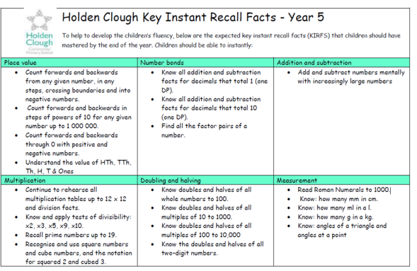


Maths
Maths is taught in Year 5 using two main schemes; White Rose and Deeper understanding which are designed to promote a deeper understanding in all areas of mathematics.
Maths in year 5 is structured in a way whereby Children first of all develop fluency skills, before progressing onto opportunities to reason, before then engaging in problem solving.

Slide 9
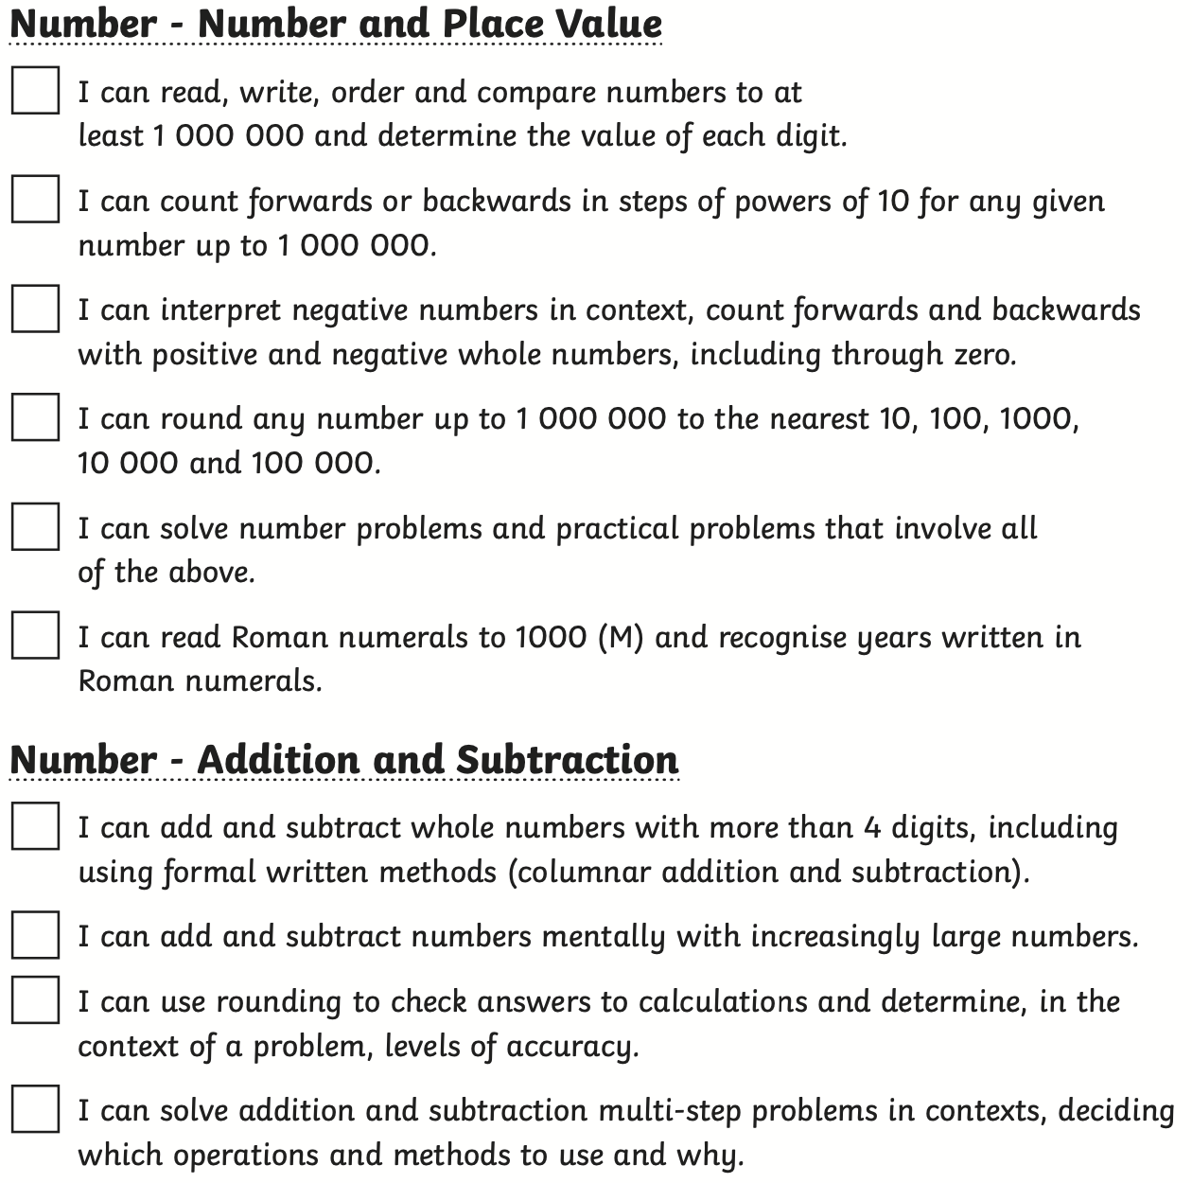
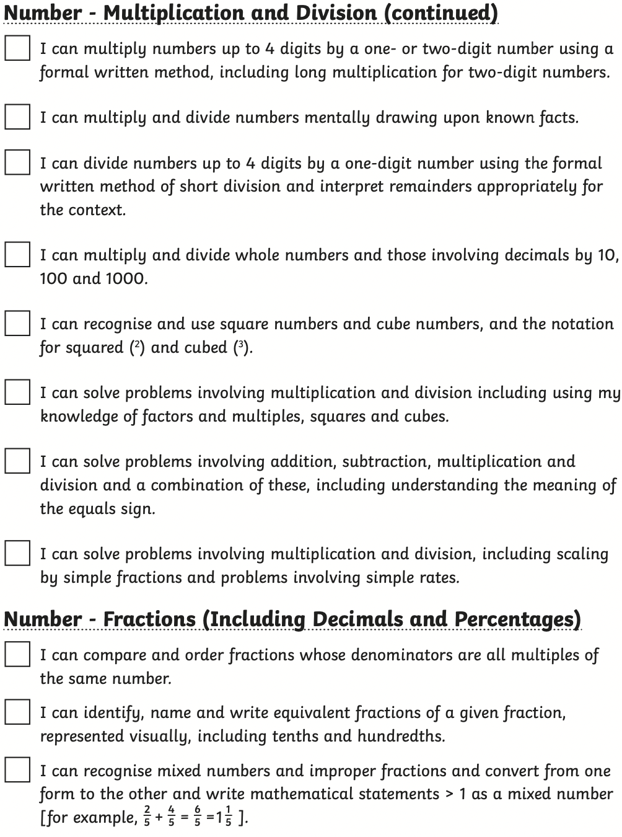
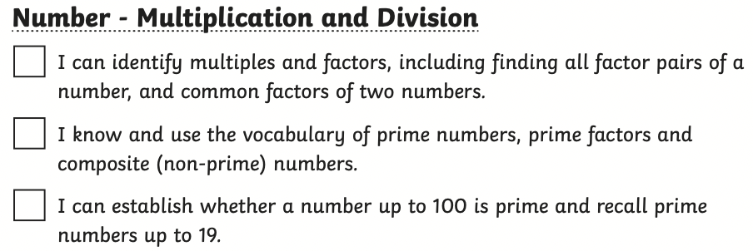
Expectations for Maths
Notes:
M

Slide 10
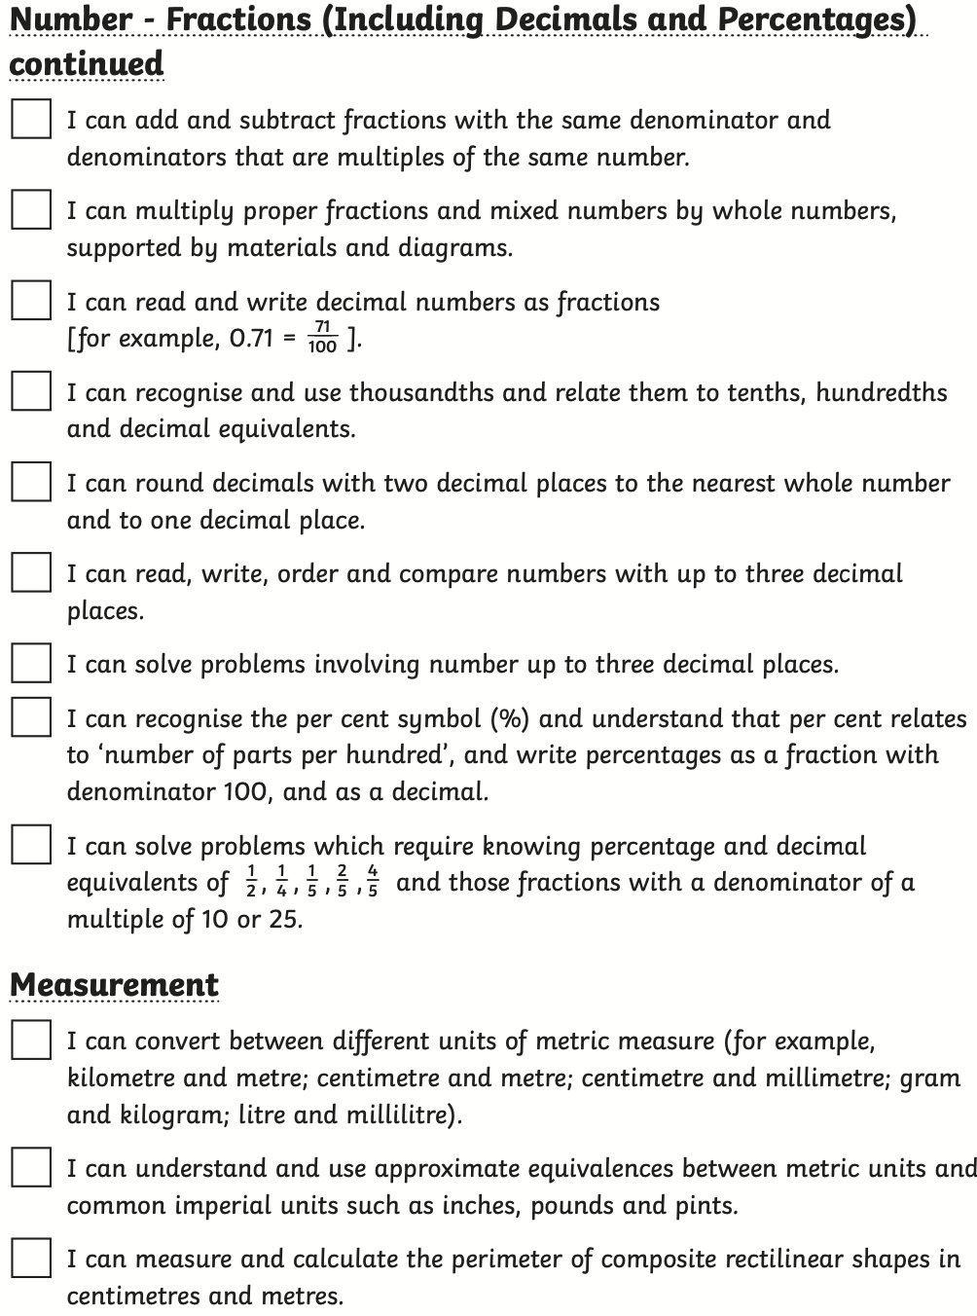
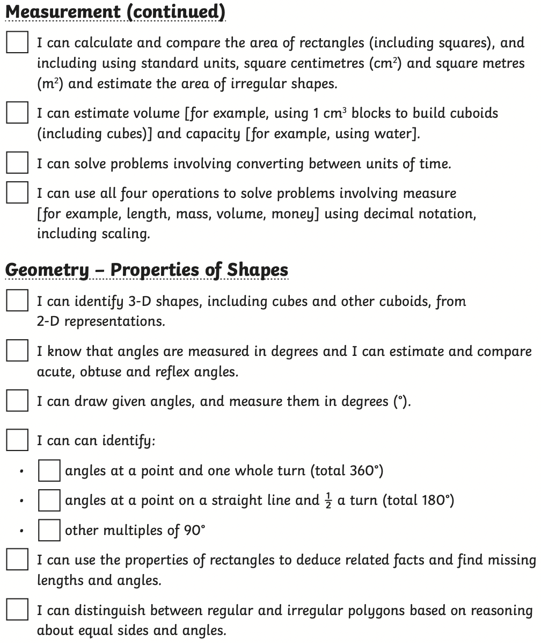
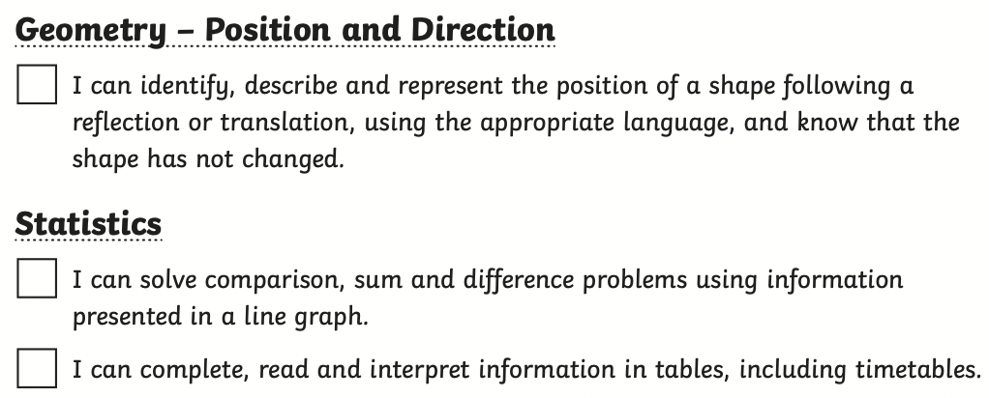
Expectations for Maths
Notes:
M

Slide 11
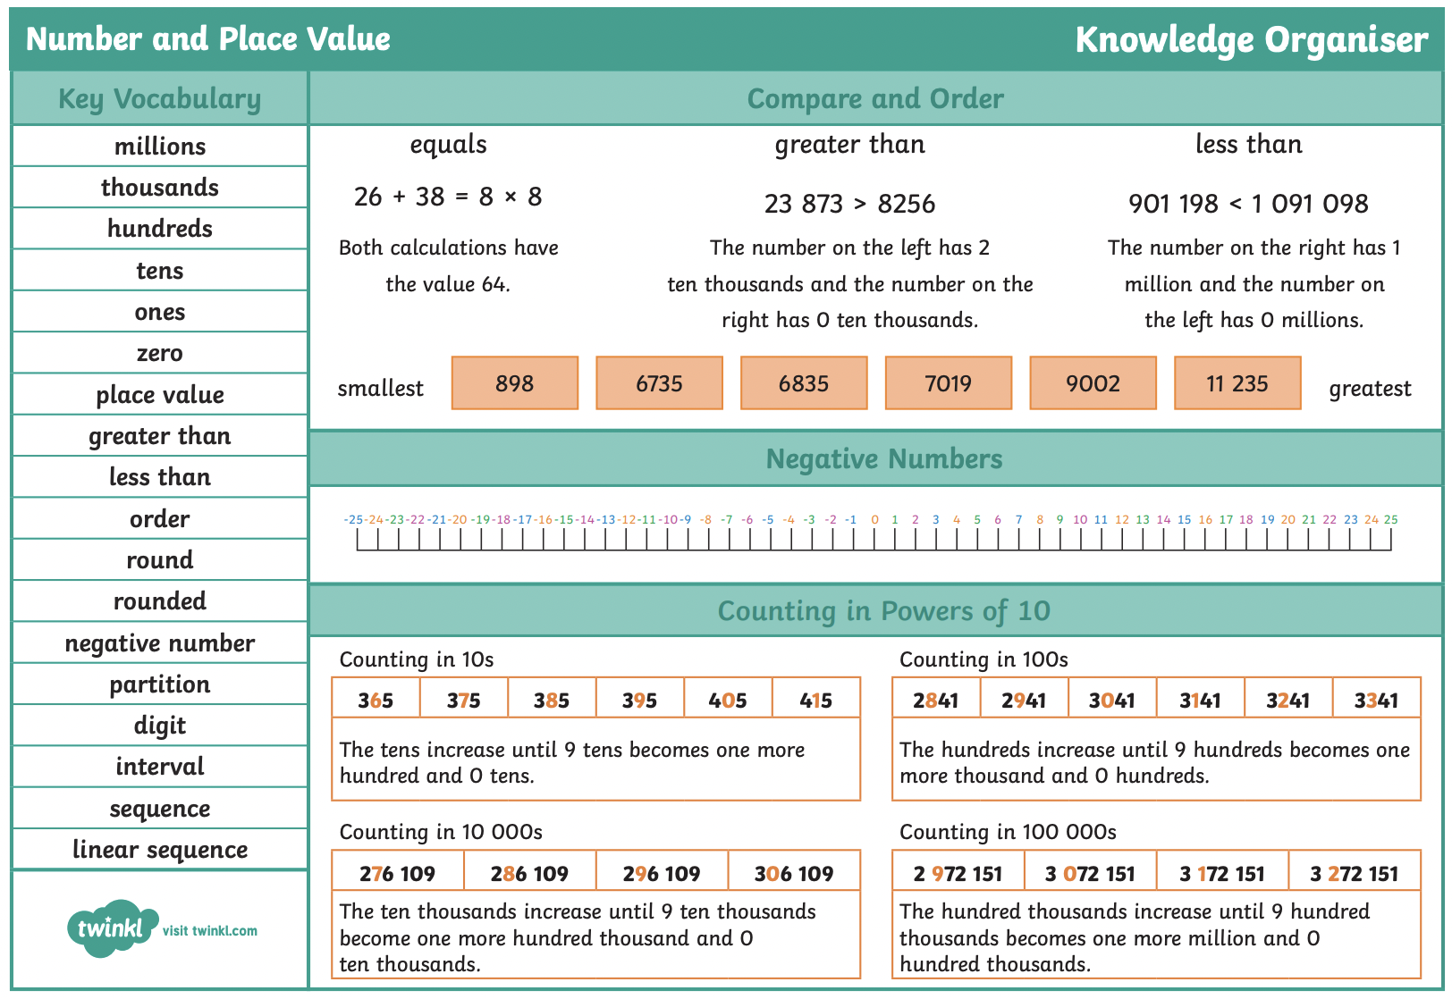
Knowledge Organisers for all topics can be found on the school website…
Notes:
M

Slide 12
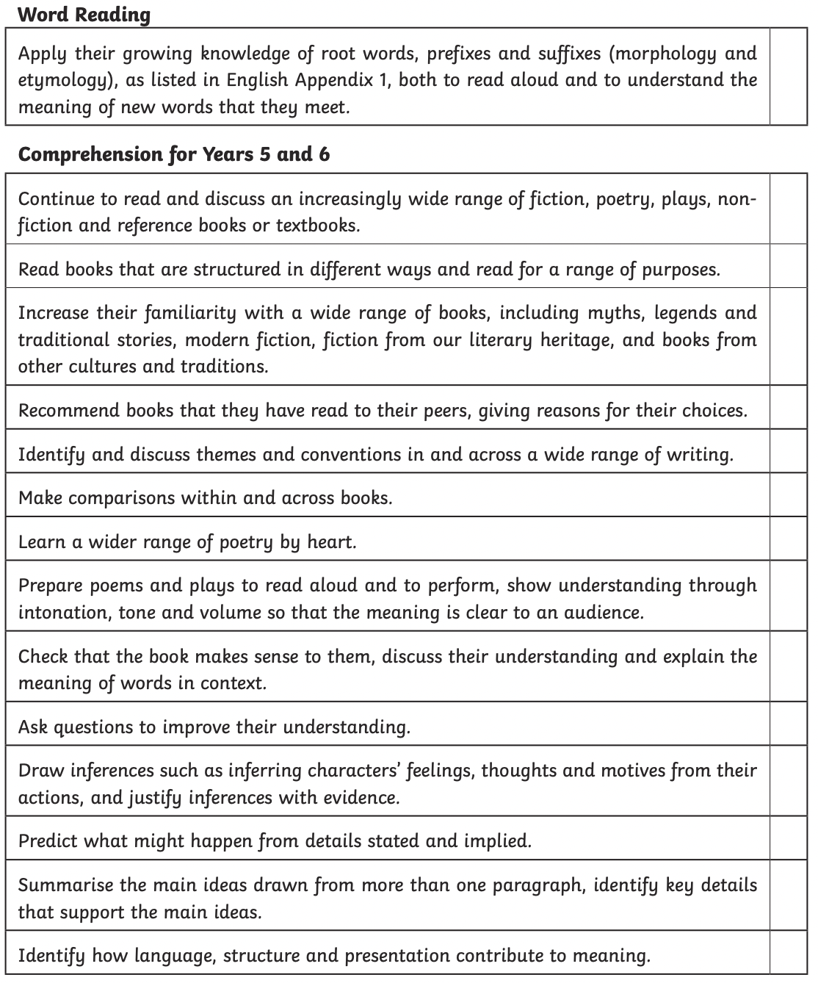
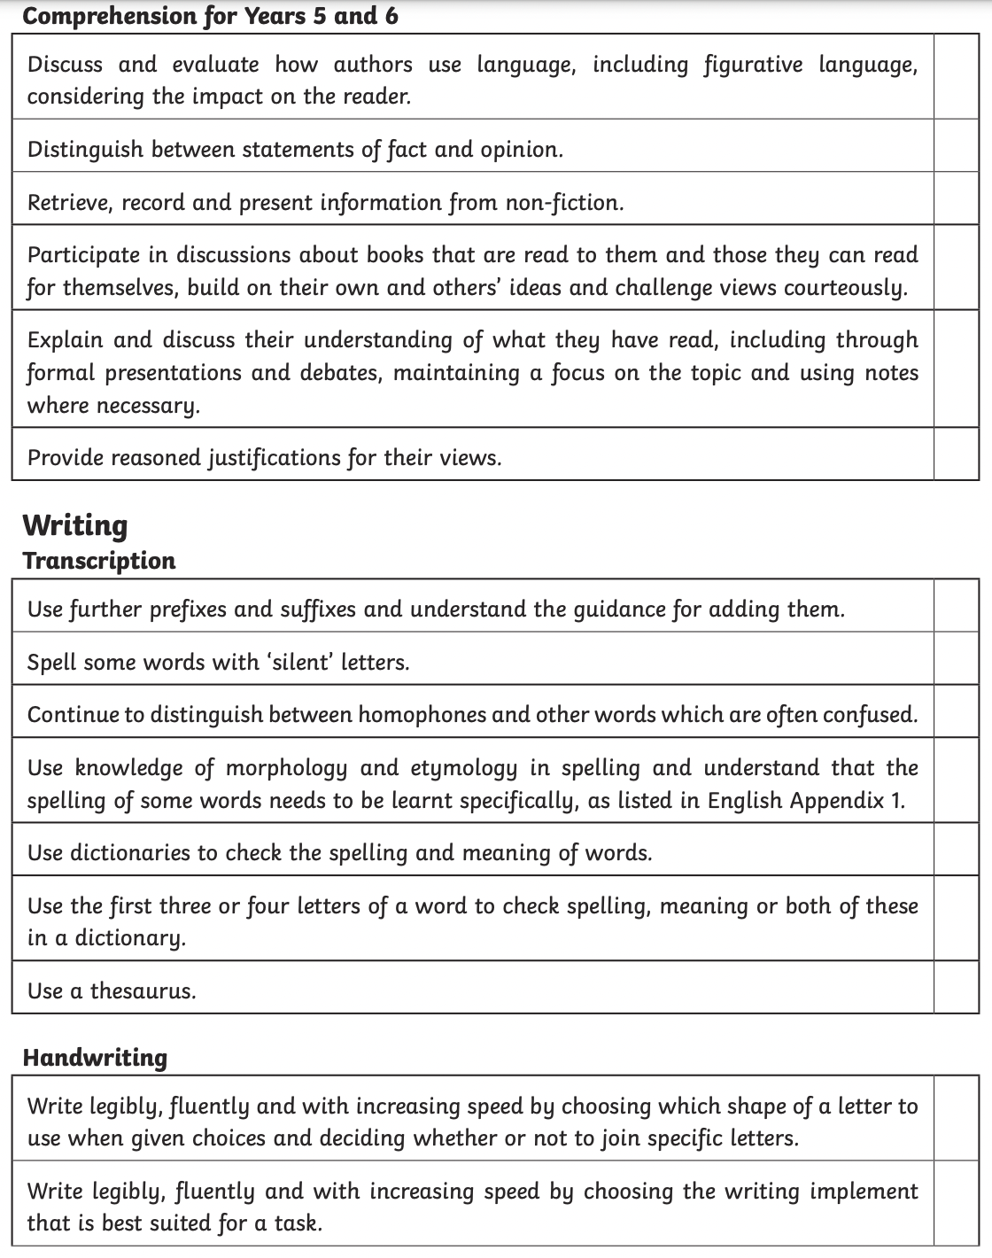
Expectations for English
Notes:
N

Slide 13
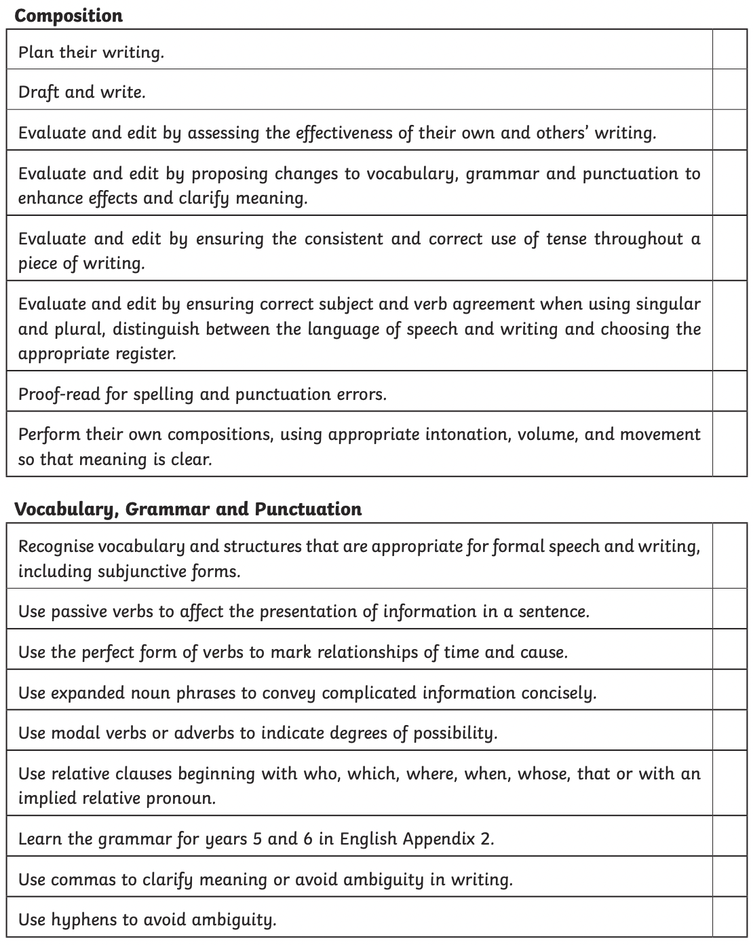
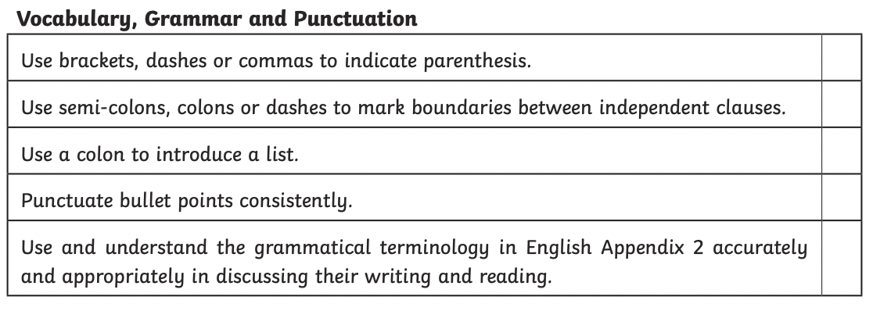
Expectations for English
Notes:
N

Slide 14

PSHE
Our PSHE scheme is linked to
My Happy Mind. Lessons,
covering the three PSHE core themes,
are taught distinctly each Monday morning.
We also have theme days and theme weeks throughout the year where objectives are covered, e.g. Friendship Week, Mental Health Day/Week, Rainbow Day, Health Week.

Slide 15
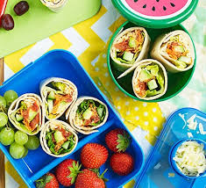
Making Holden Clough healthy…
Fruit or vegetables to be eaten at play time.
Water bottles are allowed in class and we encourage children to keep hydrated.
If your child would like to bring something into school to celebrate their birthday we ask that they bring a book for our class library. We will insert a label to show who donated the book and when. Sweets and treats will not be given out.
Guidelines for packed lunches have changed from September 2022 in order to meet National Food Standards like school dinners have to.
Main changes:
No chocolate or chocolate covered biscuits or cakes
No crisps (snack-a-jacks are fine)
No sweets
No fizzy drinks
Piece of fruit or salad ( towards 5 a day)

Slide 16

Communication
Parents/carers can speak with staff:
- At the beginning or end of the day
- Via Class Dojo: messages sent to staff after school may not be responded to until the next school day.
- Newsletters will be uploaded onto the school website and Class Dojo half-termly.
Reports/parents’ evening:
- Two reports will be provided throughout the year, to provide you with updates regarding your child’s progress. A mid-year report will be sent out in February, and an end of year report will be sent out in July.
- Two parents' evenings will happen throughout the year. Information regarding these will be provided via Class Dojo and parent mail nearer the time.
Notes:
N

Slide 17
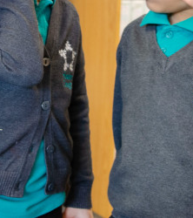
Uniform
During the school day:
- Black trousers, skirt or pinafore dress
- Jade green polo shirt
- Charcoal grey cardigan or jumper (knitwear only, no sweatshirts)
- Black or grey socks or tights
- Black shoes
- Green check dresses may be worn in summer
For P.E.:
- White round neck t-shirt (no branded sportswear please)
- Black shorts, leggings or joggers
- Black or white trainers
- Black or grey socks
- School jumpers
Please ensure ALL items of clothing and belongings have your child’s name in them; so many jumpers and cardigans were lost last year! Please see the school website for information on where to purchase uniform: https://www.holdenclough.tameside.sch.uk/uniform-information/
Notes:
M

Slide 18

Other information:
Please send in water bottles for the children to use. These should be taken home each day to be washed.
Children should not bring their own stationary/pencil cases into school.
All medication needs to be handed in to the office- teachers/teaching assistants cannot take any medication from you.
If you would like your child to walk home or walk to meet you at the gate or another classroom please let us know in writing.
Mobile phones, if brought into school, will be collected by a member of staff. They will be kept in the school office until the end of the day.
Notes:
N

Slide 19
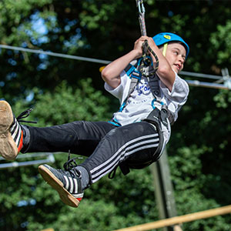
Robinwood
Children should take their luggage to the school hall for 8:30 AM on Monday 20th so that we can collect in any medication, take a register, label luggage and get ready in plenty of time for the coach arrival.
We will be leaving Robinwood at 2 PM on Wednesday 22nd October so expect to be back a little later after school. We may be a little late letting the children out as we will have to take a full register upon arrival.
More info on Class Dojo on Friday including kit list and rooms.
Notes:
M

