Slide 1
Ready-to-go Lesson Slides
Year 2
Addition and Subtraction
Lesson 3
To compare number sentences with numbers within 20
Autumn

Slide 2
Summary
Key Vocabulary and Sentence Stems
Hinge Question (Assessment Point)
Lesson Introduction Slide (Learning Objective and Success Criteria)
Starter – Checking number sentences - consolidation of previous lesson
Key Concept Introduction
Guided Practice – Comparing number sentences using inequality signs
Independent Practice 1 – Comparing number sentences using inequality signs
Guided Practice – Completing number sentences so both are equal.
Independent Practice 2 – digit cards to match a number sentence
Guided Practice – Arrange numbers to make the number sentence correct
Independent Practice 3 – Fill in missing numbers to make the number sentence correct.
Let’s Reflect
Support Slides – Based on Year 1 - compare addition and subtraction statements

Slide 3
Key Vocabulary:
add | addition
sum | total
subtract | take away
equal | fact family
multiples | less/more
Sentence Stems:
The value on both sides of the equals symbol must be the same.

Slide 4
Hinge Question:
11 + 9 = + 7
20
13
4
2
Notes:
Assessment point for the lesson – ask the pupils to vote for the answer they think is correct.
A – Pupils do not understand how to compare numbers.
B – Pupils do not understand how to compare numbers.
C – Correct
D – Pupils do not understand how to compare numbers.
If answers A, B or D are given, pupils may require extra support through small group or 1:1 discussions. There are support slides covering lessons from the previous year group at the end of these slides.

Slide 5
To compare number sentences with numbers within 20
Success Criteria I can compare number sentences to spot patterns and to find missing numbers I can compare similar calculations using >, < and = I can explain how I found the missing number in a calculation

Slide 6

Starter:
The mathstronaut’s puzzle.
The yellow mathstronaut has used the following calculation to check a number sentence in his work.
5 + 7
What number sentence could the mathstronaut be checking?
Is there more than one answer?
The yellow mathstronaut could be checking the number sentences 12 - 7 = 5 or 12 - 5 = 7. He could also be checking the number sentence 7 + 5 = 12
Answers
Notes:
Year 2 Addition and Subtraction, block 2. Consolidation from previous lesson
Concrete resources – Base 10, Number shapes, number lines etc
Key Questions – Can we represent this in a different way? Bar model? What are the number sentences that link with this calculation? What is the inverse operation? Can we check using concrete resources? Why is it important to check our calculations?
Extension – Further calculations to check - using word problems or numbers written in words.

Slide 7
How can we use the following representation to prove that
6 + 3 = 5 + 4?
Both representations are exactly the same size, showing 9 equal parts. Their starting and end points match so It doesn’t matter how they are shaded the answer will always equal 9. 6 + 3 = 9 as does 5 + 4 = 9, therefore 6 + 3 = 5 + 4
Answers
Notes:
Pupils should be encouraged to examine number sentences to find missing values using structure rather than calculation. Using numbers within 20 to explore mathematical relationships will give pupils confidence and allow them to spot patterns because they are working within context of familiar numbers.
Concrete resources – Base 10, number shapes, bead strings etc
Key Questions – What numbers make the same total? How do we know this? How does the bar model help us to check we are correct? Do we need to calculate the answers of the number sentences to check if they are equal?
Misconceptions/ Common Errors – That different numbers can have same answers and therefore be equal
Further Practice – More number sentences and representations to check
Extension – Are there other number sentences that would also equal 6 + 3? How do you know?

Slide 8
Guided Practice:
Fill in the gaps with either <, > or =
6 + 4 6 + 5
8 + 5 8 + 3
12 – 6 13 – 7
15 – 4 14 – 4
10 – 6 3 + 1
<
>
=
>
=
Answers
Notes:
Pupils should compare similar calculations using greater than, less than and equal to symbols
Concrete resources – Base 10, number shapes
Key Questions – What do the symbols mean? Do we need to calculate the answer to work out the missing symbol? Do you notice any patterns and link between the number sentences?
Misconceptions/ Common Errors – Pupils may not always see the links with the numbers, for example 6 + 4 must be less than 6 + 5 because 4 is less than 5.
Further Practice – More number sentences to compare.
Extension – Start with the symbol - can you write two number sentences that would fit with the symbol?

Slide 9
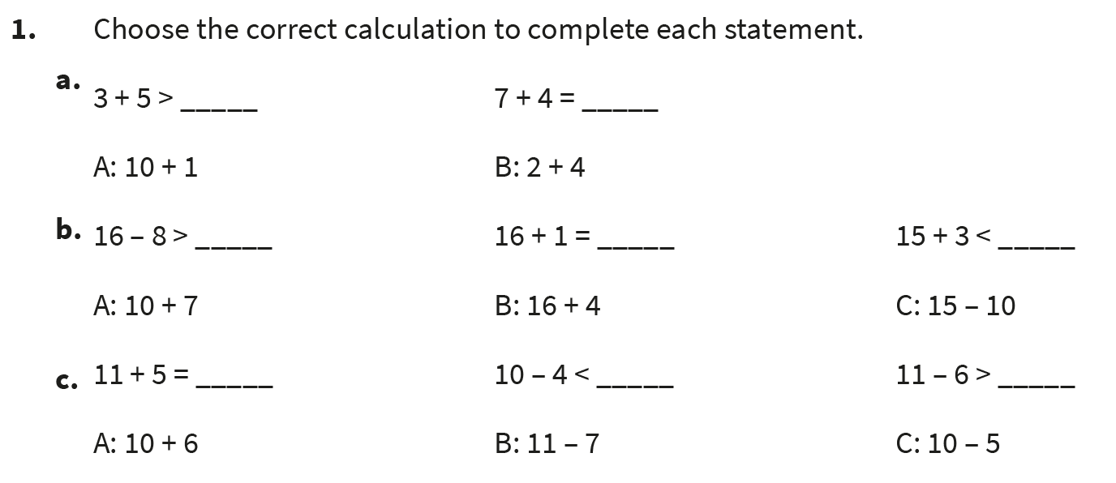
Independent Practice:
Notes:
B, A
C, A, B
A, C, B

Slide 10
Guided Practice:
Complete the missing numbers.
6 + 3 = 7 + _____
6 + 3 = _____ + 7 = 8 + ______
_____ + 3 = _____ + 4 = 15 + 5
2
2
1
17
16
Answers
Notes:
Concrete resources – Base 10, number shapes
Key Questions – Do you notice a pattern? What would come next? What other numbers would make the same total?
Misconceptions/ Common Errors – Spotting the patterns in the sequences. Understanding that addition can be done in any order.
Further Practice – Continuing the last pattern. More sequences.
Extension – Can you create a subtraction sequence, for example 20 – 10 = 19 – 9 = 18 – 8= etc

Slide 11
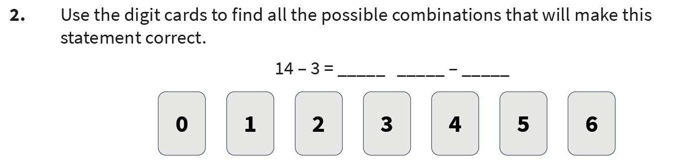
Independent Practice:
Notes:
Various answers, for example 16 – 5, 15 – 4, 13 – 2

Slide 12
Guided Practice:
These digit cards have been placed incorrectly.
Rearrange them to make the statement correct.
+ > +
5
8
3
10
Various answers, for example:
5 + 10 > 8 + 3; 8 + 10 > 5 + 3
Answers
Notes:
Concrete resources – Base 10, number shapes, digit cards
Key Questions – What do the symbols mean? How do you know you have the digit cards in the right places? How many different answers can you find?
Misconceptions/ Common Errors – Pupils get confused between the symbols < and >. A visual aid may be useful.
Further Practice – different digits and symbols
Extension – Can you create your own problem number sentence to solve?

Slide 13
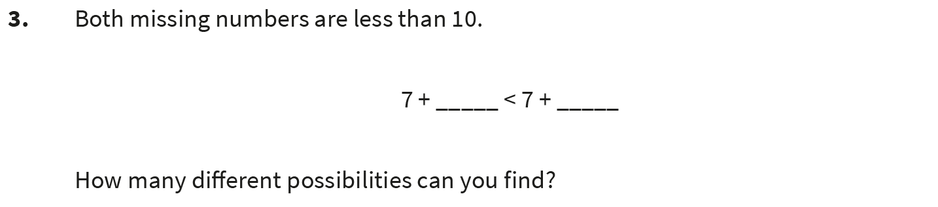
Independent Practice:
Notes:
Lots of different combinations. The left number has to be smaller than the right.
Possible combinations: 1and 2; 1 and 3; 1 and 4; 1 and 5; 1 and 6; 1 and 7; 1 and 8;
1 and 9; 2 and 3 etc

Slide 14
Let’s Reflect:
Which numbers are missing from the number sentences to make a sequence?
Can you prove that you are right?
10 + 5 = 9 +
10 + 5 = 8 +
10 + 5 = 7 +
+ = 6 +
6
7
8
10
5
9
The 10 + 5 part stays the same. The first number in the second half of the number sentence is getting smaller by 1 each time. The last number in the number sentence is getting bigger by 1 each time. Both sides equal 15.
Answers
Notes:
Concrete resources – Base 10, number shapes etc
Key Questions – Can you spot any patterns in the sequences? What would come next? Do we need to work out the answers to write the missing numbers? What do both sides have to equal?
Misconceptions/ Common Errors – Pupil may not see the patterns and how they can use this to help them find the missing numbers.

Slide 15
The following slides are based on Year 1 Addition and Subtraction – Compare addition and subtraction statements

Slide 16
Complete the sentences.
4 + 1 is greater than _____
4 + 1 is greater than _____
4 + 1 is less than ____
4 + 1 is less than ____
3
2
6
10
Various answers, for example : 4 + 1 is greater than 3; 4 + 1 is less than 6
Answers
Notes:
Pupils use the inequality symbols to compare statements. It is important that the ‘equal to’ is also recapped at this stage with the correct language used. Pupils should use concrete manipulatives and draw images to help them complete the the statements.
How and when to use these slides – Pupils struggle to understand ‘greater than’, ‘ less than’ and ‘equal to’ with number sentences.
Concrete resources – blocks, Base 10, number shapes
Key Questions – What does ‘greater than’ mean? How do we know that 4 + 1 is greater than 3? What else can be greater than? What does ‘less than’ mean? How do we know that 4 + 1 is less than 6? What else can be less than?
Misconceptions/ Common Errors – Understanding the inequality symbols. A visual add may be useful. That the whole calculation should be looked at not just the first number - 4 + 1 is greater than 4, even though they both use 4.
Further Practice – More blocks to create inequality sentences

Slide 17
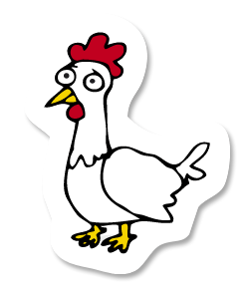
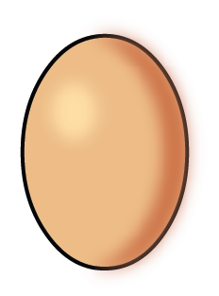
One hen lays 4 eggs. Another hen lays 3 eggs;
Complete the sentence using greater than, less than or equal to.
4 plus 3 is ___________________ 8
less than
Complete the number sentences
6
2
____ + ____ is equal to 8
____ + 4 is less than 9
5 + ____ is _____________ 2
Various answers, for example:
3
4
greater than
Answers
Notes:
Concrete resources – Blocks, Base 10, number shapes, other manipulatives to help visualise problem
Key Questions – What does greater than mean? What does less than mean? What does equal to mean? What language is missing? What steps do we need to help us complete the problem?
Misconceptions/ Common Errors – That different number sentences can equal the same answer.
Further Practice – More representations to answer questions on ‘greater than’, ‘less than’ or ‘equal to’.
Link the words to the symbols -‘Greater than’ > etc

Slide 18






Use <, > and = to complete the comparison statements below
10 is 2 + 3 5 is 4 + 3
6 is 1 + 5
>
<
=
Answers
Notes:
Concrete resources – Blocks, Base 10, number shapes, other manipulatives to help visualise problem
Key Questions – What does greater than mean? What does less than mean? What does equal to mean? What language is missing? What steps do we need to help us complete the problem?
Misconceptions/ Common Errors – That different number sentences can equal the same answer.
Further Practice – More representations to answer questions on ‘greater than’, ‘less than’ or ‘equal to’.
Link the words to the symbols -‘Greater than’ > etc

