Slide 1
Ready-to-go Lesson Slides
Year 1
Fractions
Lesson 4
Sum1

Slide 3

I can find a quarter of a small quantity by sharing equally
I can use real objects to share into four equal parts or quarters
I can describe what I see in containers when they are a quarter full
Starter: Do you agree with Evie?
Is this true or false? Can you explain why?
This shape is in quarters because it is made up of 4 triangles.

Slide 4
I can find a quarter of a small quantity by sharing equally
I can use real objects to share into four equal parts or quarters
I can describe what I see in containers when they are a quarter full
Starter: Do you agree with Evie?
Is this true or false? Can you explain why?
This shape is in quarters because it is made up of 4 triangles.
I do not agree with Evie.
It is false because a shape can only show quarters if there are four equal parts.
Only three of the triangles match. The one at the top is different.

Slide 5

Talking Time:
Can you share the bananas into four equal groups?
Can you complete the stem sentences?
There are ___ bananas.
There is ___ banana in each quarter.
A quarter of ___ is ___ .

Slide 6
Talking Time:
Can you share the bananas into four equal groups?
Can you complete the stem sentences?
There are 4 bananas.
There is 1 banana in each quarter.
A quarter of 4 is 1.

Slide 7

Talking Time:
Can you share the grapes into four equal groups?
Can you complete the stem sentences?
There are ___ grapes.
There are ___ grapes in each quarter.
A quarter of ___ is ___ .

Slide 8
Talking Time:
Can you share the grapes into four equal groups?
Can you complete the stem sentences?
There are 16 grapes.
There are 4 grapes in each quarter.
A quarter of 16 is 4.

Slide 9

Talking Time:
Can you share the strawberries into four equal groups?
Can you complete the stem sentences?
There are ___ strawberries.
There are ___ strawberries in each quarter.
A quarter of ___ is ___ .

Slide 10
Talking Time:
Can you share the strawberries into four equal groups?
Can you complete the stem sentences?
There are 12 strawberries.
There are 3 strawberries in each quarter.
A quarter of 12 is 3 .

Slide 11

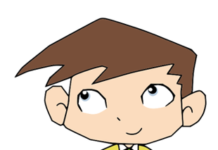
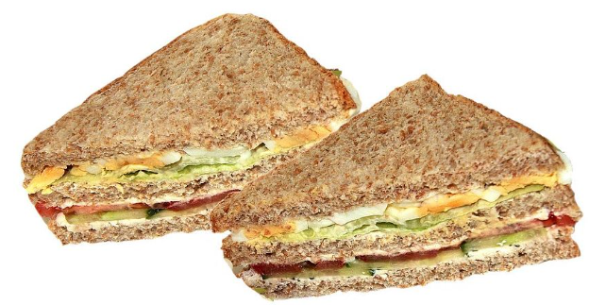


Activity 1:
There are eight sandwiches on a plate.
The children have been told that they can have one quarter of them each.
Who do you agree with? Why are the other children not correct?
I think I will get two sandwiches.
I think I will get four sandwiches.
Aisha
Ollie
I think we will all get a different number of sandwiches.
I think I will get one sandwich.
Bella
Jenson

Slide 12
Activity 1:
There are eight sandwiches on a plate.
The children have been told that they can have one quarter of them each.
Who do you agree with? Why are the other children not correct?
I think I will get two sandwiches.
I think I will get four sandwiches.
Aisha
Ollie
Aisha is correct.
Quarters means 4 equal parts,
so Ollie needs to split 8 into
4 equal groups.
I think we will all get a different number of sandwiches.
I think I will get one sandwich.
Bella
Bella has forgotten that quarters
means 4 equal parts.
Jenson has made a mistake.
1 quarter does not mean 1.
Jenson

Slide 13
Talking Time:
Here is a container.
I fill the container a quarter full with water.
Can you estimate where the level of water would be?
Can you draw it on the container?
You might want to experiment with real containers and water for a best guess.

Slide 14
Talking Time:
Here is a container.
I fill the container a quarter full with water.
Can you estimate where the level of water would be?
Can you draw it on the container?
You might want to experiment with real containers and water for a best guess.

Slide 15
Talking Time:
Here is a container.
I fill the container a quarter full with rice.
Can you estimate where the level of rice would be?
Can you draw it on the container?
You might want to experiment with real containers and rice for a best guess.

Slide 16
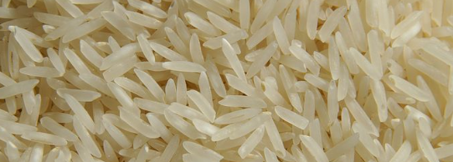
Talking Time:
Here is a container.
I fill the container a quarter full with rice.
Can you estimate where the level of rice would be?
Can you draw it on the container?
You might want to experiment with real containers and rice for a best guess.

Slide 17
Activity 2:
Is the statement true or false? Why?
The taller container is more than a quarter full because it is taller.
This container is a quarter full of water.

Slide 18
Activity 2:
Is the statement true or false? Why?
The taller container is more than a quarter full because it is taller.
The statement
is false. Both
containers
are a quarter full
of water. The
water goes
up to a quarter
of each
container’s
height.
This container is a quarter full of water.

Slide 19
Talking Time:
Can you use counters to complete the stem sentence?
A quarter of 12 is ___ .

Slide 20
Talking Time:
Can you use counters to complete the stem sentence?
A quarter of 12 is 3.

Slide 21
Talking Time:
Can you use counters to complete the stem sentence?
A quarter of 20 is ___ .

Slide 22
Talking Time:
Can you use counters to complete the stem sentence?
A quarter of 20 is 5.

Slide 23
Talking Time:
Can you use cubes to complete the stem sentence?
A quarter of 8 is ___ .

Slide 24
Talking Time:
Extension:
This is one way to show a quarter of 8 cubes. Are there others?
How many red cubes will you need every time?
Can you use cubes to complete the stem sentence?
A quarter of 8 is 2 .

Slide 25
Activity 3:
Can you carry on the pattern and complete this table?
Representation | Stem sentence | Representation | Stem sentence
 | The whole is 4. |  | A quarter of 4 is 1.
 | The whole is __. |  | A quarter of __ is __.
 | The whole is __. |  | A quarter of __ is __.
 | The whole is __. |  | A quarter of __ is 4.
 | The whole is __. |  | A quarter of __ is __.
You might need some counters to help you.

Slide 26
Activity 3:
Can you carry on the pattern and complete this table?
Representation | Stem sentence | Representation | Stem sentence
 | The whole is 4. |  | A quarter of 4 is 1.
 | The whole is 8. |  | A quarter of 8 is 2.
 | The whole is 12. |  | A quarter of 12 is 3.
 | The whole is 16 |  | A quarter of 16 is 4.
 | The whole is 20. |  | A quarter of 20 is 5.
You might need some counters to help you.

Slide 27



I can find a quarter of a small quantity by sharing equally
I can use real objects to share into four equal parts or quarters
I can describe what I see in containers when they are a quarter full
Evaluation:
Darcey, Alena and Freddie made towers with a different number of cubes each.
They then broke off a quarter of their towers.
Can you complete the stem sentences? How do you know that you are right?
Darcey has 2 cubes.
2 is a quarter of __ .
Darcey’s whole tower had
__ cubes altogether.
Freddie has __ cubes.
__ is a quarter of __ .
Freddie’s whole tower had
__ cubes altogether.
Alena has __ cubes.
__ is a quarter of __ .
Alena’s whole tower had
__ cubes altogether.

Slide 28
I can find a quarter of a small quantity by sharing equally
I can use real objects to share into four equal parts or quarters
I can describe what I see in containers when they are a quarter full
Evaluation:
Darcey, Alena and Freddie made towers with a different number of cubes each.
They then broke off a quarter of their towers.
Can you complete the stem sentences? How do you know that you are right?
Darcey has 2 cubes.
2 is a quarter of 8 .
Darcey’s whole tower had
8 cubes altogether.
Freddie has 3 cubes.
3 is a quarter of 12.
Freddie’s whole tower had
12 cubes altogether.
Alena has 4 cubes.
4 is a quarter of 16 .
Alena’s whole tower had
16 cubes altogether.

Slide 29
