Slide 1
Ready-to-go Lesson Slides
Year 2
Addition and Subtraction
Lesson 7
To explain what happens to numbers when I add or subtract 10
Autumn

Slide 2
Summary
Key Vocabulary and Sentence Stems
Hinge Question (Assessment Point)
Lesson Introduction Slide (Learning Objective and Success Criteria)
Starter – Adding and subtracting 1 - consolidation of previous lesson
Key Concept Introduction
Guided Practice – 10 less/10 more using Base 10
Independent Practice 1 – 10 less/10 more using Base 10
Guided Practice – Missing numbers - 10 more/10 less
Independent Practice 2 – Missing numbers - 10 more/10 less
Guided Practice – Problem solving - 10 more/10 less
Independent Practice 3 – Reasoning using 10 more/10 less
Let’s Reflect
Support Slides – Based on Year 1 - count in 10s

Slide 3
Key Vocabulary:
add | addition
sum | total
subtract | take away
equal | fact family
multiples | less/more
Sentence Stems:
When adding 10, the tens digit changes, the ones digit stays the same.
When subtracting 10, the tens digit changes, the ones digit stays the same.
If (number) plus (number) is equal to (number), then (number) tens plus (number) tens is equal to (number) tens.
If 3 plus 2 is equal to 5, then 3 tens plus 2 tens is equal to 5 ten.
This is (number). Ten more than (number) is (number). (number) is ten more than (number).
This is 5. Ten more than 5 is 15. 15 is ten more than 5.
If (number) minus (number) is equal to (number), then (number) tens minus (number) tens is equal to (number) tens.
If 3 minus 2 is equal to 1, then 3 tens minus 2 tens is equal to 1 ten.
This is (number). Ten less than (number) is (number). (number) is ten less than (number).
This is 15. Ten less than 15 is 5. 5 is ten less than 15.

Slide 4
Hinge Question:
What numbers should replace the ?
10 less | Number | 10 more
16 | 26
 | 54 | 64
44 and 36
6 and 54
53 and 27
16 and 64
Notes:
Assessment point for the lesson – ask the pupils to vote for the answer they think is correct.
A – Correct
B – Pupils do not understand adding and subtracting 10
C – Pupils do not understand adding and subtracting 10
D – Pupils do not understand adding and subtracting 10
If answers B, C or D are given, pupils may require extra support through small group or 1:1 discussions. There are support slides covering lessons from the previous year group at the end of these slides.

Slide 5
To explain what happens to numbers when I add or subtract 10
Success Criteria I can find 10 more and 10 less than a number I can use a hundred square to see how only the ten digit changes when counting up or down in 10s I can explain and justify my answers

Slide 6
Starter:
Here are some jigsaw pieces from a hundred square.
Which numbers are missing?
How do you know?
48
35
17
56
57
58
59
60
43
44
45
46
47
25
26
27
28
29
68
55
37
The missing numbers are all 1 or 2 more than the middle number.
You can work out the middle number because it is 10 more than 17 or 10 less than 37.
Answers
Notes:
Year 2 addition and subtraction - block 2. Consolidation of previous lesson - Adding and subtracting 1s.
Concrete resources – Number lines, hundred square, Base 10
Key Questions – Which number should we start from? What happens to the numbers as we move forwards? What happens when we move backwards? What happens to the numbers when we move down the hundred square? What happens when we move up?
Extension – Larger jigsaw of hundred square with more numbers missing.

Slide 7
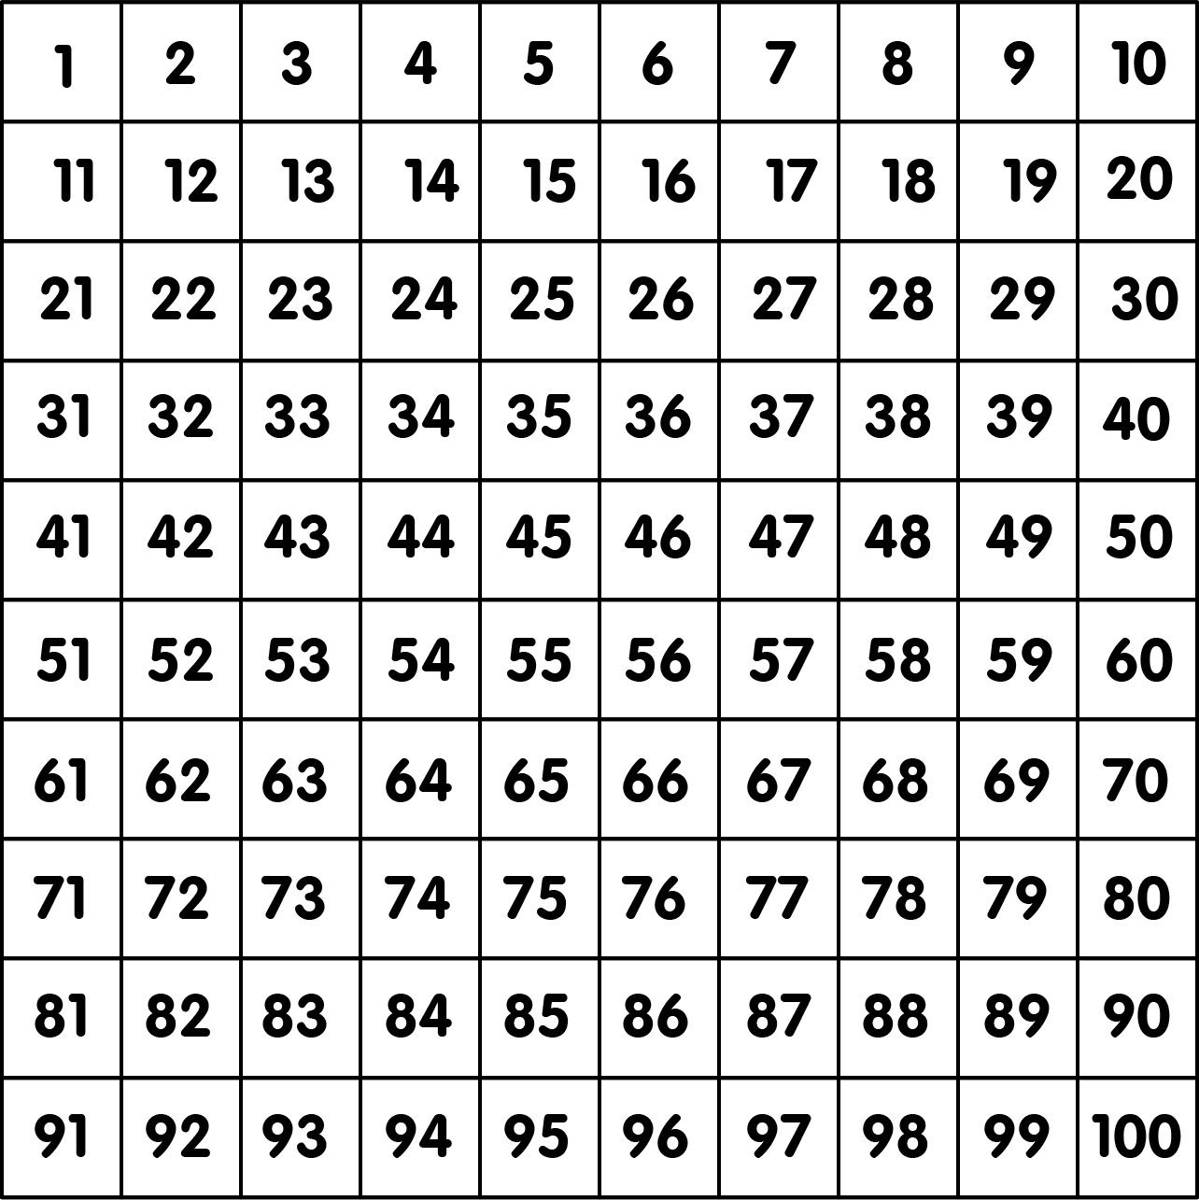
Look at the highlighted number sequence on the hundred square.
Can you explain the pattern?
The tens are increasing by 1 each time and the ones remain the same.
Circle the number that is 10 less than 46.
Circle the number that is 10 more than 62.
Repeat in different colours for different numbers.
What do you notice?
10 less than 46 is 36.
10 more than 62 is 72
The number that is 10 less is just above the original number. The number that is 10 more is just below the original number.
Answers
Notes:
Teachers need to focus on the importance of the tens digit. Using a 100 square, explore with the children what happens to the numbers in the columns. Draw attention the idea that the tens digit changes while the ones remains the same.
Concrete resources – hundred square
Key Questions – What is the same? What is different? When you look at a hundred square, what do you notice about the number that are ten more than 62? Or ten less than 46? Which direction will your finger move on a hundred square if you are finding ten more/ten less?
Misconceptions/ Common Errors – Understanding that move up a hundred square the numbers go down in 10s. Moving down the hundred square the numbers go up in 10s. Some pupils may still count 10 along the hundred square.
Further Practice – Finding different numbers and marking 10 more/10 less
Extension – Challenge each other to find 10 more/ 10 less than any number on the hundred square. Can you find 20 more/20 less?

Slide 8


Guided Practice:
What is 10 less than the number shown below?
40
24
What is 10 more than the number shown below
50
46
Answers
Notes:
Pupils will need to see how the number changes with concrete materials before moving onto more abstract ideas.
Concrete resources – Base 10
Key Questions – What happens when I take a ten away? Do the ones change? What happens when I add a ten? Do the ones change now?
Misconceptions/ Common Errors – That taking a ten will change the ones column as well.
Further Practice – different 2 digit numbers to make using Base 10 - adding and subtracting 10
Extension – what happens if I add 20? What happens if I subtract 20?

Slide 9
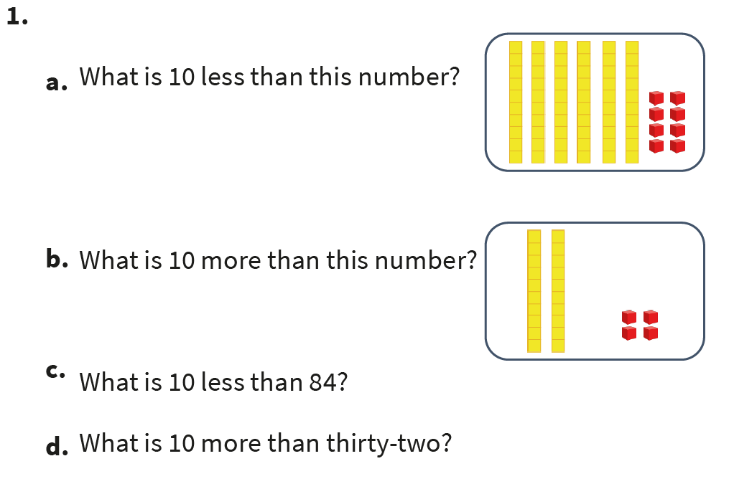
Independent Practice:
Notes:
58
34
74
42 (forty-two)

Slide 10
Guided Practice:
Fill in the missing numbers.
Use concrete resources to help you.
10 less | Number | 10 more
48 | 58
 | 43 | 53
27 |  | 47
 | 15
 |  | 68
33
 | 37
5 |  | 25
Answers
Notes:
Concrete resources – Base 10 to support
Key Questions – What happens to the number when we add ten more? What happens when we add ten less? Which digit changes? Which digit remains the same?
Misconceptions/ Common Errors – That both tens and ones change when we add or subtract 10. Sometimes pupil will miss out the ones altogether and put a 0 in the ones column.
Further Practice – Different numbers to find 10 more/10 less of
Extension – To find 20 more/20 less of any number within the hundred square

Slide 11
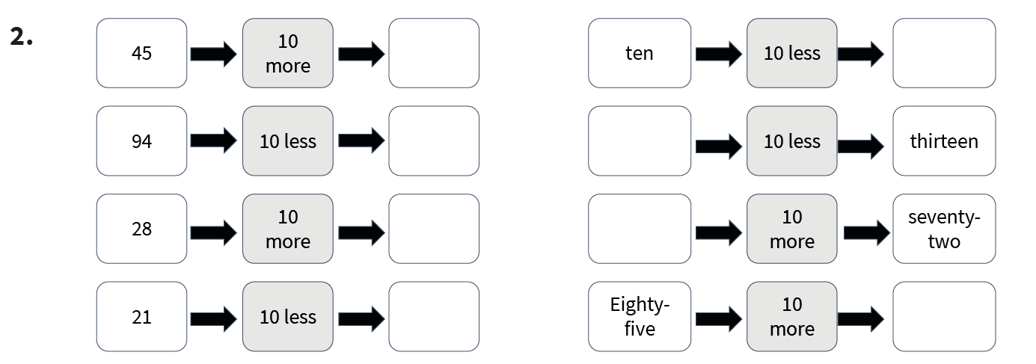
Independent Practice:
Notes:
55
84
38
11
zero (0)
twenty-three (23)
sixty-two (62)
ninety-five (95

Slide 12
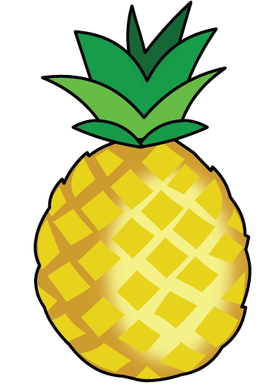




Guided Practice:
The cost of each piece of fruit is reduced by 10p.
What is the new price of the fruit?
82p 21p 18p 57p 64p
Pineapple 72p
Strawberry 11p
Banana 8p
Pear 47p
Grapes 54p
Answers
Notes:
Concrete resources – concrete manipulatives, Base 10
Key Questions – What does reduced mean? Is the amount going to get bigger or smaller? What will happen to the ten digit when we reduce the price? What will happen to the ones?
Misconceptions/ Common Errors – When you take 10 from a teen number, for example 18 - 10. This may cause confusion as there are now no tens.
Further Practice – What would happen is the fruit was increased by 10p?
Extension – Increasing/ decreasing by 20p/30p

Slide 13
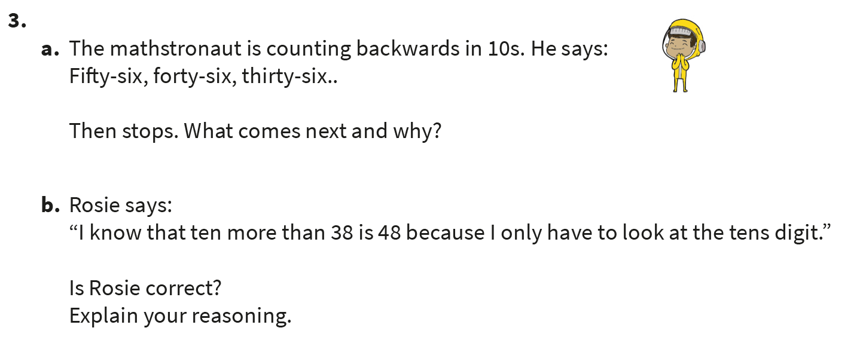
Independent Practice:
Notes:
26
Because you take one ten away from 36.
56, 46, 36, 26, 16, 6
Rosie is correct because when you add ten you are not adding ones.

Slide 14
Let’s Reflect:
Fill in the missing numbers on the number grid.
What happens when you add or subtract 10?
 |  |  | 64
 | 72 |  | 74
 | 82 |  | 84 | 85
91 |  | 93 |  | 95 | 96
51 | 52 | 53 | 54 | 55 | 56
61 | 62 | 63 |  | 65 | 66
71 |  | 73 |  | 75 | 76
81 |  | 83 |  |  | 86
 | 92 |  | 94
The ten digit changes while the ones remain the same.
Answers
Notes:
Concrete resources – Hundred square
Key Questions – Where should we start ofj the hundred square? Why? What happens when we move down the hundred square? What happens when we move up the hundred square? Can you see any patterns ?
Misconceptions/ Common Errors – Pupil may get confused - Moving across and back on the hundred square is counting in 1s. Moving up and down ias counting in 10s

Slide 15
The following slides are based on Year 1 Addition and Subtraction – count in 10s

Slide 16
Complete the missing numbers on the hundred square.
10
20
30
40
50
60
70
80
90
100
1 | 2 | 3 | 4 | 5 | 6 | 7 | 8 | 9
11 | 12 | 13 | 14 | 15 | 16 | 17 | 18 | 19
21 | 22 | 23 | 24 | 25 | 26 | 27 | 28 | 29
31 | 32 | 33 | 34 | 35 | 36 | 37 | 38 | 39
41 | 42 | 43 | 44 | 45 | 46 | 47 | 48 | 49
51 | 52 | 53 | 54 | 55 | 56 | 57 | 58 | 59
61 | 62 | 63 | 64 | 65 | 66 | 67 | 68 | 69
71 | 72 | 73 | 74 | 75 | 76 | 77 | 78 | 79
81 | 82 | 83 | 84 | 85 | 86 | 87 | 88 | 89
91 | 92 | 93 | 94 | 95 | 96 | 97 | 98 | 99
Answers
Notes:
Pupils will be grouping in 10s.They will use picture, number lines and bead strings to support their counting. Counting in 10s on a hundred square will also support the pupils to see similarities between the numbers when you count in 10s.
How and when to use these slides – To support pupils who are not as confident at counting in 10s.
Concrete resources – hundred square
Key Questions – What pattern do you see when you count in 10s? What happens to the ten digit? What happens to the ones? Will ___ appear as we count? Why/Why not?
Misconceptions/ Common Errors – Make sure pupil pronounce the 10s numbers correctly as they count. Pupil can get mixed up with the tens numbers and teen numbers.
Further Practice – Start at different points on the 10s line. Can you count backwards in 10s?

Slide 17
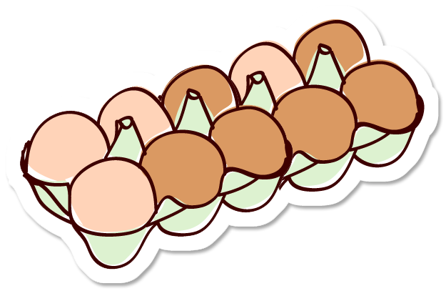
How many eggs are there altogether?
10
There are ______ eggs in a egg box.
There are ______ egg boxes.
There are _______ eggs altogether.
5
50
Answers
Notes:
Concrete resources – concrete manipulative, Base 10, hundred square.
Key Questions – How many eggs in the egg box? How many egg boxes have we got? Do we have to count every egg? What are we going to count in as we move along the egg boxes?
Misconceptions/ Common Errors – Counting in 1s and not 10s
Further Practice – Different scenarios for counting in 10s

Slide 18
Josie thinks the arrow is pointing to 50.
Is she correct?
Explain how you know.
30
40
50
60
70
80
Josie is not correct because the arrow is pointing to the number 60
Answers

