Slide 1
Ready-to-go Lesson Slides
Year 2
Addition and Subtraction
Lesson 5
To find bonds to, and within, 100 using multiples of 10
Autumn

Slide 2
Summary
Key Vocabulary and Sentence Stems
Hinge Question (Assessment Point)
Lesson Introduction Slide (Learning Objective and Success Criteria)
Starter – Bonds to 20
Key Concept Introduction
Guided Practice – Relating numbers and number sentence order with bonds using multiples of 10
Independent Practice 1 – Relating numbers and number sentence order with bonds using multiples of 10
Guided Practice – Spotting pattern when finding bonds to 100
Independent Practice 2 – making up pattern using bonds within 100, using multiples of 10
Guided Practice – Arranging digit cards to make up bonds to 100
Independent Practice 3 – Arranging digit cards to make up bonds
Let’s Reflect
Support Slides – Based on Year 1 - number bonds within 10

Slide 3
Key Vocabulary:
add | addition
sum | total
subtract | take away
equal | fact family
multiples
Sentence Stems:
When adding 10, the tens digit changes, the ones digit stays the same.
When subtracting 10, the tens digit changes, the ones digit stays the same.
If (number) plus (number) is equal to (number), then (number) tens plus (number) tens is equal to (number) tens.
If 3 plus 2 is equal to 5, then 3 tens plus 2 tens is equal to 5 ten.

Slide 4
Hinge Question:
30 + = 80
30
50
5
110
Notes:
Assessment point for the lesson – ask the pupils to vote for the answer they think is correct.
A – Pupils do not understand bonds to 100
B – Pupils do not understand bonds to 100
C – Correct
D – Pupils do not understand bonds to 100
If answers A, B or D are given, pupils may require extra support through small group or 1:1 discussions. There are support slides covering lessons from the previous year group at the end of these slides.

Slide 5
To find bonds to, and within, 100 using multiples of 10
Success Criteria I can find bonds to 100 in multiples of 10 I can see the link between single digit bonds and tens bonds I can use ten frame to show what I know about number bonds to 100

Slide 6


Starter:
The mathstronauts are playing ‘bonds to 20’.
What replies will the Yellow Mathstronaut give to the Blue Mathstronaut’s numbers?
17
3
8
12
10
10
0
20
Answers
Notes:
Consolidation on number bonds to 20. Pupils to understand the relationship between bonds to 10 and 20 and subsequently bonds to 100.
Concrete resources – Base 10, number shapes, beads, digit cards
Key Questions – If I know my number bonds to 10, how does that help my bonds to 20? Do we need to count on to find the answers? How quickly can you shout out your number bonds to 20 if I show this digit card?
Extension – Using digit cards, how quickly can you write the bond to 20 on a whiteboard?

Slide 7
Match the 10 frame to the sentences below.
Each square represents 10.
One hundred equals eighty plus twenty
100 = 100 + 0
40 + 60 = 100
Answers
Notes:
Teachers should focus on multiples of 10 at this stage, up to and within 100. Links should be made again between single digit bonds and ten bonds. Using a 10 frame to represent 100 would be useful resource to make this link.
Concrete resources – Ten frame and counters
Key Questions – What does the word multiple mean? What does the blue represent? What does the yellow represent? Why is this different to a normal 10 frame?
Misconceptions/ Common Errors – That each square represents 10 not 1. That we are counting in 10s not 1s.
Further Practice – Different number sentences to represent on a 10 frame.
Extension – Colour own ten frames and give it a partner to write a number sentence to represent it.

Slide 8

Guided Practice:
Fill in the missing numbers.
Use Base 10 to represent the numbers.
2 + 6 = 8 20 + 60 = _____
20 + ____ = 80 80 = ____ + 6__
80
60
20
0
+ =
Answers
Notes:
Concrete resources – Base 10
Key Questions – What patterns can you see? Does it matter which way the addition sentences are written? How does the Base 10 help us represent the numbers?
Misconceptions/ Common Errors – Seeing the links between the single numbers and the multiples of 10.
Further Practice – Different numbers sentences.
Extension – Can you write a subtraction sentence that is related to the addition sentences?

Slide 9
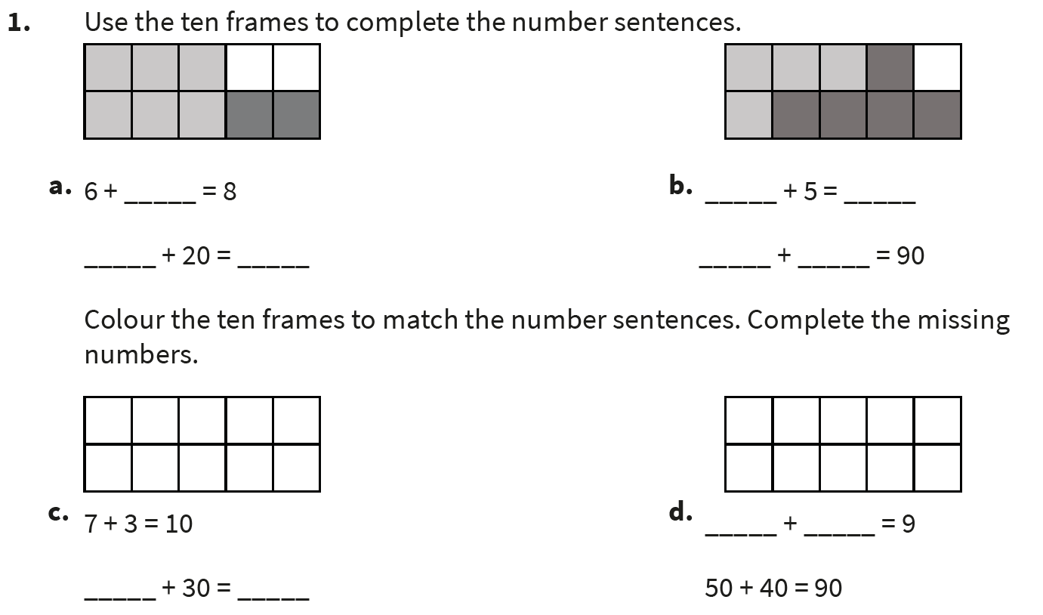
Independent Practice:
Notes:
2, 60, 80
4, 9, 40, 50
70, 100
5, 4

Slide 10
Guided Practice:
Can you continue the pattern?
90 = 100 – 10
80 = 100 – 20
70 = 100 – 30
How do you are correct?
What do you notice about the pattern?
60 = 100 – 40
50 = 100 – 50
40 = 100 – 60
30 = 100 – 70
20 = 100 – 80
10 = 100 – 90
The first numbers decrease by 10 each time. The last numbers increase by 10 each time.
Answers
Notes:
Concrete resources – Base 10
Key Questions – What patterns do you see? How does this help us to continue the pattern?
Misconceptions/ Common Errors – Pupils need to spot the pattern and work systematically.
Further Practice – See independent task
Extension – Can you write the addition sequence that is related to this pattern? 10 + 90; 20 + 80 etc

Slide 11
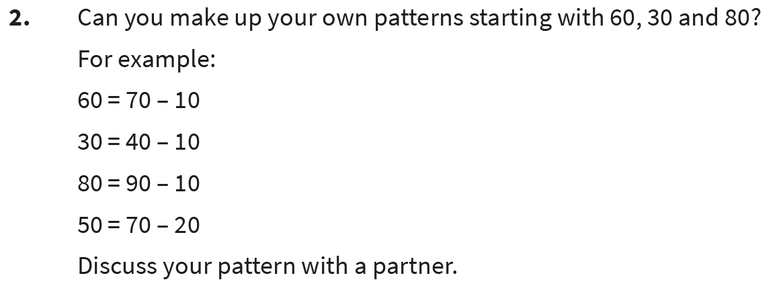
Independent Practice:
Notes:
Various answers. For example 60 = 70 – 10
50 = 70 – 20
40 = 70 – 30
30 = 70 – 40
20 = 70 – 50
10 = 70 – 60

Slide 12
Guided Practice:
Arrange the digit cards below to create a number sentence.
Find all the possibilities.
60
=
40
60 + 40 = 100
40 + 60 = 100
100 – 40 = 60
100 – 60 = 40
100 = 40 + 60
100 = 60 + 40
40 = 100 – 60
60 = 100 – 40
–
100
+
Answers
Notes:
Concrete resources – Digit cards, Base 10
Key Questions – What are the numbers and symbols on the digit cards? How can we put the cards together to make a number sentence? Can we put the = near the beginning of the number sentence?
Misconceptions/ Common Errors – Some pupils may write that 60 + 40 = 100 therefore 60 – 40 = 100. Using concrete resources may aid this error.
Further Practice – See independent task
Extension – To write the related single digit bonds for the number sentences - 60 + 40 = 100 6 + 4 = 10

Slide 13
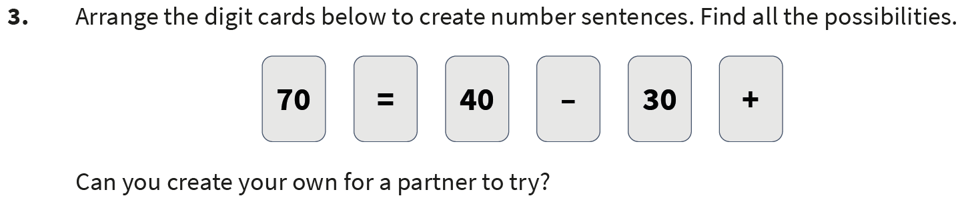
Independent Practice:
Notes:
30 + 40 = 70
40 + 30 = 70
70 – 40 = 30
70 – 30 = 40
70 = 40 + 30
70 = 30 + 40
40 = 70 – 30
30 = 70 – 40

Slide 14



Let’s Reflect:
Here is a grid:
Squares are worth 20
Triangles are worth 30
Circles are worth 40
Can you complete the grid so that all the horizontal and vertical lines add up to 90?
Answers
Notes:
Concrete resources – Base 10
Key Questions – What shapes and values are in the grid already? How does this help us? Now we have put that shape in, how does this help us? Does it matter what order you complete the grid in?
Misconceptions/ Common Errors – Pupils may struggle knowing where to begin and looking for what they know from the grid to begin with.

Slide 15
The following slides are based on Year 1 Addition and Subtraction – Number bonds within 10

Slide 16

Here are 6 beads.
Can you split them apart in different way to find all the number bonds to 6.
One has been done for you.
6 = 3 + 3
6 = 6 + 0
6 = 5 + 1
6 = 4 + 2
6 = 3 + 3
6 = 2 + 4
6 = 1 + 5
6 = 0 + 6
Answers
Notes:
Pupils combine their knowledge of part-whole models and addition facts to explore numbers within 10. Starting with a whole, pupils break numbers into parts and explore how many different ways a number can be partitioned.
How and when to use these slides – If pupils are struggling with number bonds to 10, they may need to consolidate their number bonds to 10 to see the link.
Concrete resources – Bead string
Key Questions – What is a whole? What is a part? Does the whole always stay the same? How can we partition the whole? Do the parts stay the same or change?
Misconceptions/ Common Errors – That 0 is also part of a number bond - 6 + 0 = 6
Further Practice – Different starting whole numbers.

Slide 17
If 8 is the whole, what could the parts be?
Show your finding in part-whole models.
Can you write an addition sentence for each part-whole model?
8
8
8
8
8
8
8
0
7
1
6
2
5
3
4
4
8 = 8 + 0 8 = 7 + 1 8 = 6 + 2 8 = 5 + 3 8 = 4 + 4
8 = 0 + 8 8 = 1 + 7 8 = 2 + 6 8 = 3 + 5
8
8
8
8
0
8
1
7
2
6
3
5
Answers
Notes:
Concrete resources – bead string
Key Questions – If 8 is the whole, what would the parts be? What number sentences would represent the parts we have split the whole into? Is there more than 1 number sentence for each part-whole model?
Misconceptions/ Common Errors – Remember to use zero as a bond. 8 + 0 = 8; 0 + 8 = 8
Further Practice – Different part-whole models with different whole numbers.

Slide 18


The ladybirds have lost their spots.
How many different ways can you put them back on?
There are 9 different ways altogether.
8 and 0
0 and 8
7 and 1
1 and 7
6 and 2
2 and 6
5 and 3
3 and 5
4 and 4
Answers
Notes:
Concrete resources – counters and an image of a ladybird
Key Questions – How can I arrange the spots over both ladybirds? Do they all need to have a spot on or can one have zero? Explain your idea.
Misconceptions/ Common Errors – Remember to use zero as a bond. 8 + 0 = 8; 0 + 8 = 8

