Slide 1
Ready-to-go Lesson Slides
Year 1
Fractions
Lesson 2
Sum1

Slide 3
I can find a half of a quantity
I can find a total amount and then share it equally into two
I can use real objects to show a half of a quantity
Starter: I have halved a number using a bar model.
Can you work out which number I started with?
How do you know?

Slide 4
I can find a half of a quantity
I can find a total amount and then share it equally into two
I can use real objects to show a half of a quantity
Starter: I have halved a number using a bar model.
Can you work out which number I started with?
How do you know?
There are 6 cubes in the first half of the bar model.
If I match that with 6 more cubes in the other half I would have 12 cubes altogether.
So, I started with 12 cubes.

Slide 5
Talking Time:
How many counters would be half of this amount?
Can you explain how you know?

Slide 6
Talking Time:
How many counters would be half of this amount?
Can you explain how you know?
8 counters is half of this amount.
I could show this by sharing the counters into the hoops.

Slide 7
Talking Time:
How many counters would be half of this amount?
Can you explain how you know?

Slide 8
Talking Time:
How many counters would be half of this amount?
Can you explain how you know?
7
7
7 counters is half of this amount.
I could show this by sharing the counters into hoops.
I could split them down the middle with 7 on each side.

Slide 9
Talking Time:
How many counters would be half of this amount?
Can you explain how you know?

Slide 10
Talking Time:
How many counters would be half of this amount?
Can you explain how you know?
9
9
9 counters is half of this amount.
I could show this by sharing the counters into hoops.
I could split them across the middle with 9 on each side.

Slide 11
Activity 1:
How many different ways can you shade exactly one half of these shapes?
How do you know that you have got exactly half each time?

Slide 12
Extension:
Here are 6 possible answers.
Can you find at least 3 different examples to the ones that are here?
Activity 1:
How many different ways can you shade exactly one half of these shapes?
How do you know that you have got exactly half each time?
Each shape has 8 squares. Half of 8 = 4, so each shape needs 4 shaded squares.

Slide 13
Talking Time:
Can you find half of the amount?
Can you complete the stem sentences?
There are ____ holes in the number tile.
Half of ___ is ___ .

Slide 14
Talking Time:
Can you find half of the amount?
Can you complete the stem sentences?
There are 8 holes in the number tile.
Half of 8 is 4 .

Slide 15
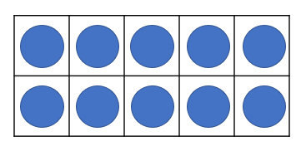
Talking Time:
Can you find half of the amount?
Can you complete the stem sentences?
There are ____ counters in the tens frames.
Half of ___ is ___ .

Slide 16
Talking Time:
Can you find half of the amount?
Can you complete the stem sentences?
There are 20 counters in the tens frames.
Half of 20 is 10 .

Slide 17


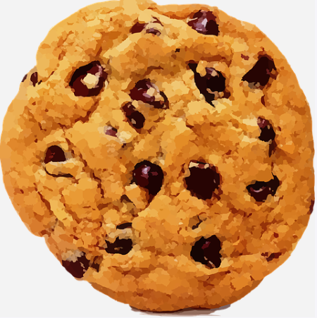
Activity 2:
Darcey and Jenson have some mini-cookies.
As they are friends, they decide to share them equally.
How many mini-cookies will each child get? How did you work this out?

Slide 18
Activity 2:
Darcey and Jenson have some mini-cookies.
As they are friends, they decide to share them equally.
How many mini-cookies will each child get? How did you work this out?
Jenson has 9 mini-cookies.
Darcey has 7 mini-cookies.
9 + 7 = 16.
Half of 16 = 8.
That means that both children will get 8 mini-cookies each.

Slide 19
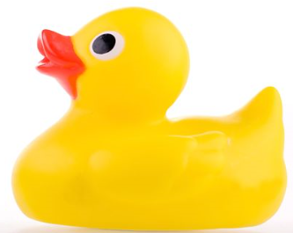
Talking Time:
Can you find half of the ducks?
Can you complete the stem sentences?
There are ____ plastic ducks.
Half of ___ is ___ .

Slide 20
Talking Time:
Can you find half of the ducks?
Can you complete the stem sentences?
There are 10 plastic ducks.
Half of 10 is 5.

Slide 21
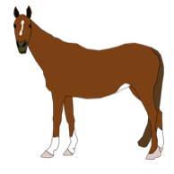
Talking Time:
Can you find half of the horses?
Can you complete the stem sentences?
There are ____ horses.
Half of ___ is ___ .

Slide 22
Talking Time:
Can you find half of the horses?
Can you complete the stem sentences?
There are 12 horses.
Half of 12 is 6 .

Slide 23

Talking Time:
Can you find half of the cows?
Can you complete the stem sentences?
There are ____ cows.
Half of ___ is ___ .

Slide 24
Talking Time:
Can you find half of the cows?
Can you complete the stem sentences?
There are 14 cows.
Half of 14 is 7.

Slide 25
Activity 3:
Can you draw the images in the hoops to match the stem sentences?
Can you fill in the gaps in the stem sentences?
How do you know that you are right?
There are ____ fish.
Half of ___ is 9.

Slide 26

Activity 3:
Can you draw the images in the hoops to match the stem sentences?
Can you fill in the gaps in the stem sentences?
How do you know that you are right?
There are 18 fish.
Half of 18 is 9.

Slide 27

I can find a half of a quantity
I can find a total amount and then share it equally into two
I can use real objects to show a half of a quantity
Evaluation:
Ava is chanting her halves from half of 2 up to half of 20.
Which numbers are missing from the list? How do you know?
A half of 2 is 1, a half of 4 is __, a half of 6 is 3,
a half of 8 is __, a half of __ is 5,
a half of 12 is __, a half of 14 is 7, a half of __ is 8,
a half of __ is 9, a half of 20 is 10.

Slide 28
I can find a half of a quantity
I can find a total amount and then share it equally into two
I can use real objects to show a half of a quantity
Evaluation:
Ava is chanting her halves from half of 2 up to half of 20.
Which numbers are missing from the list? How do you know? There is a pattern. The whole amounts go up in 2s and the halves go up in 1s.
A half of 2 is 1, a half of 4 is 2, a half of 6 is 3,
a half of 8 is 4, a half of 10 is 5,
a half of 12 is 6, a half of 14 is 7, a half of 16 is 8,
a half of 18 is 9, a half of 20 is 10.

Slide 29


