Slide 1
Ready-to-go Lesson Slides
Year 1
Time
Lesson 1
Sum6

Slide 3
I can sequence events
I can use ‘before’ and ‘after’ when describing events.
Starter:
What is different and what is the same about these?
Eating breakfast
Eating lunch
Eating dinner
Brushing your teeth

Slide 4
I can sequence events
I can use ‘before’ and ‘after’ when describing events.
Starter:
What is different and what is the same about these?
Eating breakfast
Eating lunch
Eating dinner
Brushing your teeth
Example answer: ‘They are all events that happen throughout the day. They are all mealtimes except for brushing your teeth.’

Slide 5
Talking time:
Would you do this event before school or after school?
Putting on your uniform

Slide 6
Talking time:
Would you do this event before school or after school?
Putting on your uniform
Before school

Slide 7
Talking time:
Would you do this event before school or after school?
Eating your dinner

Slide 8
Talking time:
Would you do this event before school or after school?
Eating your dinner
After school

Slide 9
Talking time:
Would you do this event before school or after school?
Doing your homework

Slide 10
Talking time:
Would you do this event before school or after school?
Doing your homework
After school

Slide 11
Activity 1:
Sort these events into before school and after school. Then, can you sort them into morning, afternoon and evening events?
Eating your dinner
Eating your breakfast
Watching a TV show
Reading a bedtime story
Extension:
Can you add your own events to each category?

Slide 12
Activity 1:
Sort these events into before school and after school. Then, can you sort them into morning, afternoon and evening events?
Eating your dinner – after school, evening
Eating your breakfast – before school, morning
Watching a TV show – before school or after school, morning, afternoon or evening
Reading a bedtime story – after school, evening
Extension:
Can you add your own events to each category?

Slide 13
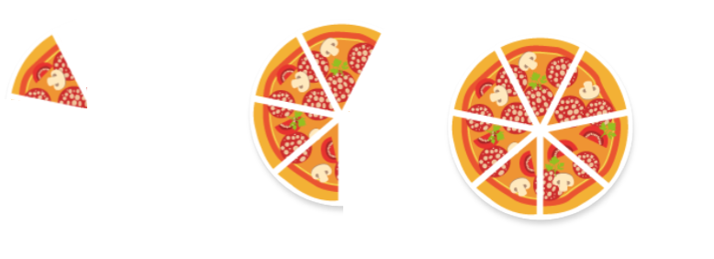
Talking time:
Mauricio is eating a pizza . Match the words to the pictures to order them to show how much was left.
First, next, finally

Slide 14
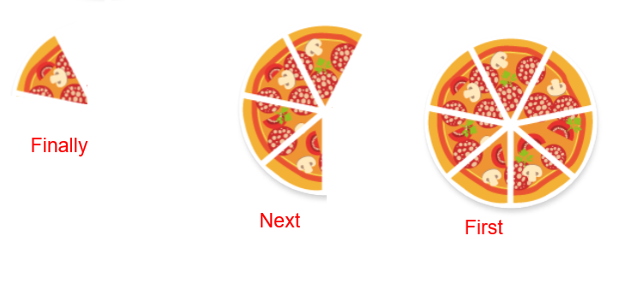
Talking time:
Mauricio is eating a pizza . Match the words to the pictures to order them to show how much was left.
First, next, finally

Slide 15

Activity 2:
Sandra is eating some sweets. Use the words ‘first’, ‘next’ and ‘finally’ to order the pictures and show how many were left.
Extension:
Could you draw your own example?

Slide 16

Activity 2:
Sandra is eating some sweets. Use the words ‘first’, ‘next’ and ‘finally’ to order the pictures and show how many were left.
Extension:
Could you draw your own example?

Slide 17
Talking time:
Listen to your teacher describe a special day. They will use the words: before, after, first, next, morning, afternoon, evening.

Slide 18
Activity 3:
Describe a special day to your partner. Use the words: before, after, first, next, morning, afternoon, evening.
Extension:
Can you retell your teacher’s special day to your partner?

Slide 19
Activity 3:
Describe a special day to your partner. Use the words: before, after, first, next, morning, afternoon, evening.
Answers dependent on children’s descriptions.
Extension:
Can you retell your teacher’s special day to your partner?

Slide 20
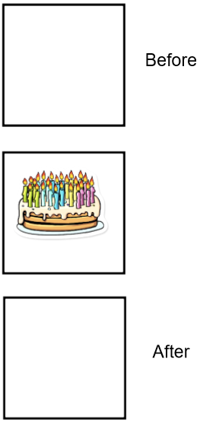
I can sequence events
I can use ‘before’ and ‘after’ when describing events.
Evaluation:
Draw pictures to show what could have happened before and after.

Slide 21
I can sequence events
I can use ‘before’ and ‘after’ when describing events.
Evaluation:
Draw pictures to show what could have happened before and after.
Example answer:
Before - opened
birthday presents
After - played party
games

Slide 22
