Slide 1
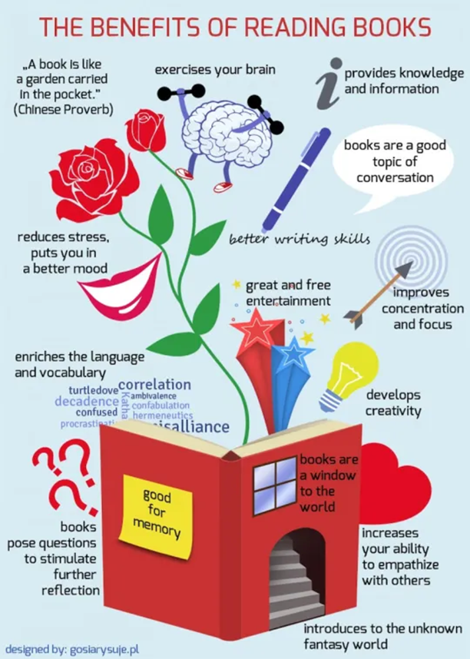
Developing a
Love of Reading
Information for parents at Huntington Community
Primary School.

Slide 2
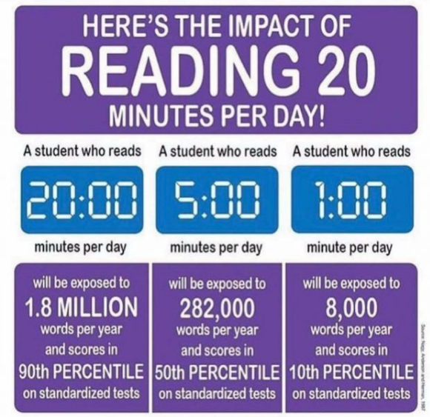
The Importance of Reading

Slide 3
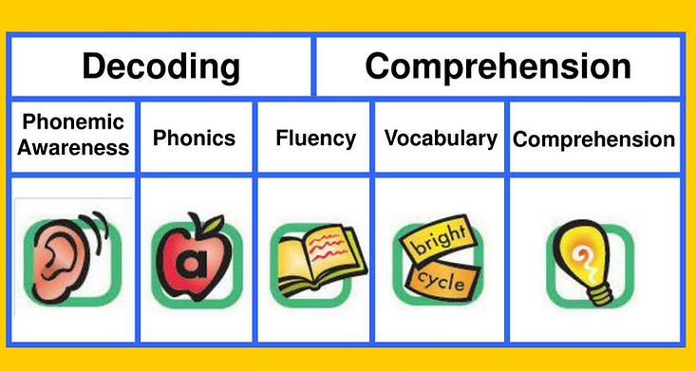
How we Teach Reading in Key Stage 2
Phonics- Little Wandle Rapid Catch-up
Whole Class Guided Reading – Pathways to Read and VIPERS

Slide 4

Vocabulary
Inference
Prediction
Explanation
Retrieval
Summary and sequencing

Slide 5
How we Teach Reading in Key Stage 2
Phonics- Little Wandle Rapid Catch-up
Whole Class Guided Reading – Pathways to Read and VIPERS
Pathways to Write – text based
Cross-curricular reading tasks

Slide 6
Reading Assessment
Continual teaching assessment during lessons- notes are made for every pupil for each lesson.
NTS standardised assessment twice per year (Autumn and Summer)
Benchmarking for reading books.

Slide 7
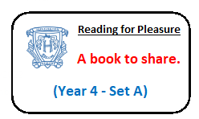
Home Reading Books
Colour banded reading book (from benchmarking assessment).
Reading for Pleasure book which have been chosen by the children from our Reading Spine. This is a book to be shared and is not necessarily at a specific assessed level.

Slide 8
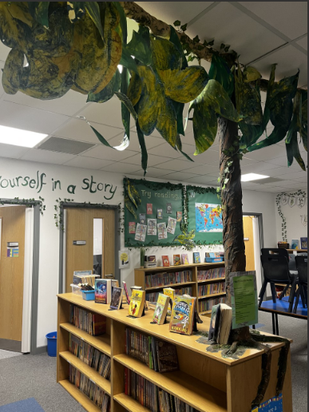
Reading for Pleasure
Lovely libraries with Year 6 librarians

Slide 9
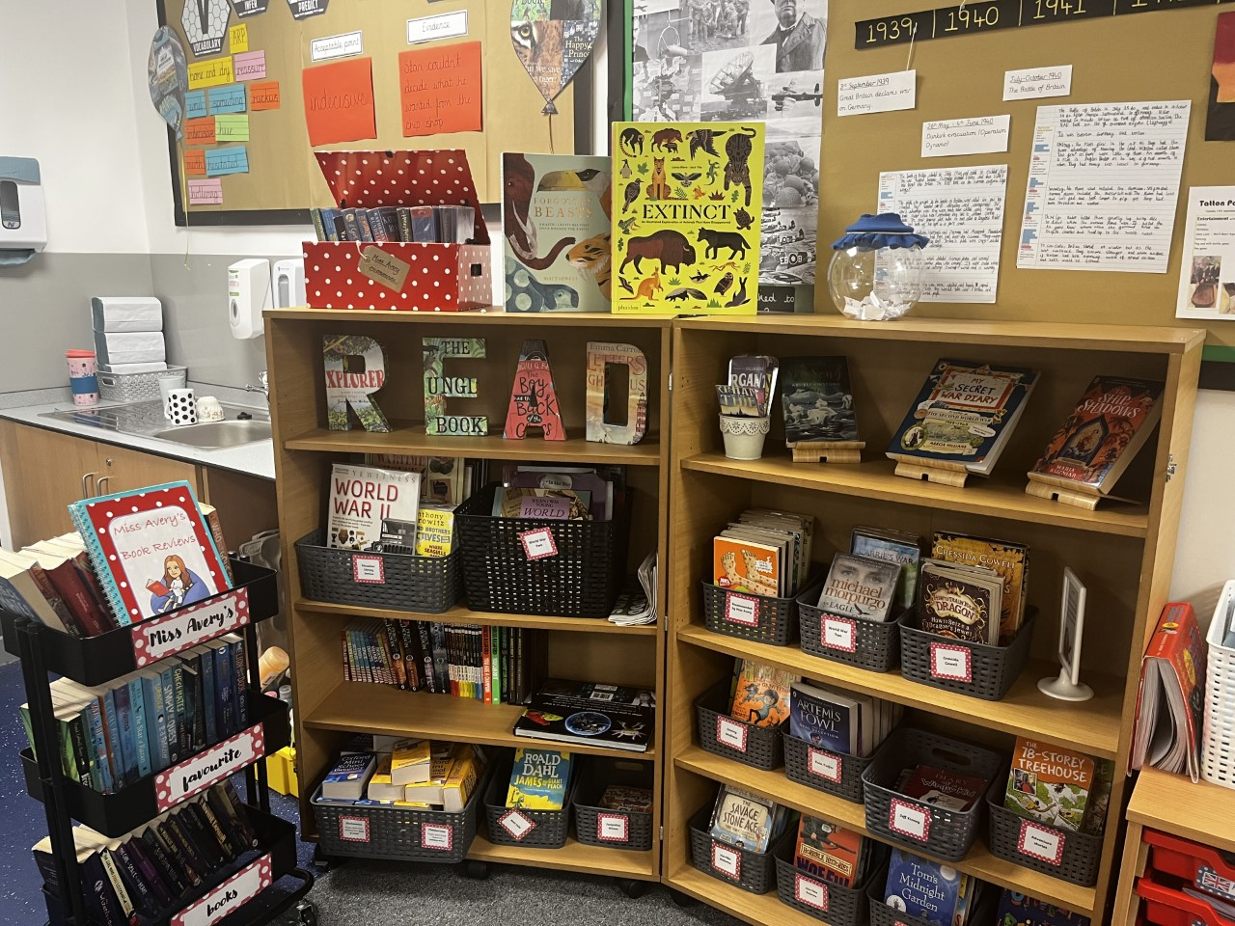
Reading for Pleasure
Inviting book corners in classrooms

Slide 10
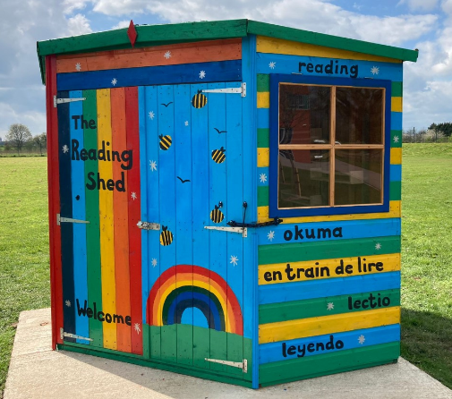
Reading for Pleasure
Reading Shed

Slide 11
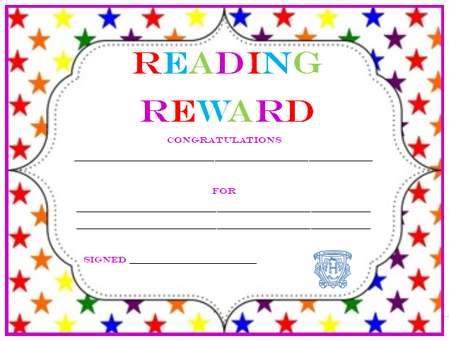
Reading for Pleasure
Reading Rewards
Shared on Twitter #hcpsread

Slide 12
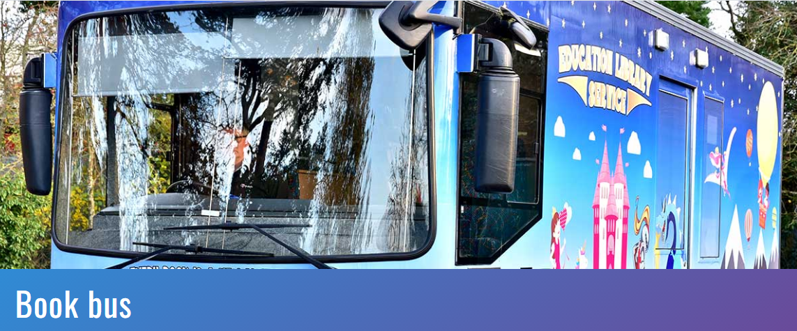
Reading for Pleasure
Visits from the Education Library Service bus

Slide 13
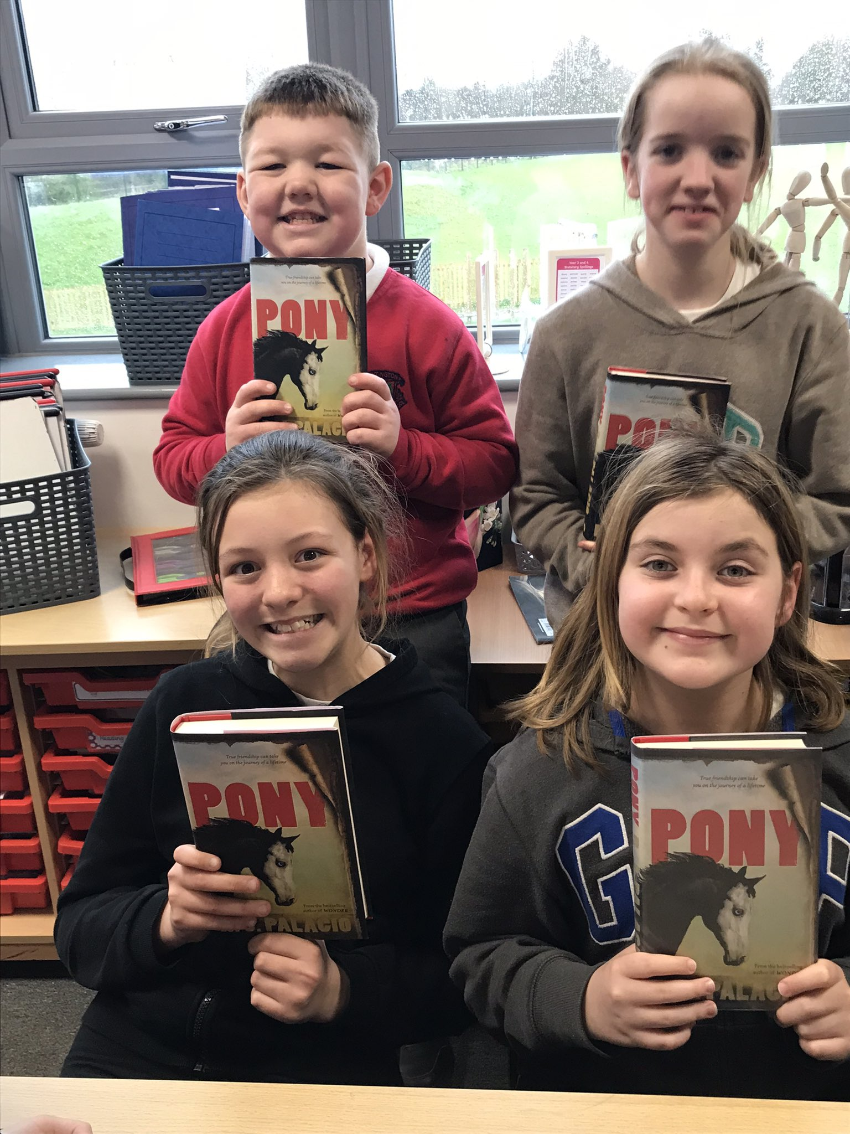
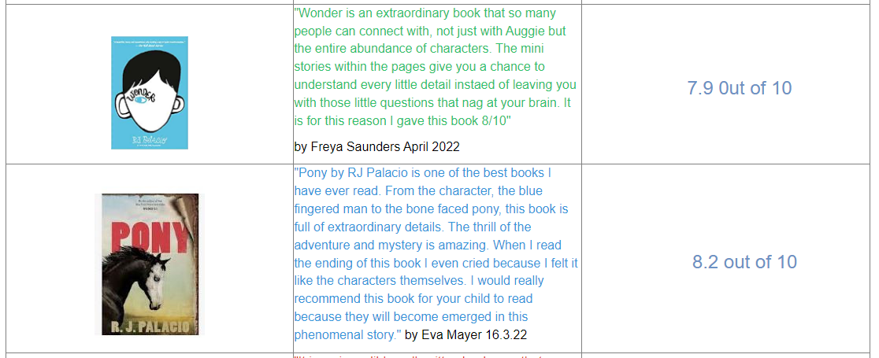
Book Club

Slide 14
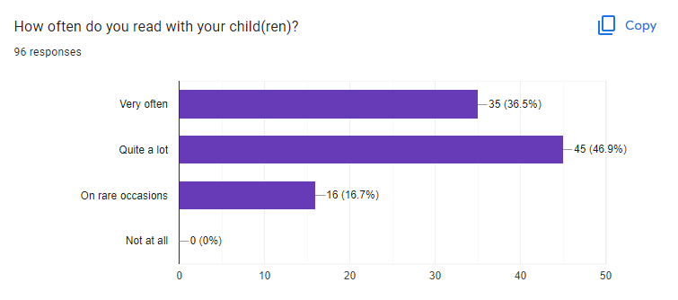
Parents’ View
Quality time together
Watching them grow and develop
Seeing their enjoyment
Listening to their expression

Slide 15
Still important in KS2 and into secondary
Average reading age for a GCSE paper is 15 years and 7 months, across all subjects, including Maths.

Slide 16

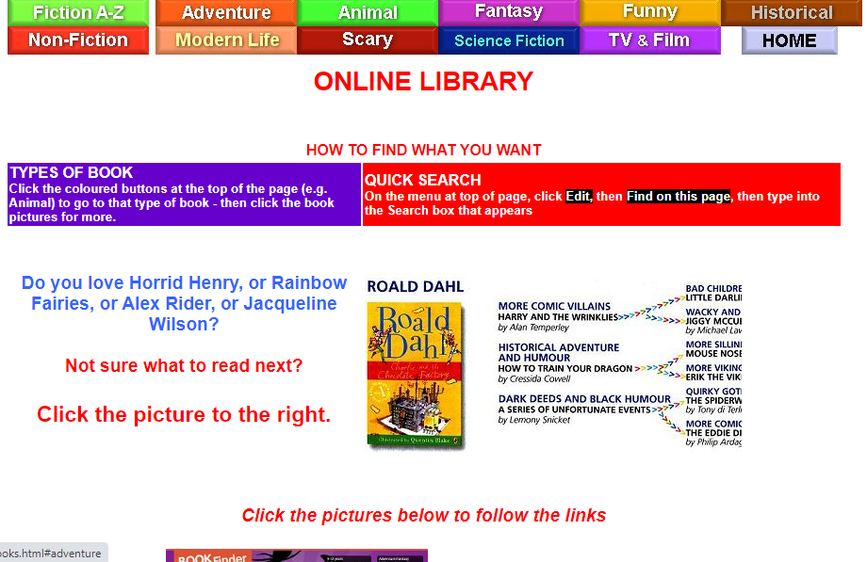
Parental Queries
Book suggestions?
School website – School Subjects – English – Reading – bottom of page
https://www.booksfortopics.com/
Online library
Branching Out – on Books for Topics and on our website)

Slide 17

Branching Out

Slide 18
Parental queries
Time?
Little and often is best.
Encourage independent reading for 15 mins and then join for the last 5 mins
Carry a book with you
Change focus – just listen, read with them, question (doesn’t all need to be done on one evening)

Slide 19
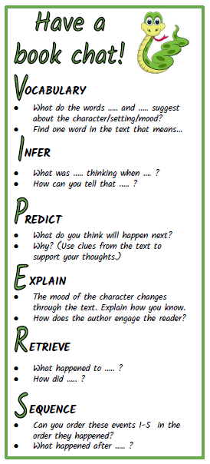
Parental Queries
Questioning

Slide 20
Parental queries
Time?
Little and often is best
Encourage independent reading for 15 mins and then join for the last 5 mins
Carry a book with you
Change focus – just listen, read with them, question (doesn’t all need to be done on one evening)
Listen to audio books in the car
Still important to read aloud for fluency – whilst making evening meal

Slide 21
Parental queries
Boring Books ?
Reading for pleasure will be their choice
Updated titles
Range of fiction, non-fiction, poetry, classics.
Children are welcome to make recommendations to be bought for the library.

Slide 22
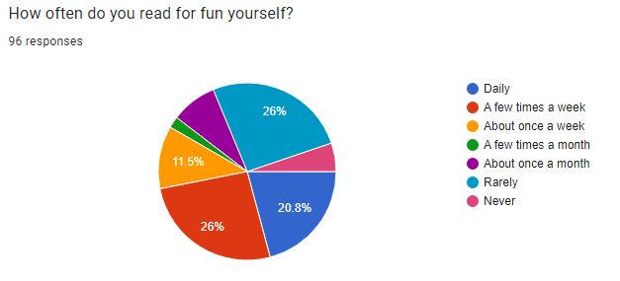
Biggest influence is adults being a “Reading Example”
Teachers have a frame on their door sharing the book that they are currently reading
Parent “Reading for Pleasure” swap box in foyer

