Slide 1


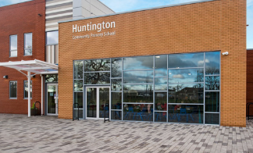
Phonics and Early Reading
Huntington Community Primary School

Slide 2




Aims of the workshop
Provide an introduction to our new approach to teaching phonics and early reading
Explain how you can best support your child or children at home with reading
Share and signpost phonics materials that you may find useful

Slide 3
A love of reading is the biggest indicator of future academic success.
OECD (The Organisation for Economic Co-operation and Development)

Slide 4
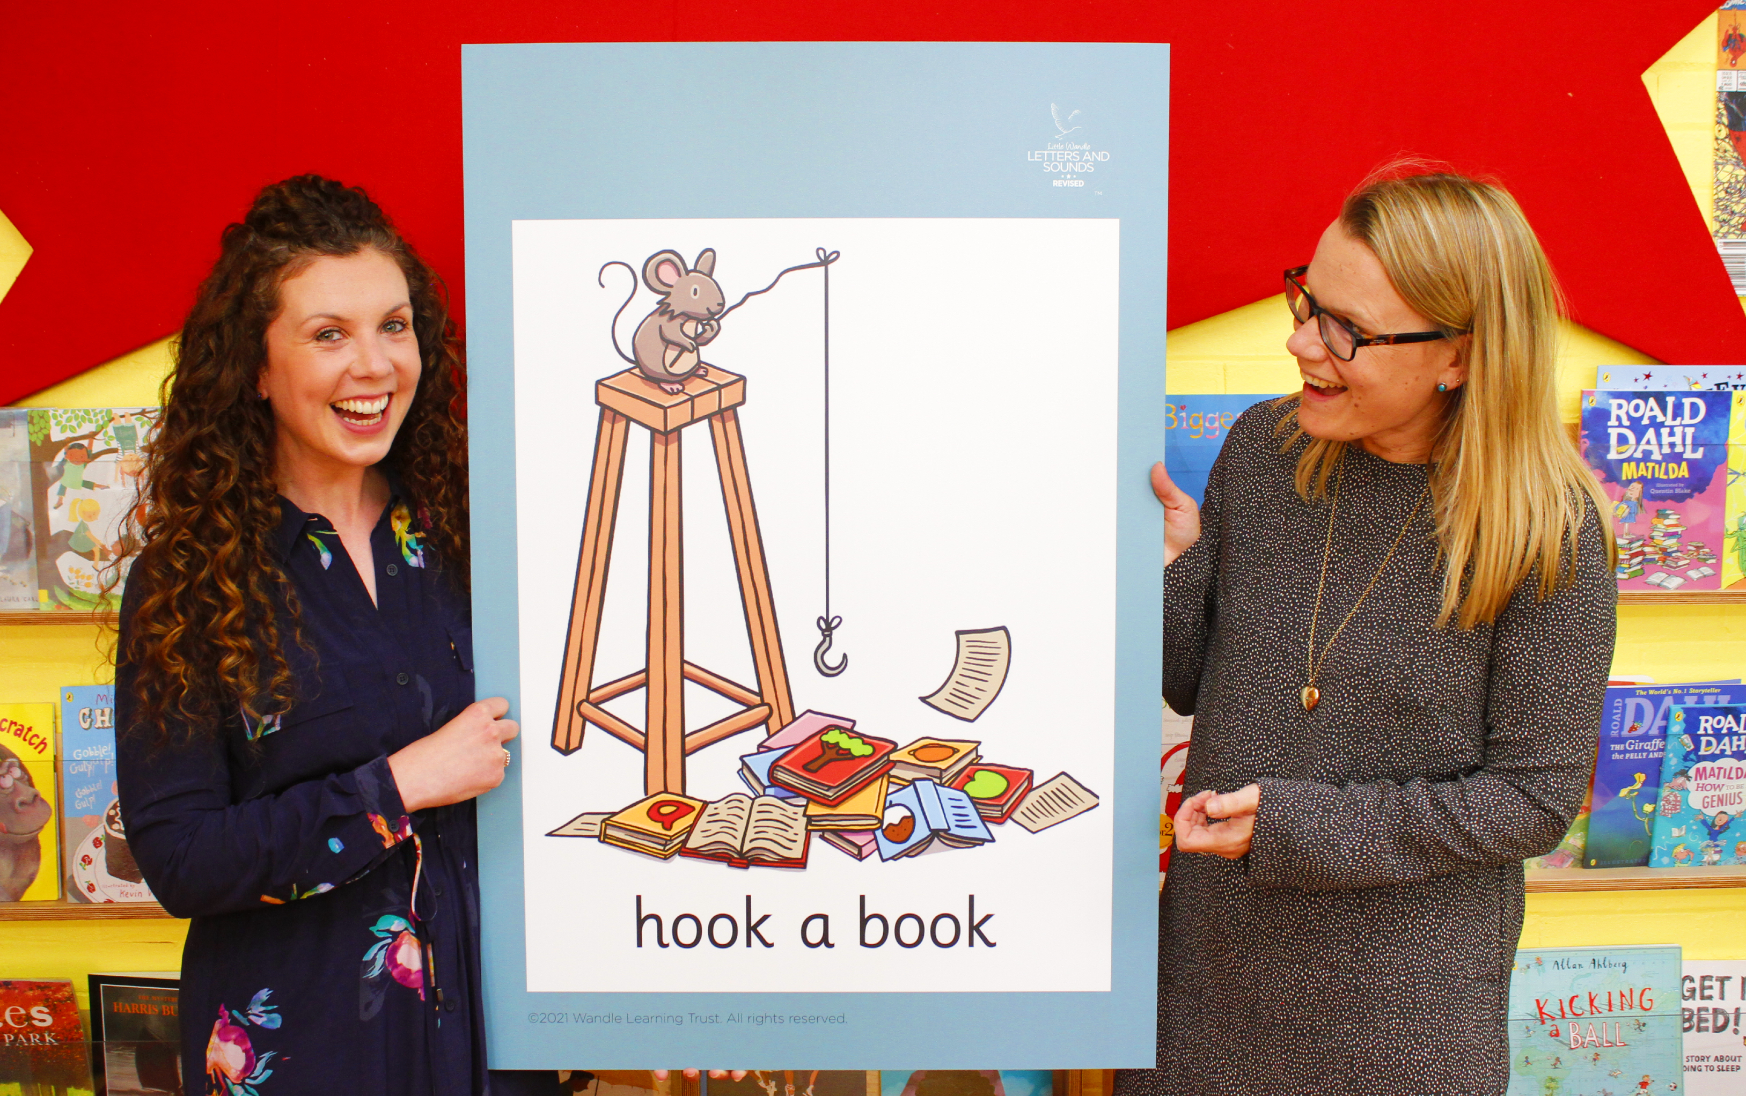
Little Wandle Letters and Sounds Revised
Our school has chosen
Little Wandle Letters and Sounds Revised as our systematic, synthetic phonics (SSP) programme to teach early reading and spelling.

Slide 5

Phonics

Slide 6
Phonics is:
making connections between the sounds of our spoken words and the letters that are used to write them down.

Slide 7
mat

Slide 8
paint

Slide 9
sigh

Slide 10
Terminology
phoneme
split vowel digraph
grapheme
blend
digraph
segment
trigraph

Slide 11
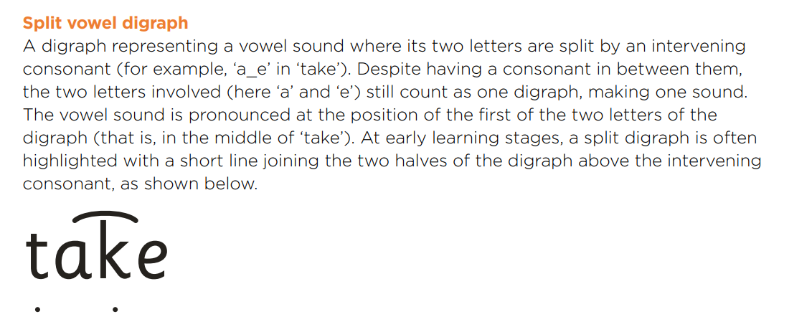
Split vowel digraph

Slide 12
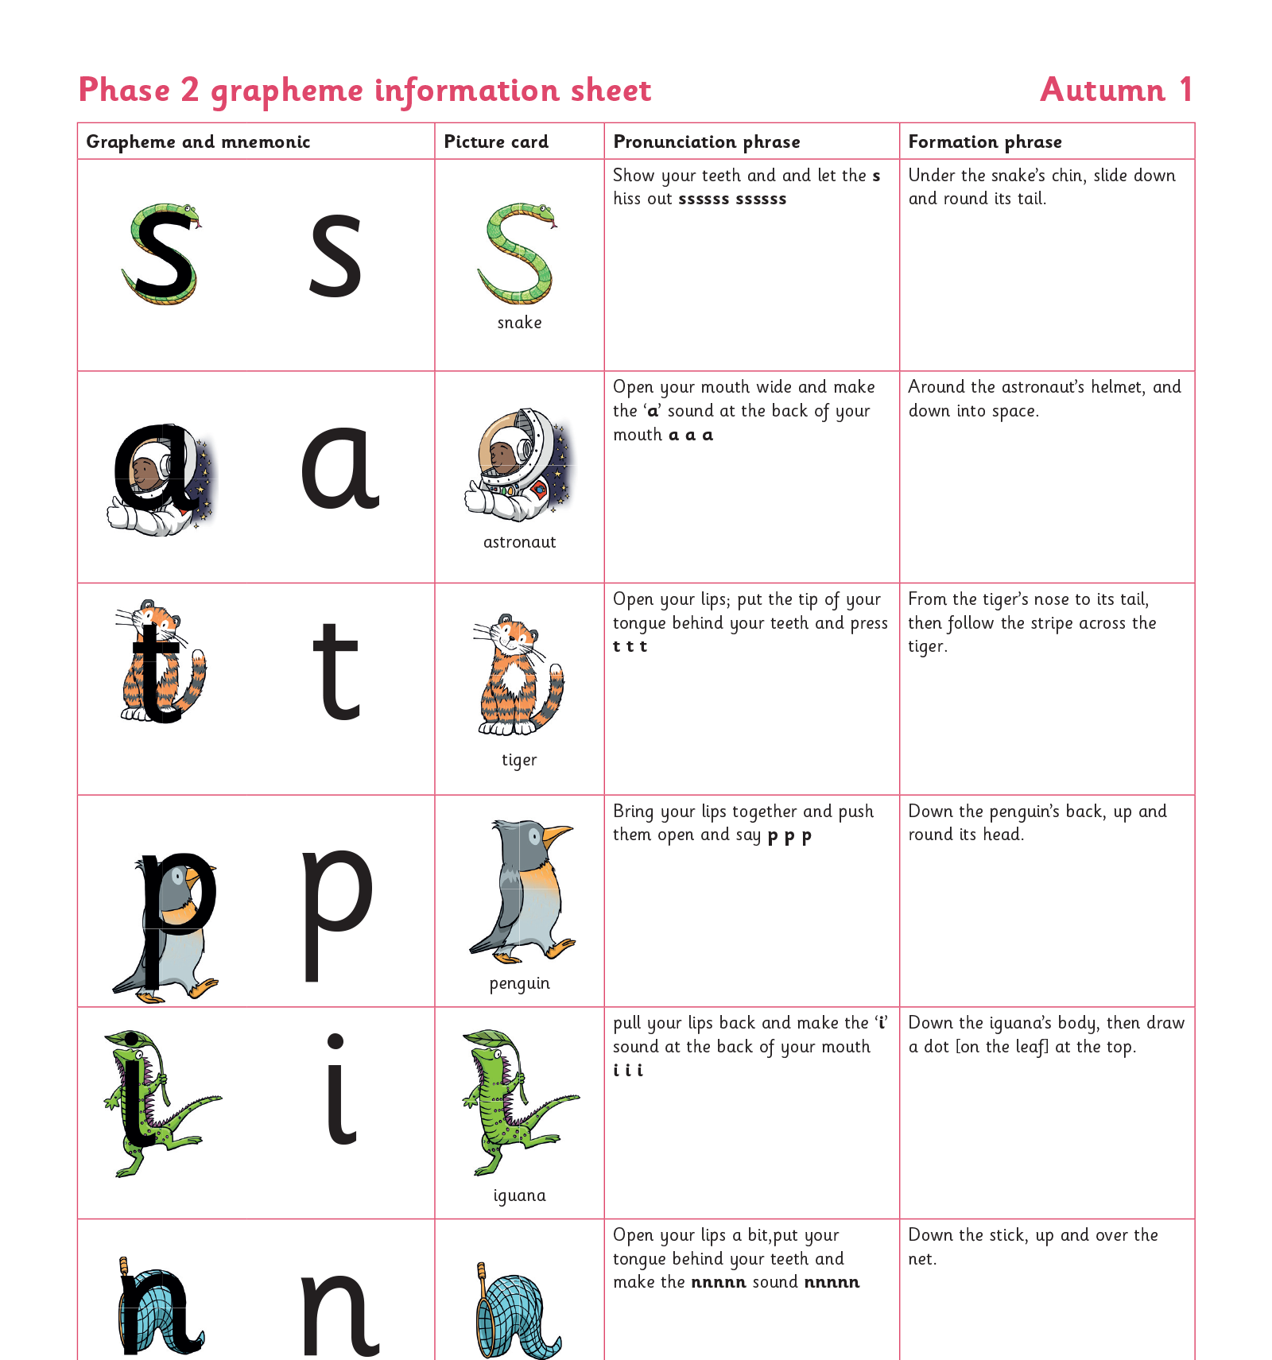
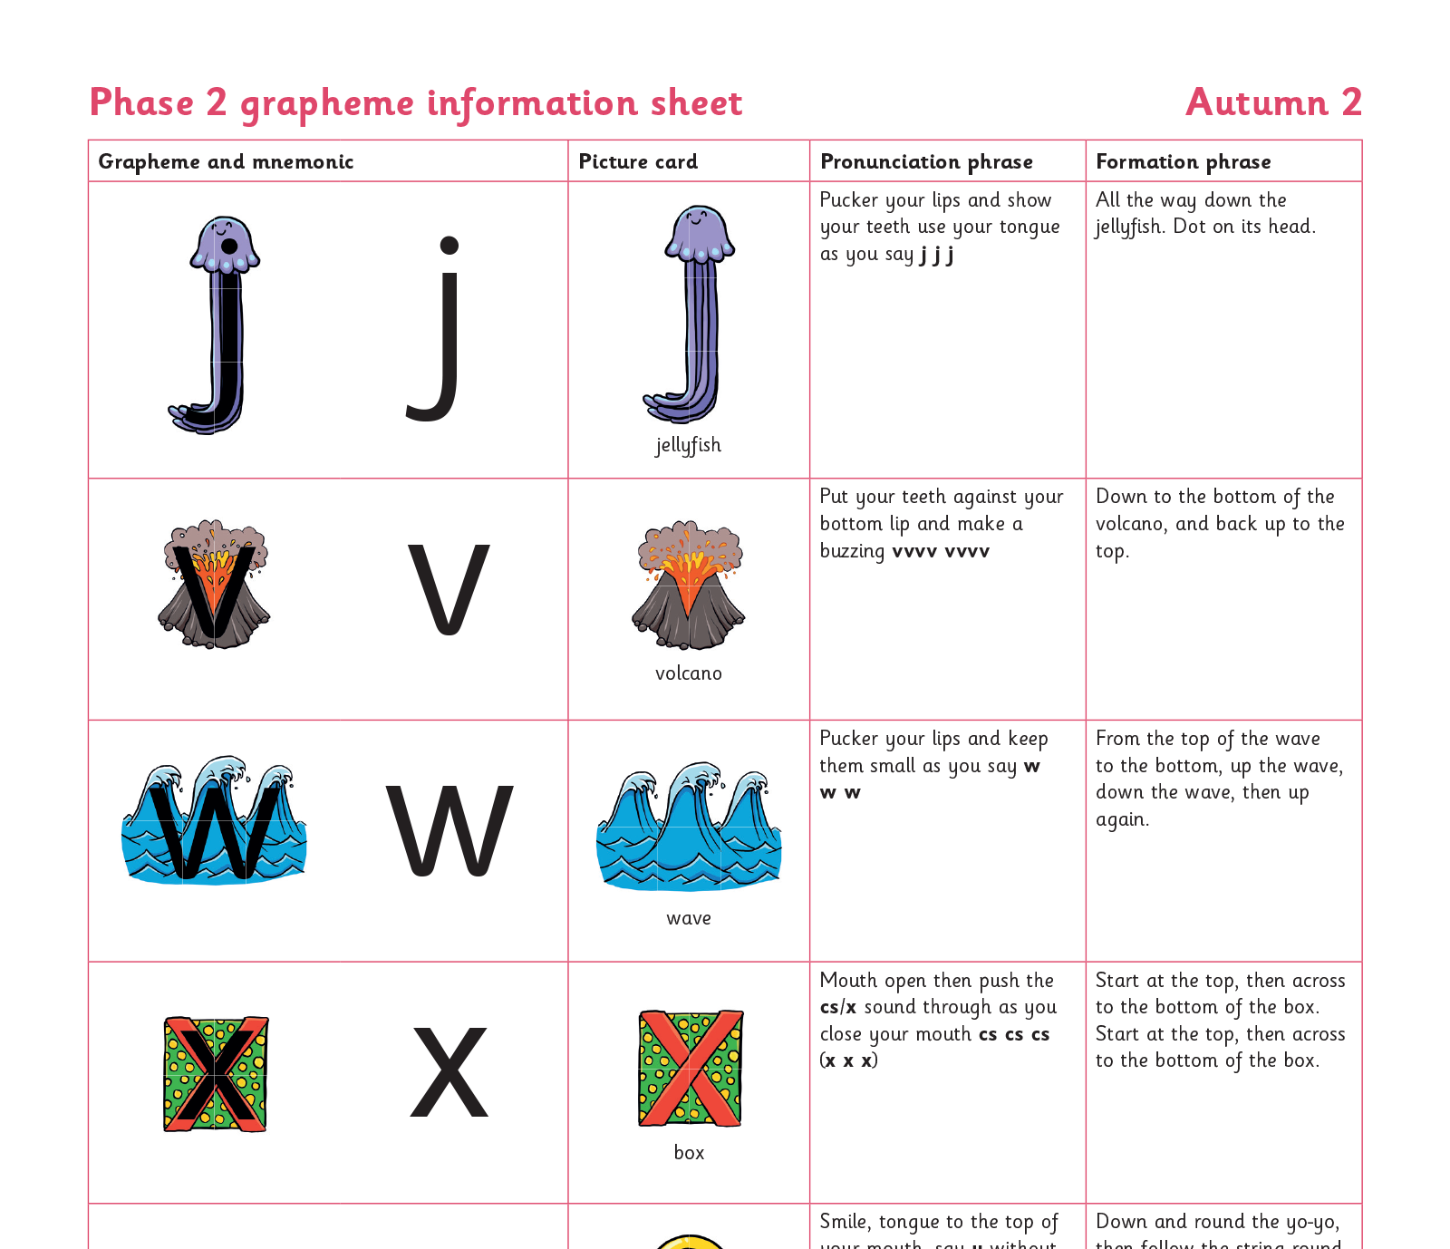
Teaching order

Slide 13
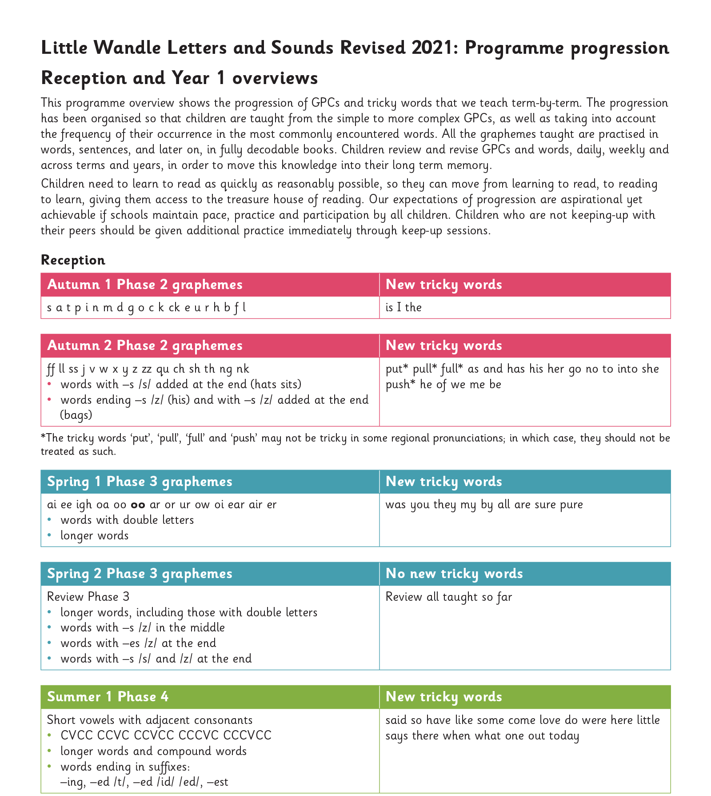
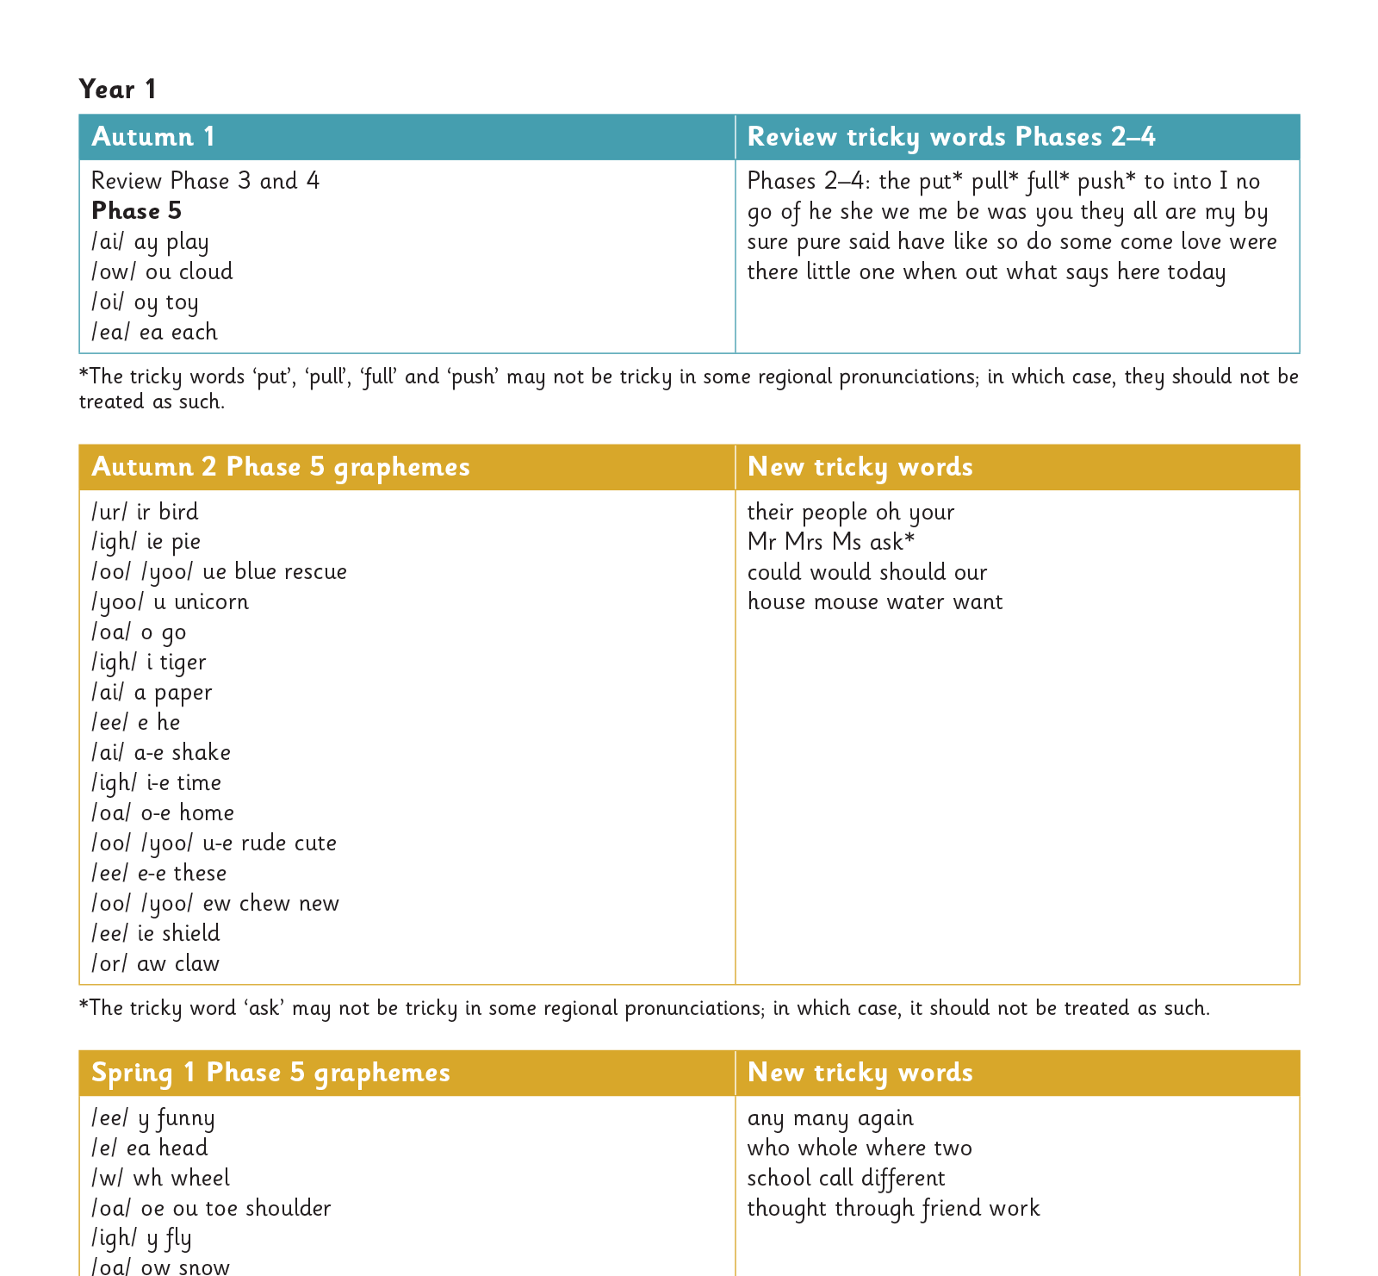
Gradually your child learns the entire alphabetic code:

Slide 14
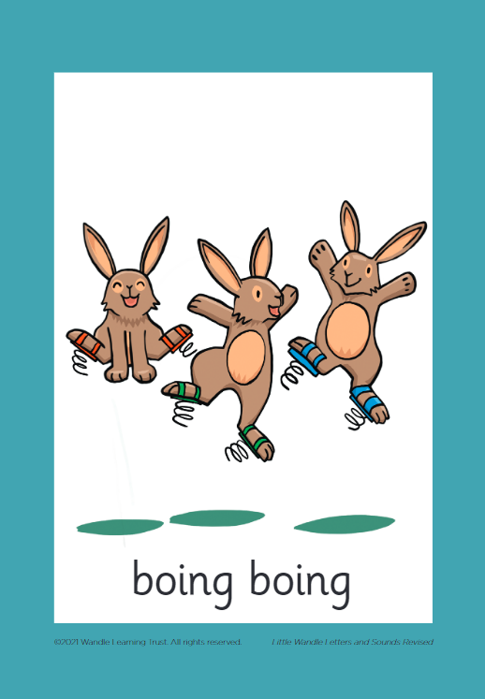



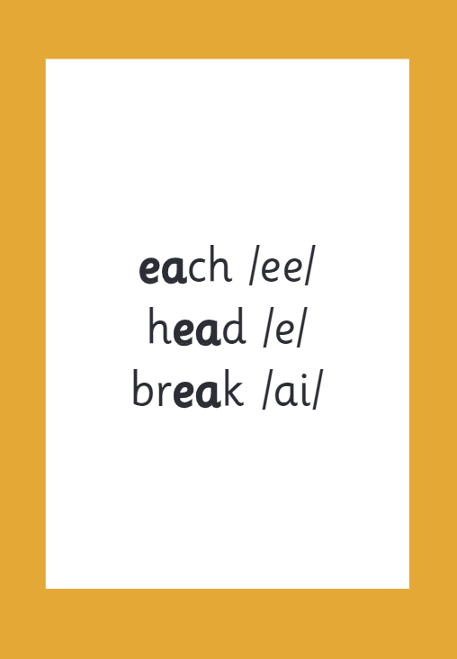

How we make learning stick

Slide 15
Reading and spelling

Slide 16
Reading and spelling

Slide 17
And all the different ways to write the phoneme sh:
shell
chef
special
caption
mansion
passion

Slide 18

Tricky words

Slide 19

Spelling
Say the word.
Segment the sounds.
Count the sounds.
Write them down.

Slide 20
How do we teach reading in books?
Reading practice sessions are:
timetabled three times a week
taught by a trained teacher/teaching assistant
taught in small groups.

Slide 21
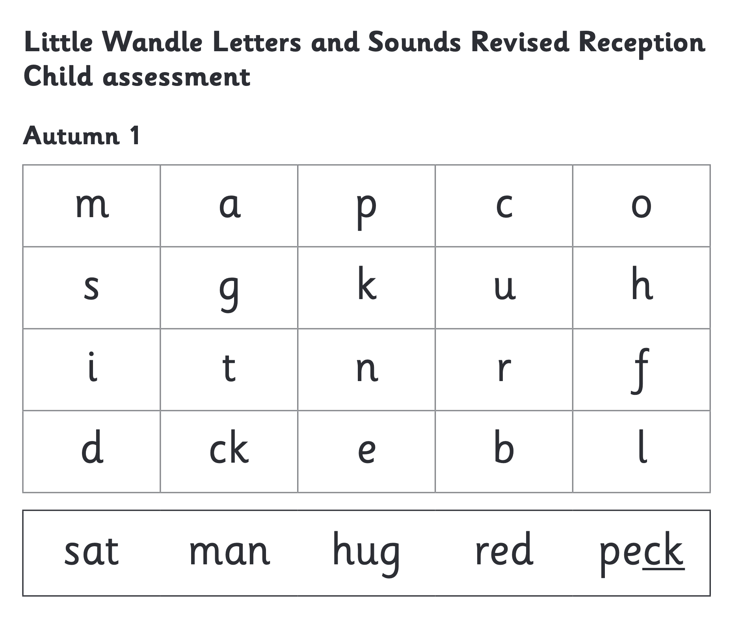
We use assessment to match your child the right level of book

Slide 22
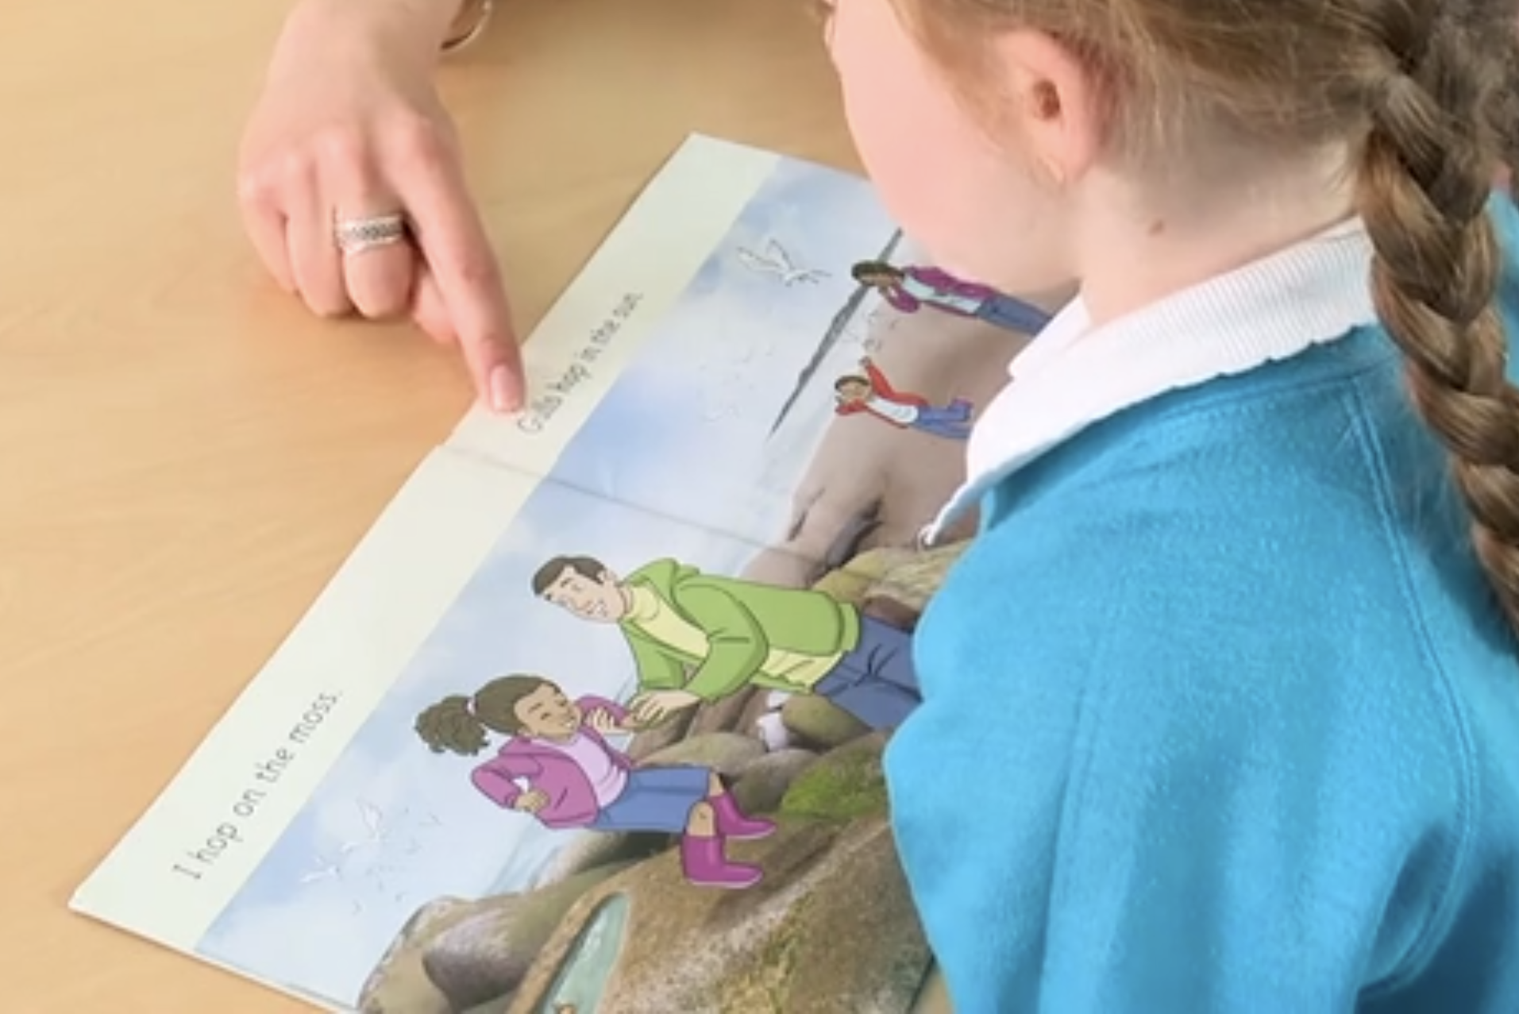
Reading a book at the right level
This means that your child should:
Know all the sounds and tricky words in their phonics book well
Read many of the words by silent blending (in their head) – their reading will be automatic
Only need to stop and sound out about 5% of the words by the time they bring the book home – but they should be able to do this on their own.

Slide 23
Reading at home

Slide 24



Supporting your child with phonics

Slide 25

Books going home

Slide 26
Listening to your child read their phonics book
Your child should be able to read their book without your help.
If they can’t read a word read it to them or support them to sound it out and blend.
Talk about the book and celebrate their success.

Slide 27

Read to your child
The shared book is for YOU to read:
Make the story sound as exciting as you can by changing your voice.
Talk with your child as much as you can:
  Introduce new and exciting language
  Encourage your child to use new vocabulary
  Make up sentences together
  Find different words to use
  Describe things you see in the pictures

Slide 28

The most important thing you can do is read with your child
Reading a book and chatting had a positive impact a year later on children’s ability to…
understand words and sentences
use a wide range of vocabulary
develop listening comprehension skills
The amount of books children were exposed to by age 6 was a positive predictor of their reading ability two years later.
Parental involvement in the development of children’s reading skills: A five-year longitudinal study (2002) Senechal, M. and Lefvre, J

Slide 29
One of the greatest gifts adults can give is to read to children
Carl Sagan

