Slide 1
Teach reading: change lives
Parent workshop: Year 1 Phonics Screening Check
Notes:
For this presentation, you will need to download and print out the following resources and information for parents:
the parent handout ‘Your child’s reading journey – Year 1 Phonics Screening Check’
‘Grow the code’ chart/mat
You will need:
access to the Little Wandle website
a copy of the Little Wandle Glossary (in Getting started/Teaching).

Slide 2

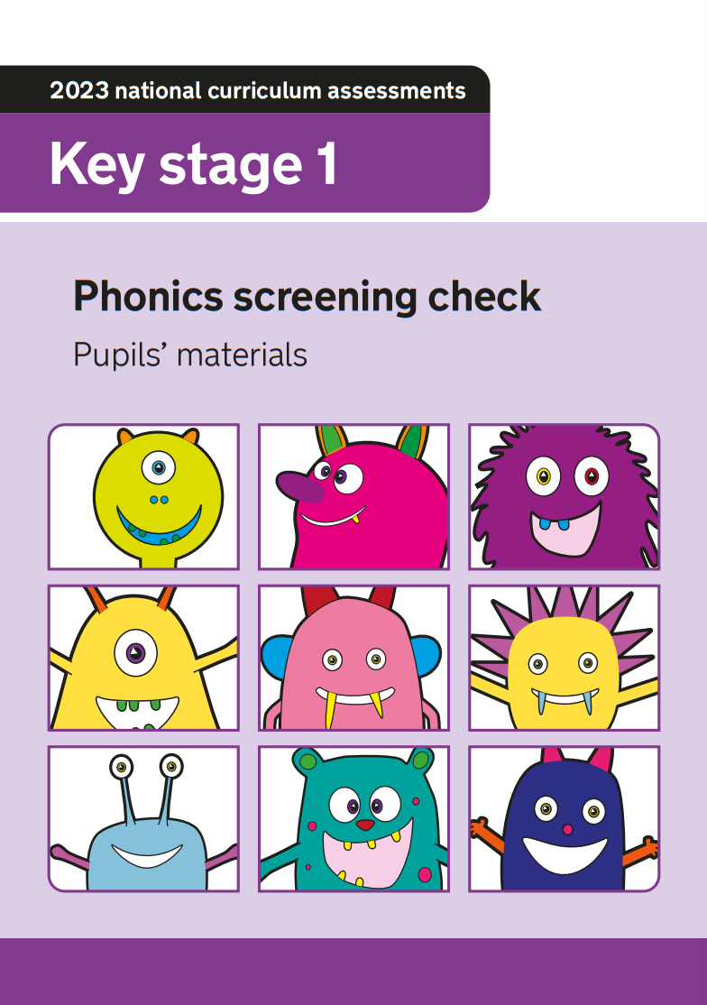
Phonics Screening Check

Slide 3
Key Dates
Checks take place during the week beginning Monday 8th June.
The final date for assessments is Friday 15th June.
Results will be sent home with end of year reports on Friday, 10th July.

Slide 4
What is the Phonics Screening Check?
It is a quick check of your child’s phonics knowledge and decoding skills.
It is not designed to create any stress or anxiety for your child.
Carried out 1:1 with your child’s class teacher in a quiet space.
It consists of 40 words (20 real words and 20 ‘alien words’).
Not timed, but we allow for around 10 minutes per child.
If children do not achieve the required score in Year 1, they will retake the screening the following June in Year 2.
Notes:
Slide purpose:
To introduce the Phonics Screening Check.
Suggested script:
Read the slide.

Slide 5
How does the check work?
It consists of 20 real words and 20 ‘alien words’.
We begin with two practice sheets to get the children ready.
The check is split into two sections and the words get progressively more difficult.
We encourage the children to look for digraphs, trigraphs or split vowel digraphs and then to sound talk and blend every word in the check. We also encourage the children to ‘chunk up’ two-syllable words. We are not allowed to prompt them to do this during the actual check.
Notes:
Slide purpose:
To provide an overview of the Phonics Screening Check.
Suggested script:
Staff will use their judgement on whether they feel children need a break from reading the 40 words.
If staff feel that the check is too much, they will stop.

Slide 6
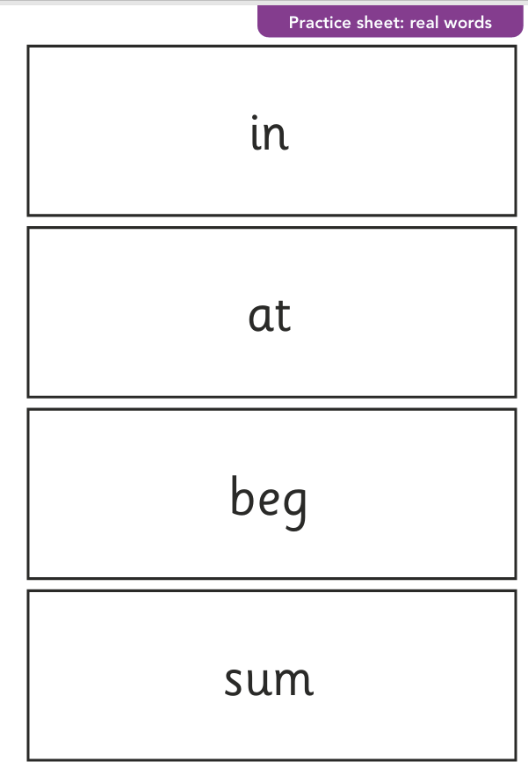
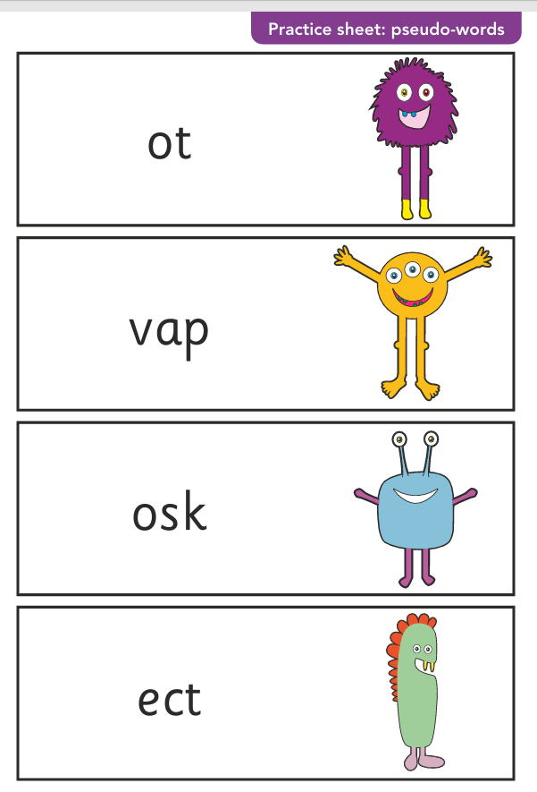

Slide 7
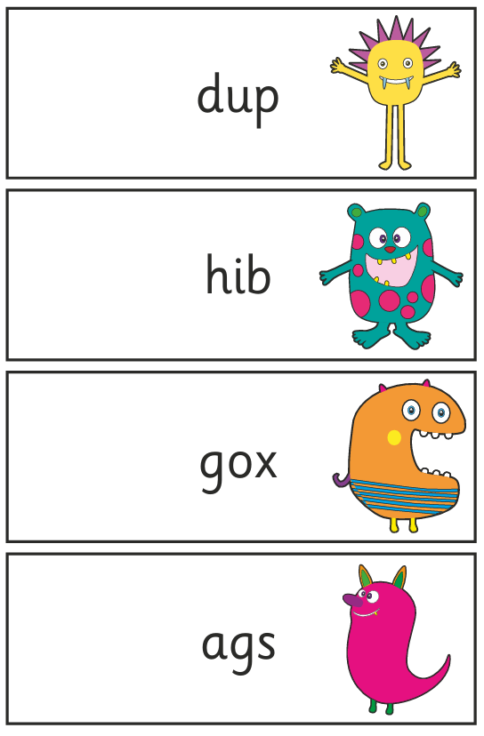
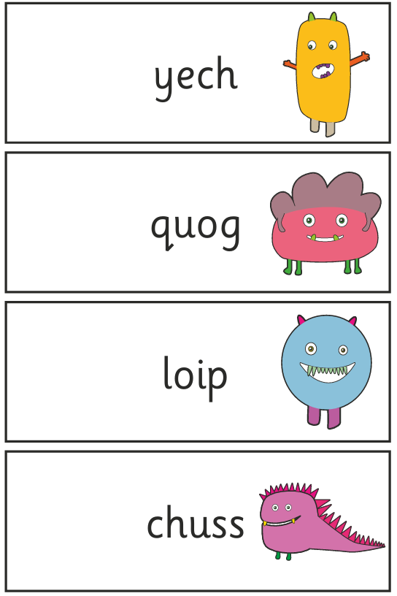
Section 1

Slide 8
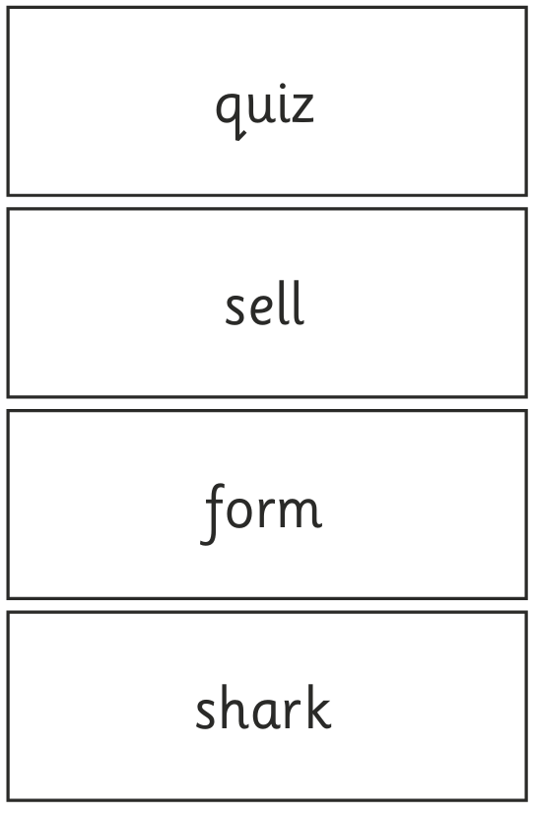
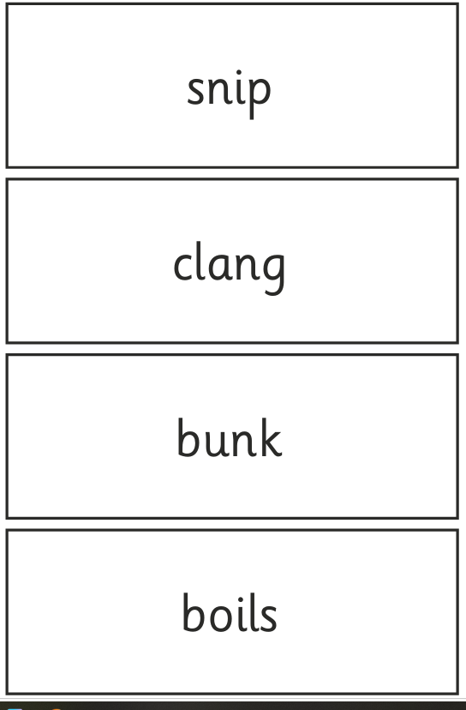
Section 1

Slide 9
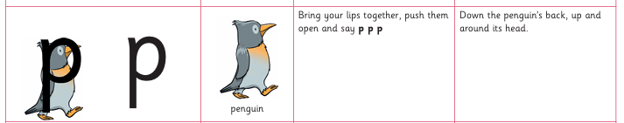
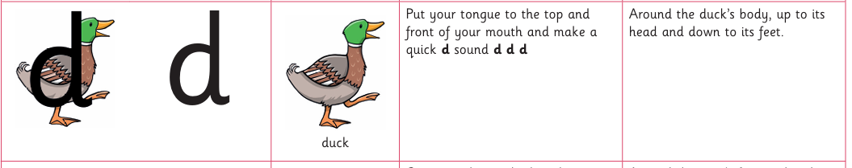
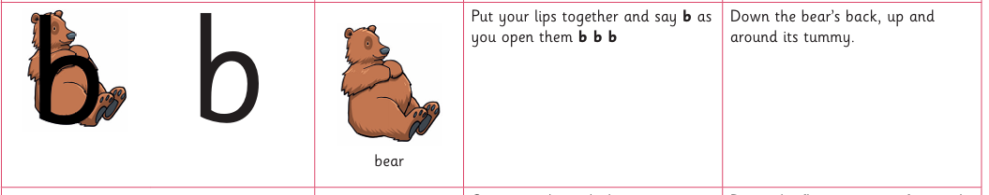
Watch out for…
If your child has speech and language issues, these are taken into account during the check.
Pupils are allowed to use any plausible regional pronunciation or dialect variation during the phonics screening check.

Slide 10
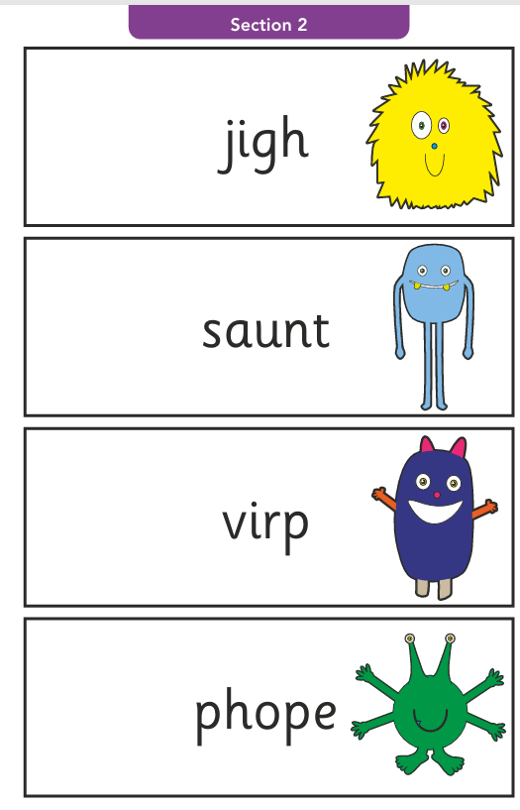
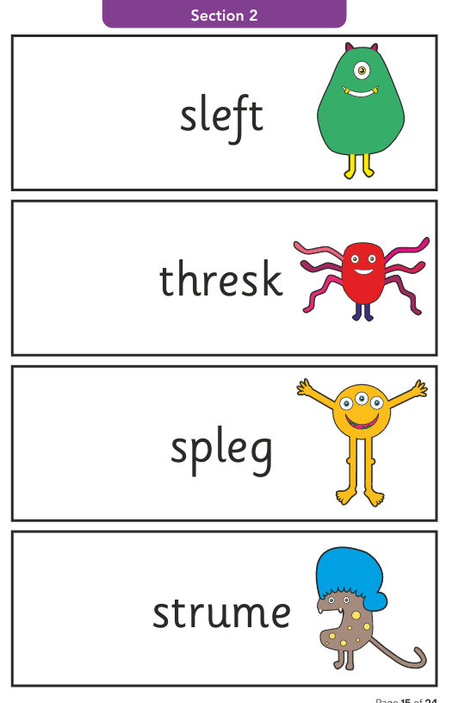
Section 2

Slide 11
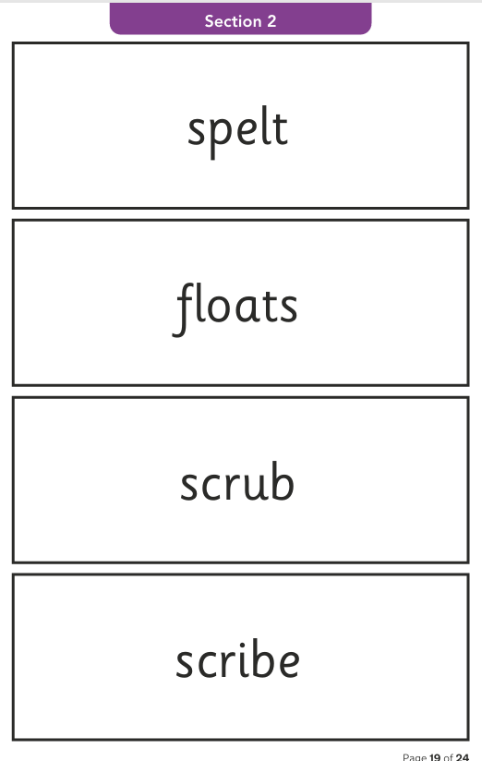
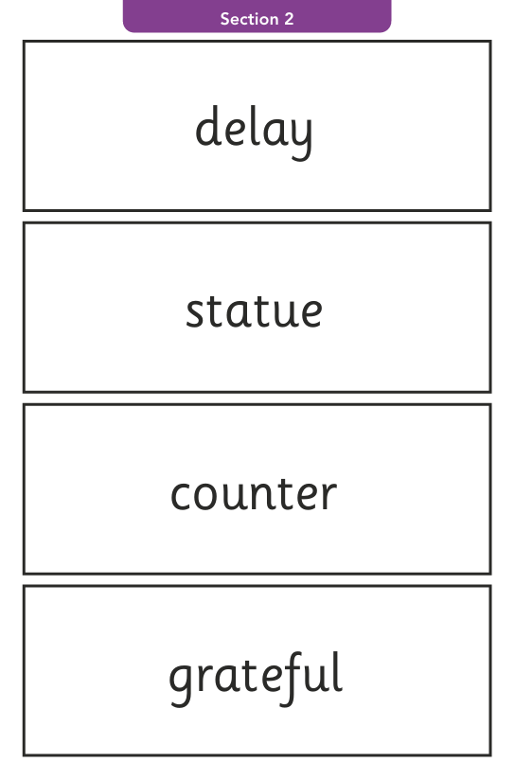
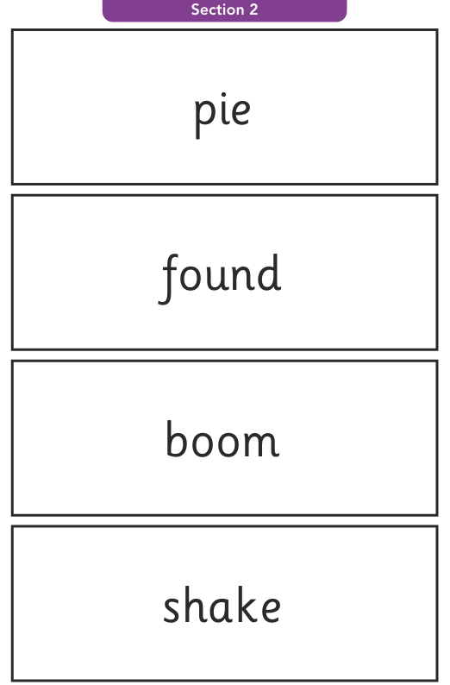
Section 2

Slide 12
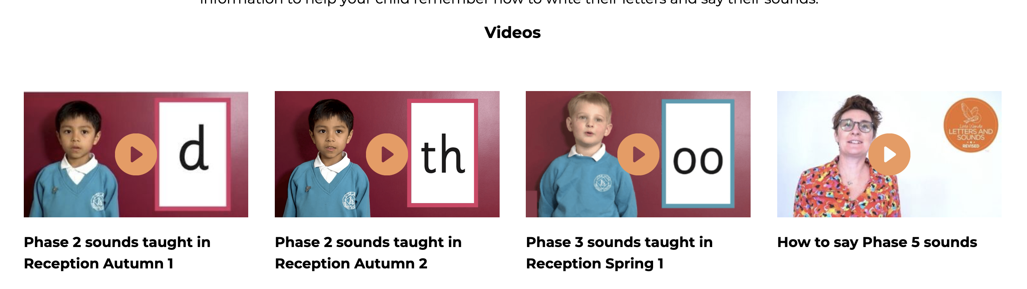


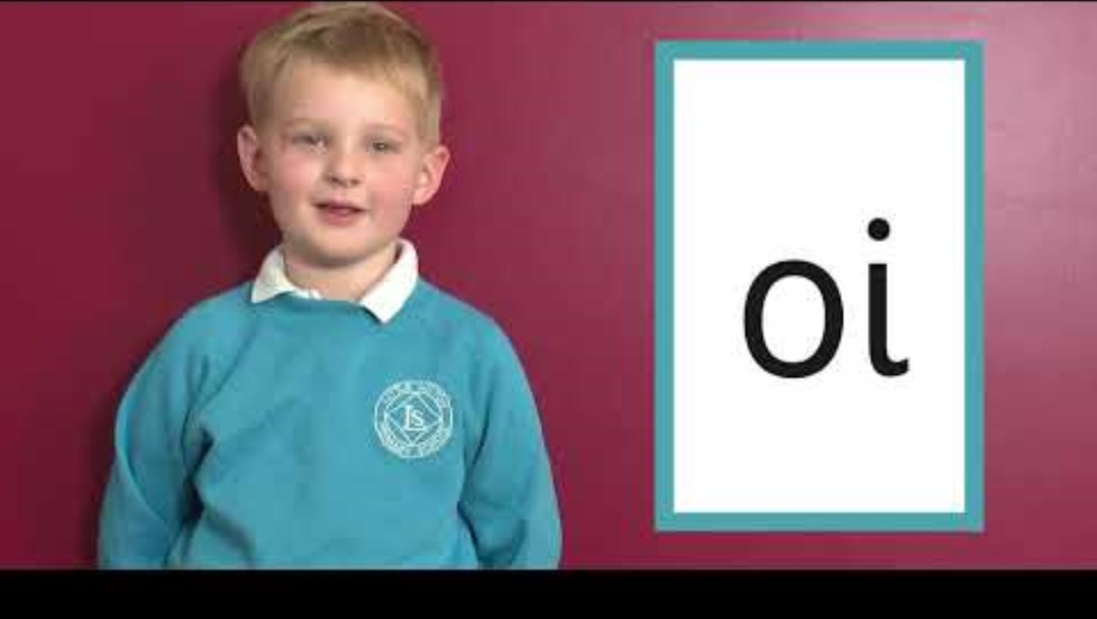
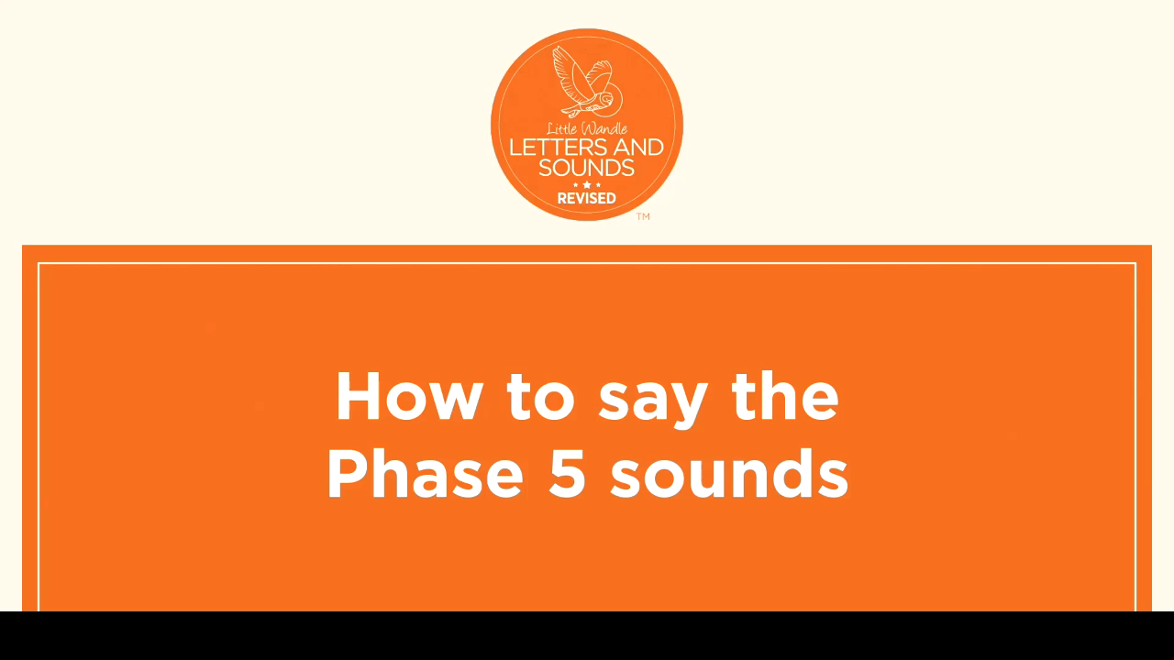
Supporting your child with phonics
Past Phonics Screening Check papers are available online
Notes:
Slide purpose:
To give guidance on supporting phonics learning at home.
Suggested script:
It is really important that you pronounce the sounds correctly at home if you are supporting your child.
These videos are on the website for you to refer to and if you are unsure, please ask your child’s teacher.
Show the parents where to access the videos on the website and play them!
https://www.littlewandlelettersandsounds.org.uk/resources/for-parents/

Slide 13
