Slide 1
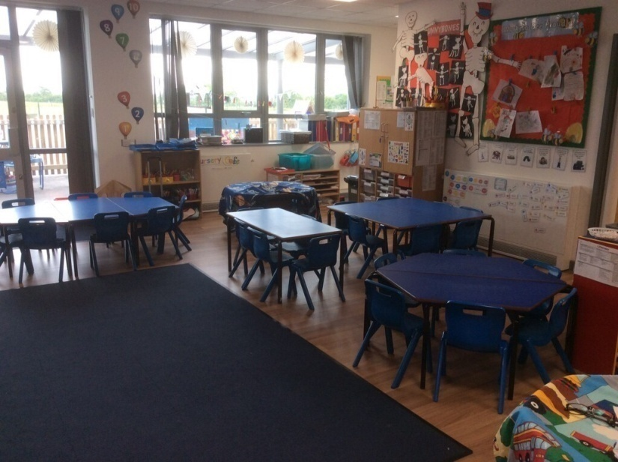
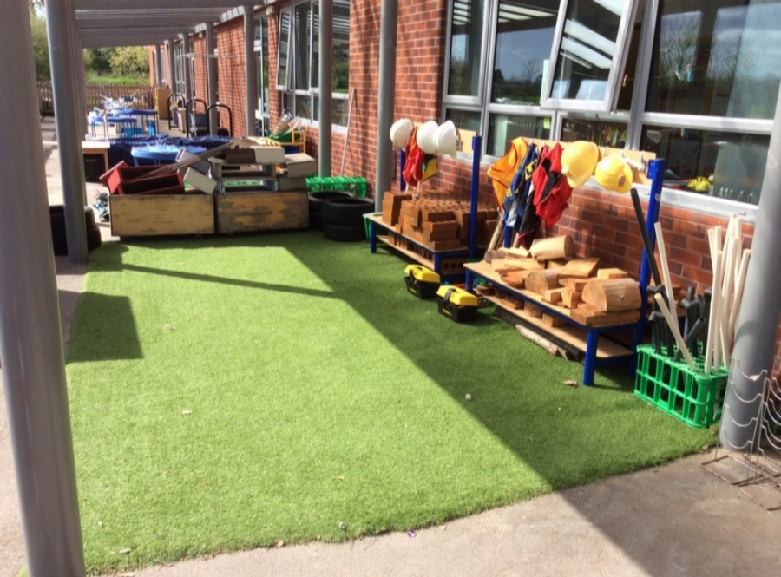

Nursery Induction Information
2025 Entry

Slide 2
Welcome
Dear Parents
We would like to take this opportunity to welcome you and your child to our Nursery class. We will do everything we can to ensure that your child enjoys their time with us here at Huntington, and we trust that the following information will clarify our procedures and assist you and your child with settling into our setting.
Any queries, please contact our school administration team on admin@huntington.Cheshire.sch.uk

Slide 3
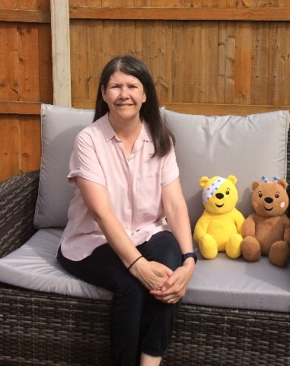

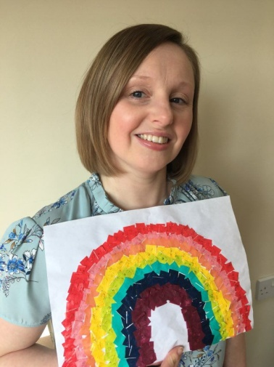
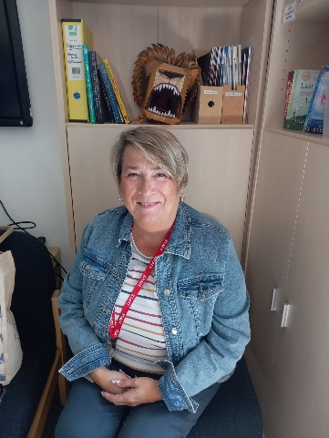
Meet our Nursery team
Our Key Workers
(clockwise from top left)
Mrs Roberts - Nursery Teacher (Monday all day, Tuesday all day and Wednesday morning)
Mrs Robinson - Nursery Teacher (Wednesday afternoon, Thursday all day and Friday all day)
Miss James - Teaching assistant (Monday and Tuesday all day)
Mrs Bennett - Teaching assistant (Wednesday, Thursday and Friday all day)

Slide 4
Weekly procedure
Our session hours are
Morning Nursery
8:55am to 11:55am
Afternoon Nursery
11:55am to 2:55pm
All Day Nursery
- 8:55am to 2:55pm
Pick up from Nursery
Please inform us if your child is to be picked up by grandparents, day nursery staff, after-school club or a childminder.
A ‘Collection from school form’ should have been completed providing this information, but if there are any changes, please inform staff at the start of the session.

Slide 5
School uniform/ spare clothes
School uniform can be ordered through myschoolstyle.com - Huntington Community Primary School.
P.E is on a Wednesday. On this day your child can continue wearing school uniform, but we ask that your child wears appropriate footwear, such as trainers or pumps.
In warm weather we ask you to provide a sun hat, which will remain in school for that term. We also ask that a long lasting sun cream be applied before coming to school.
Please make sure your child ALWAYS comes to school with a coat suitable for the weather, as there are outdoor activities available for the children every day. We have Forest School sessions for which your child will require a coat and a pair of wellies - please provide the wellies at the beginning of the school year (they will remain in school).
Please label all of your child’s clothing, especially jumpers, cardigans and coats.
We would appreciate a spare set of clothes being left in school, at all times, in a carrier bag labelled with your child’s name.

Slide 6
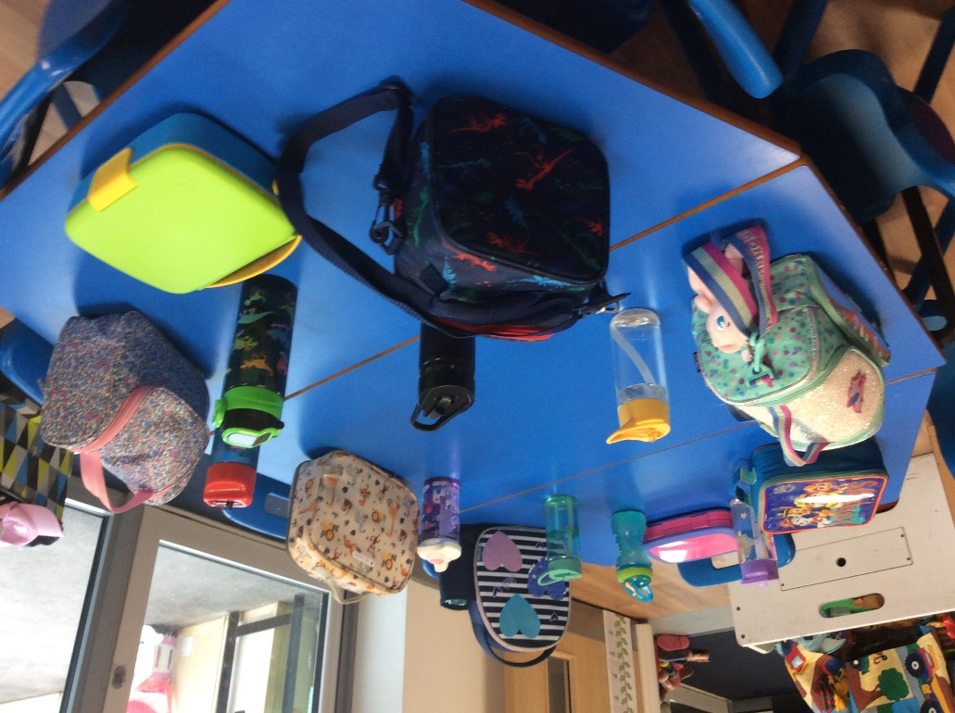
Lunchtime
Packed lunch
Nursery children are to bring in a packed lunch if they are staying all day. Also, a water bottle is always required. Please LABEL lunchboxes and water bottles (quite often we can have 2 or 3 lunch boxes which are the same, and you may have made the packed lunch without your child seeing it, so they may not recognise it).
Please only provide WATER in your child’s bottle. Try to keep your child's packed lunch very simple and with food items that they are used to and will eat. We also recommend that tangerines are ready peeled, apples cut if possible, and yoghurts possibly decanted into a Tupperware pot if your child cannot independently open a lid (please provide a spoon too). Grapes must be cut up for safety reasons.
Please bring the packed lunch in a cool lunch box/bag/container.
If your child has any allergies to certain food items please inform a member of staff.
No nuts should be included in any child’s lunch.

Slide 7

Tapestry: Our online Learning Journey
Learning Journeys and information from home – Tapestry
Every child attending the Nursery will have a Learning Journey created for them which will be online using the Tapestry app. It will contain photographs and observations of your child taken by the practitioners in our setting.
We would very much appreciate it if you could share activities and events from home: tell us what your child likes to do at home, whether they attend any clubs or have received any certificates (please bring these in to share or post a picture onto Tapestry), if they have attended a special family occasion or been on holiday. Such information gives us an insight into your child’s experiences outside school.
Please do not forget the following guidance which all parents will be asked to agree to when signing up to use Tapestry: I will not publish any of my child’s observations, videos or photographs on any social media site.
Wow moments
In the Summer Term, your child will be bringing home a ‘Wow moment’ sheet each week. Please fill it in, return it to school and we will share your child’s ‘Wow’ moment with our class. This could include putting on their clothes independently, being polite or doing a job to help at home. We want to hear about anything your child has achieved (e.g. swimming or ballet certificates).

Slide 8
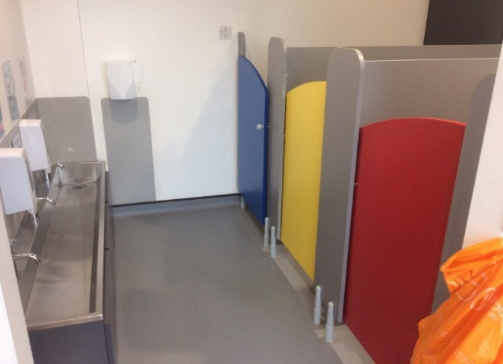
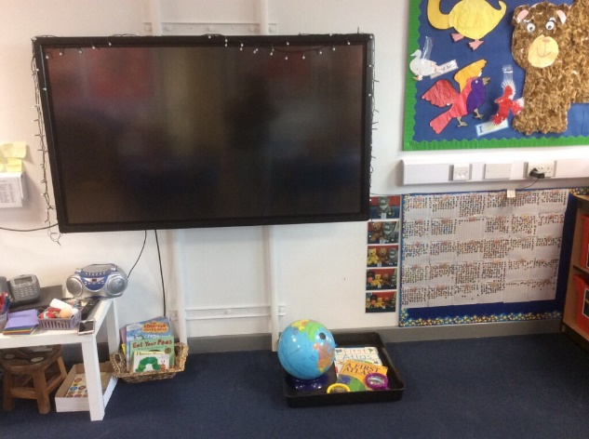
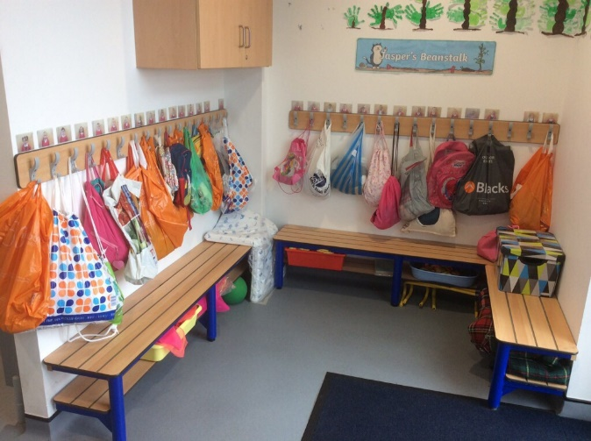
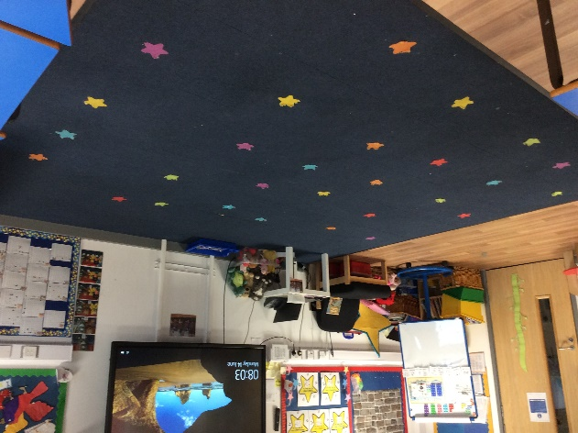
Photographs of our classroom
Cloakroom and Toilet area
Carpet area

Slide 9
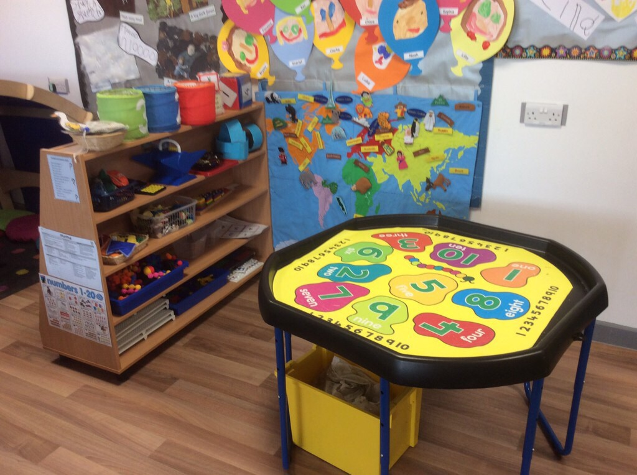
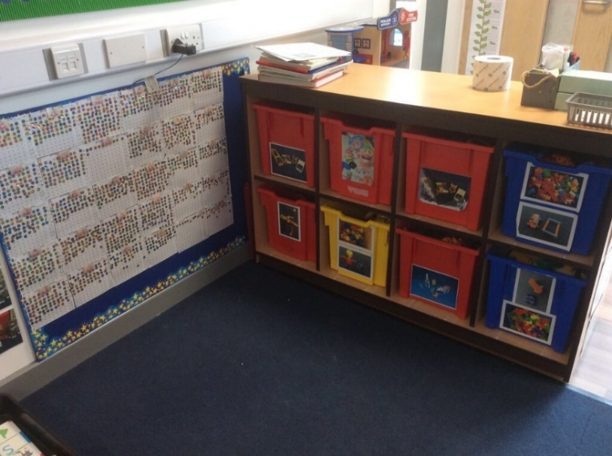
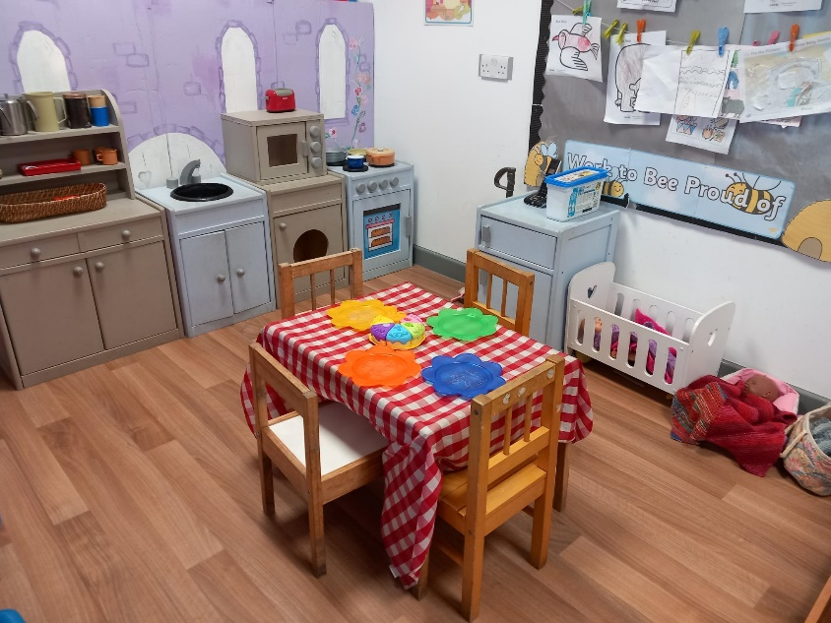
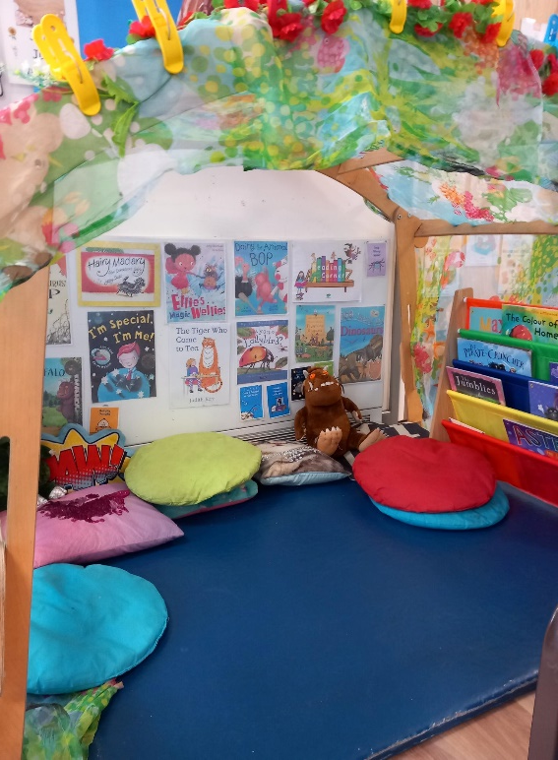

Slide 10
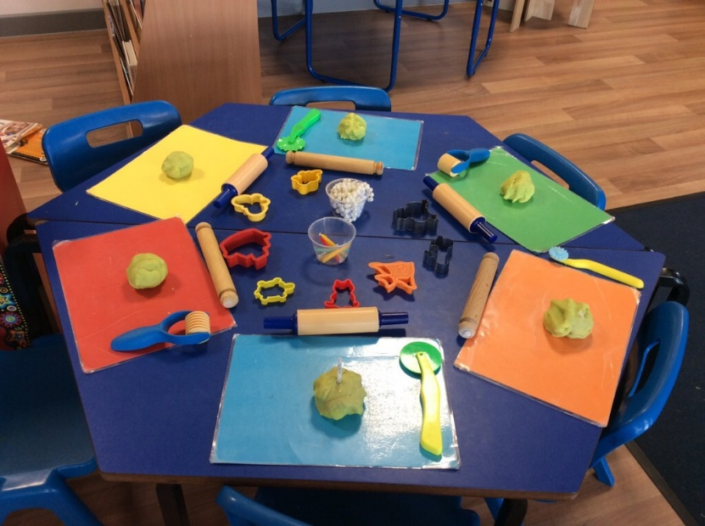
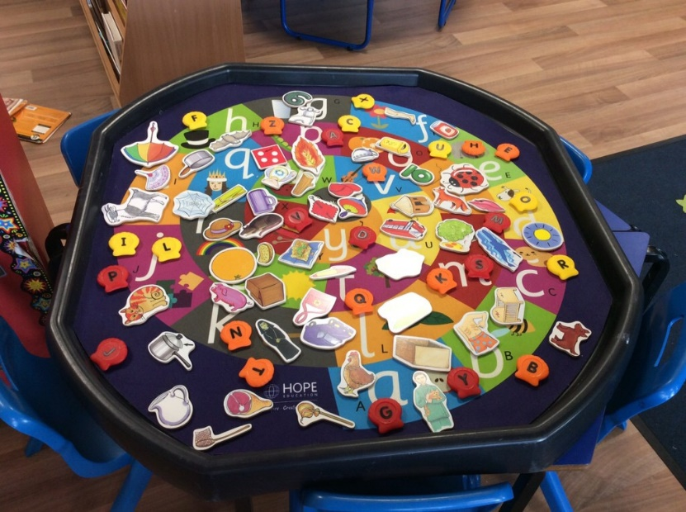
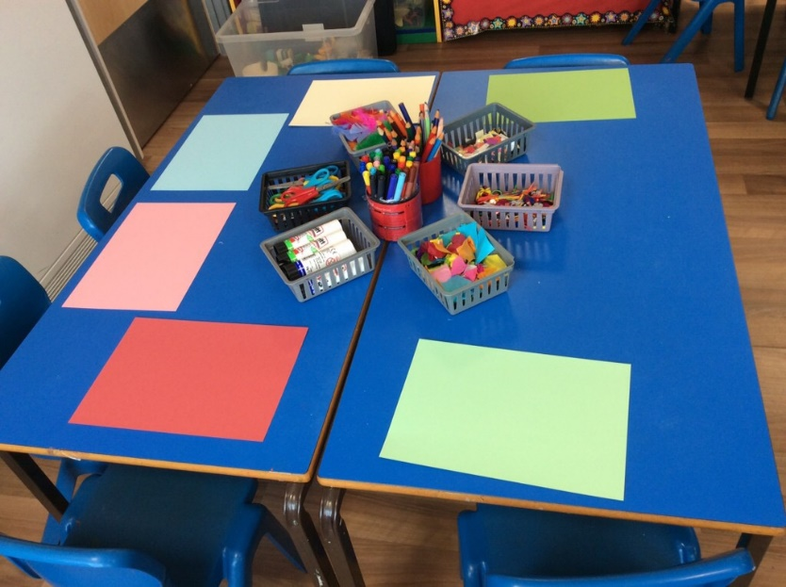
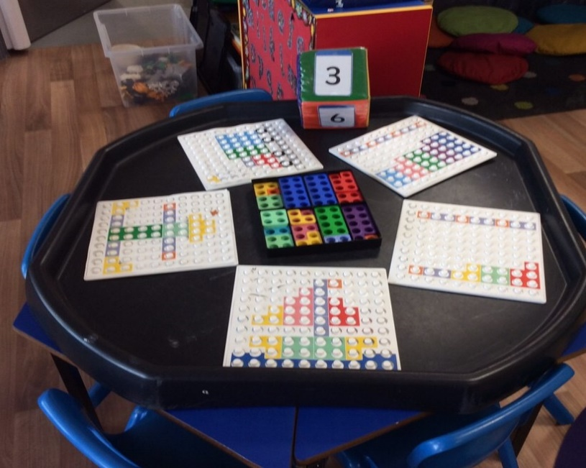
Examples of Activities

Slide 11
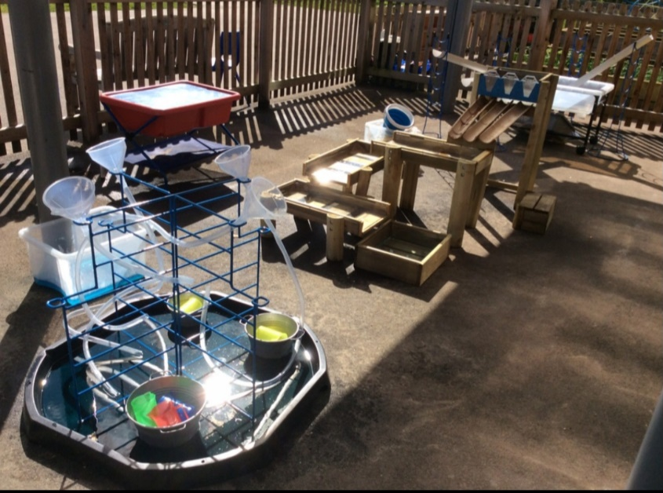

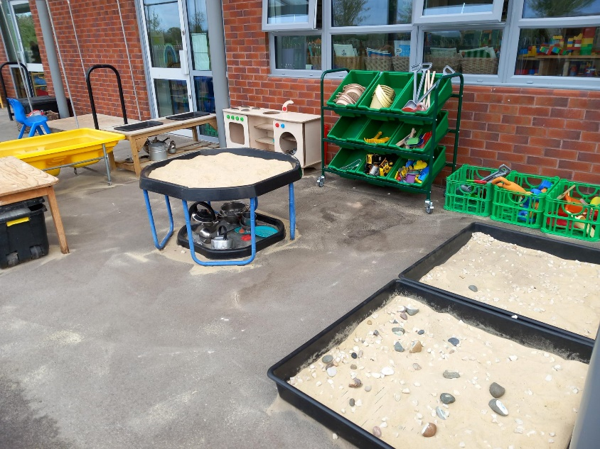
Outside Area

Slide 12
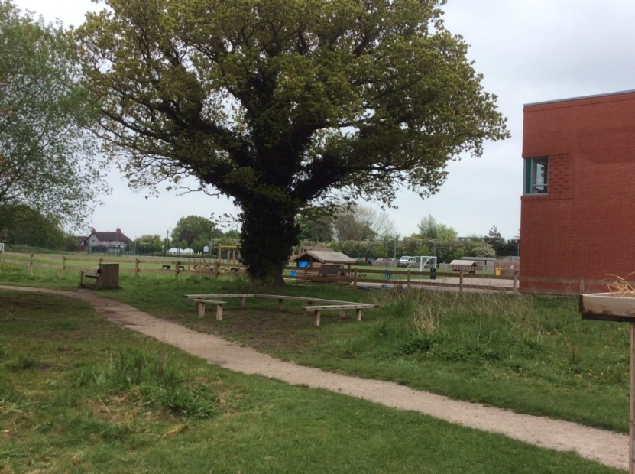
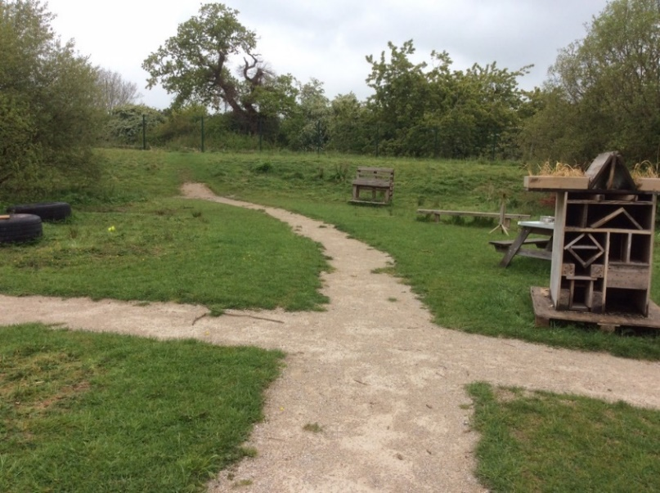
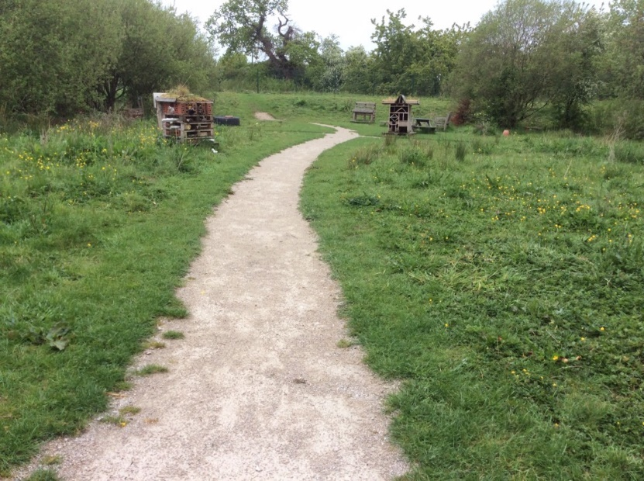
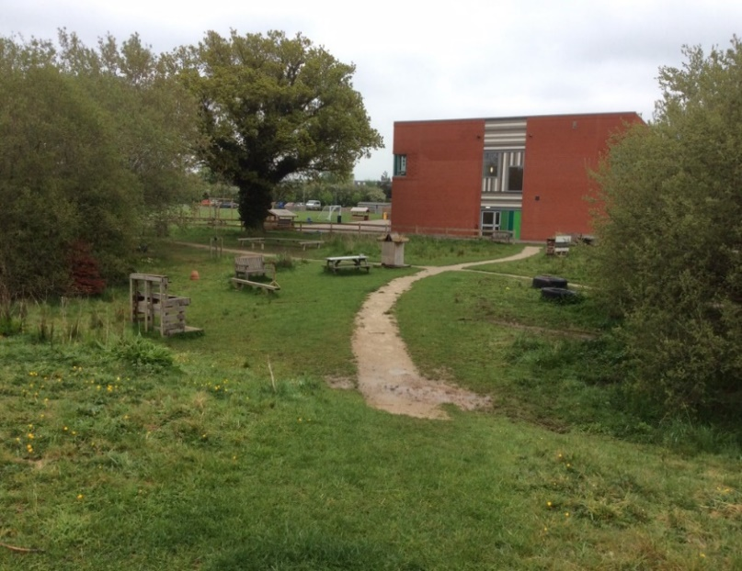
Forest School

Slide 13
Principles of EYFS
“Every child is a unique child who is constantly learning”
is the EYFS principle.
A Unique Child
Positive Relationships
Enabling Environments
Learning and Development
Our next slide will give more detail about these 4 principles

Slide 14
Principles of EYFS
A unique child
Every child is a unique child, who is constantly learning and can be resilient, capable, confident and self assured.
Positive relationships
Children learn to be strong and independent through positive relationships.
Enabling environments
Children learn and develop well in enabling environments, with teaching and support from adults, who respond to their individual interests and needs and help them to build their learning over time.
Learning and development
Children learn and develop in different ways and at different rates. Practitioners teach children by ensuring challenging, playful opportunities across the Prime and Specific areas of development and learning.
They foster the characteristics of effective early learning – which are Playing and Exploring, Active Learning and Thinking Creatively and Critically.

Slide 15
Learning through play
Play is essential for children’s development, building their confidence as they learn to explore, relate to others, set up their own goals and solve problems. Children learn by leading their own play, and by taking part in play which is guided by adults.
Statutory framework for the Early Years Foundation
Stage, EYFS reforms Early Adopters version 2020
Play, both indoors and outdoors, makes a powerful contribution to children’s wellbeing, development and learning.
Birth to 5 Matters – Foundations of highest quality provision. Early Education 2021

Slide 16
Areas of Learning and Development
Prime Areas
Personal, Social and Emotional Development
Physical Development
Communication and Language
Specific Areas
Literacy
Mathematics
Understanding the World
Expressive Arts and Design

Slide 17
Learning Overview
We will inform parents of any events occurring during the term.
At the beginning of each term we will upload a curriculum letter to our school website, on the Nursery class page. This will also be shared on Tapestry, our online learning journey. An example is shown on the next slide.

Slide 18


Slide 19
School place in September 2026
Reception Class places 2026-27
From September 2025 you should receive a letter from Cheshire West and Chester Council regarding your child’s place in primary school (Reception and onwards).
There is also an option to complete this form online on the Cheshire West and Chester website (school admissions). The closing date will be in January 2026.
The link below will take you to the school admissions page online:
School admissions (cheshirewestandchester.gov.uk)
Please complete the necessary forms to ensure your child has the best chance of a place in your chosen school. We will provide more detail from September in regards to the closing date for the admission form for a Reception school place.

