Slide 1



Our ACE Curriculum
Aspire Collaborate Experience

Slide 2
Rationale for Curriculum Design
Following extensive self-evaluation and an in depth knowledge of the local community, school leaders have a clear rationale for their curriculum design. Following careful analysis of the barriers to learning which include some children having well- being needs, high levels of deprivation and disadvantage, limited social and cultural experiences, restricted vocabulary and poor understanding of social norms.
We aim to provide an excellent education for our children, which develops the highest possible standards. We have an ACE curriculum which has been developed by the academy. Everything children do in our academy is part of this curriculum. The total learning experience is designed to maximise achievement within the National Curriculum and develop skills, attitudes and attainment in the widest sense.
A – Aspiration
C – Collaboration
E – Experience
We aim to:
Provide children with opportunities to engage with the world beyond Chaddesden.
Ensure reading is a priority as we see this as the cornerstone of all learning.
Ensure our children have mathematical fluency and confidence in numeracy.
Give children high aspirations, opportunities to collaborate and a wide range of experiences. (The ACE curriculum)
Increase cultural capital by specifically giving children experiences of authors, artists, music and theatre.
Increase children’s knowledge of cultures and those from different faiths and backgrounds.
Provide a broad and balanced curriculum for all year groups which builds progressive skills and knowledge of which the children can base their future learning.

Slide 3
Deliver a curriculum which allows children to commit learning to their long term memory.
Teach a wide range of metacognitive strategies to enable children to understand how they learn.
Ensure there is sufficient depth and coverage in all subjects we teach.
Base our curriculum on pupils’ current knowledge and understanding.
Provide opportunities for the children to build character including resilience, perseverance, confidence and tolerance through initiatives such as Forest schools and The Harmony Pledge.
Implementation
Subject leaders are responsible for implementation within their curriculum area and this continues to be an area of development within the academy. Through continuous professional development, school leaders are ensuring subject leaders have the knowledge, expertise and practical skills to fulfil their role effectively. Leaders role model exemplary subject leadership and provide individual training and coaching where identified. Core subjects have been addressed as a priority and have resulted in improved pupil outcomes. Our primary focus has been ensuring quality first teaching in every lesson of every day. Learning is now good and initiatives to further enhance QFT are being developed.
Schemes of work have been put in place for some subjects to support staff in some areas of the curriculum. Initiatives such as Forest school and the teaching of sport are strengths of the school. The Harmony Pledge has been implemented in October to further strengthen personal development of our pupils.
Partnerships have been developed to enable a wide range of enrichment to the curriculum. All year groups experience a singing programme which includes performing and understanding opera. A strong link has been formed with a school in China, resulting in reciprocal visits.
The impact of the changes we have implemented are being regularly monitored.

Slide 4
Key Drivers
Our Key drivers at Cavendish Close Junior Academy are
Aspirations is a key part of our curriculum. Our Curriculum is aspirational across all subjects and is designed to ensure pupils are given opportunities to develop their skills as an effective learner as well as learning the skills and content relevant to their age and ability. By ensuring we have a deep, rich curriculum which is progressively sequenced over time, we build the children’s aspirations for their future and provide opportunities to build on and extend their knowledge.
All of our curriculum and lesson design is built around collaboration. This is such an important part of the pupils learning in order for them to work in different groups, have different roles within the group and learn from different people. It is in these situations skills such as flexibility, problem solving and decision making needed in future careers are developed.
By offering our children a wealth of planned experiences both in and outside of the classroom, we expand our pupils knowledge and horizons to a world they may otherwise not have known. Opera to Samba, William Morris to Stephen Wiltshire and Martin Luther King to Malala are a handful of learning opportunities which build the children’s cultural capital to enable them to succeed in their future.
Aspiration
Collaboration
Experiences

Slide 5
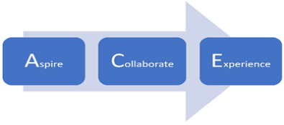

We make a pledge to support every one of our pupils to achieve their potential. We want our pupils to be life-long learners to BELIEVE – ACHIEVE – SUCCEED.
We pledge to provide a curriculum which will -
We want our pupils to have drive and tenacity; to stick at a task; to understand how to work towards long term goals; and be able to pick themselves up and bounce back from life’s challenges.
*Develop our pupils’ character, resilience and a range of social and emotional competencies.
*Provide our pupils with academic excellence.
*Support our pupils’ spiritual, moral, cultural and physical development.
*Build our pupils’ confidence to have the highest expectation of themselves and their future.
*Celebrate our pupils’ academic, creative and sporting achievements.
*Instill in them a desire for learning which continues throughout their lives.
By the time children leave Cavendish Close Junior Academy they will have completed the following pledges.
1.To take responsibility for their own safety, health and well-being.
2.To engage in fundraising and charitable events.
3.To take part in a presentation, sporting event or performance to an audience or in a public place.
4.To contribute to environmental sustainability.
5.To understand and learn from and about other cultures and faiths in our diverse community.
6.To help others through volunteering activities.
7.To be involved in a democratic process.
8.To experience educational visits/overnight residential trip.
9.To take an active role as a learner.
10.To understand the world of work and have high aspirations for their future.

Slide 6

Through The Harmony Pledge we aim to develop these character traits.
Within each lesson we promote the following skills and attributes.
Resilient
Problem-Solver
Compassionate
Cooperative
Aspirational
Confident
Effective
Communicator
Motivated
Tolerant
Honest
Memory
Remembering
Questioning
Problem –Solving
Effective communicator
Effective listener
Thinking
Responsible
Compassionate
Motivated
Resourceful
Resilient
Tolerant
Honest
Reasoning
Responsive
Reflective
Confident

Slide 7
At Cavendish Close Junior Academy, children are encouraged to be reflective learners who are able to self-regulate and are aware of their strengths and weaknesses. Our curriculum encourages our children to motivate themselves and engage in improving their learning.
During the week, our curriculum provides opportunities for children to reflect on their learning with their peers through discussions around the following questions.
Looking for Learning Questions
What do I have to do next to get even better?
How do I learn best?
What makes this learning interesting?
What have I learned today?
Am I enjoying my learning?
What stops me learning?
The curriculum is designed to develop pupil’s metacognitive knowledge of how they learn and their knowledge of themselves as a learner. By developing these skills, children learn that they can always improve and value learning from their mistakes and that this is part of the learning process.

Slide 8
Memory
Our curriculum is designed to enable the children to know more and remember more. Our clearly sequenced lessons are designed to allow children to store, retain and recall knowledge. Children are given opportunities to repeat and use their new knowledge in order to retain in their long term memory.
We have designed our curriculum to ensure their are vertical, horizontal and diagonal links so that the children can encounter concepts in different contexts, giving them the knowledge, self belief and cultural capital they need to succeed in life.
Pre learning task at the start of lesson 1. | New vocabulary introduced each lesson ( 1/2 words), recap previous vocabulary. | Key concepts.
Quadrant – Last lesson, last week, last unit, last term. | Knowledge organiser - key concepts and knowledge. | Daily Rainbow
‘I wonder’ on front cover sheet alongside tier 1,2 and 3 vocabulary. | Big Question. | Post learning task at the end of the final lesson.
Thinkers’ keys | Low stakes quizzes. | Learn to learn teaching methods

Slide 9

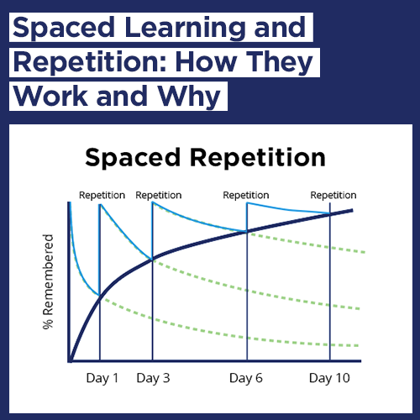
The Daily Rainbow
The Daily Rainbow provides children with opportunities to retrieve previous knowledge on a regular basis. By organising these daily opportunities and spacing learning we are enabling our children to know more and remember more. Using this approach helps children to commit their learning to their long term memory and supports quicker retrieval of the information.
Each week, the teacher plans a series of activities which are linked to previous learning. The children take part in these activities daily for 10 minutes and then repeat them after two weeks and six weeks followed by a low stakes quiz.

