Slide 1

Welcome to
Year 4

Slide 2
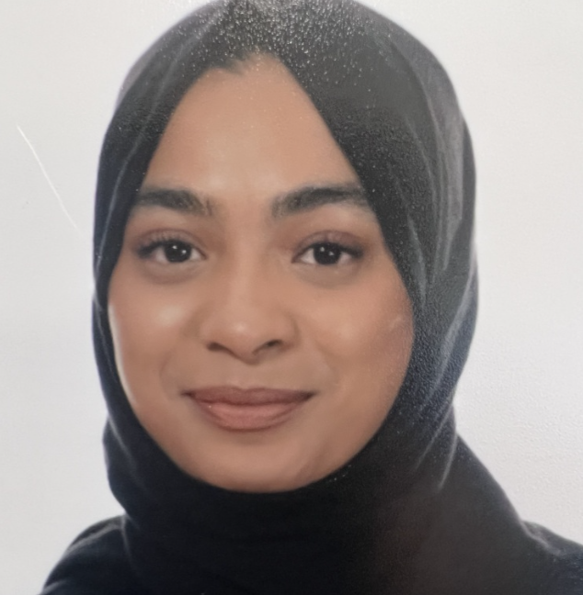
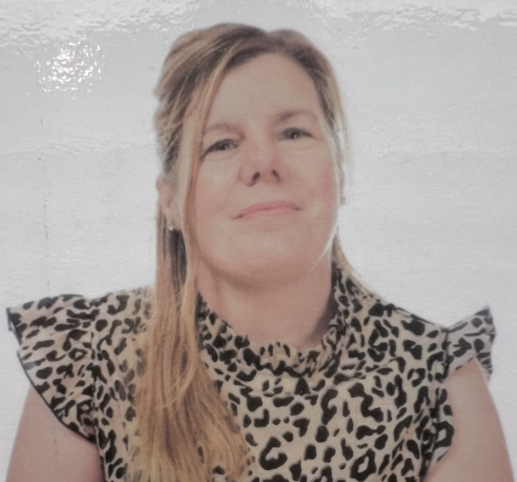
Class Teachers...
Class 9 = Mrs Cummins
Class 10 = Miss Chowdhery

Slide 3
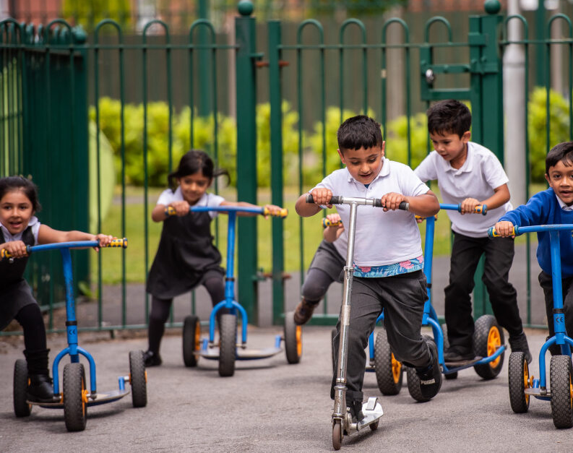
Our Learning…

Slide 4
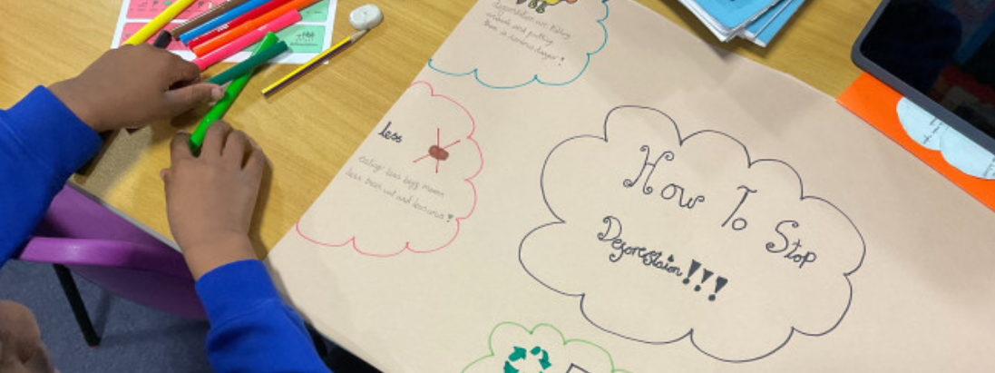


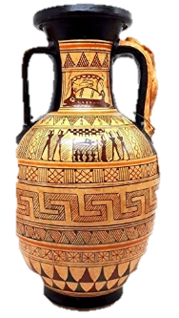

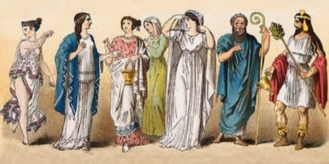
Be able to explain what life was like for the Ancient Greeks, including their beliefs
Know how life differed for some people living in that time e.g. rich/poor, boys/girls, Athenians/Spartans etc
Know how the Ancient Greeks have influenced our life today (democracy, Olympics, Battle of Marathon)
Topics
Understand the impact of the Roman Invasion upon life in Britain today (aqueducts, roads, town names, democracy).
Know about the rise and fall of the Roman Empire.
Understand how the Anglo Saxons influenced life in Britain today (settlements, Christianity).
Invasions and resistance by the British and the ongoing struggle for control of the kingdom
Rainforests
That tropical rainforests are located between the tropics of Cancer and Capricorn.
The key characteristics of a tropical rainforest, including some human and physical features.
The location of the Amazon rainforest, plus facts about animals and their habitats within the rainforest.
Some of the main causes of deforestation and the impact deforestation is having on the rainforest and the wider world.
Invaders and Settlers
Ancient Greece
Notes:
ADD TOPIC names here with some images- brief description to be discussed with what they will learn.

Slide 5
Key Learning in Year 4
Writing
Paragraphs
Fronted adverbials e.g. “Quietly, they climbed the stairs.”
Maths
All times tables (12 x 12) – quick recall
Column addition and subtraction
Reading
Identifying themes and conventions in a wide range of books
Place value with 4 digit numbers
Speech marks
Metaphors
Similes
Multiplying using grid method and short multiplication
24 Hour Clock
Discussing words and phrases that capture the reader’s interest and imagination
Using dictionaries to check the meaning of words that they have read
Increasing their familiarity with a wide range of books, including fairy stories, myths and legends, and retelling some of these orally
Notes:
ADD KEY LEARNING FOR YOUR YEAR GROUP – Think of coverage and End of Year expectations

Slide 6
Multiplication Tables Check
For all Year 4 pupils in 2024 (with certain exceptions).
The purpose of the MTC is to determine whether pupils can recall their times tables fluently.
Help us to support children with gaps in knowledge
Notes:
THIS WOULD BE PHONICS year 1, SATS year 2 and 6 Yr 3 and 5 can omit this slide

Slide 7
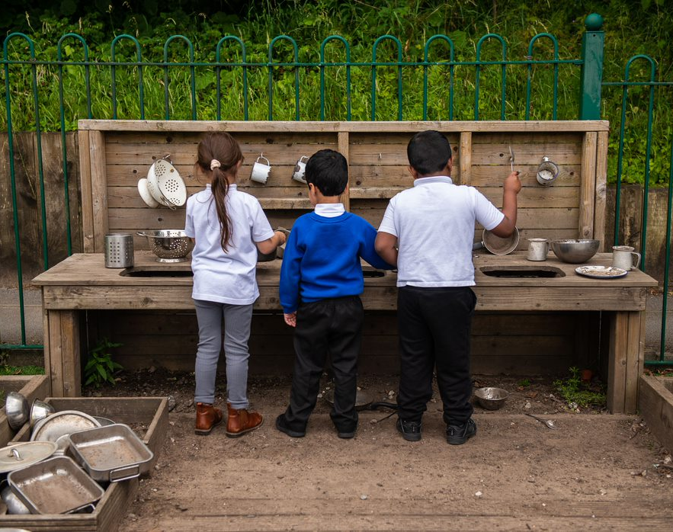
Important information…

Slide 8

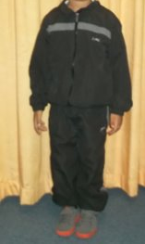
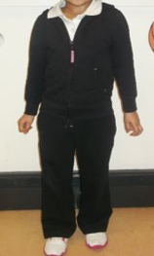
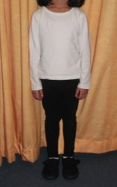
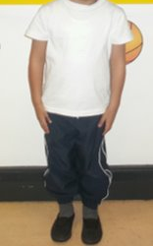
PE kit
Indoor kit
A White T-Shirt
Blue or Black Shorts/Jogging Pants or Leggings
Black Pumps
Outdoor kit
A White T-Shirt
Blue or Black Leggings or Jogging Pants
A Hooded Jacket
Sensible Trainers (No Football Shoes/Boots)
Class 9 PE Days: Wednesday and Thursday
Class 10 PE Days: Wednesday and Thursday

Slide 9
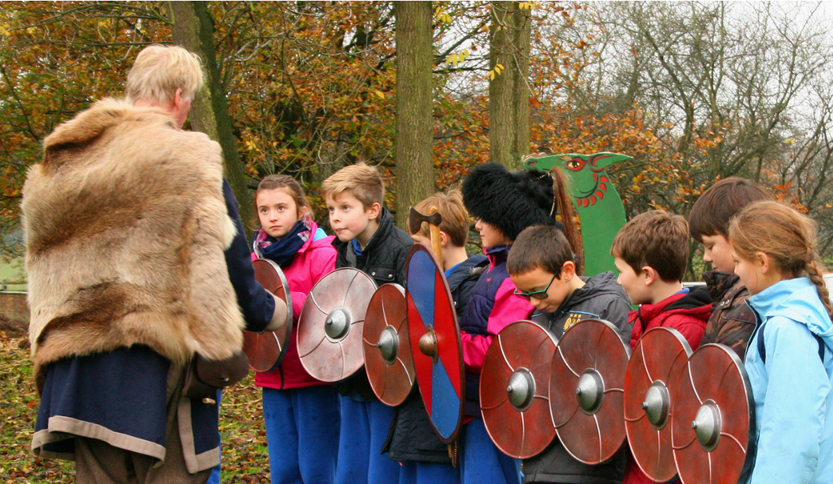
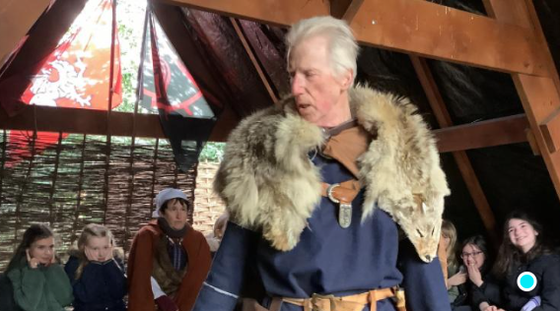
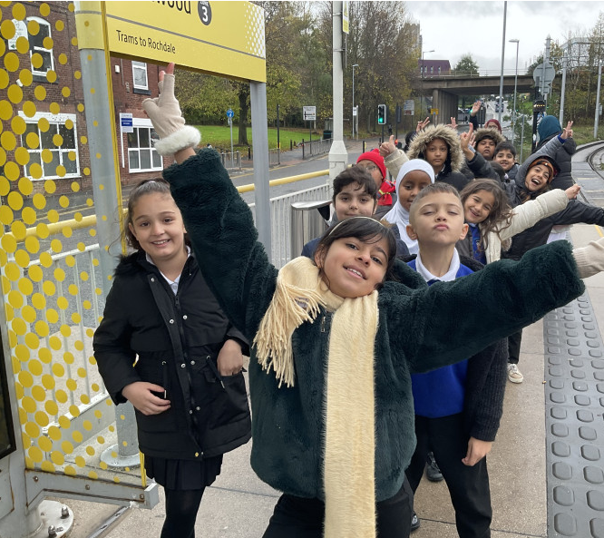

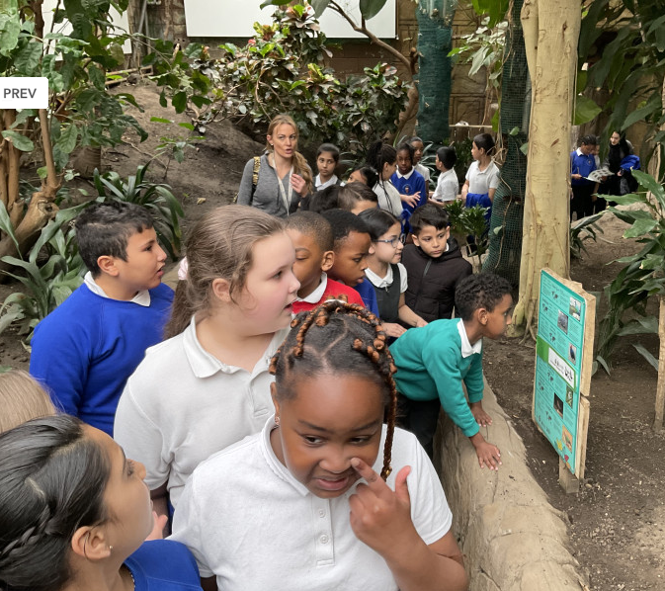

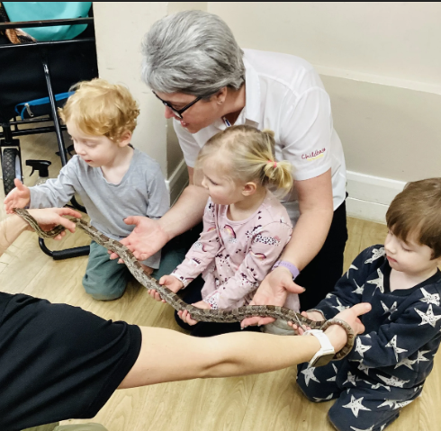
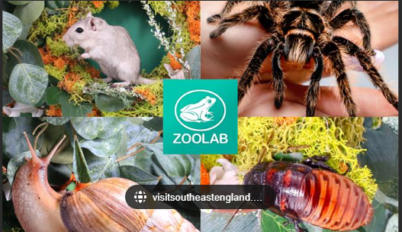
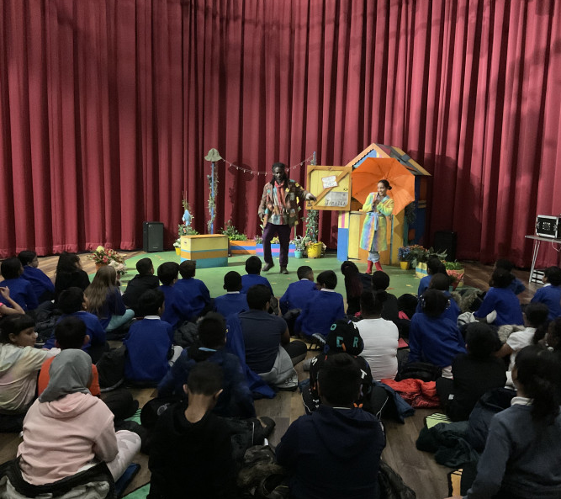
School Trips
Meet the Viking- school visitor
Tatton Park
Visit from Zoolab
Notes:
CHANGE THE PHOTOS TO MATCH WHERE YOU ARE GOING ON A TRIP WHERE POSSIBLE – Discuss Parent volunteers

Slide 10
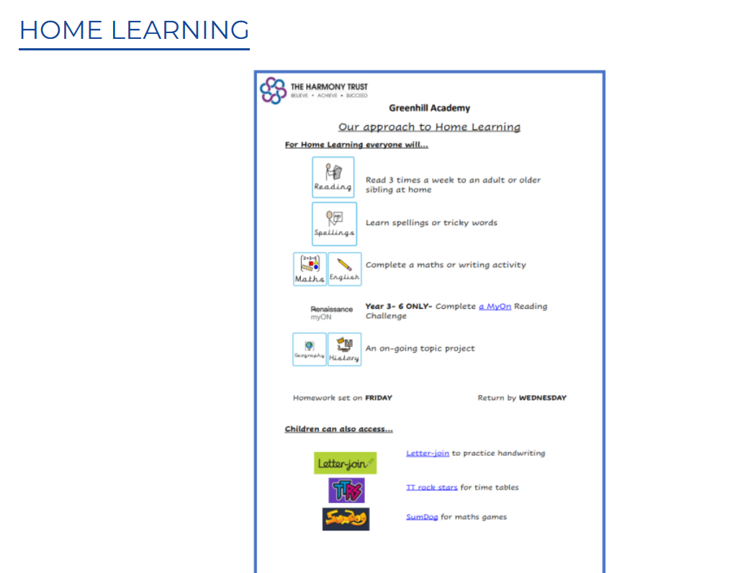
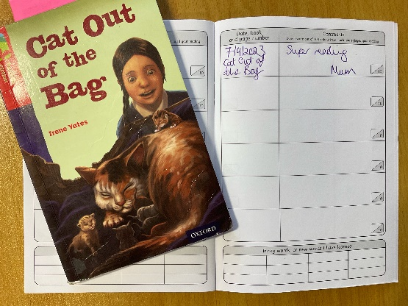

Homework
Spellings
  Set on a Friday
  Children to practise at home.
  Spelling test the following Monday.
Reading
  Every children will read to an adult once per week in school.
  Please read every day at home but at least 3 times per week
  Write in the reading record
  Weekly reward for reading champions
  End of term reward for Word Millionaire
Notes:
ADAPT where needed for your year group

Slide 11

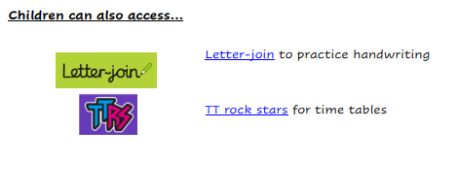

Homework
Other homework

Slide 12

How you can help at home…
Notes:
Reminder of how parents can support with reading, homelearning, getting children to school on time etc

Slide 13
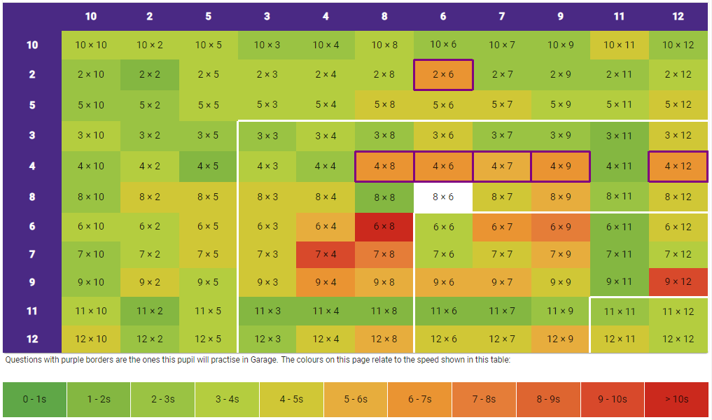
Times Tables at Home
Recall Games
Games from packs
Create posters
Encourage children to use TTRockstars and Hit the Button.
Stay up to date with their heat maps on TTRockstars
Notes:
Year 1- this slide can be changed to phonics, Year 2 and Year 6 - CGP and SATs revision mentions, Year 3 and Year 5 can continue to be times table

Slide 14
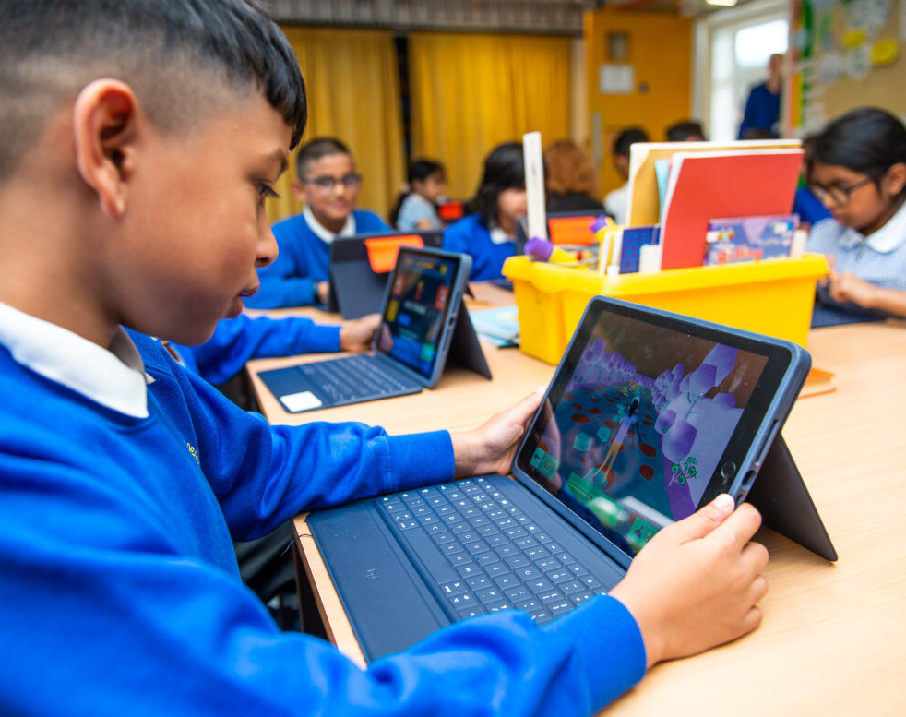
Online safety @ Greenhill…

Slide 15


Slide 16
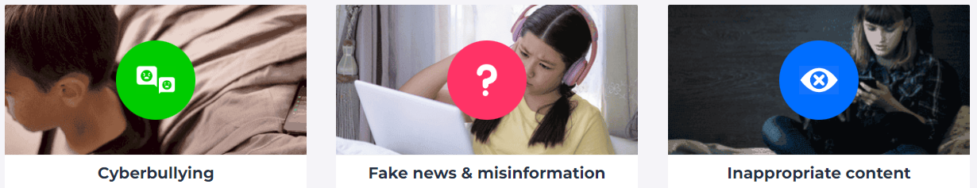
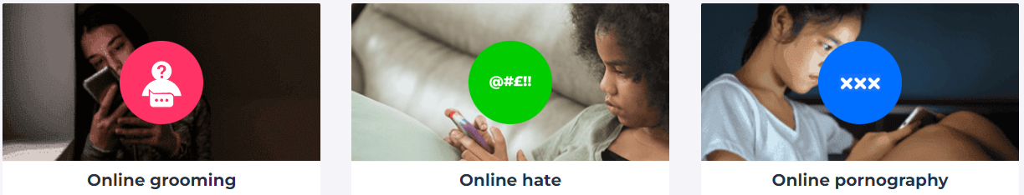


Slide 17
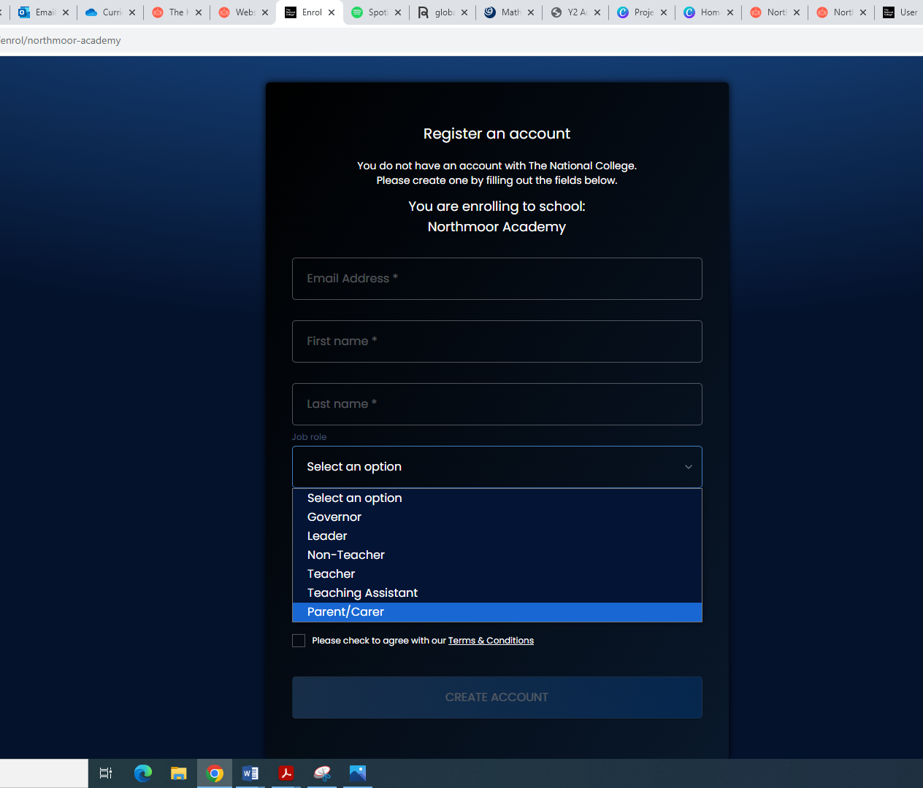

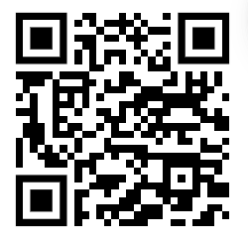

National Online Safety Parent Course
Register for an account using the QR code or go to: https://nationalcollege.com/enrol/greenhill-academy
Register (selecting parent/carer)
Search for the following courses:
Notes:
FREE course for parents to sign up to- scan QR code

Slide 18


Slide 19


Slide 20
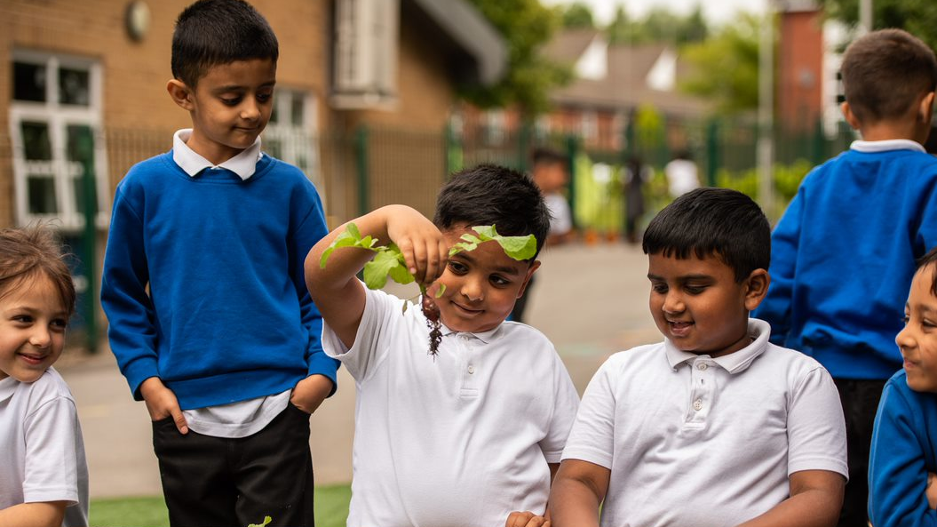
Thank you for listening!

