Slide 1

Welcome to
Year 1

Slide 2
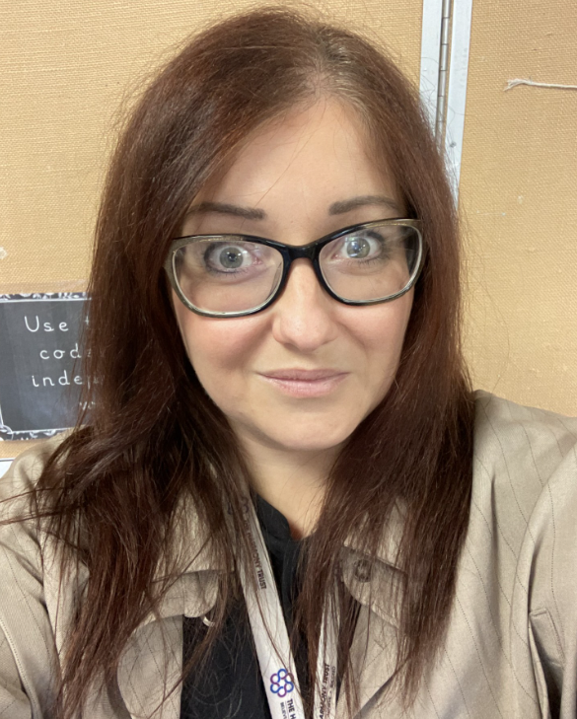
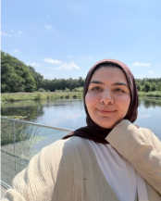
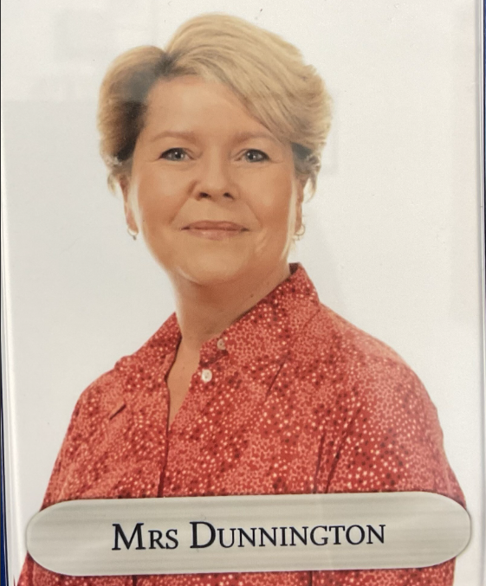
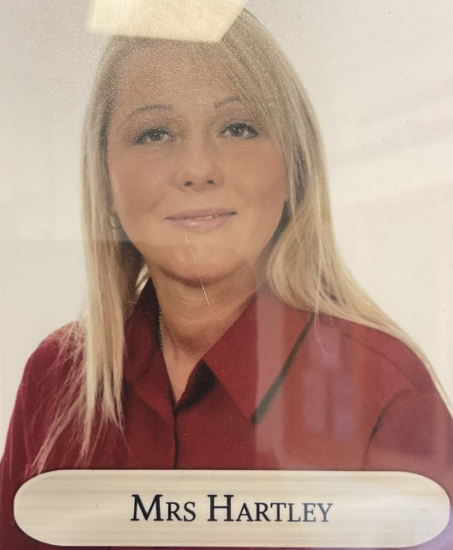
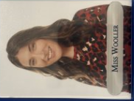
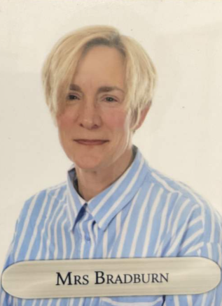
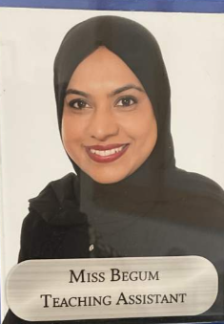
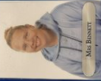
Class Teachers...
Mrs McMahon Miss Yasin Miss Wooller Mrs Dunnington Mrs Hartley Mrs Bradburn Miss Begum Mrs Bennet

Slide 3
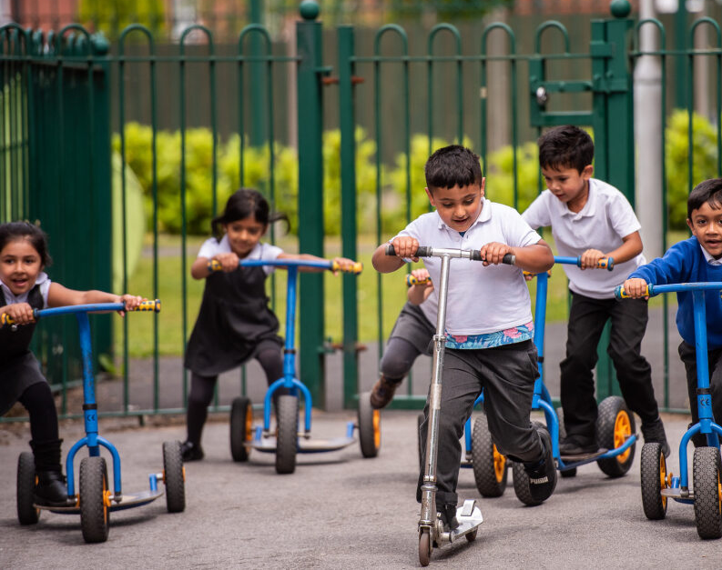
Our Learning…

Slide 4
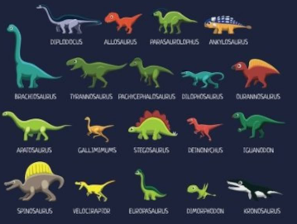
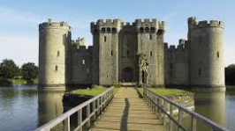
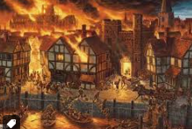
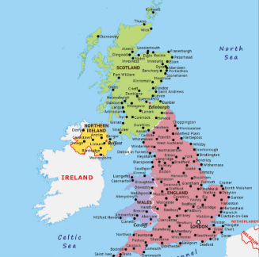
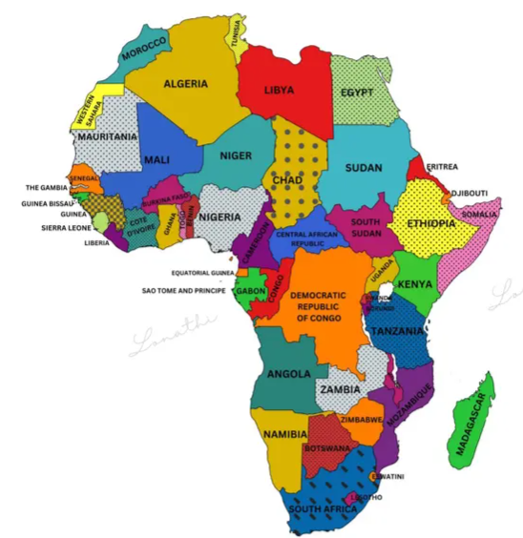
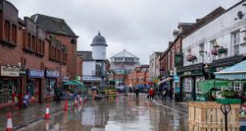
Topics
Autumn 1 - Geography | Autumn 2 - History | Spring 1 - Geography | Spring 2 - History | Summer 1 - Geography | Summer 2 - History
Me and My World To explain where I live and know my address To use simple maps of a local area To name, describe and compare places I know To ask simple geographical questions Pledge 8: Be an adventurer | Digging for Dinosaurs To put 3 events and objects in chronological order To understand the passing of time To begin to use dates To know one cause of an event To use words and phrases like old, new and a long time ago To sort a range of differed artefacts describing the similarities and differences | Great Britain Now To name the four countries in the United Kingdom and locate them on a map To name some of the main towns and cities in the UK To ask simple geographical questions | Castles To use words and phrases like old, new and a long time ago. To explain how I have changed since I was born To know difference between past and present To know simple facts To answer simple questions from sources To talk, write or draw about aspects of the past | A is for Africa To ask simple geographical questions To name, describe and compare places I know To name and locate the world’s seven continents and five oceans To explain some of the main things in hot and cold places | London’s Burning, London’s Burning To put 3 events and objects in chronological order To understand the passing of time To begin to use dates To know one cause of an event. To use words and phrases like old, new and a long time ago
Notes:
ADD TOPIC names here with some images- brief description to be discussed with what they will learn.

Slide 5
Key Learning in Year 1
Writing
Spag skills: Capital letters Letter formation Finger spaces Punctuation ( . ! ?) Adjectives Nouns Verbs (including imperative) Suffix and Prefix Plurals Conjunctions Text types: Character description Setting description Retell Poetry Instruction Graphic Novel Non-chronological report Diary
Maths
Number: Read, write and count numbers to 100 in numbers and words Find 1 more and 1 less Write numbers 1 – 20 in words Number facts to 20 Add one and two digit numbers Solve missing number problems Know the 2, 5 and 10 times table ½ and ¼ Shape, Space and Measure: Time to o'clock and half past 2D and 3D Shapes Recognise coins and notes for pounds and pence Length, Mass and Volume
Reading
Phonics lessons: whole class and interventions Reading comprehension: Prediction Decoding Fluency Comprehension questions Variety of texts: fiction, non-fiction and poetry Understand features of texts e.g. title, blurb, contents, glossary, index
Notes:
ADD KEY LEARNING FOR YOUR YEAR GROUP – Think of coverage and End of Year expectations

Slide 6
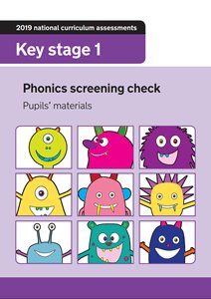
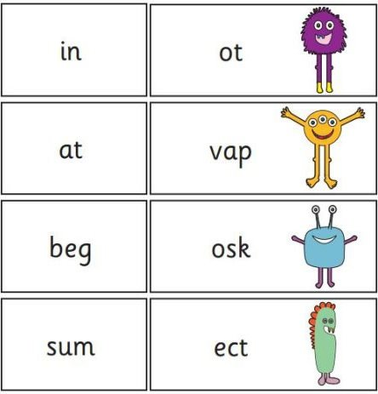
Phonics Screening Check
For all pupils.
The purpose of the PSC is to ensure pupils meet expected milestones for the end of Year 1 so that they are ready for Year 2.
Help us to support children with gaps in knowledge to create fluent readers and confident writers.
For all pupils.
The purpose of the PSC is to ensure pupils meet expected milestones for the end of Year 1 so that they are ready for Year 2.
Help us to support children with gaps in knowledge to create fluent readers and confident writers.
Notes:
THIS WOULD BE PHONICS year 1, SATS year 2 and 6 Yr 3 and 5 can omit this slide

Slide 7
Phonics Screening Check
We teach phonics daily
We will complete a phonics check at the end of every half term.
Your child will bring home a reading book based on the phonics level that they are at. Please read it with them and encourage them to "blend" the words using "pure sounds".
Always ask your child to smooth read their sentences to make sure they understand it.
You can read your child's book to them. You can read a page each. They can read to siblings and cousins. Make reading fun!

Slide 8
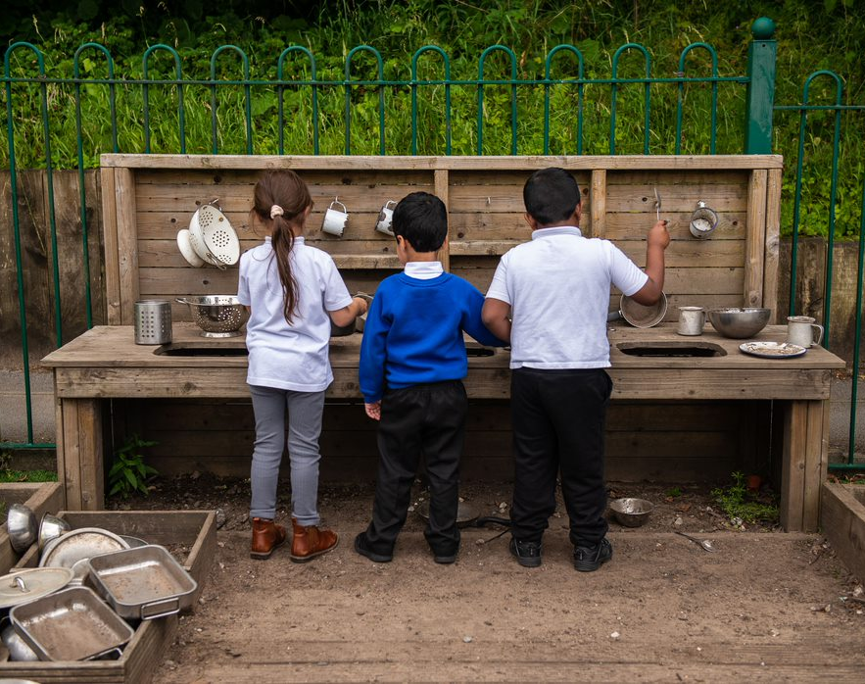
Important information…

Slide 9

🌞Morning Routine – Year 1
Starting the Day
Children are dropped off at the Infant Door each morning.
They will come into the classroom independently, put away their belongings, and begin their
morning jobs.
This routine helps the children settle quickly and prepares them for a positive start to their day of
learning.
Communication at Drop-Off
At the beginning of the day, staff are focused on ensuring that all children arrive safely and settle
happily, into class. For this reason, we are unable to have detailed conversations during morning
dropoff.
If you need to pass on a message or speak with us, please:
✅ Let the staff member on the door know, and they will pass the message on to the class team.
✅ Email the info@greenhill.theharmonytrust.org account, and the school office will ensure your message reaches us.
Thank you for your support in helping us create a calm, safe, and positive start to every school day.

Slide 10
Home Time Arrangements
Children will be collected from the white doors at the end of the school day.
Parents and carers will be asked for their collection password to ensure all children go home safely.
This helps staff become familiar with parents and carers while keeping our children secure.

Slide 11
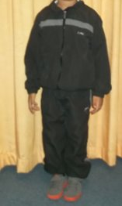
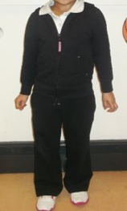
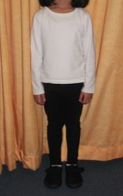
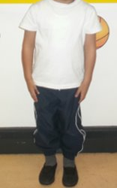
PE kit
Indoor kit
A White T-Shirt
Blue or Black Shorts/Jogging Pants or Leggings
Black Pumps
Outdoor kit
A White T-Shirt
Blue or Black Leggings or Jogging Pants
A Hooded Jacket
Sensible Trainers (No Football Shoes/Boots)
Class 3 PE Days: Wednesday and Thursday
Class 4 PE Days: Wednesday and Thursday

Slide 12
Trips and visitors
Autumn 1 | Autumn 2 | Spring 1 | Spring 2 | Summer 1 | Summer 2 | Total cost for Year 1
Topic: Me and my world Local walk Local walk – FREE Literacy: Author visit Au1 or Au2 | Topic: Dinosaurs Topic: Dinosaurs (visitor into school) - Experience: Pantomime |  | Topic: Literacy Alexandra park –Literacy link (make sandwiches and have picnic in the park – Paddington story) | Topic: A is for Africa – print workshop Science: Northern Roots - FREE Topic: Great Fire of London: London Museum Online Session – FREE | Topic: PE Alexandra park – Free | *TBC - £23.30
* Please not prices are based on last academic year and may change slightly.
Notes:
Parent pay – payment plan for trips throughout the year

Slide 13
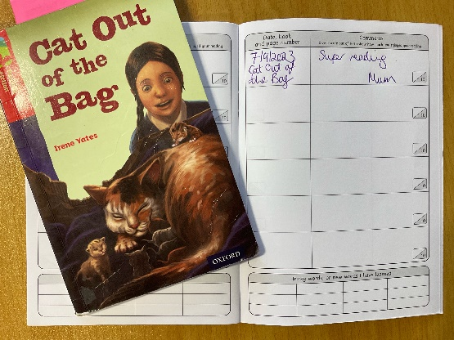
Homework
Reading
  Every child will read to an adult once per week in school, usually 3 times (GR)
  Please read home at least 3 times per week, everyday if possible.
  Write in the reading record.
  Every child will also on a Friday choose a book to read for pleasure that they can take home and read.
  Book bags will remain in school till Friday every week.
Notes:
ADAPT where needed for your year group

Slide 14

Homework
In Autumn 1, children will bring home their reading books each week. Alongside their reading, they will receive homework activities linked to their learning.
Once the children have completed our introductory computing lessons and are confident using the technology, homework will also be set through Purple Mash. This will allow children to practise and consolidate their learning at home in a fun and engaging way.
We appreciate your support in encouraging your child to complete their reading and homework activities regularly.
Notes:
ADAPT where needed for your year group

Slide 15

How you can help…
Notes:
Reminder of how parents can support with reading, homelearning, getting children to school on time etc

Slide 16
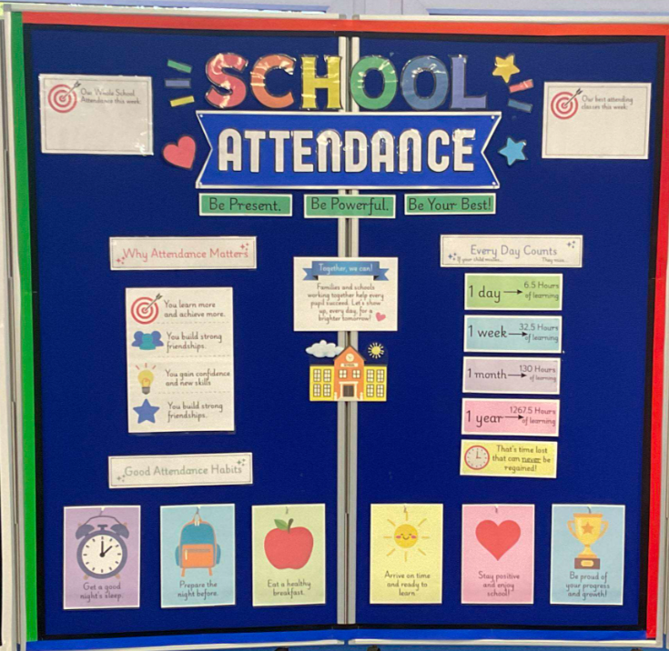
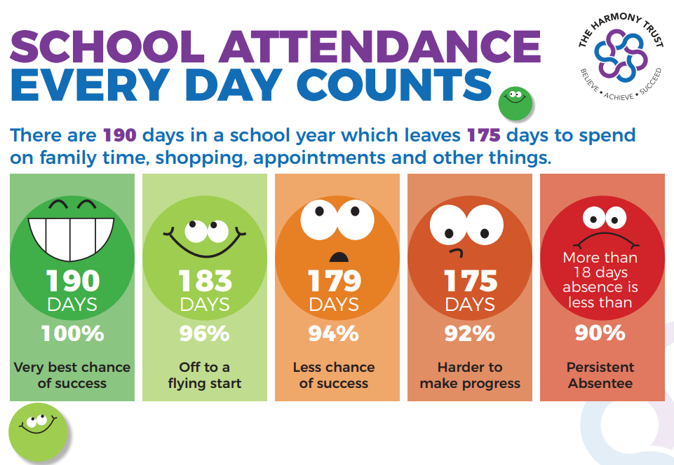
Attendance

Slide 17
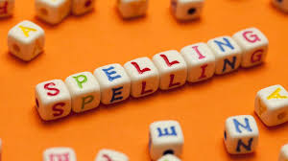
Spelling Games
Reading
Writing
Boggle
Make your own word searches using spelling words
Chanting
Silly sentences
Rainbow writing
Roll and spell
Read Daily
Look at signs in the local area
Key words in shops
Visit the library- it is FREE
Share a love of reading
Family Read Time
Play dough
Tie shoe laces
Threading
Painting
Cutting skills paper and helping cook dinner
Real life experiences
Talk Time
Notes:
Year 1- this slide can be changed to phonics, Year 2 and Year 6 - CGP and SATs revision mentions, Year 3 and Year 5 can continue to be times table

Slide 18
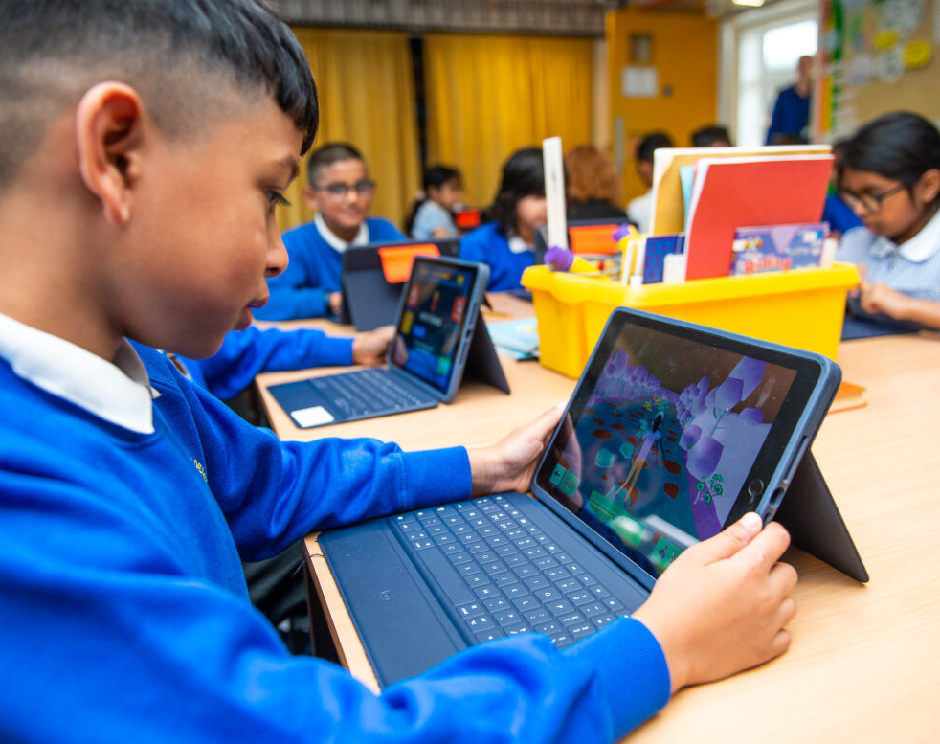
Online safety @ Greenhill…

Slide 19


Slide 20
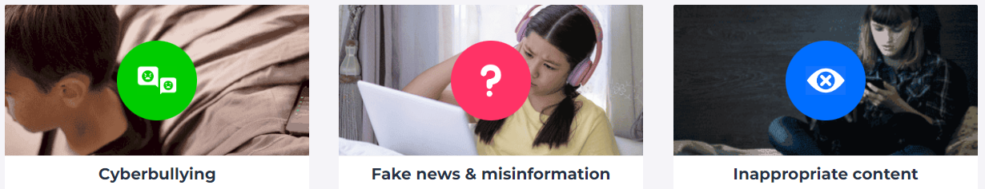
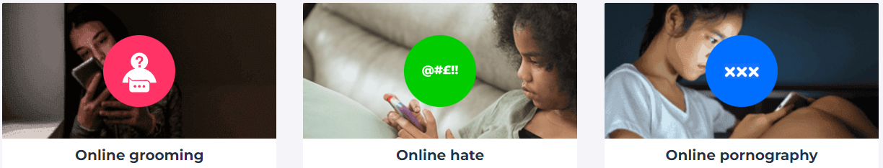


Slide 21
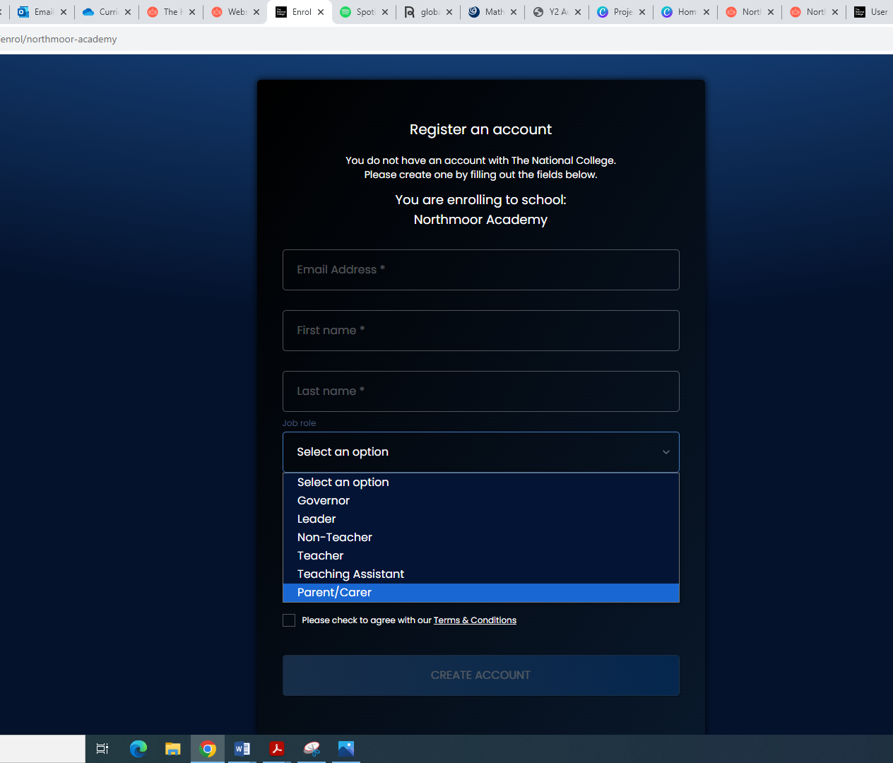

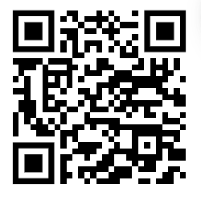

National Online Safety Parent Course
Register for an account using the QR code or go to: https://nationalcollege.com/enrol/greenhill-academy
Register (selecting parent/carer)
Search for the following courses:
Notes:
FREE course for parents to sign up to- scan QR code

Slide 22


Slide 23


Slide 24
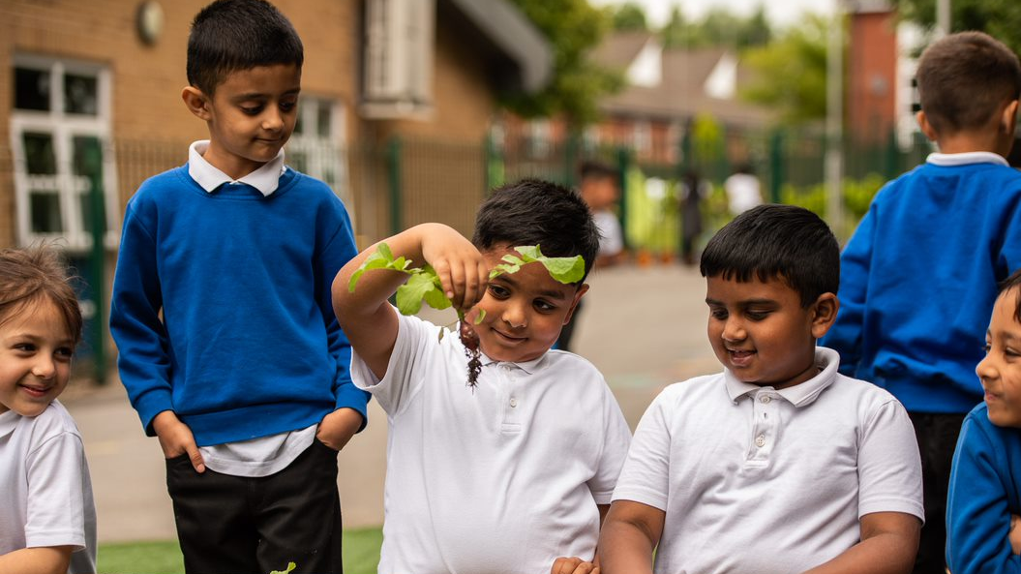
Thank you for listening!

