Slide 1




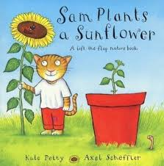



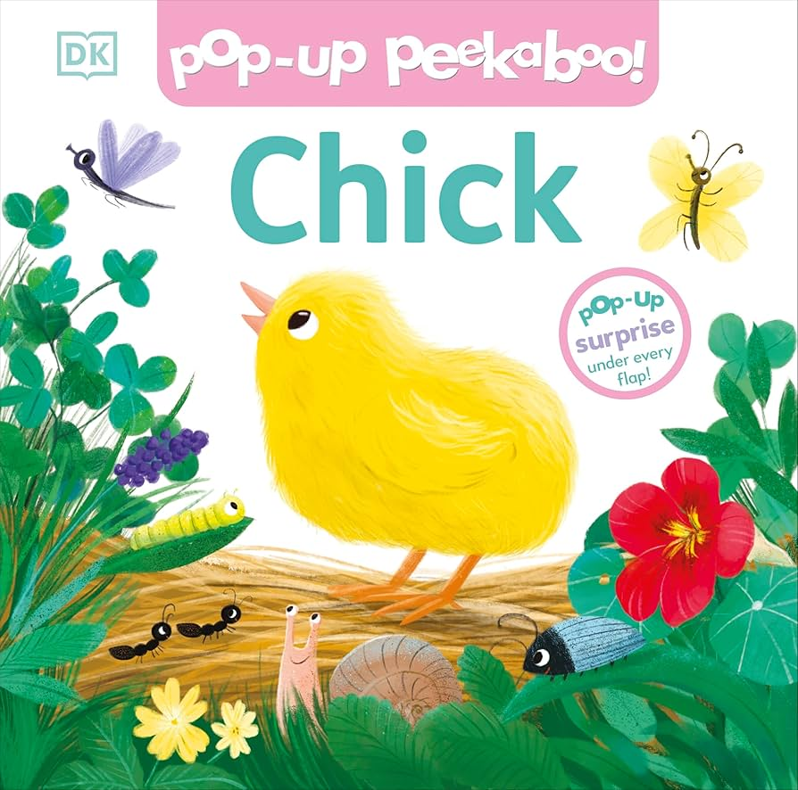


Literacy
Explore stories like ‘the very hungry caterpillar’ and ‘Sam plants a sunflower’
Engage in mark-making and writing tasks related to different jobs. Use some of their print and letter knowledge in their early writing.
Personal, Social & Emotional Development
Develop appropriate ways of being assertive
Begin to understand how others might be feeling.
Understanding the World
Plant seeds and care for growing things. Understand the features of the life cycle of a plant and an animal.
Develop appropriate ways of being assertive. Begin to understand how others might be feeling
Physical Development
Start taking part in some group activities which they make up for themselves, or in teams.
Collaborate with others to manage large items, such as moving long planks safely, carrying large hollow blocks
Making healthy choices about food, drink, activity & toothbrushing
Maths
3D Shapes
Counting Beyond 10
Sequencing
More than
Less than
Matching numeral to amounts
Summer 1
Learning In Nursery
Music- Singing
Record a performance
Improve tone, controlling breathing and pitch.
Communication and Language
Be able to express a point of view and to debate when they disagree with an adult or a friend, using words as well as actions.
Can start a conversation with an adult or a friend and continue it for many turns.
Art/DT- Art – Portraits
Create job-related props, role-play scenarios, and participate in songs like “Old McDonald Had a Farm.”

