Slide 1







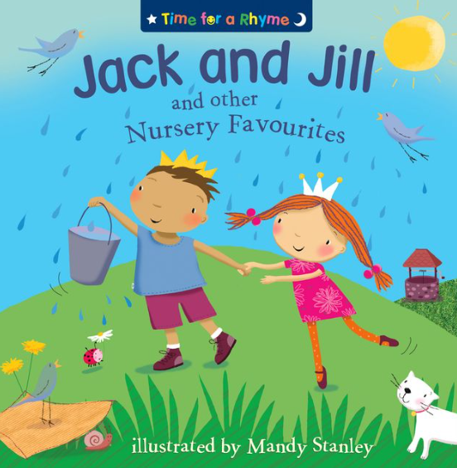



Literacy
Explore stories like “The Toy Maker” and “Can’t you sleep little bear?”
Engage in mark-making and writing tasks related to different jobs. Use some of their print and letter knowledge in their early writing.
Personal, Social & Emotional Development
Help find solutions to conflicts & rivalries, e.g. accepting not everyone can be Spiderman in a game.
Understanding the World
Use all their senses in hands-on exploration of natural materials.
Begin to make sense of their own life story and history and show interest in different occupations. Talk about what they see, using a wide vocabulary.
Physical Development
Start taking part in some group activities which they make up for themselves, or in teams.
Collaborate with others to manage large items, such as moving long planks safely, carrying large hollow blocks
Using a comfortable grip with good control when holding pens and pencils
Maths
This term we will be focussing on counting, sorting, and measuring through practical activities like building and cooking.
Repeating pattern
Positional Language
Comparing capacity
2D shapes
Spring 2
Learning In Nursery
Music- Singing
Record a performance
Improve tone, controlling breathing and pitch.
Understanding the World
This term, the children Explore and talk about different forces they can feel.
Talk about the differences between materials and changes they notice.
Explore collections of materials with similar and/or different properties.
Communication and Language
Understand ‘how’ and ‘why’ questions, like: “why do you think the caterpillar got so fat?” Know many rhymes, be able to talk about familiar books, and be able to tell a long story.
Art/DT- Art – Portraits
Create job-related props, role-play scenarios, and participate in songs like “Old McDonald Had a Farm.”

