Slide 1



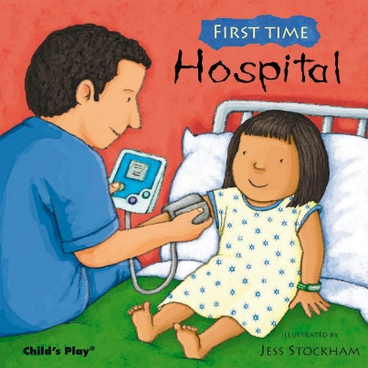

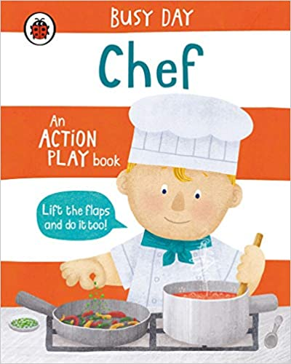

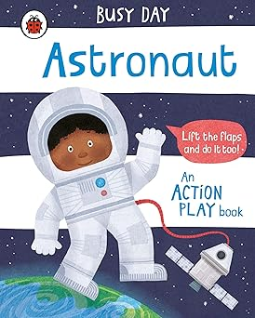





Literacy
Explore stories like “Busy Day Chef” and “I Want to Be a Pilot.”
Engage in mark-making and writing tasks related to different jobs. Use some of their print and letter knowledge in their early writing.
Personal, Social & Emotional Development
This half-term we will focus on building confidence, self-awareness, and teamwork through role-play and discussions. Practice working together in role-play scenarios, such as being chefs in a pretend kitchen or builders on a construction site.
Understanding the World
Use all their senses in hands-on exploration of natural materials.
Begin to make sense of their own life story and history.
Physical Development
Children will continue to develop fine motor skills through tasks like writing and crafting. Are increasingly able to use and remember sequences and patterns of movements which are related to music and rhythm.
Strengthen gross motor skills through active role-play and job-themed activities. Skip, hop, stand on one leg and hold a pose for a game like musical statues
Maths
• Recites numbers to 10
• Has fun counting as far as they can go and is fascinated with large numbers
• Can count things of different sizes
• Know that the last number reached when counting a small set of objects tells you how many there are in total (cardinal principle)
• Link some numerals with their cardinal value to 5
• Can quickly recognise up to 3 objects without having to count them individually
• Experiments with recording
Spring 1
Learning In Nursery
Music- Singing
Record a performance
Improve tone, controlling breathing and pitch.
Understanding the World
This term, the children will learn about roles in our community and explore real-world jobs through visits and stories.
Communication and Language
This half term we will encourage the children to listen to longer stories, learn new vocabulary such as “chef,” “pilot,” “builder,” and “police”. We will
encourage children to answer questions and share ideas through storytelling and conversations.
The children will also be encouraged to develop storytelling skills as they create their own role-play adventures.
Art/DT- Art – Portraits
Create job-related props, role-play scenarios, and participate in songs like “Old McDonald Had a Farm.”

