Slide 1

Welcome to
Year 3

Slide 2
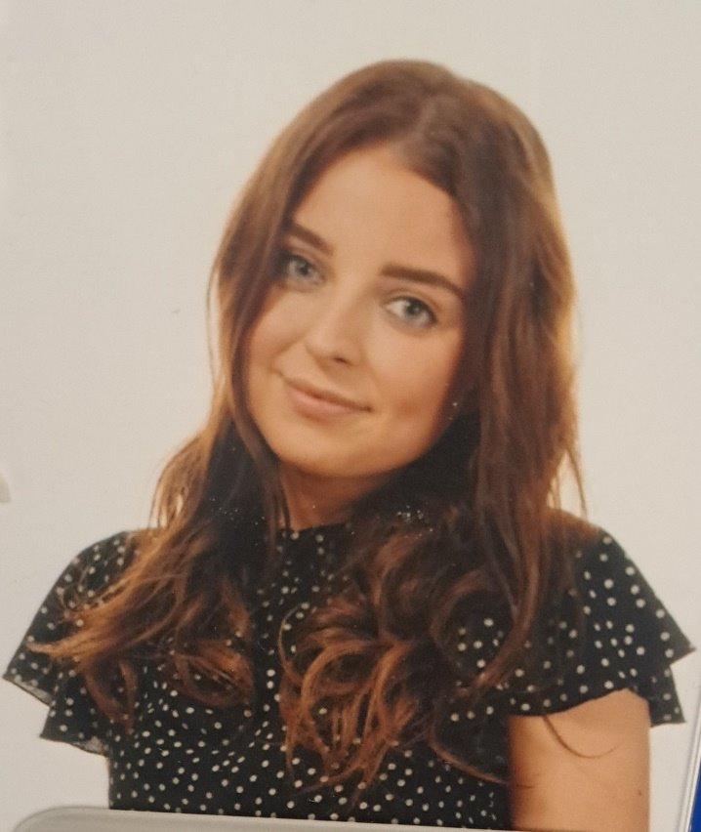
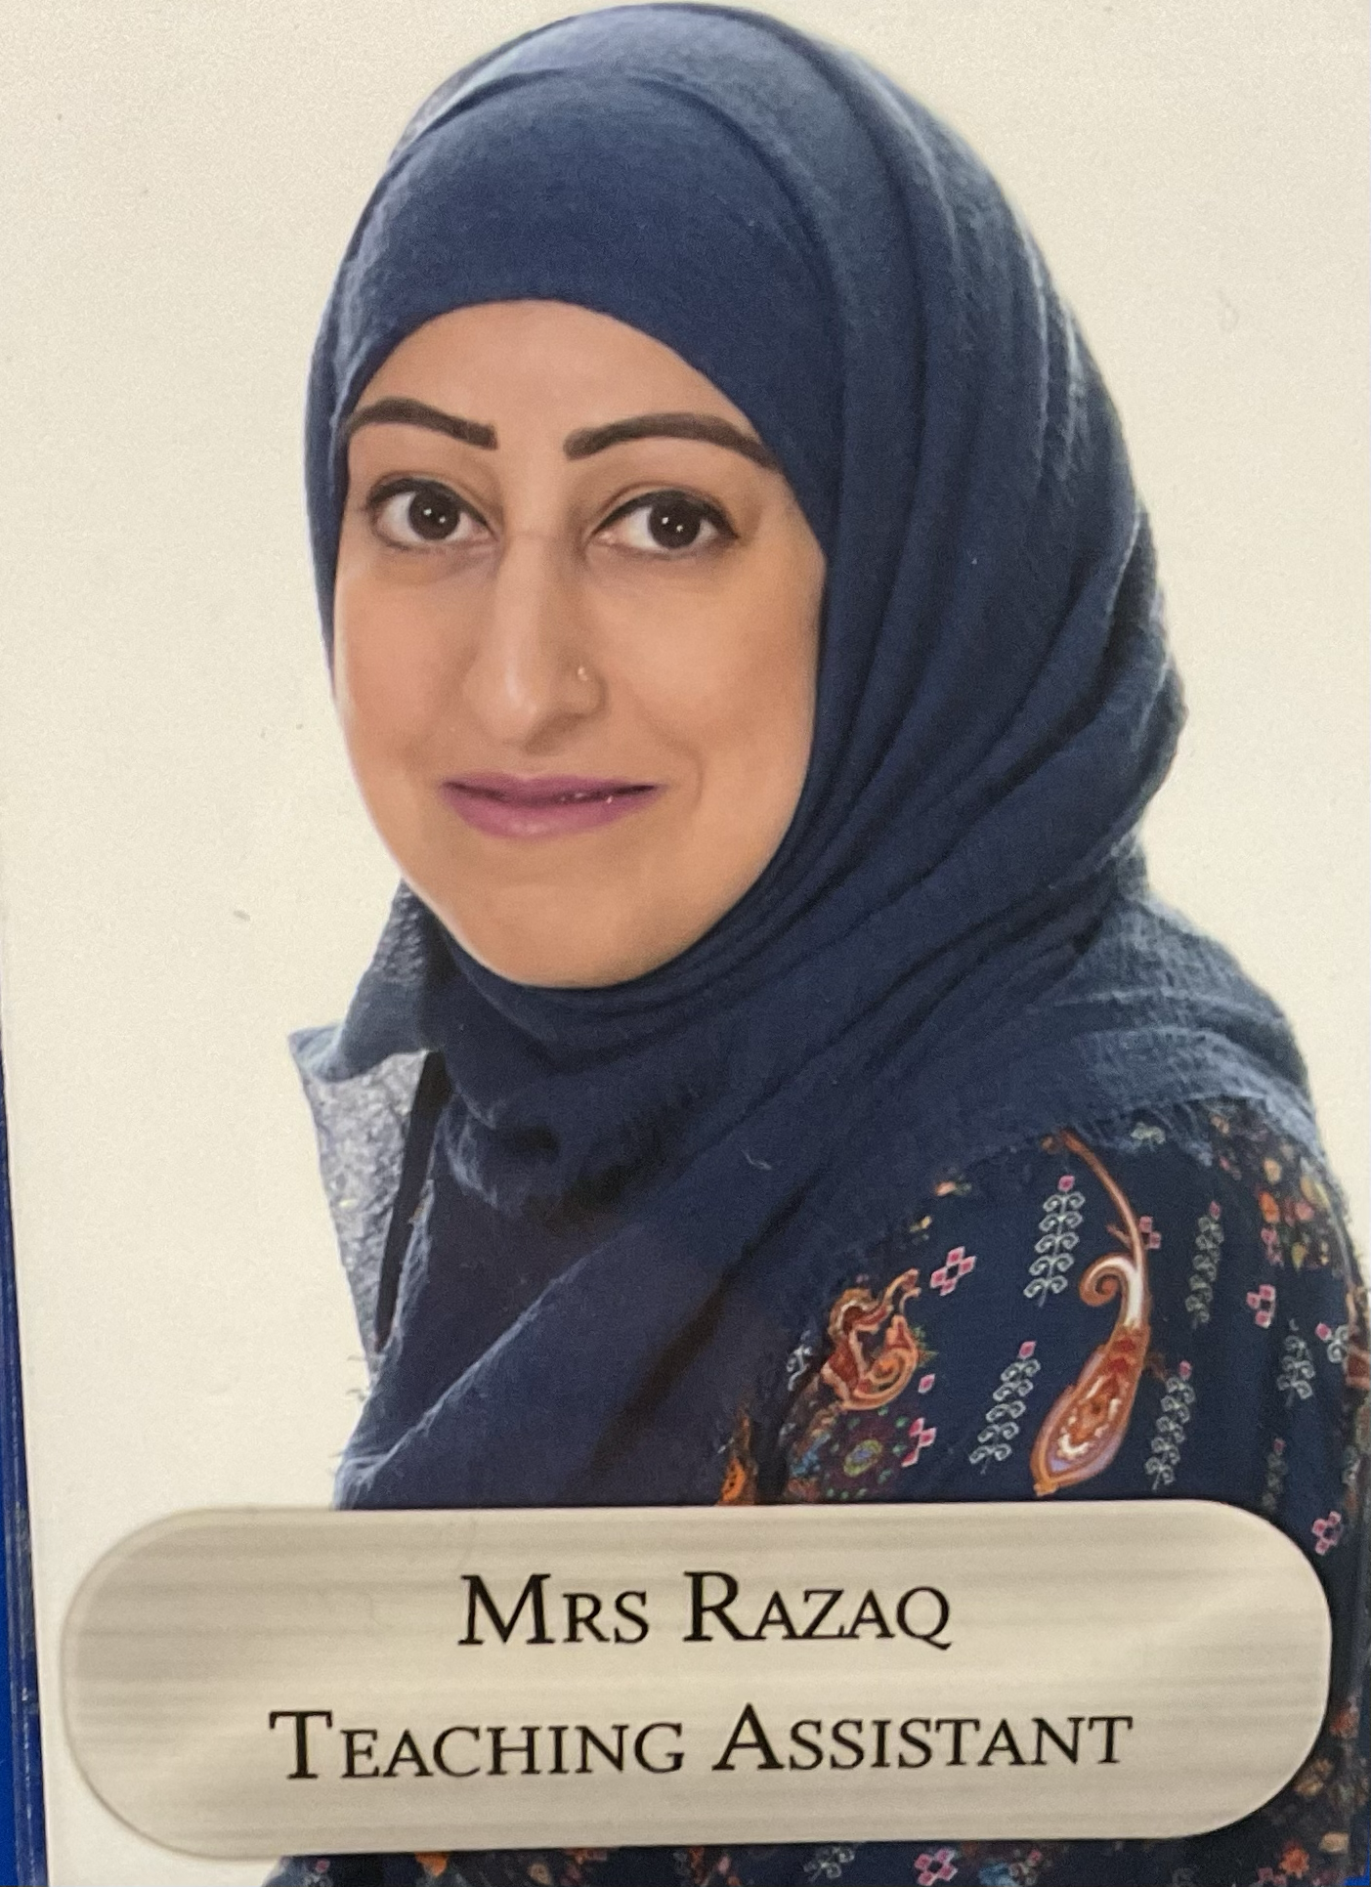
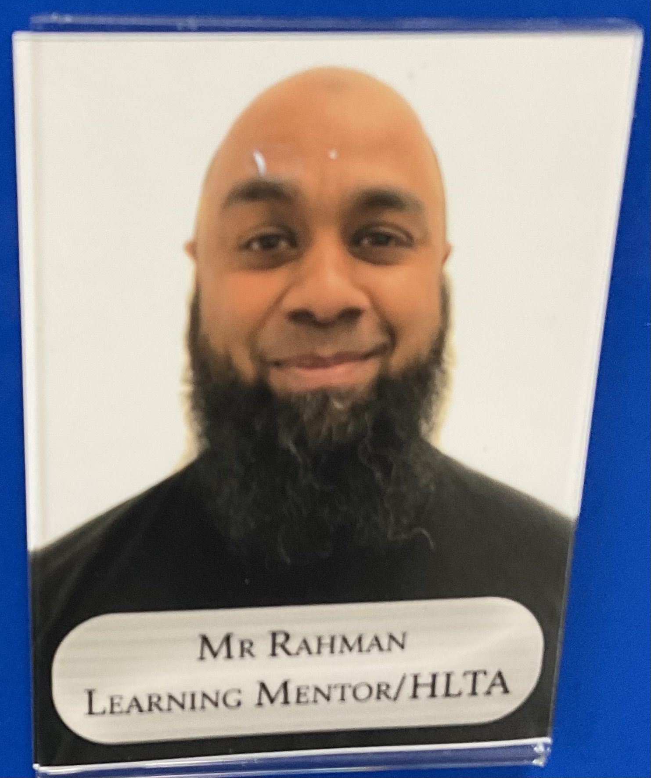
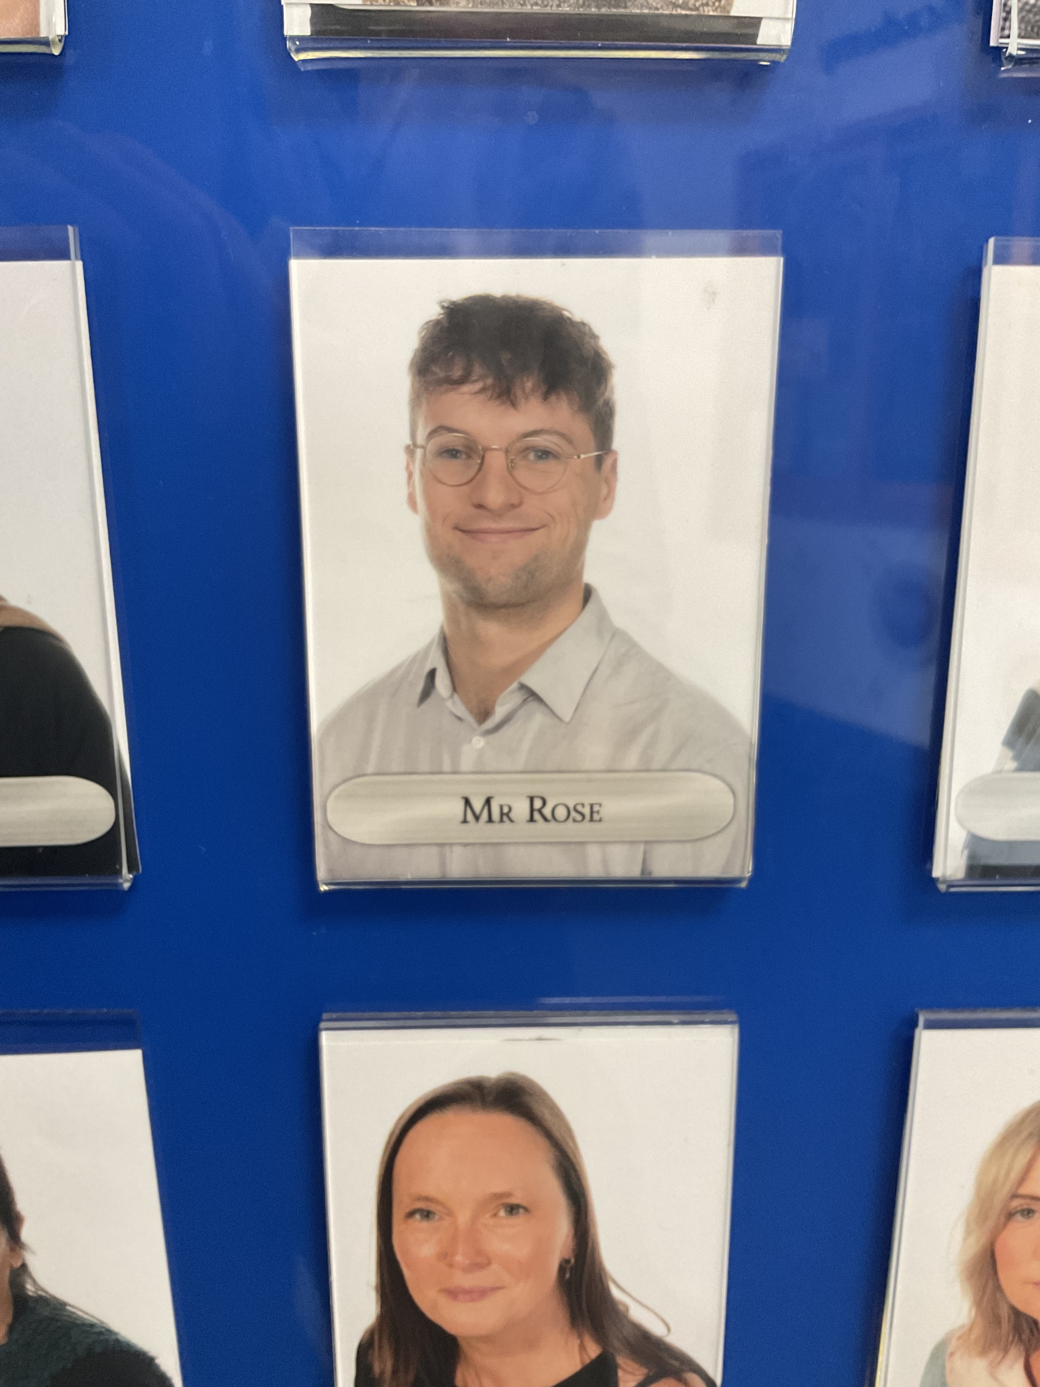
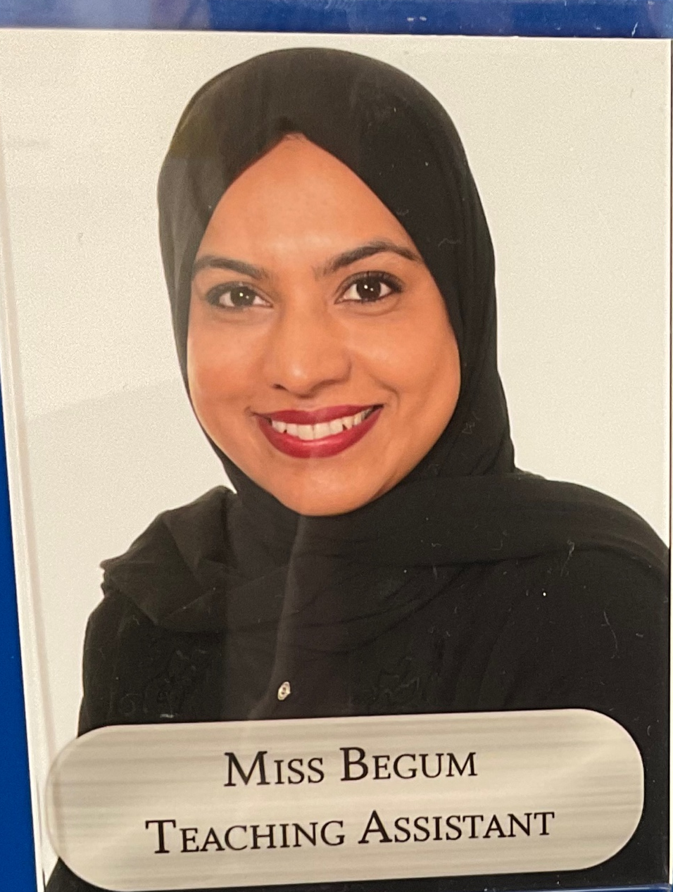
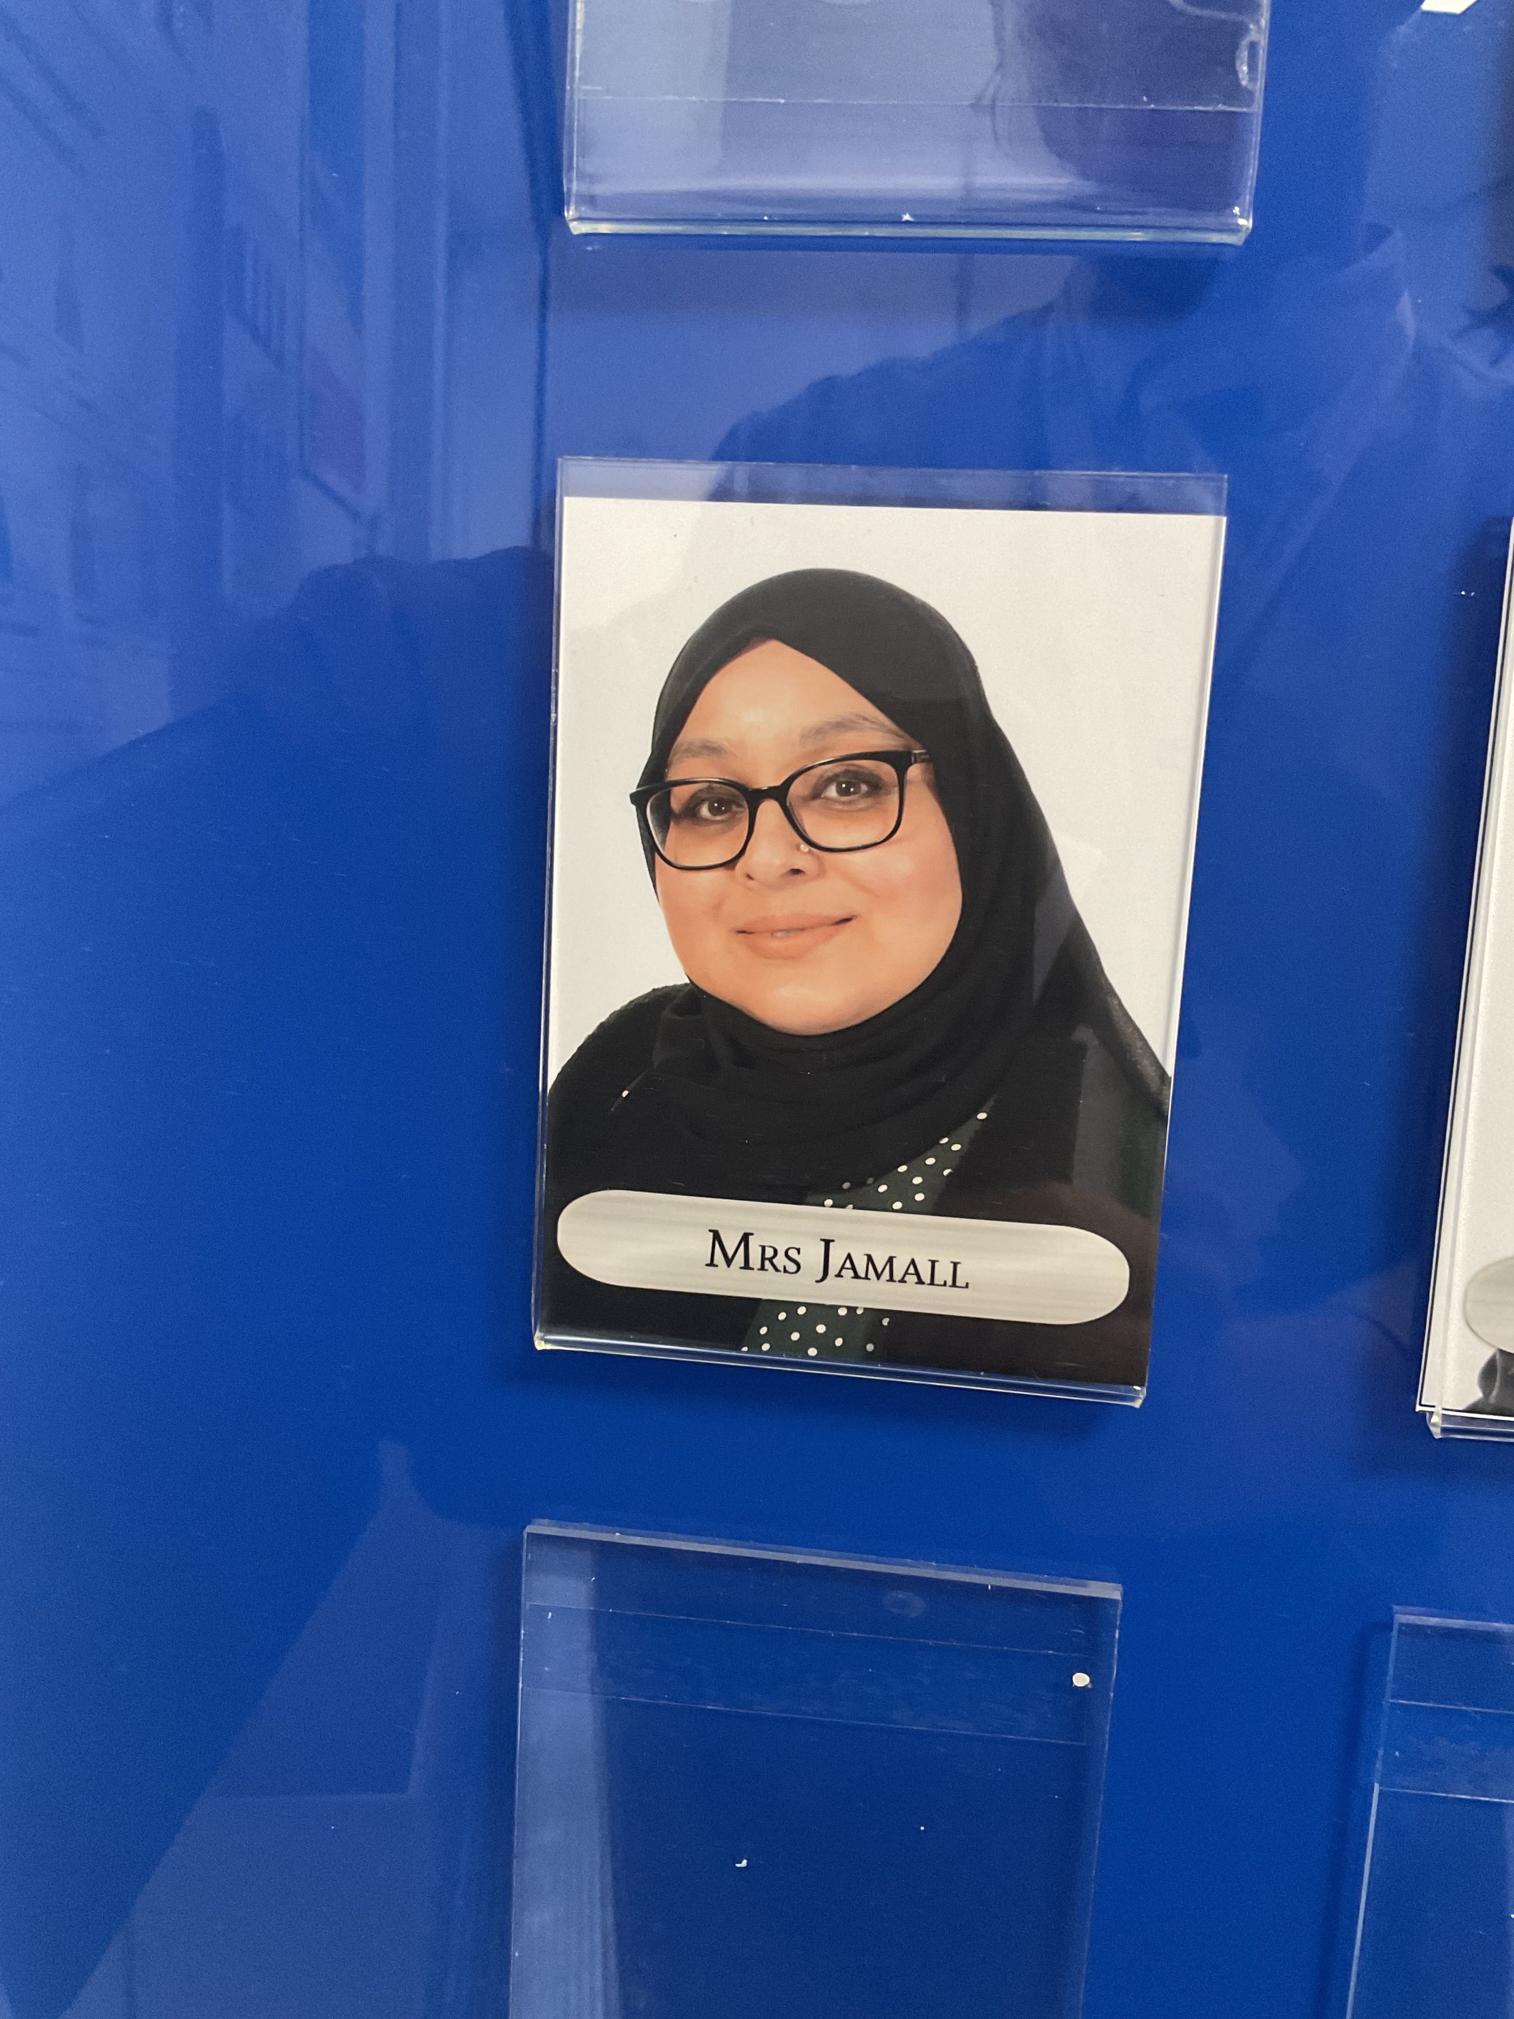
Class Teachers...
Mr Rose
Class 7 Teacher
Miss Mott
Class 8 Teacher
Mrs Razaq
Teaching Assistant
Mr Rahman
HLTA
Mrs Jamall
Teaching Assistant
Mrs Begum
Teaching Assistant

Slide 3
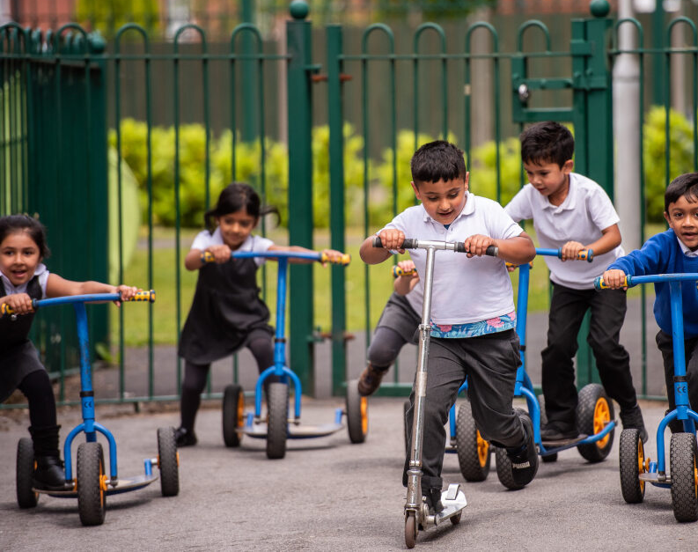
Our Learning…

Slide 4
Topics
Ancient Egypt
Great Britain
Compare different eras considering similarities and differences
Order key dates on a timeline
Develop understanding how and why the past is represented in different ways
Use a range of sources
Use maps and atlases
Describe key aspects of human geography/physical geography
Similarities and differences
Volcanoes
The Stone Age
Use maps and atlases
Describe key aspects of human geography/physical geography
Similarities and differences
The Mayans
Compare different eras considering similarities and differences
Order key dates on a timeline
Develop understanding how and why the past is represented in different ways
Use a range of sources
Compare different eras considering similarities and differences
Order key dates on a timeline
Develop understanding how and why the past is represented in different ways
Use a range of sources
Notes:
ADD TOPIC names here with some images- brief description to be discussed with what they will learn.

Slide 5
Key Learning in Year 3
Writing
Paragraphs
Maths
2s,5s,10s,3s,4s and 8s times tables – quick recall
Column addition and subtraction
Reading
Making predictions
Place value with 3 digit numbers
Speech marks
Recognise 3D shapes
Interpret data
Metaphors
Similes
Multiplying using grid method
24 Hour Clock
Create setting descriptions, character descriptions and narratives
Edit their learning
Spellings
Handwriting- Letter join
Summarising the story
Discuss meaning of words
Discuss characters feelings
Listen to a wide range of stories
Retell stories
Identify themes
Perform poetry
Ask questions to improve understanding
Recognise angles
Compare and order numbers to 1000
Solve number problems
Recognise fractions
Compare and order fractions
Wide range of prefixes and suffixes
Wide range of conjunctions and subordinating conjunctions
An or a
Vary sentences openers
Link ideas across paragraphs using adverbials
Notes:
ADD KEY LEARNING FOR YOUR YEAR GROUP – Think of coverage and End of Year expectations

Slide 6
Multiplication Tables Check
For all Year 4 pupils in 2025 (with certain exceptions).
The purpose of the MTC is to determine whether pupils can recall their times tables fluently.
Help us to support children with gaps in knowledge
Notes:
THIS WOULD BE PHONICS year 1, SATS year 2 and 6 Yr 3 and 5 can omit this slide

Slide 7
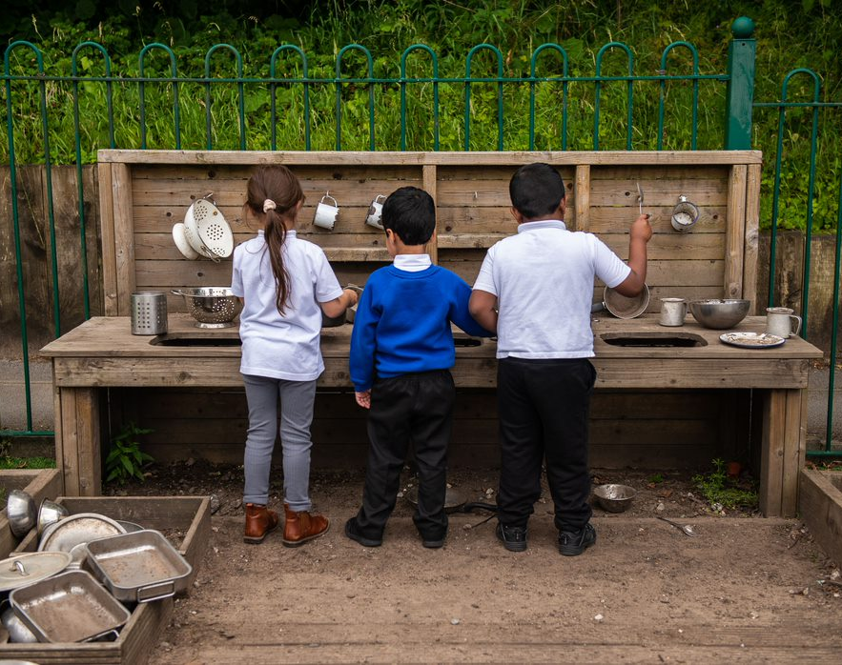
Important information…

Slide 8

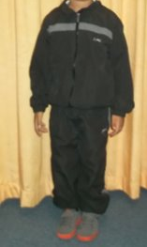
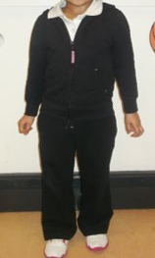
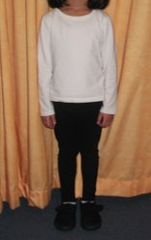
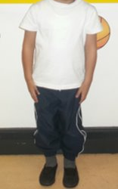
PE kit
Indoor kit
A White T-Shirt
Blue or Black Shorts/Jogging Pants or Leggings
Black Pumps
Outdoor kit
A White T-Shirt
Blue or Black Leggings or Jogging Pants
A Hooded Jacket
Sensible Trainers (No Football Shoes/Boots)
Class 7 PE Days: Tuesday and Thursday
Class 8 PE Days: Tuesday (swimming) and Thursday

Slide 9
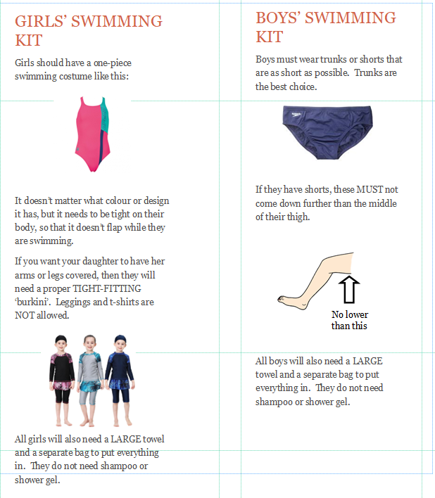
Swimming kit
Swimming will be every Tuesday unless a letter is sent out or a parent email.
Children can be picked up from the swimming centre at 3pm or from school at approximately 3:30pm
Please put your child's name in every item of clothing in case the children misplace them.
Class 7 PE Days: Tuesday and Thursday
Class 8 PE Days: Tuesday (swimming) and Thursday

Slide 10
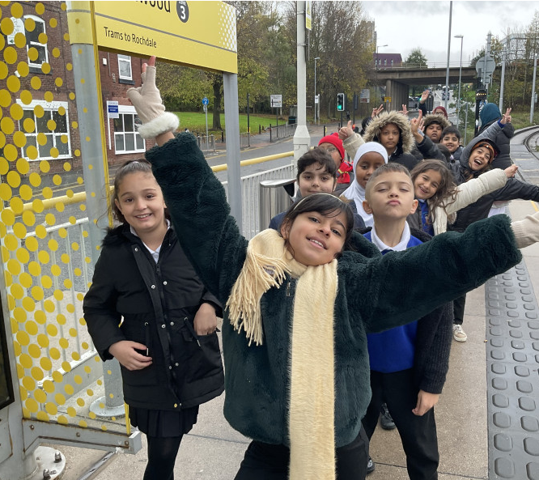

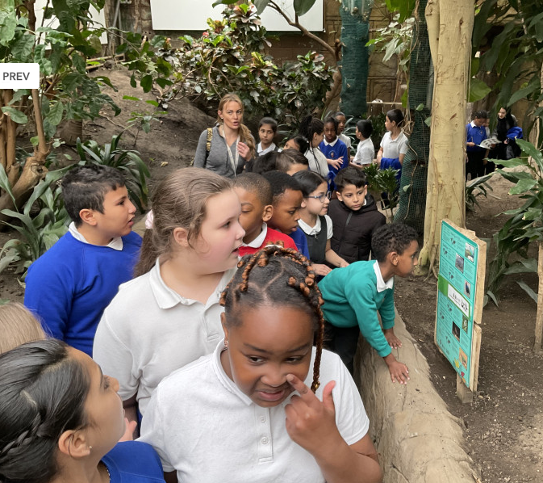

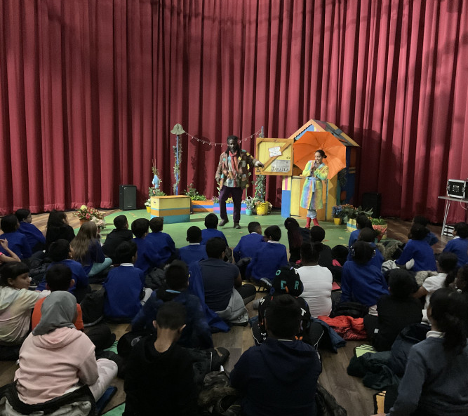
School Trips
Pantomime
Alexandra Park- Plants
Manchester Museum – Ancient Egypt
RHS Bridgewater gardens – plants and diet and nutrition
Notes:
CHANGE THE PHOTOS TO MATCH WHERE YOU ARE GOING ON A TRIP WHERE POSSIBLE – Discuss Parent volunteers

Slide 11
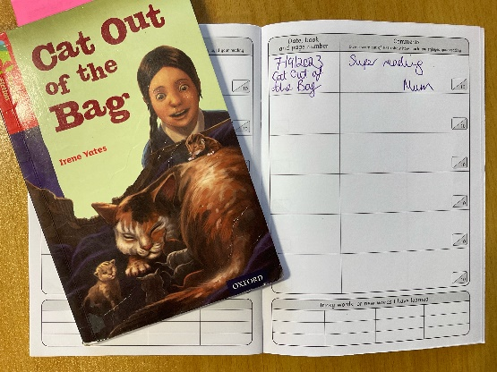

Homework
Reading
Every child will read to an adult once per week in school.
Please read every day at home but at least 3 times per week
Write in the reading record
Weekly reward for reading champions
End of term reward for Word Millionaire
Notes:
ADAPT where needed for your year group

Slide 12

Homework
Other homework
Sent every Friday to be completed by the following Thursday
Literacy homework
Maths homework
Spellings
Topic/Science homework

Slide 13

How you can help at home…
Notes:
Reminder of how parents can support with reading, homelearning, getting children to school on time etc

Slide 14
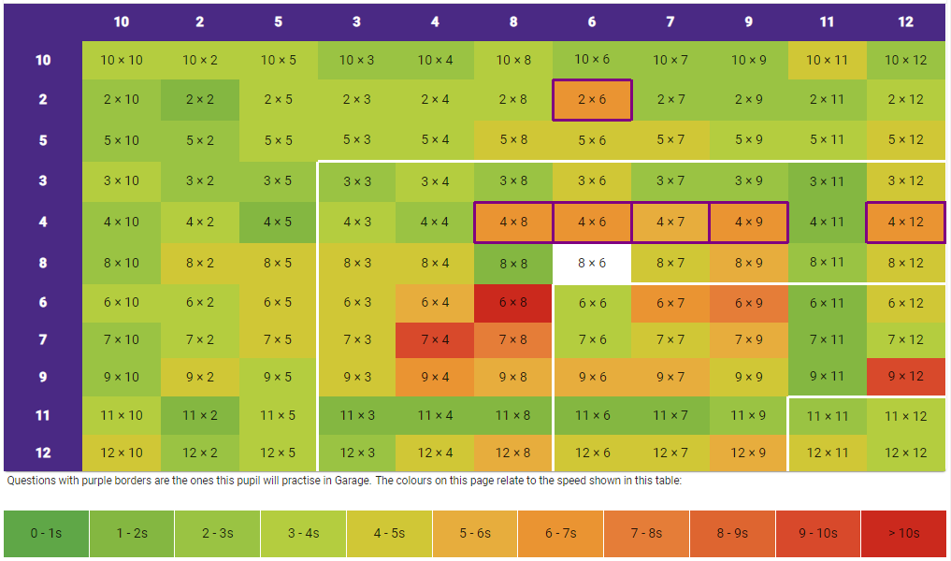
Times Tables at Home
Recall Games
Games from packs
Create posters
Encourage children to use TTRockstars and Hit the Button.
Stay up to date with their heat maps on TTRockstars
Notes:
Year 1- this slide can be changed to phonics, Year 2 and Year 6 - CGP and SATs revision mentions, Year 3 and Year 5 can continue to be times table

Slide 15
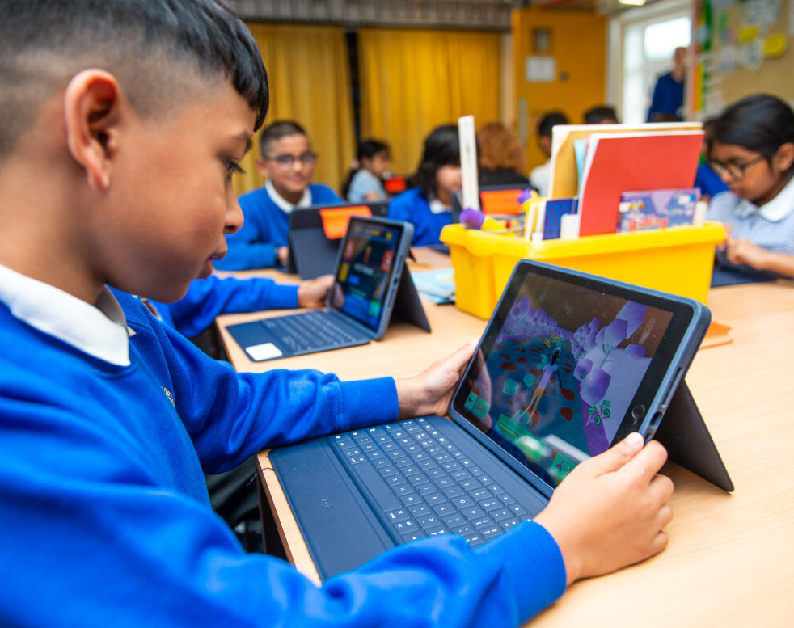
Online safety @ Greenhill…

Slide 16


Slide 17
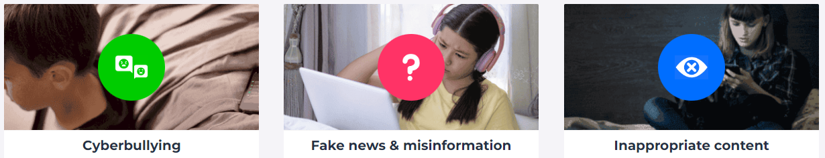
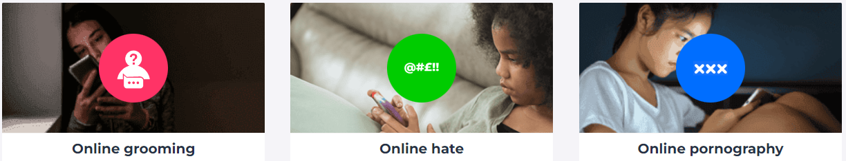


Slide 18
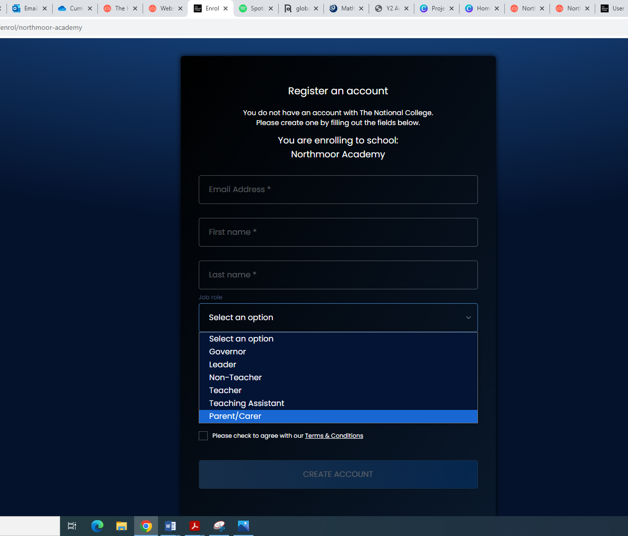

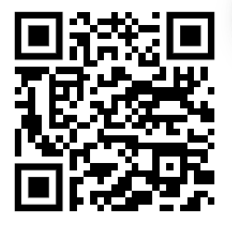

National Online Safety Parent Course
Register for an account using the QR code or go to: https://nationalcollege.com/enrol/greenhill-academy
Register (selecting parent/carer)
Search for the following courses:
Notes:
FREE course for parents to sign up to- scan QR code

Slide 19


Slide 20


Slide 21
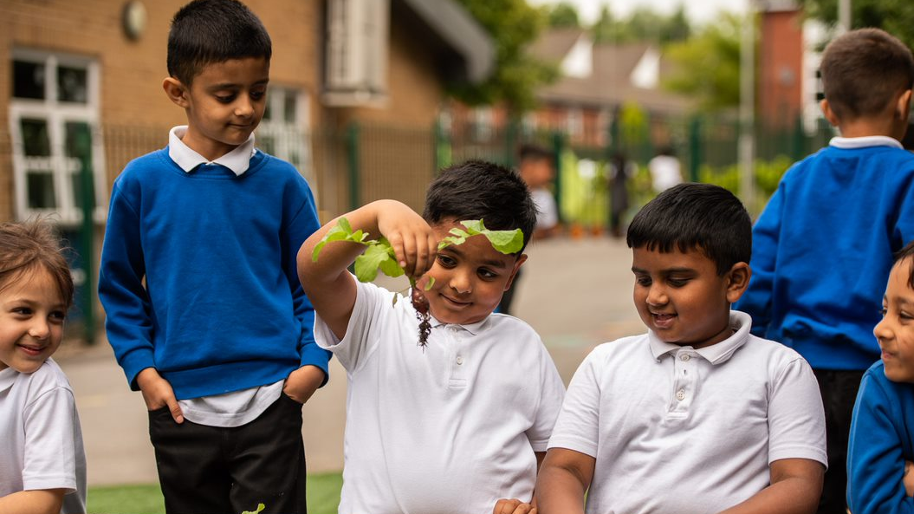
Thank you for listening!

