Slide 1

Welcome to
Year 2

Slide 2
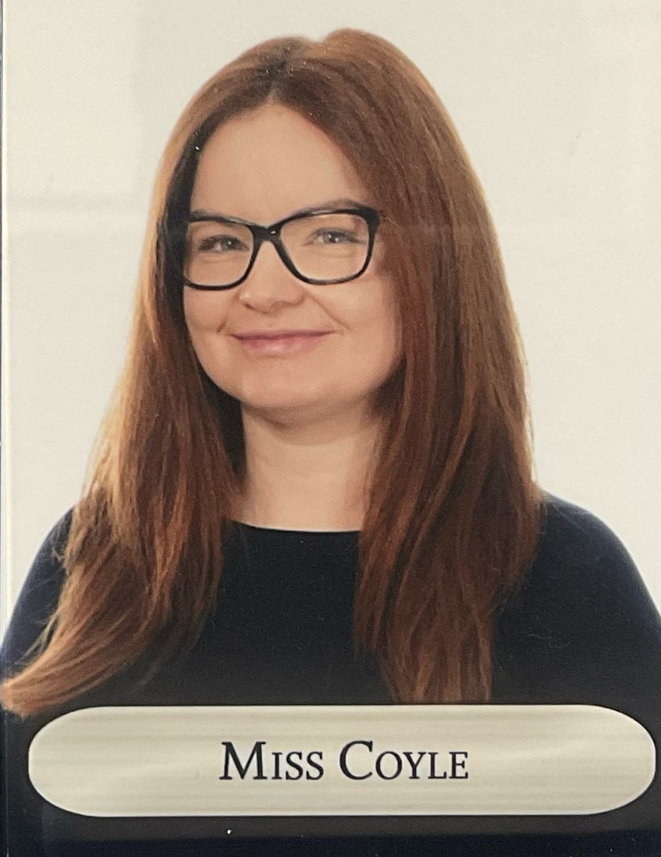
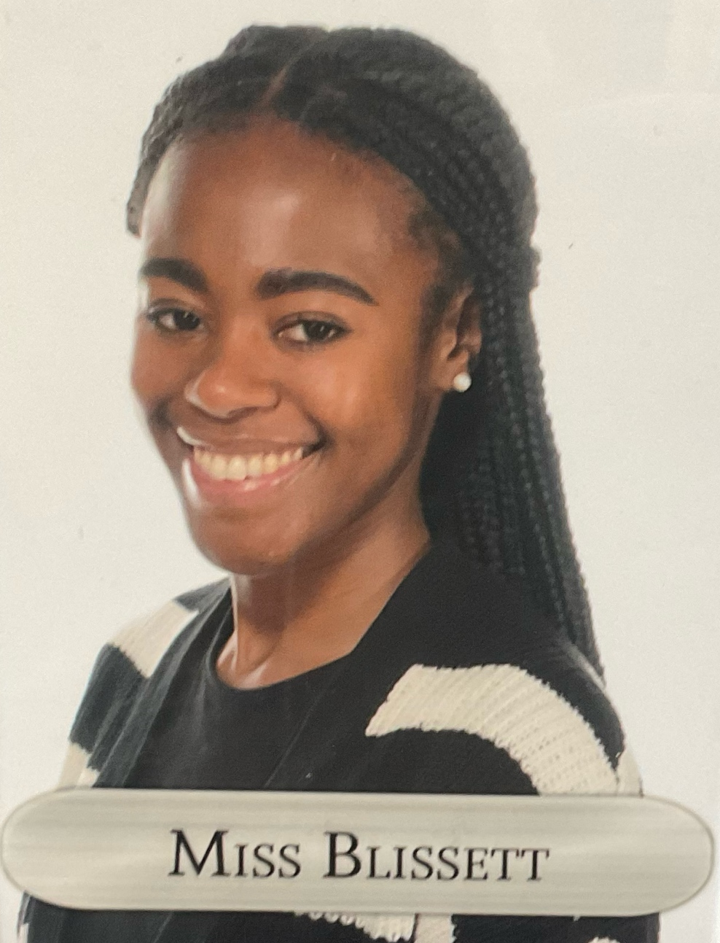
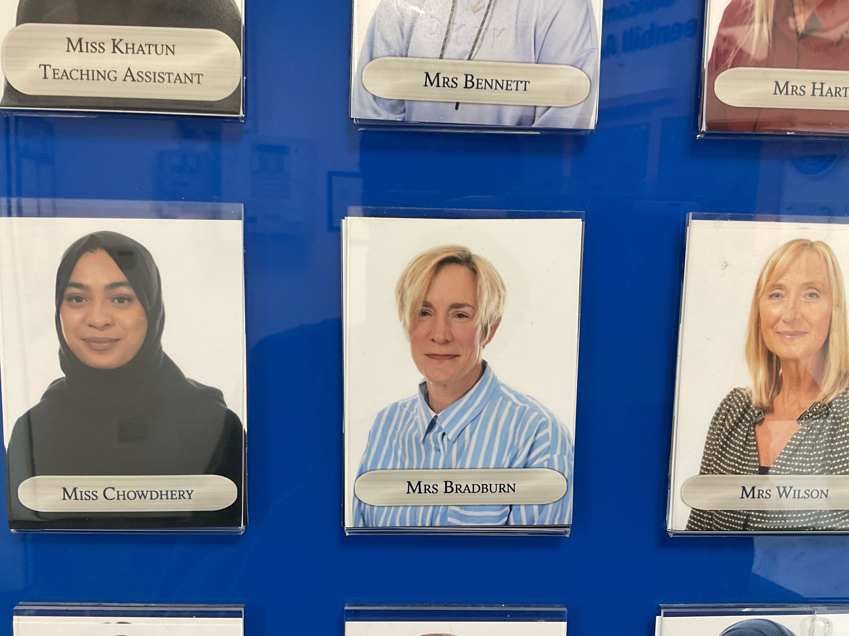
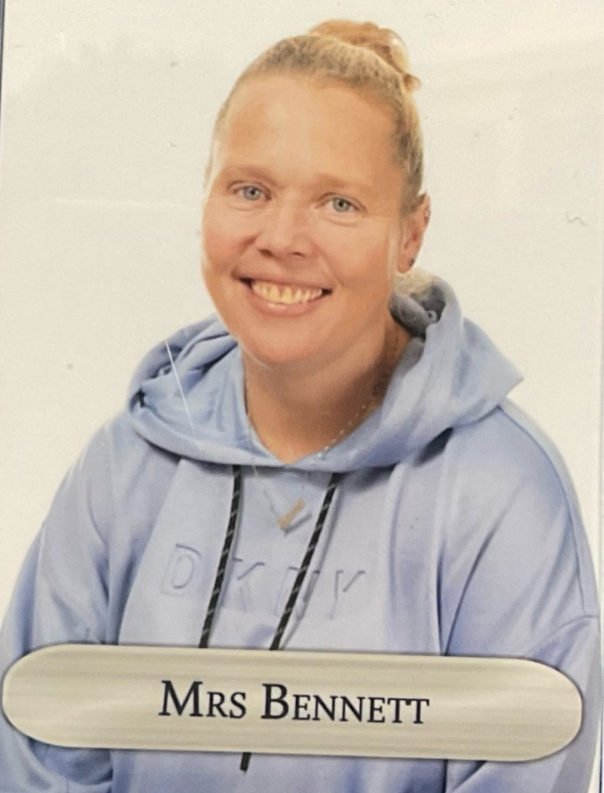
Class Teachers...
Miss Coyle
Class 5
Miss Blissett
Class 6
Mrs Bradburn
Phase 2 TA
Mrs Bennett
Phase 2 TA
Notes:
TB

Slide 3
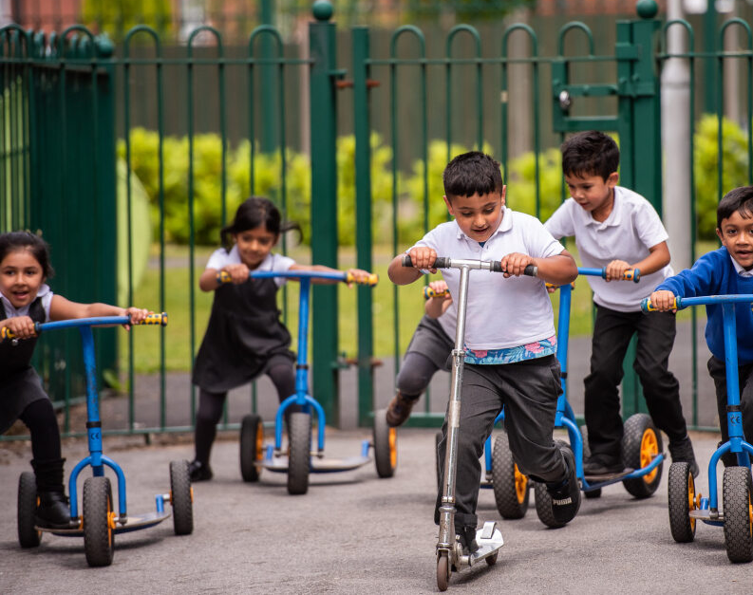
Our Learning…

Slide 4

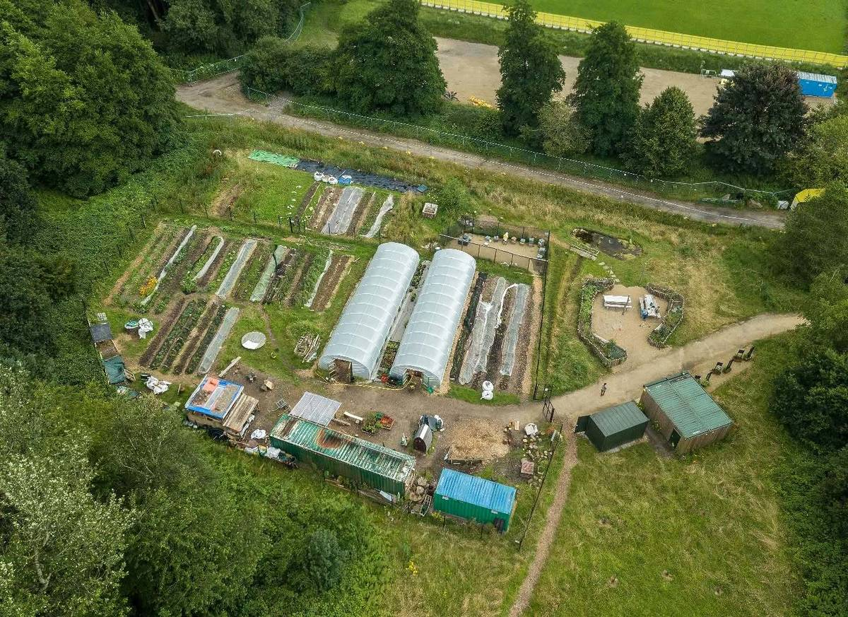

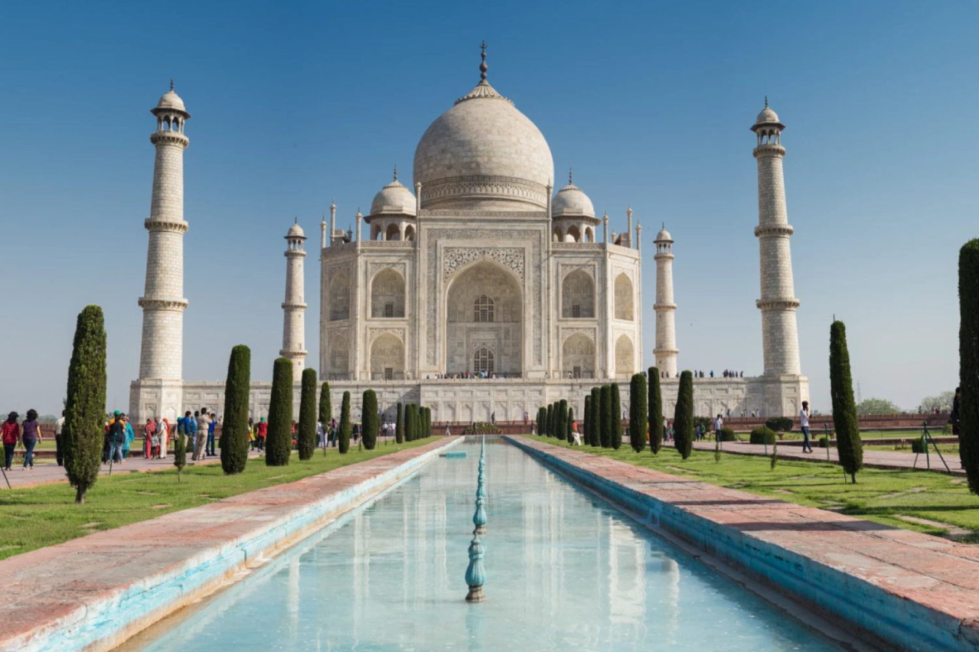
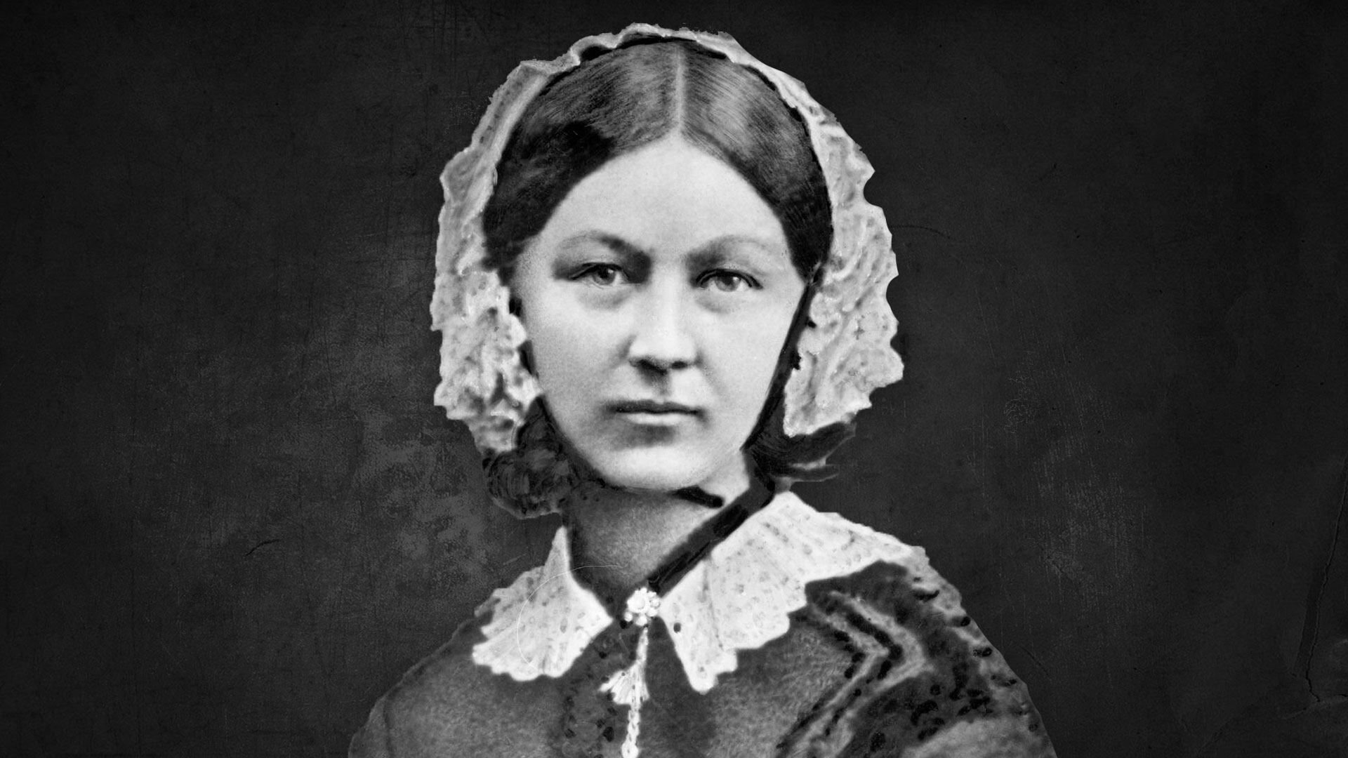
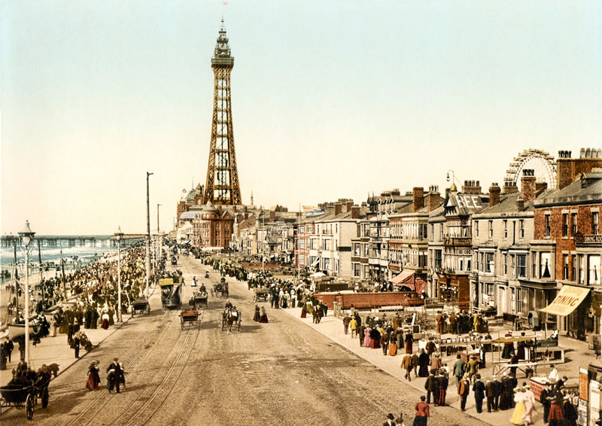
Topics
Autumn 1 - Geography | Autumn 2 - History | Spring 1 - Geography | Spring 2 - History | Summer 1 - Geography | Summer 2 - History
Old MacDonald had a Farm | The Space Race | I is for India | How will we remember you? | The Places People Go | Oh, I do like to be beside the seaside
Notes:
FC

Slide 5
Key Learning in Year 2
Writing
Spag skills: Noun phrase Verb Statement Question Exclamation Command Compound Suffix Adjective Adverb Text types: Character description Setting description Retell Poetry Instruction Alternative ending Non-chronological report Diary
Maths
Number: Place value: tens, ones Addition & Subtraction Multiplication & Division Fractions Measure: Time Length Mass Money Capacity Geometry: 2D & 3D shapes Statistics: Tally charts, pictograms and block diagrams
Reading
Phonics lessons: whole class and interventions Reading comprehension: Prediction Decoding Fluency Definitions: dictionary skills Comprehension questions Variety of texts: fiction, non-fiction and poetry
Notes:
FC

Slide 6
Phonics Screening Check
For any Year 2 pupils who require.
The purpose of the PSC is to support pupils with reading fluently and spelling.
Help us to support children with gaps in knowledge.
Notes:
FC

Slide 7
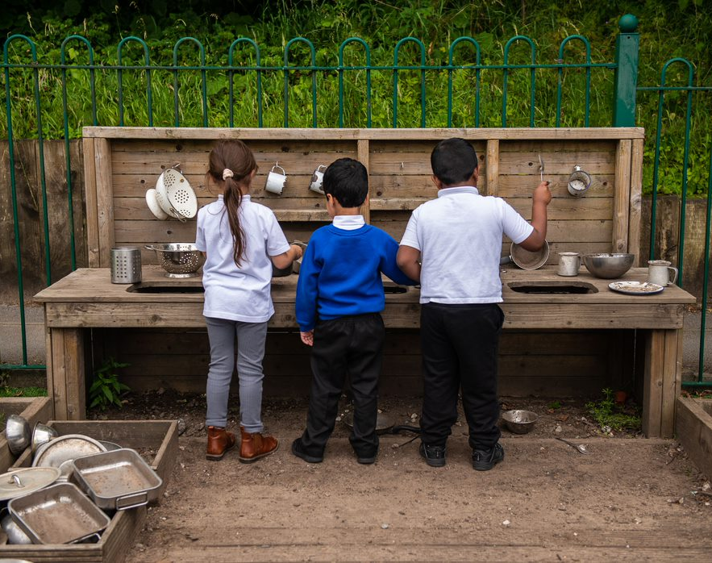
Important information…

Slide 8

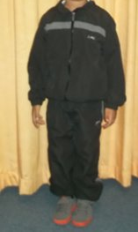
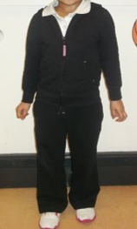
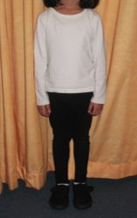
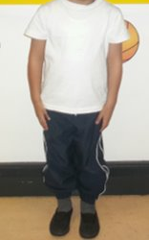
PE kit
Indoor kit
A White T-Shirt
Blue or Black Shorts/Jogging Pants or Leggings
Black Pumps
Outdoor kit
A White T-Shirt
Blue or Black Leggings or Jogging Pants
A Hooded Jacket
Sensible Trainers (No Football Shoes/Boots)
Class 5 PE Days: Wednesday and Thursday
Class 6 PE Days: Tuesday and Thursday
Notes:
TB

Slide 9


Trips and visitors
Autumn 1 | Autumn 2 | Spring 1 | Spring 2 | Summer 1 | Summer 2 | Total cost for Year 2
Topic: Northern Roots farm - TBC | Music: Snowman performance with live orchestra Experience: Pantomime | Topic: Bollywood dancing workshop* | Harmony Pledge: Choral Speaking festival | Literacy: Author Visit RE: Diary of a Disciple workshop* | PE: Alexandra Park Topic: Oldhamers by the Seaside workshop Topic: Seaside day* | TBC - £20.40
*Visitor in school
If you would like to volunteer for any trips, please inform your child's class teacher.
Notes:
FC

Slide 10

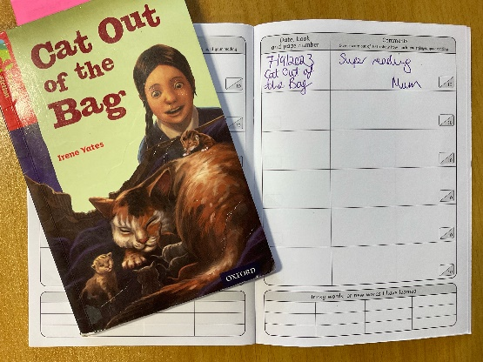
Homework
Purple Mash Activities
  Set on a Friday
  Children to complete at home
  Submit by the following Wednesday
Reading
  Every child will read to an adult once per week in school.
  Please read home at least 3 times per week, everyday if possible.
  Write in the reading record
Notes:
FC

Slide 11

How you can help at home…
Notes:
Reminder of how parents can support with reading, homelearning, getting children to school on time etc

Slide 12
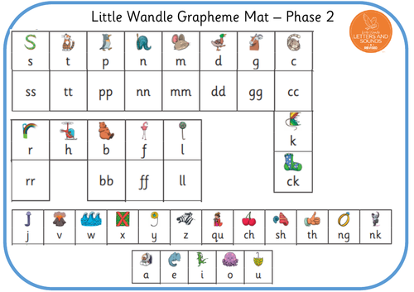
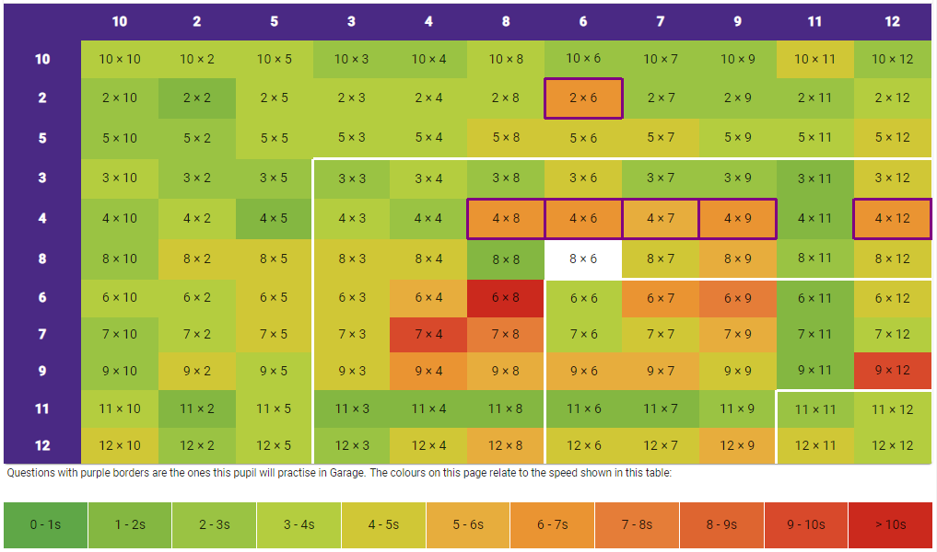
Reading, Phonics and Times Tables at Home
Apply phonics knowledge when reading at home
Once secure with place value, addition and subtraction we will be learning 2,5,10 times tables
Listen to songs, play games and recite at home.
Notes:
FC

Slide 13
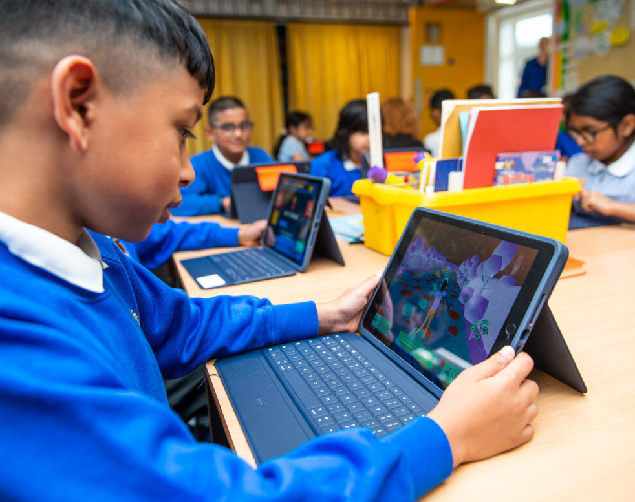
Online safety @ Greenhill…
Notes:
TB

Slide 14


Slide 15

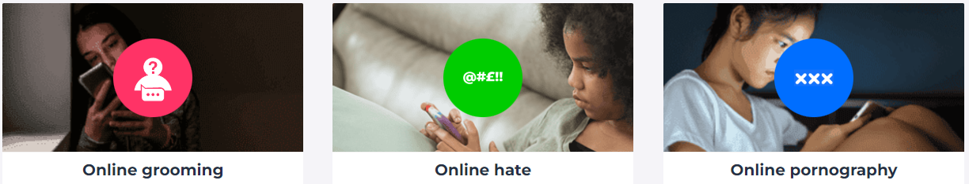


Slide 16
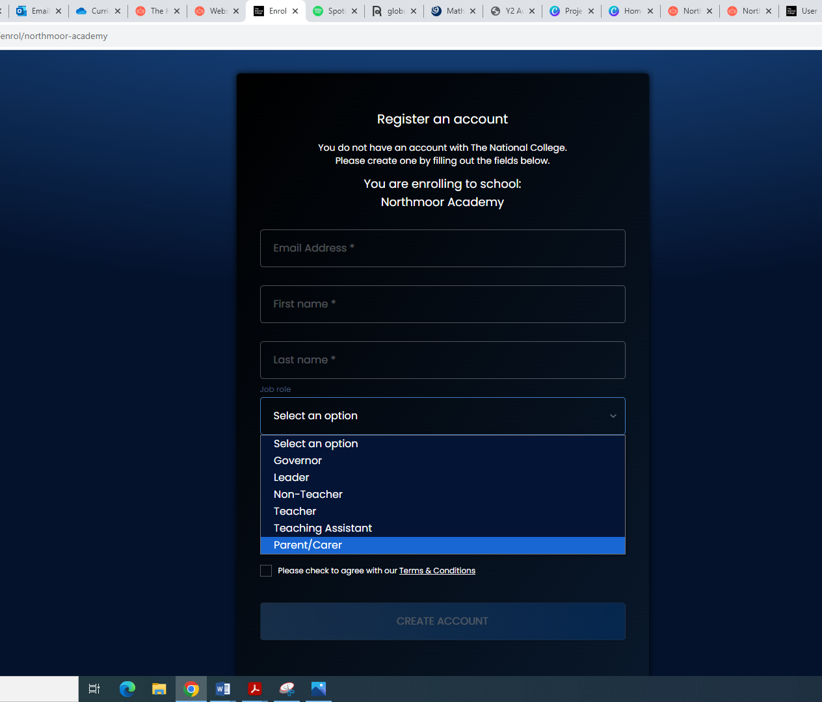

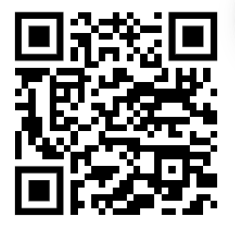
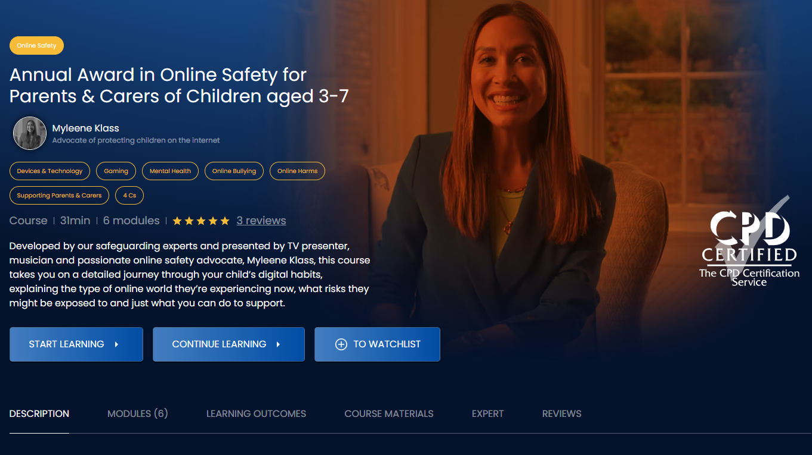
National Online Safety Parent Course
Register for an account using the QR code or go to: https://nationalcollege.com/enrol/greenhill-academy
Register (selecting parent/carer)
Search for the following courses:
Notes:
FREE course for parents to sign up to- scan QR code

Slide 17


Slide 18


Slide 19
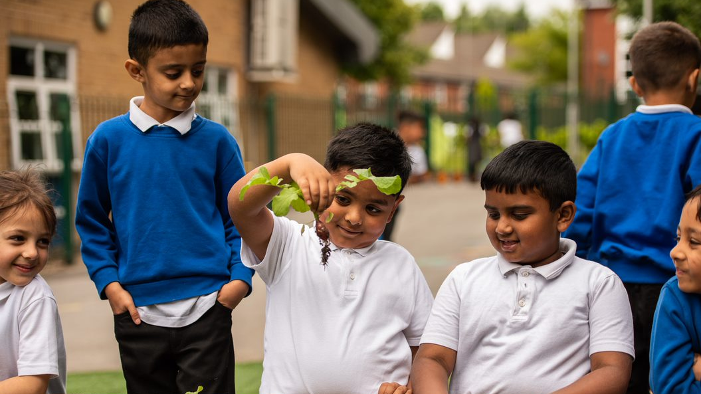
Thank you for listening!

