Slide 1
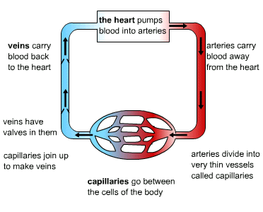

Retrieval Practice
Blood Vessels

Slide 2
To explore the structure and functions of the human heart
Key Vocabulary
Left Atrium
Right Atrium
Right Ventricle
Left Ventricle
Valves
https://www.youtube.com/watch?v=Vot7V7_2UoI

Slide 3
