Slide 1

The Bloody Code

Slide 2
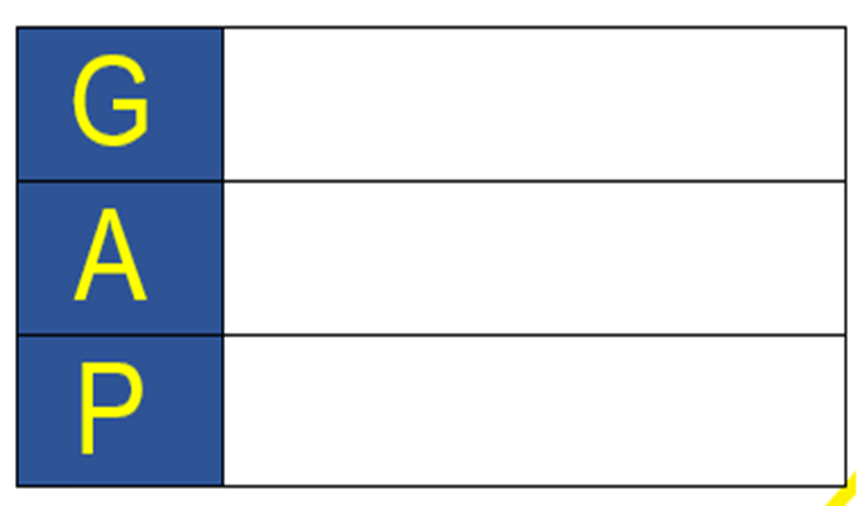
Your task today is to write a non-chronological report all about the Bloody Code.
You must use the information you researched on Wednesday.
Non-Chronological Report
Anyone interested in learning about the Bloody Code
To provide information about the Bloody Code

Slide 3
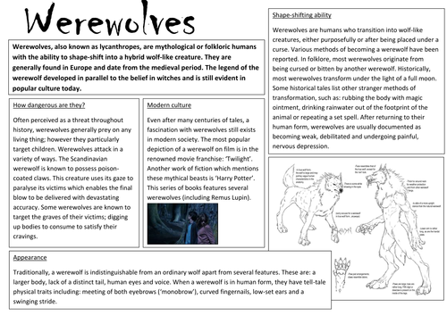
Remind me of the features…
Introduction
Present Tense & Third person
Sub-headings
Main information
Pictures/Diagrams
Notes:
Children look at the image and try to identify the features of a non-chronological report.

Slide 4
The Bloody Code
Below are the sub-headings you will use. You should have researched these on Monday.
What is ‘The Bloody Code’?
Why was The Bloody Code introduced?
How did The Bloody Code end?
What were common punishments during this time?
What crimes carried the death penalty during this time?
Facts and statistics (e.g. How many deaths were recorded)

Slide 5
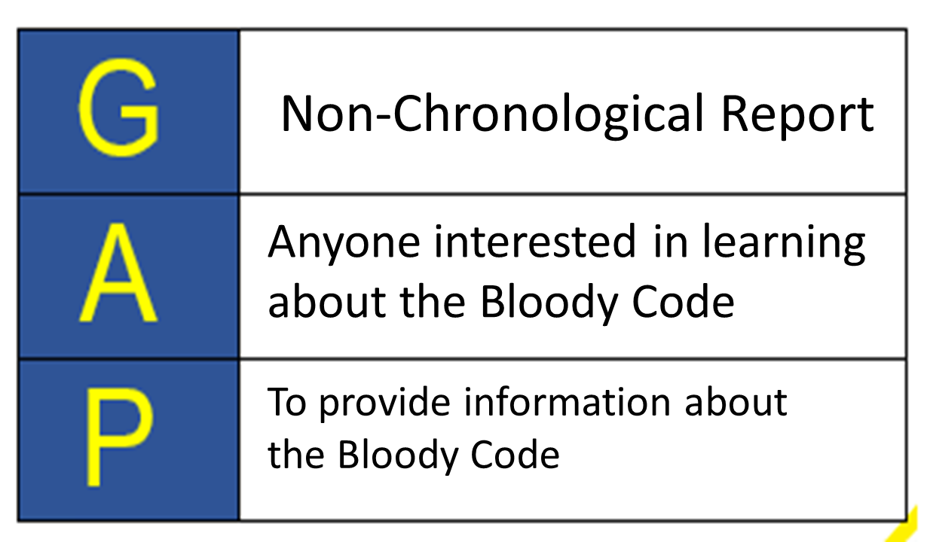
What is ‘The Bloody Code’?
The 'Bloody Code' was the name given to the English legal system from the late 17th Century to the early 19th Century.
It was known as the Bloody Code because of the huge numbers of crimes for which the death penalty could be imposed. It would seem as if every crime was punishable by death in the 1800s, even those which we would consider to be very minor or trivial today such as stealing a rabbit.

