Slide 1

Counting
13x
15x
18x

Slide 2
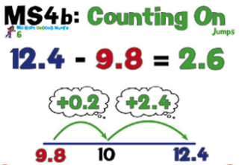
25/09/20
Mental Maths – Counting On test

Slide 3
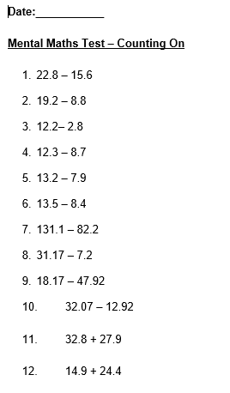

Slide 4

23/09/20
To multiply numbers mentally
To perform mental calculations, including with mixed operations and large numbers
÷
What do we know about this symbol?

Slide 5
23/09/20
To multiply numbers mentally
To perform mental calculations, including with mixed operations and large numbers
14 ÷ 2
What mental methods could we use to solve this problem?

Slide 6
23/09/20
To multiply numbers mentally
To perform mental calculations, including with mixed operations and large numbers
140 ÷ 2
140 ÷ 20
What about these?

Slide 7
23/09/20
To multiply numbers mentally
To perform mental calculations, including with mixed operations and large numbers
72 ÷ 4
How might you solve this problem mentally?

Slide 8
23/09/20
To multiply numbers mentally
To perform mental calculations, including with mixed operations and large numbers
186 ÷ 6
How might you solve this problem mentally?

