Slide 1

Counting
13x
15x
18x

Slide 2
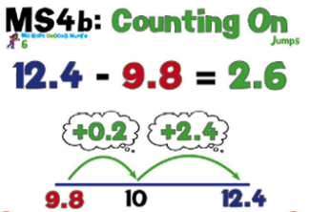
5.71 - 3.58

Slide 3
Solve the following problems mentally.
4.16 – 3.24
5.23 – 4.3
6.26 – 5.19
7.1 – 5.28

Slide 4

24/09/20
To multiply numbers mentally
To perform mental calculations, including with mixed operations and large numbers
9 x 18
How might you solve this problem mentally?
What about this? 19 x 18

Slide 5
24/09/20
To multiply numbers mentally
To perform mental calculations, including with mixed operations and large numbers
30 x 40 x 20
How might you solve this problem mentally?

Slide 6
24/09/20
To multiply numbers mentally
To perform mental calculations, including with mixed operations and large numbers
7 x 16 + 47
How might you solve this problem mentally?

