Slide 1

L.O: To identify the features of a non-chronological report.
Non-chronological reports
Does anyone know what a non-chronological report is?

Slide 2

Purpose:
Non-chronological reports don’t have to be read in any order.
Aim to give us information on a topic.
Written to give other people information.
Useful for studying things we don’t know a lot about.
Written in paragraphs often under sub-headings.
Reports contain specific features.

Slide 3
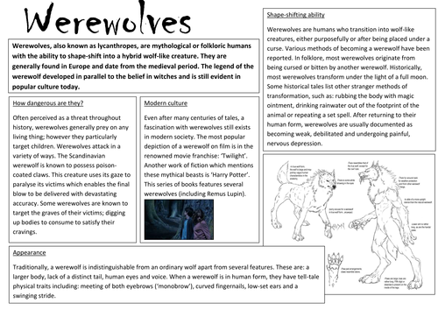
What do you think the features are?
Introduction
Look at the following example of a non-chronological report.
In your groups, do you think you know what the features used might be? Try to identify them.
Present Tense & Third person
Sub-headings
Main information
Pictures/Diagrams
Notes:
Children look at the image and try to identify the features of a non-chronological report.

Slide 4
Features of a non-chronological report:
Introduction -
What is the report about?
Sub-headings -
Separate your information.
Main information -
Facts about your topic.
Present Tense -
Imagine it is happening now.
Third Person -
Use he, she, it, etc.
Pictures/Diagrams-
What does it look like?

Slide 5
Your task:
So that you are clear with how to write a non-chronological report, I have provided three further examples for you to look at. Similar to the way I did with the werewolves text, label the examples with the features shown on the previous slide.
This will then help you with tomorrow’s task, which will be to write our own non-chronological report on the information you should have researched about the Bloody Code.

