Slide 1

Counting
13x
15x
18x

Slide 2
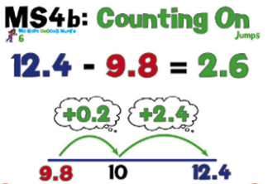
25.7 - 3.5

Slide 3
Solve the following problems mentally.
15.6 – 3.4
18.3 – 4.3
28.2 – 15.9
113.1 – 95.2

Slide 4

23/09/20
To subtract numbers mentally
87 - 48
Apart from counting on, what other mental methods could you use to solve the problem above.

Slide 5
23/09/20
To subtract numbers mentally
587 - 268
How are we going to solve this problem?

Slide 6
23/09/20
To subtract numbers mentally
Now have a go at your independent work. Make sure you choose the most appropriate basket to challenge you! Also make sure you are tackling these challenges mentally!
Once you’ve finished, check your work using a calculator.

