Slide 2
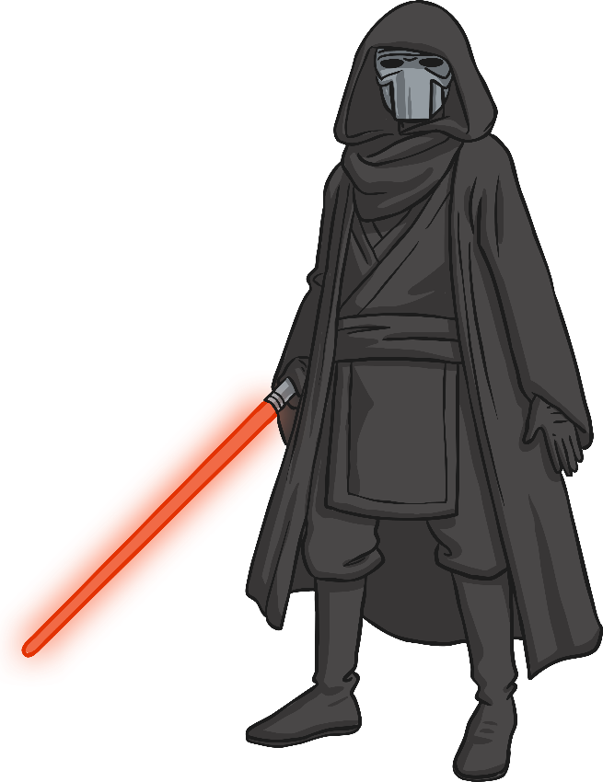
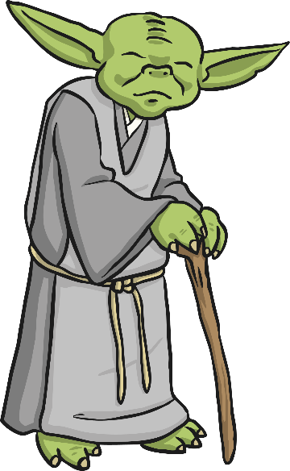
Instructions
If you think that the word on the space station is a real one, then click on the Space Master. If you think the word is not real, then click on the Space Villain.
You can move onto the next question by clicking on the green arrow once you have answered correctly.
Have fun!
Space Master
Space Villain

Slide 3
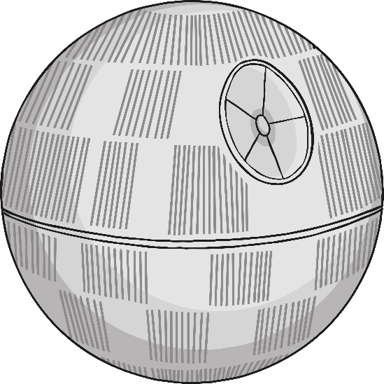
Real or fake word?
like
Space Master
Space Villain

Slide 4

Correct. It is a real word! Well done!
next slide

Slide 5
Incorrect. It’s not a fake word!
click to go back

Slide 6
Real or fake word?
grint
Space Master
Space Villain

Slide 7

Correct. It is a fake word! Well done!
next slide

Slide 8
Incorrect. It’s not a real word!
click to go back

Slide 9
Real or fake word?
help
Space Master
Space Villain

Slide 10
Correct. It is a real word! Well done!
next slide

Slide 11
Incorrect. It’s not a fake word!
click to go back

Slide 12
Real or fake word?
dreet
Space Master
Space Villain

Slide 13
Correct. It is a fake word! Well done!
next slide

Slide 14
Incorrect. It’s not a real word!
click to go back

Slide 15
Real or fake word?
from
Space Master
Space Villain

Slide 16
Correct. It is a real word! Well done!
next slide

Slide 17
Incorrect. It’s not a fake word!
click to go back

Slide 18
Real or fake word?
went
Space Master
Space Villain

Slide 19
Correct. It is a real word! Well done!
next slide

Slide 20
Incorrect. It’s not a fake word!
click to go back

Slide 21
Real or fake word?
skarb
Space Master
Space Villain

Slide 22
Correct. It is a fake word! Well done!
next slide

Slide 23
Incorrect. It’s not a real word!
click to go back

Slide 24
Real or fake word?
kelf
Space Master
Space Villain

Slide 25
Correct. It is a fake word! Well done!
next slide

Slide 26
Incorrect. It’s not a real word!
click to go back

Slide 27
Real or fake word?
glorpid
Space Master
Space Villain

Slide 28
Correct. It is a fake word! Well done!
next slide

Slide 29
Incorrect. It’s not a real word!
click to go back

Slide 30
Real or fake word?
clear
Space Master
Space Villain

Slide 31
Correct. It is a real word! Well done!
next slide

Slide 32
Incorrect. It’s not a fake word!
click to go back

Slide 33
Real or fake word?
plood
Space Master
Space Villain

Slide 34
Correct. It is a fake word! Well done!
next slide

Slide 35
Incorrect. It’s not a real word!
click to go back

Slide 36
Real or fake word?
stand
Space Master
Space Villain

Slide 37
Correct. It is a real word! Well done!
next slide

Slide 38
Real or fake word?
sping
Space Master
Space Villain

Slide 39
Correct. It is a fake word! Well done!
next slide

Slide 40
Incorrect. It’s not a real word!
click to go back

Slide 41
Real or fake word?
bamp
Space Master
Space Villain

Slide 42
Correct. It is a fake word! Well done!
next slide

Slide 43
Incorrect. It’s not a real word!
click to go back

Slide 44
Real or fake word?
brown
Space Master
Space Villain

Slide 45
Correct. It is a real word! Well done!
next slide

Slide 46
Incorrect. It’s not a fake word!
click to go back

Slide 47
Real or fake word?
spunch
Space Master
Space Villain

Slide 48
Correct. It is a fake word! Well done!

Slide 49
Incorrect. It’s not a real word!
click to go back

