Slide 1
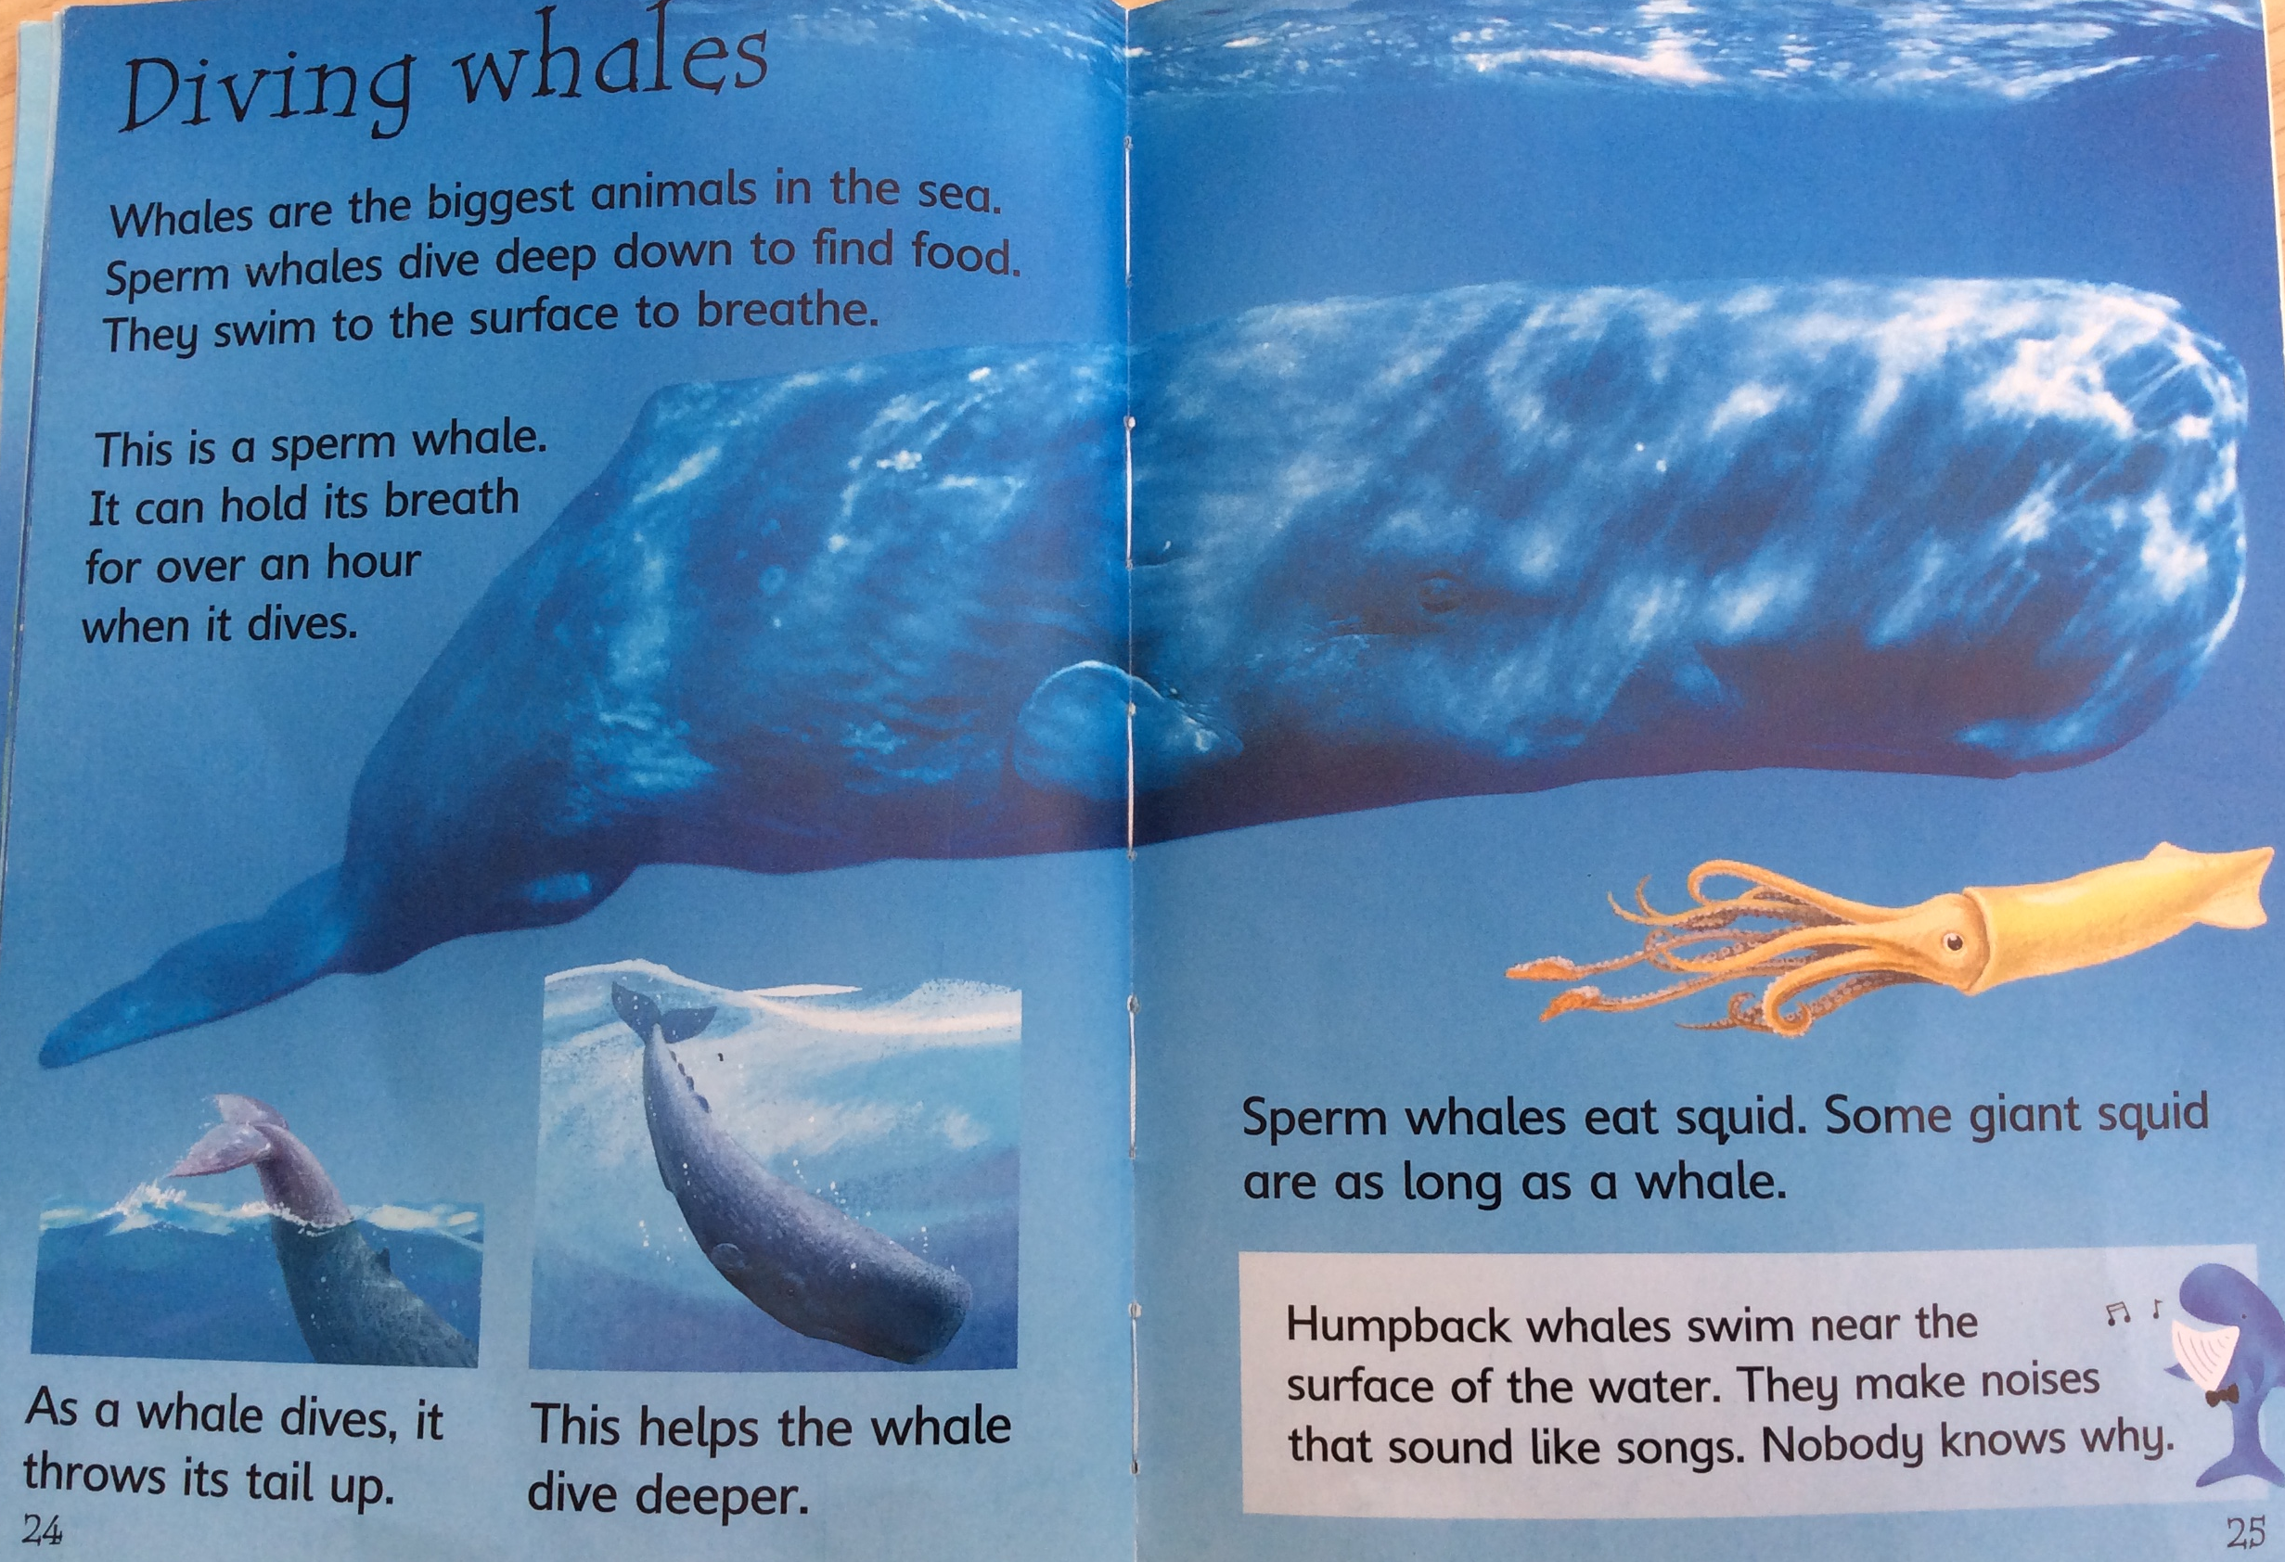

Slide 2
Top Whale Facts for Kids
1. Whales are mammals. This means that whale calves grow inside their mothers until they are born. Besides, they are nursed and taken care by their mothers until they reach certain age.
2. Whales breathe air as we do. They need to reach the surface of the ocean to breathe because they cannot breathe underwater.
3. To breathe, whales have a blowhole in the top of their heads. When they reach the surface, they take air in through this blowhole.
4. There are two types of whales, Baleen Whales and Toothed Whales. There are several species of whales out there, but they are classified according to the way they feed in two types, baleen whales and toothed whales.
5. Baleen whales feed from krill and plankton. Krill are shrimp-like creatures which are very important ocean creatures.
6.Toothed whales eat several kind of fish, like tuna, cod and salmon among others and some small mammals like seals.
7. The Blue whale is the largest animal in the world. It is the largest animal that has ever existed, even larger than the largest dinosour ever found. The blue whale is a baleen whale.
8. Some baleen whales sing. Blue whales and the humpback whales are well known for singing.
9. Whales can swim as fast as 30 miles per hour.
10. Some Whales can stay underwater for as long as 90 minutes.The sperm whale which can stay underwater for as long as 90 minutes, although a typical dive for other species is around 35 minutes.
11. Whales do not sleep as we do. To rest, whales sleep only half brain so they remember to take air in, otherwise they would drown.

Slide 3
For more information about whales you might like to look at the following website or video:
https://www.wwf.org.uk/learn/fascinating-facts/top-10-facts-about-whales?gclsrc=aw.ds&&gclid=EAIaIQobChMIt6b35Mqk6gIVG-vtCh0Q4gx5EAAYASAAEgKn0fD_BwE&gclsrc=aw.ds
https://www.youtube.com/watch?v=6JjKl_3KntQ

Slide 4
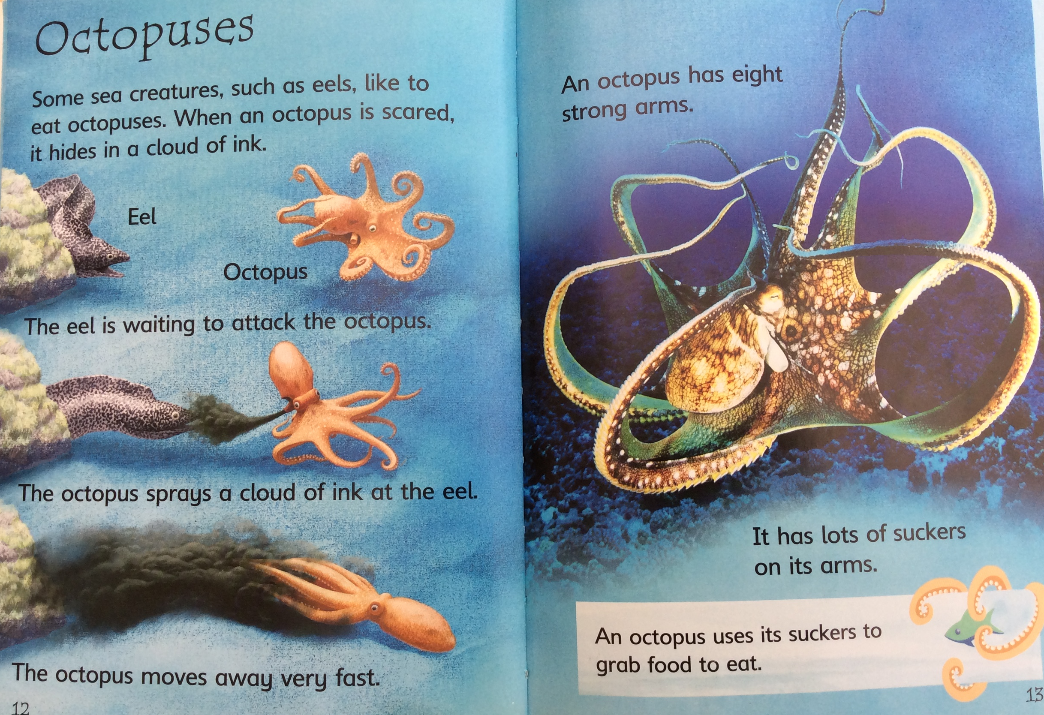

Slide 5
OCTOPUSES
Lifespan (in wild): 1-2 years Weight: 3-10kg
Body length: Generally 30-90cm (some species can grow to 5.4m!)
Top speed: 40km/h Diet: Carnivore Habitat: Ocean
Octopuses are sea animals famous for their rounded bodies, bulging eyes and eight long arms. These cool critters live in all the world’s oceans, but especially in warm, tropical waters. Octopuses are often considered ‘monsters of the deep’, lurking in the depths of the seas. However, there are some kinds of octopus that live in relatively shallow waters. Most octopuses stay along the ocean’s floor, although some live near the water’s surface. Other octopus species live in deep, dark waters, and rise from below at dawn and dusk to search for food. They perform their famous backward swim by blasting water through a muscular tube on their body. They also crawl along the ocean’s floor, tucking their arms into small openings to search for food. Octopuses like to eat crabs, shrimps and lobsters, but they will sometimes eat larger prey, too, such as sharks. They typically drop down on their prey from above, and then use the suction cups that line their arms to pull their victim into their mouth. Octopuses are sometimes eaten by other sea creatures, such as seals, whales and large fish. But these eight-armed animals have a few tricks to help defend themselves! If threatened, octopuses shoot an inky fluid from their body that darkens the water around them, confusing the attacker. They can also hide and blend in with their surroundings, too, by changing colour to grey, brown, pink, blue or green. As well as for camouflage, these incredible invertebrates use colour change as a way to communicate with other octopuses.

Slide 6
For more information about octopuses you might like to watch this short video:
https://www.youtube.com/watch?v=fHRS3bD4yPM

Slide 7
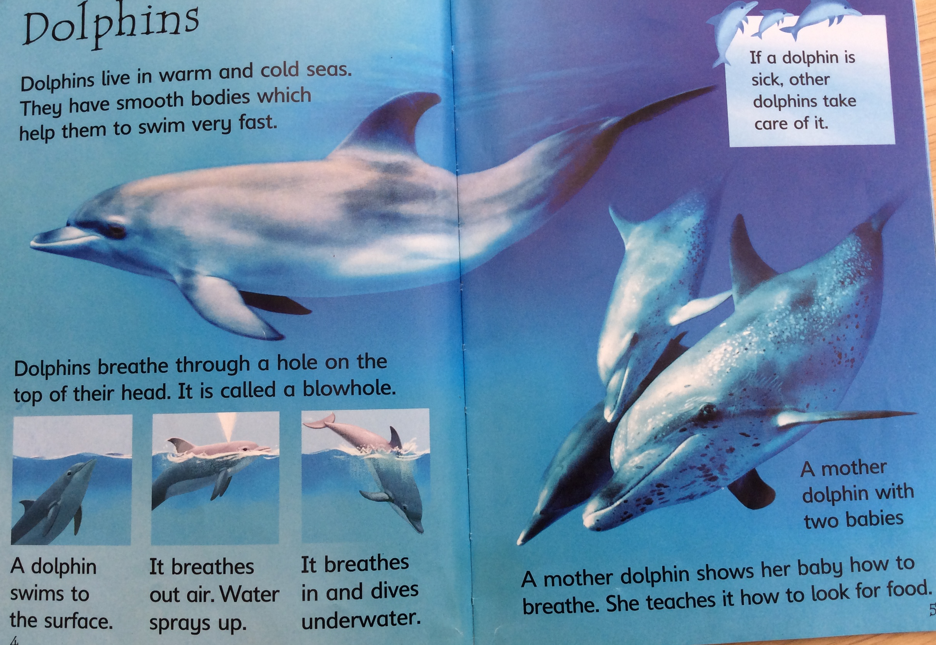

Slide 8
Facts about bottlenose dolphins
Bottlenose dolphins are marine mammals that live in oceans with mild temperatures around the world. This includes the waters off the UK.
2) These beautiful creatures have a short thick beak and a curved mouth, giving the appearance that they are always smiling. They are usually grey in colour, and measure around two to four metres in length.
3) Bottlenose dolphins travel in groups, called “pods“, of around 10-15. They play and hunt together, as well as cooperate to raise young dolphin calves and help each other.
4) Bottlenose dolphins are super swimmers. They can reach speeds over 30km an hour and dive as deep as 250m below the surface!
5) These cool creatures are awesome acrobats, and can be seen flipping up to 5m out of the water!

Slide 9
6) Although they live underwater, the bottlenose dolphin must come up to the surface to breath air. It breathes through a “blowhole“, a hole at the top of its head. They open this hole when breathing out of the water, and close it when below the ocean surface. They can hold their breath underwater for around seven minutes.
7) Bottlenose dolphins send each other messages in different ways – they squeak and whistle and also use body language, leaping out of the water, snapping their jaws and even butting heads!
8) Dolphins also produce high-pitched clicks to help them find their way around and find food – a process called “echolocation“. When the clicking sounds hit an object in the water – such as a rock or fish – they bounce back to the dolphin as echoes. From this, they can work out the location, size and shape of the object.
9) Dolphins are carnivores and eat mostly fish, but will also eat shrimp and squid, too.
10) Thankfully, bottlenose dolphins are not classed as endangered. However, illegal hunting, fishing nets and pollution pose threats to these incredible creatures.

Slide 10
For more information about dolphins, you might enjoy this video or website:
https://www.youtube.com/watch?v=45F2kH144zY
https://www.wwf.org.uk/learn/fascinating-facts/dolphins?gclsrc=aw.ds&&gclid=EAIaIQobChMIkKON2tmk6gIVRLTtCh17xwEqEAAYASAAEgJ8vvD_BwE&gclsrc=aw.ds

