Slide 1
Wednesday 8th July
Guided reading

Slide 2
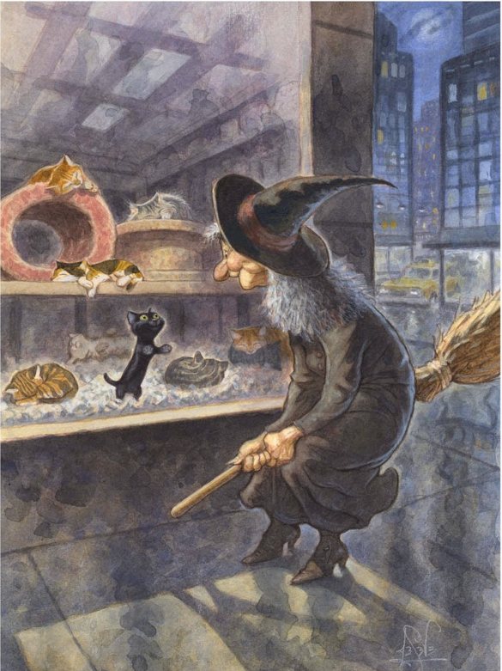
Why is the black cat the only cat looking at the witch?
Why did the witch come here? Was she just passing or did she come to the shop for a reason?
What is the ‘something familiar’? Why?
Do the witch and the cat already know each other?

