Slide 1
Tuesday 7th July
Guided reading

Slide 2
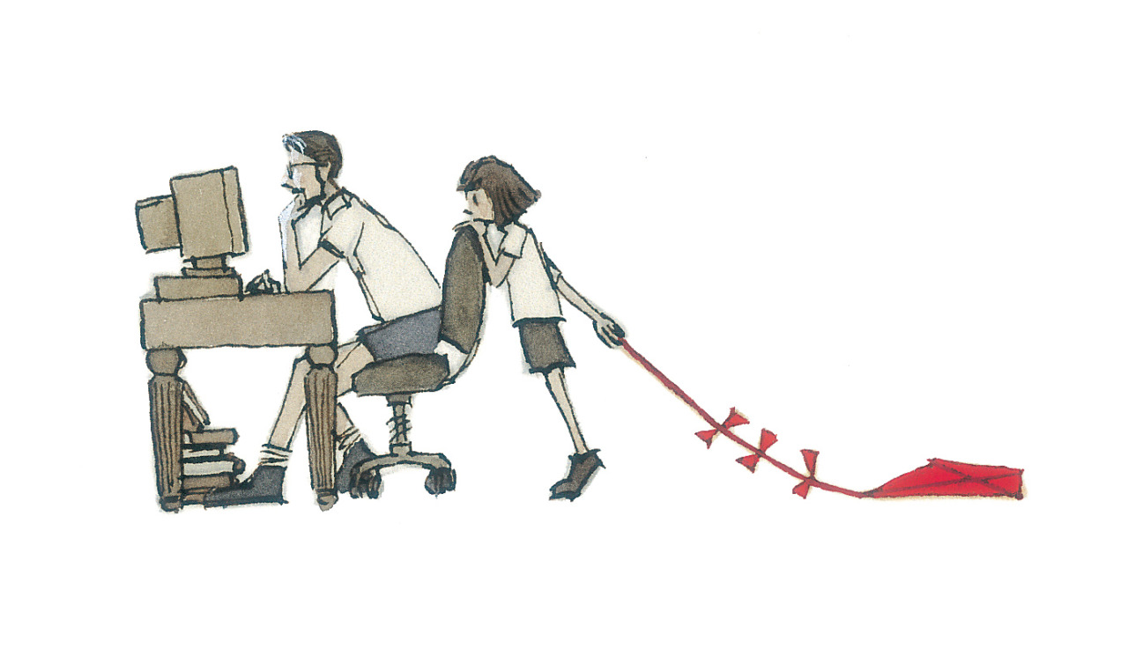
Look at the picture

Slide 3
Answer…
What is the dad doing?
Why is the girl standing behind him?
Why is she dragging a kite on the floor?
Has she said anything to him? Does he know she’s there?
How is she feeling? What is she thinking?
Do you think this has happened before? Why/why not

