Slide 1
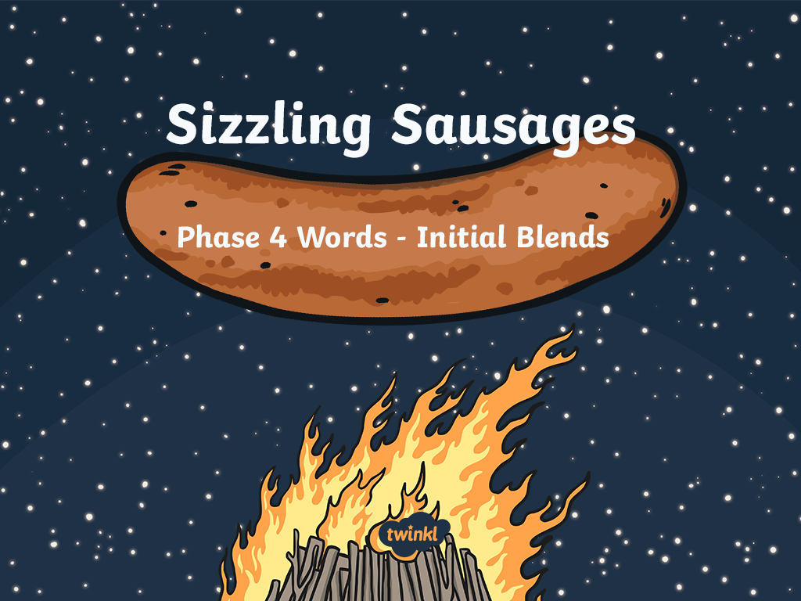

Slide 2
Guess the hidden 3 phoneme word on the sausage!
Round 1
Click the sausage to reveal a hidden letter or letters – can you guess what the word might be? Write down as many suggestions as you can.
Round 2
Click again to reveal another letter or letters. Write down your suggestions. How many words can you get now?
Check
Click the sausage again to reveal the hidden word. Score a point for each incorrect but possible word, and 3 points for guessing the correct answer!

Slide 3



pl
o
p

Slide 4
fr
o
m

Slide 5
st
o
p

Slide 6
pl
a
n

Slide 7
tr
i
p

Slide 8
tr
a
ck

Slide 9
sp
i
n

Slide 10
tw
i
n

Slide 11
sn
i
ff

Slide 12
dr
o
p

