Slide 1
Friday 3rd July
Guided reading

Slide 2
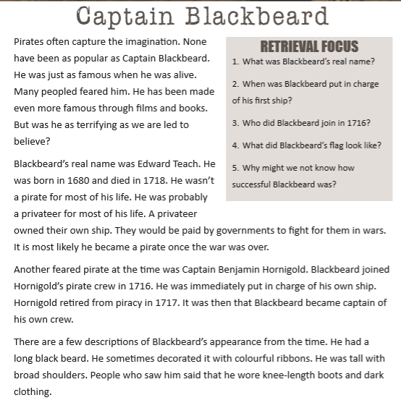
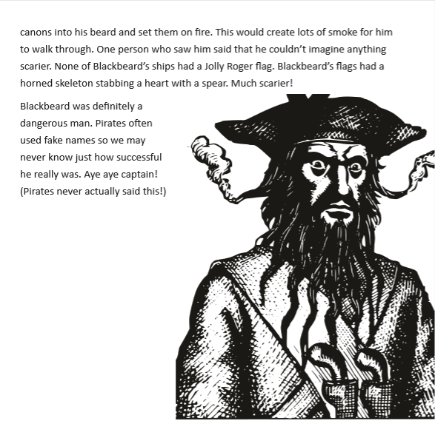

Slide 3
