Slide 1
Thursday 2nd July
Guided reading

Slide 2
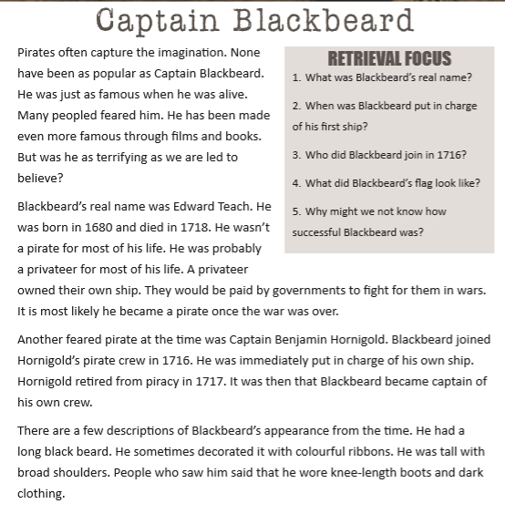
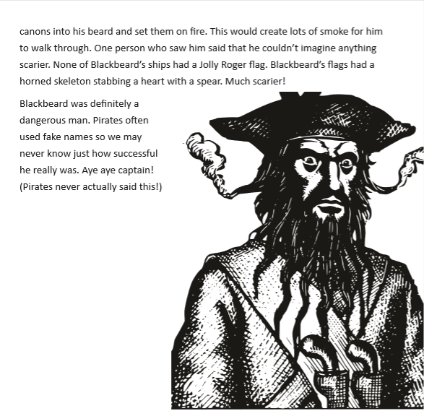
Read the text and answer the retrieval questions in your book.

