Slide 1
Wednesday 1st July
Guided reading

Slide 2
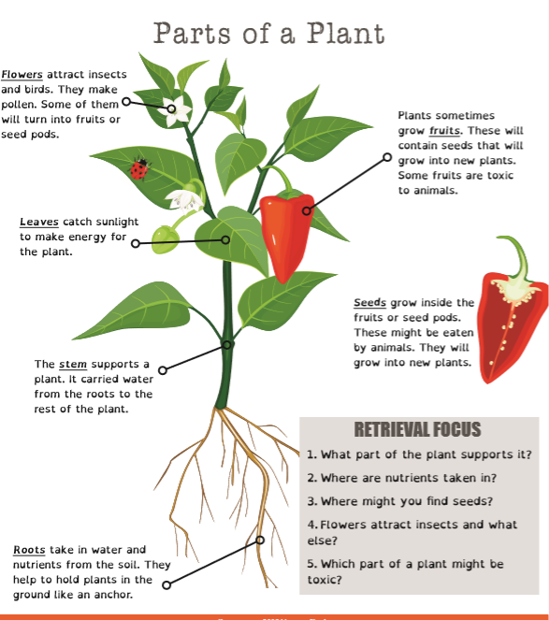
Answers
Stem
2. Roots
3. Fruit
4. Birds
5. Fruit

