Slide 1
Wednesday 1st June
Guided reading

Slide 2
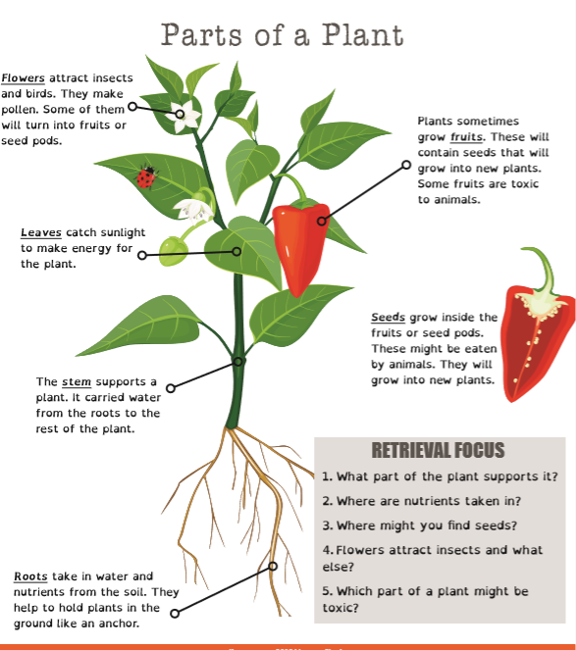
Read the information and answer the retrieval questions in your book.

