Slide 1
Tuesday 30th June
Guided reading answers

Slide 2

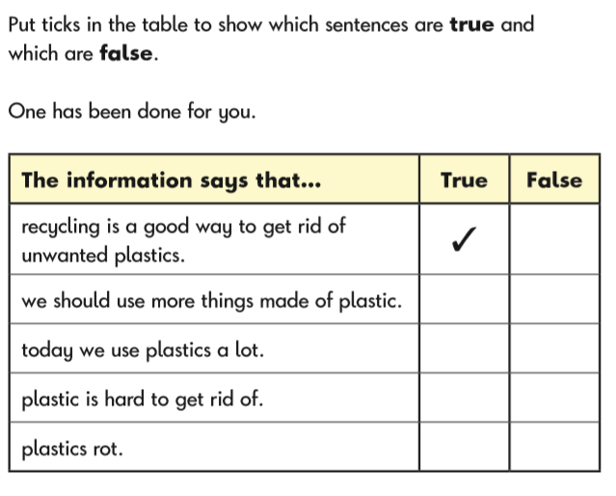

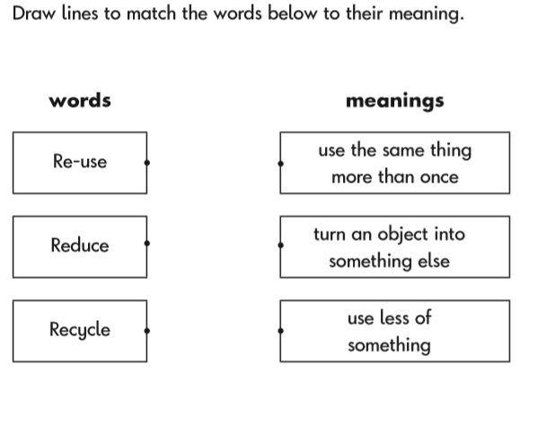
Donated
Bags, bottles, clothing

