Slide 1
Tuesday 30th June
Guided reading

Slide 2
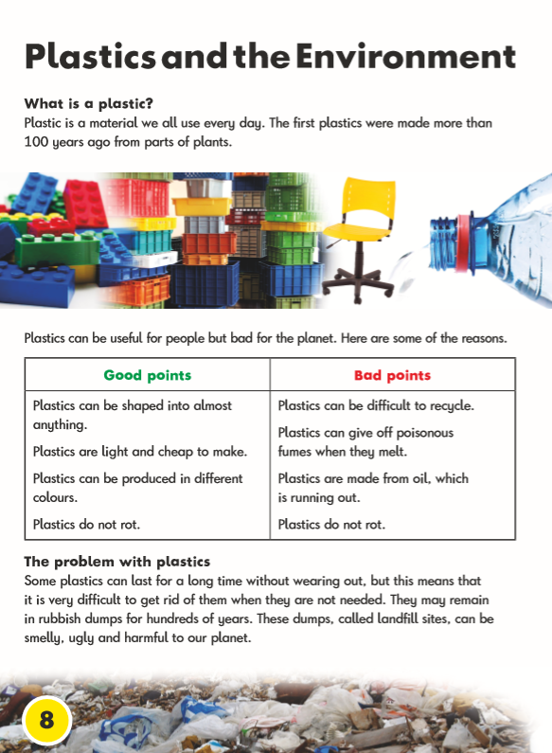


Slide 3


