Slide 1
Monday 29th June
Guided reading answers

Slide 2
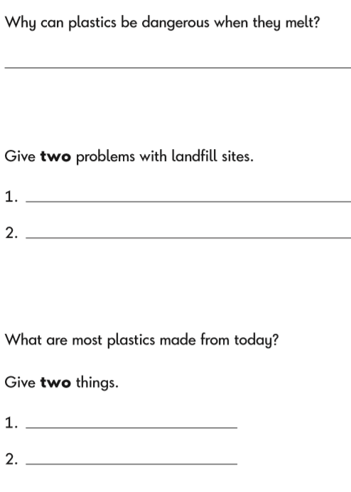

They are poisonous and give off fumes.
More than 100 years ago.
Ugly, smelly, harmless to the planet
Any shape
Many colour
Oil
Coal
Gas

