Slide 1
Monday 29th June
Guided reading

Slide 2
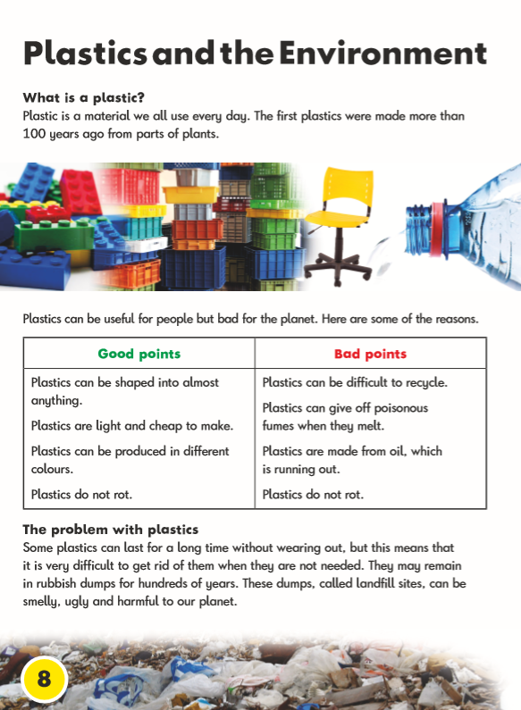


Slide 3
