Slide 2

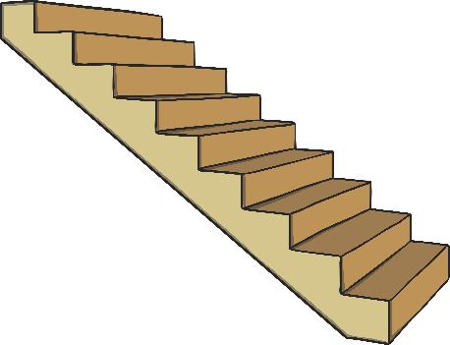

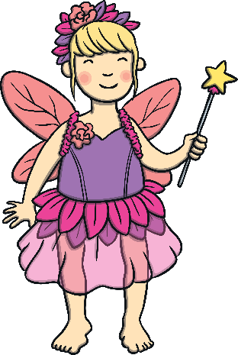

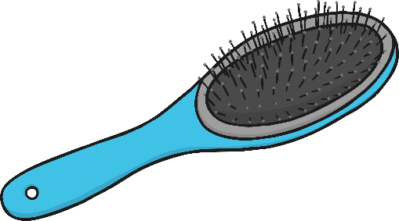
Click the pictures that contain the ‘air’ sound to move them into the middle.
air

Slide 3






Click the pictures that contain the ‘ure’ sound to move them into the middle.
ure

Slide 4






Click the pictures that contain the ‘er’ sound to move them into the middle.
er

Slide 5


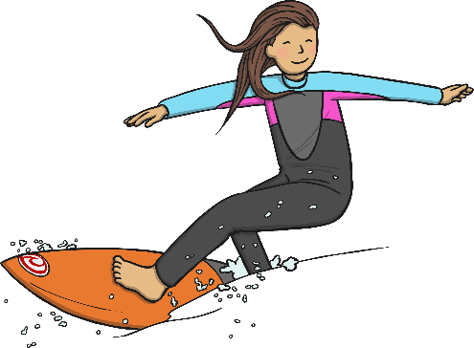

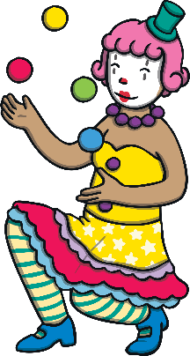


ur
oi
air
er
ow
ear
ure

