Slide 2
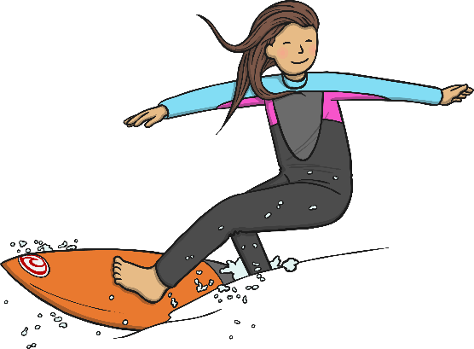
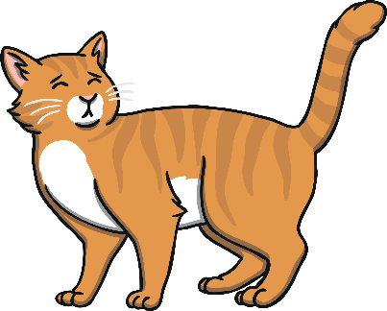

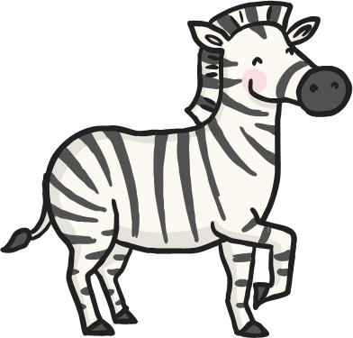


Click the pictures that contain the ‘ur’ sound to move them into the middle.
ur

Slide 3
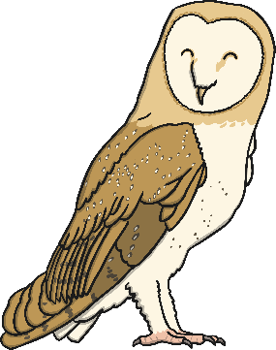
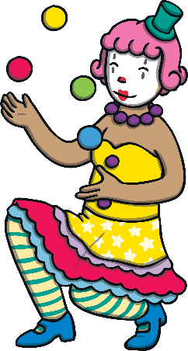

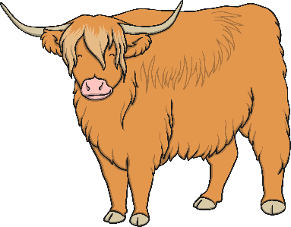


Click the pictures that contain the ‘ow’ sound to move them into the middle.
ow

Slide 4



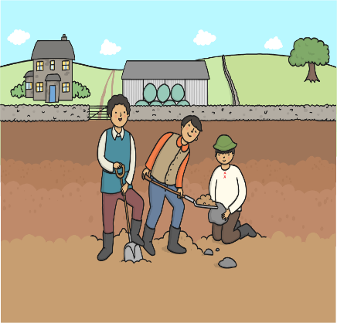


Click the pictures that contain the ‘oi’ sound to move them into the middle.
oi

Slide 5

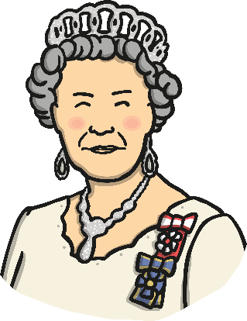


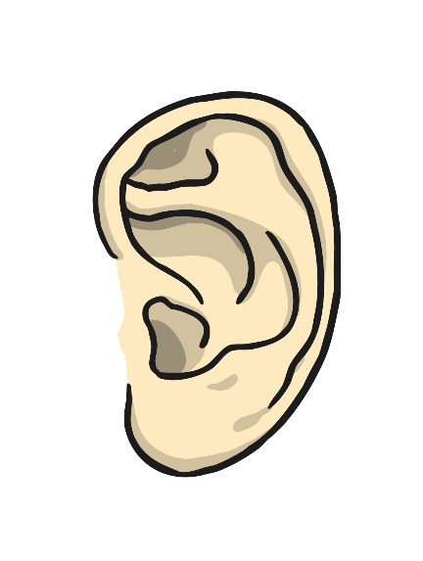

Click the pictures that contain the ‘ear’ sound to move them into the middle.
ear

