Slide 1
Formby

Slide 2
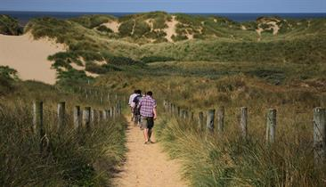
Coastal path through the sand dunes

Slide 3
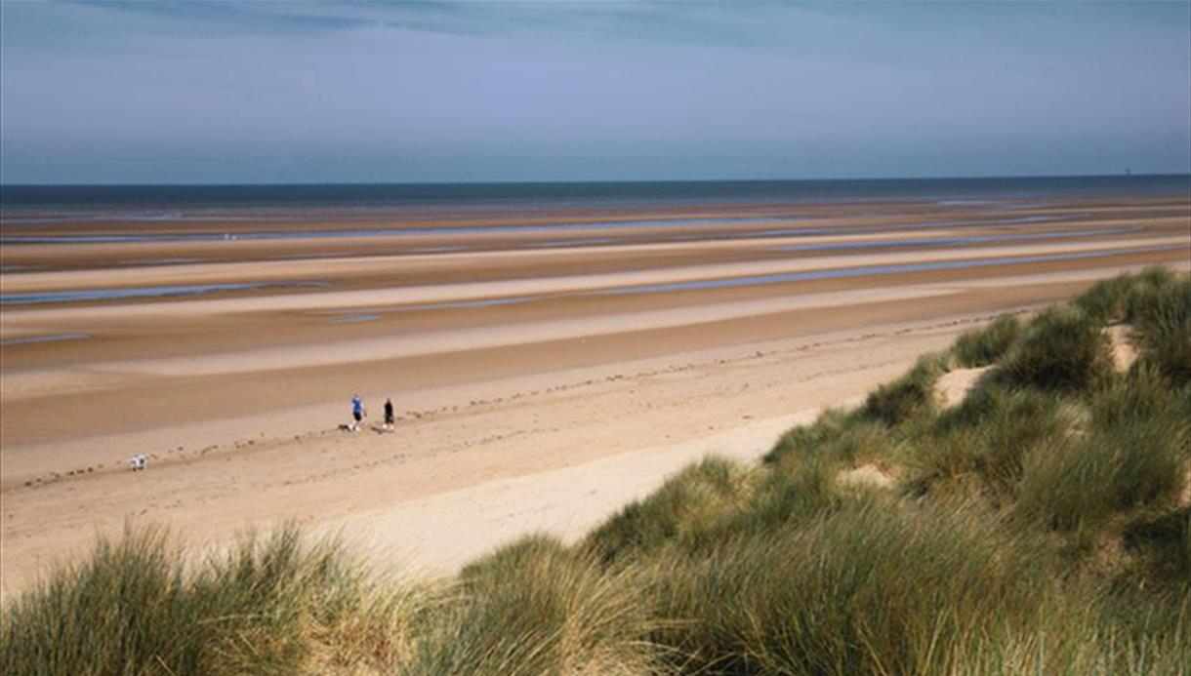
Long flat beach

Slide 4
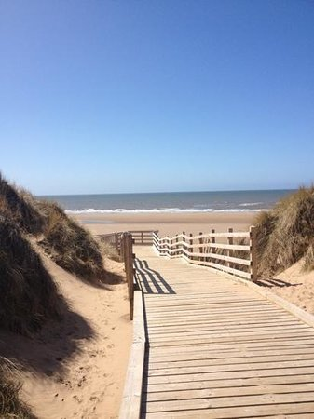
Decked path for easy access over the sand

Slide 5
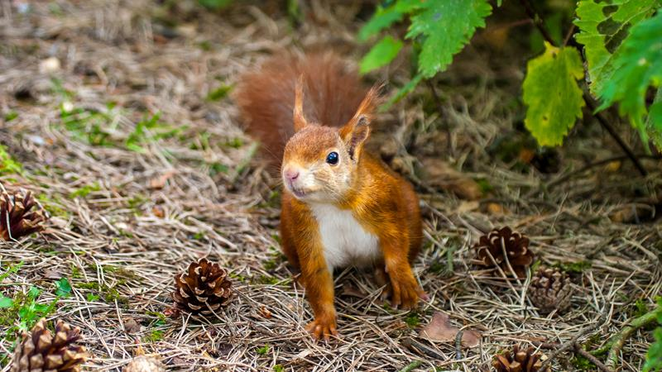
Red squirrel nature reserve

Slide 6
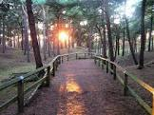
Forest trails

Slide 7
Blackpool

Slide 8
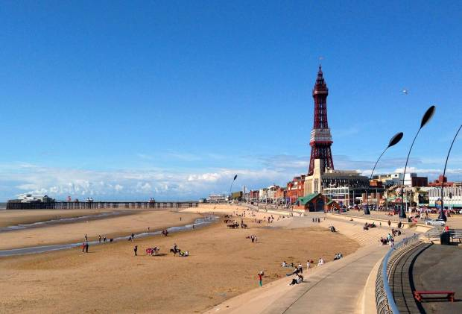
Blackpool beach next to the town

Slide 9
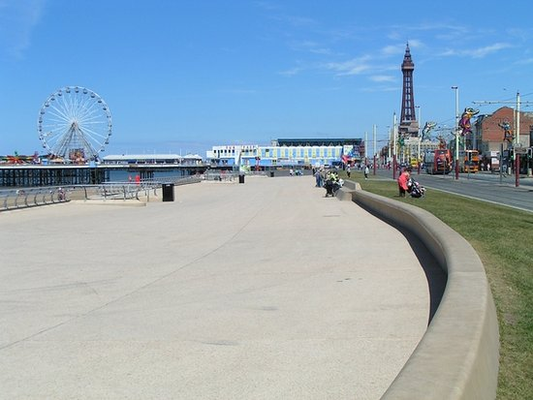
The Promenade and Tower

Slide 10
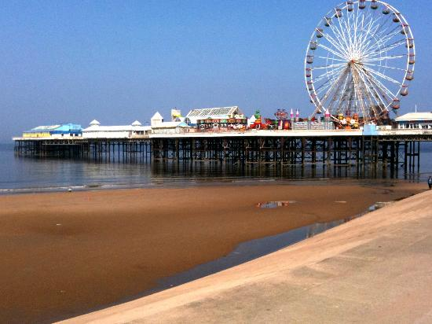
The pier

Slide 11
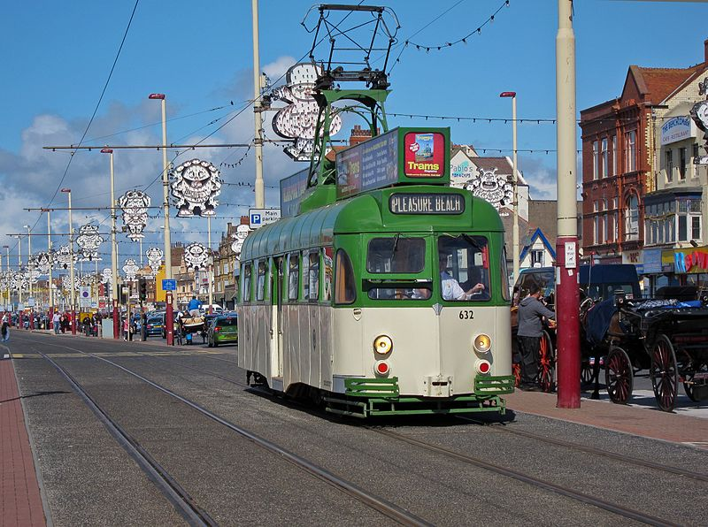
Trams along the promenade

Slide 12
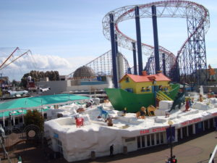
The Pleasure beach funfair

Slide 13

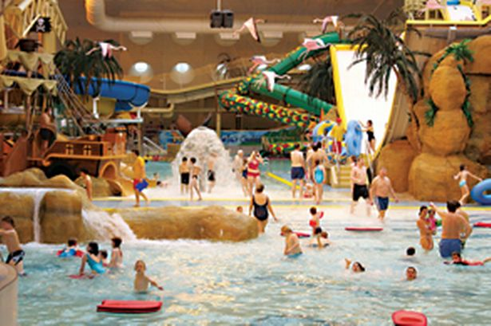
Sea life Centre and Sandcastle swimming centre

