Slide 1
Monday 22nd June
Guided reading

Slide 2
Portrait of a Dragon
If I were an artist
I’d paint the portrait
Of a dragon.
To do a proper job
I’d borrow colours from the world.
For his back I’d need a mountain range,
All misty blue.
For spikes I’d use dark fir trees pointing to the sky.
For overlapping scales
I’d squeeze dye from bright anemones.
I’d gild his claws
Like shining swords
With starlight.
His tail would be a river, silver in the sun.
For his head, the secret green of forests and deep seas.
And his eyes would glow like embers in a fire.
But I’d keep the best till last. For his hot breath
I’d use all reds and yellows-crocus, saffron, peony, poppy,
And fierce orange flames from a marigold.

Slide 3
Read the poem describing the dragon twice.
Do you like the poem?
Explain your answer.
I have made a word bank of some of the tricky words from the poem to help you.

Slide 4
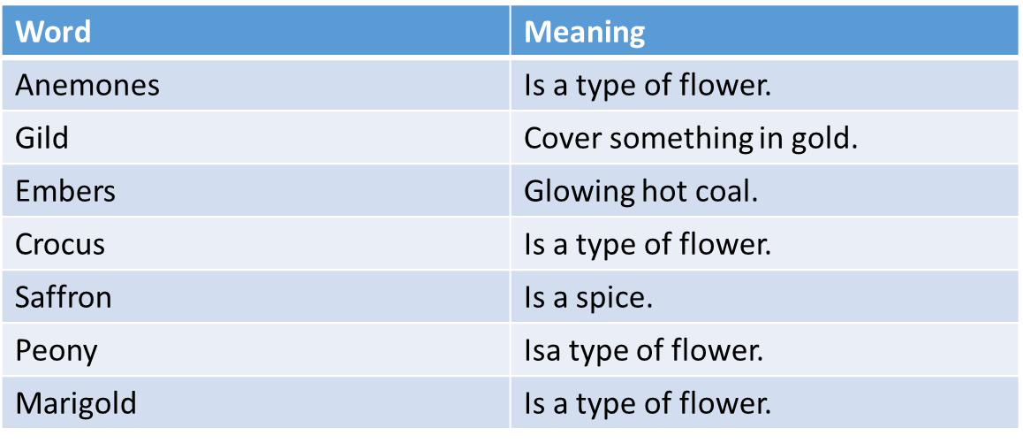
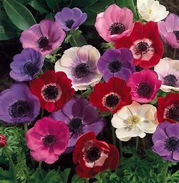
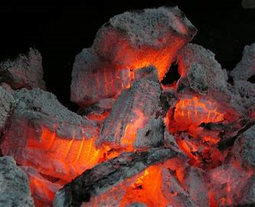
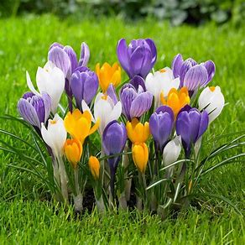
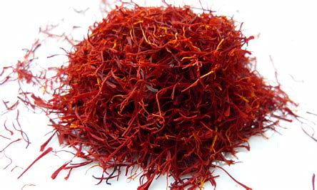
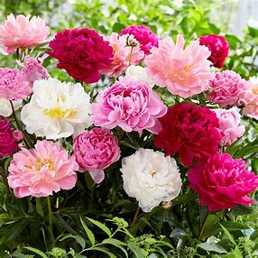
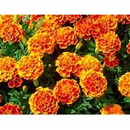
Embers
Anemones
Saffron
Marigold
Crocus
Peony

