Slide 1
Monday 22nd June
English

Slide 2
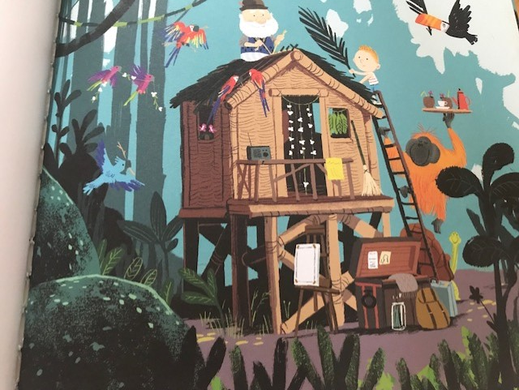
Look at the image from the book.
Around Grandad and Syd are lots of animals that live in the jungle.
Pick one and research it.

Slide 3
Find out..
Where it lives
What it eats
How long it lives for
Amazing and interesting facts about it
Write these down on a scrap piece of paper ready for tomorrow.

