Slide 1

Tuesday 12th May 2020
This week we will be linking our Literacy work to a wonderful story called ‘Grandad’s Island’ by Benji Davies.
Please watch/read it together: https://www.youtube.com/watch?v=vqDtPXeV7cU

Slide 2
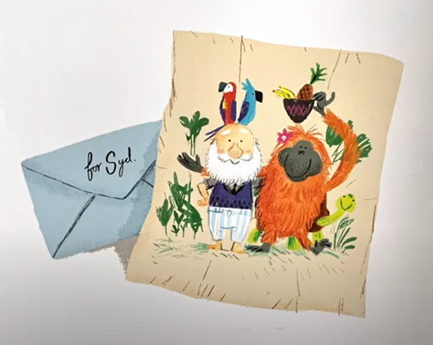
At the end of the story there is a letter addressed to Syd. It has a picture on it.
What can you see on the picture?
What do you think the letter says on the other side?
Who do you think it’s from?

Slide 3
Literacy Activity
Using those brilliant ideas, we would like you to write the letter that might on the other side of the paper.

Slide 4
Literacy Activity
Green: Write a letter that starts with ‘Dear’ and ends with ‘From’. Include one message/sentence in your letter.
Amber: Write a letter that starts with ‘Dear’ and ends with ‘From’. Include two or three messages/sentences in your letter.
Red: Write a letter that starts with ‘Dear’ and ends with ‘From’. Include three or more messages/sentences in your letter.

Slide 5
Literacy EXAMPLE
To Syd
This is a picture of me and my animal friends.
We have been very busy building a new shack.
I am missing you lots and lots.
From
Grandad x

