Slide 1
The four operations
Today we are going to be completing some retrieval practice looking at some of our arithmetic.
I have included images over the next four slides to act as a reminder on the written methods for +, -, x and ÷.

Slide 2
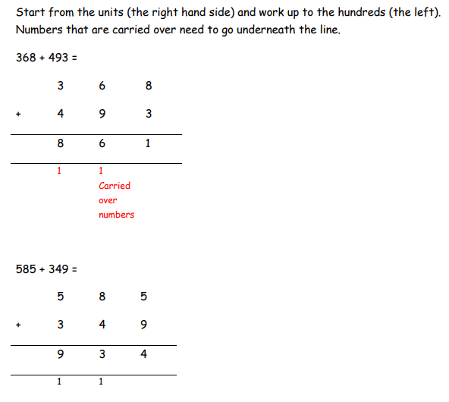
Addition

Slide 3
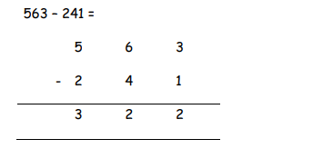
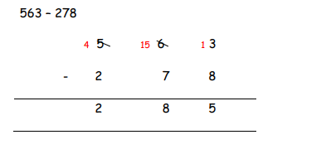
Subtraction

Slide 4
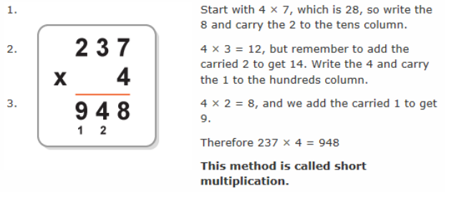
Multiplication

Slide 5
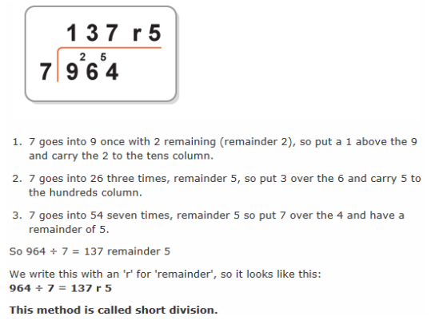
Division

