Slide 1
Thursday 14th May
English

Slide 2
Lets get creative…
Today you are going to come up with your own characters for your own story!
Hilda has three little monkeys but what animals might your character have for pets?
Think about cheeky animals that can get into mischief!
For example- gorillas, sheep, or tigers.

Slide 3
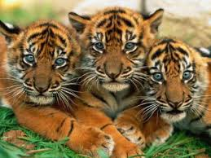
I have picked tigers for my story.
Now, draw your three little animals for your story and write words around them that describe what they are like.
Brave
Loud
Hungry
Playful

Slide 4
I have picked tigers for my story.
In a different colour, write ideas around them of what they do when they’re up to mischief.
Scratch and claw.
Pounce and jump.
Brave
Loud
Climb.
Hungry
Playful

