Slide 1
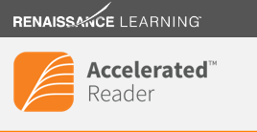
Reading has changed!
Are you ready?

Slide 2
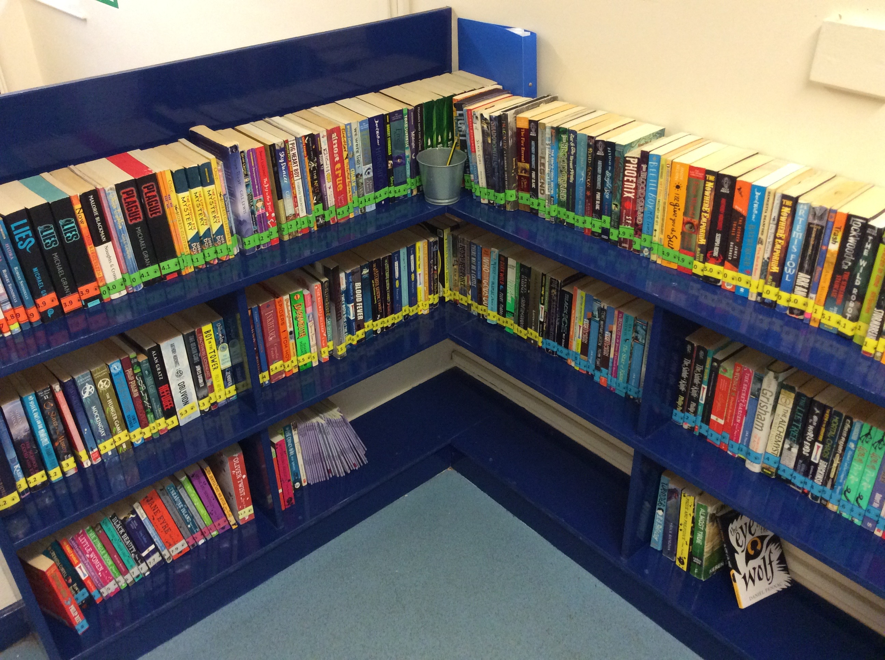
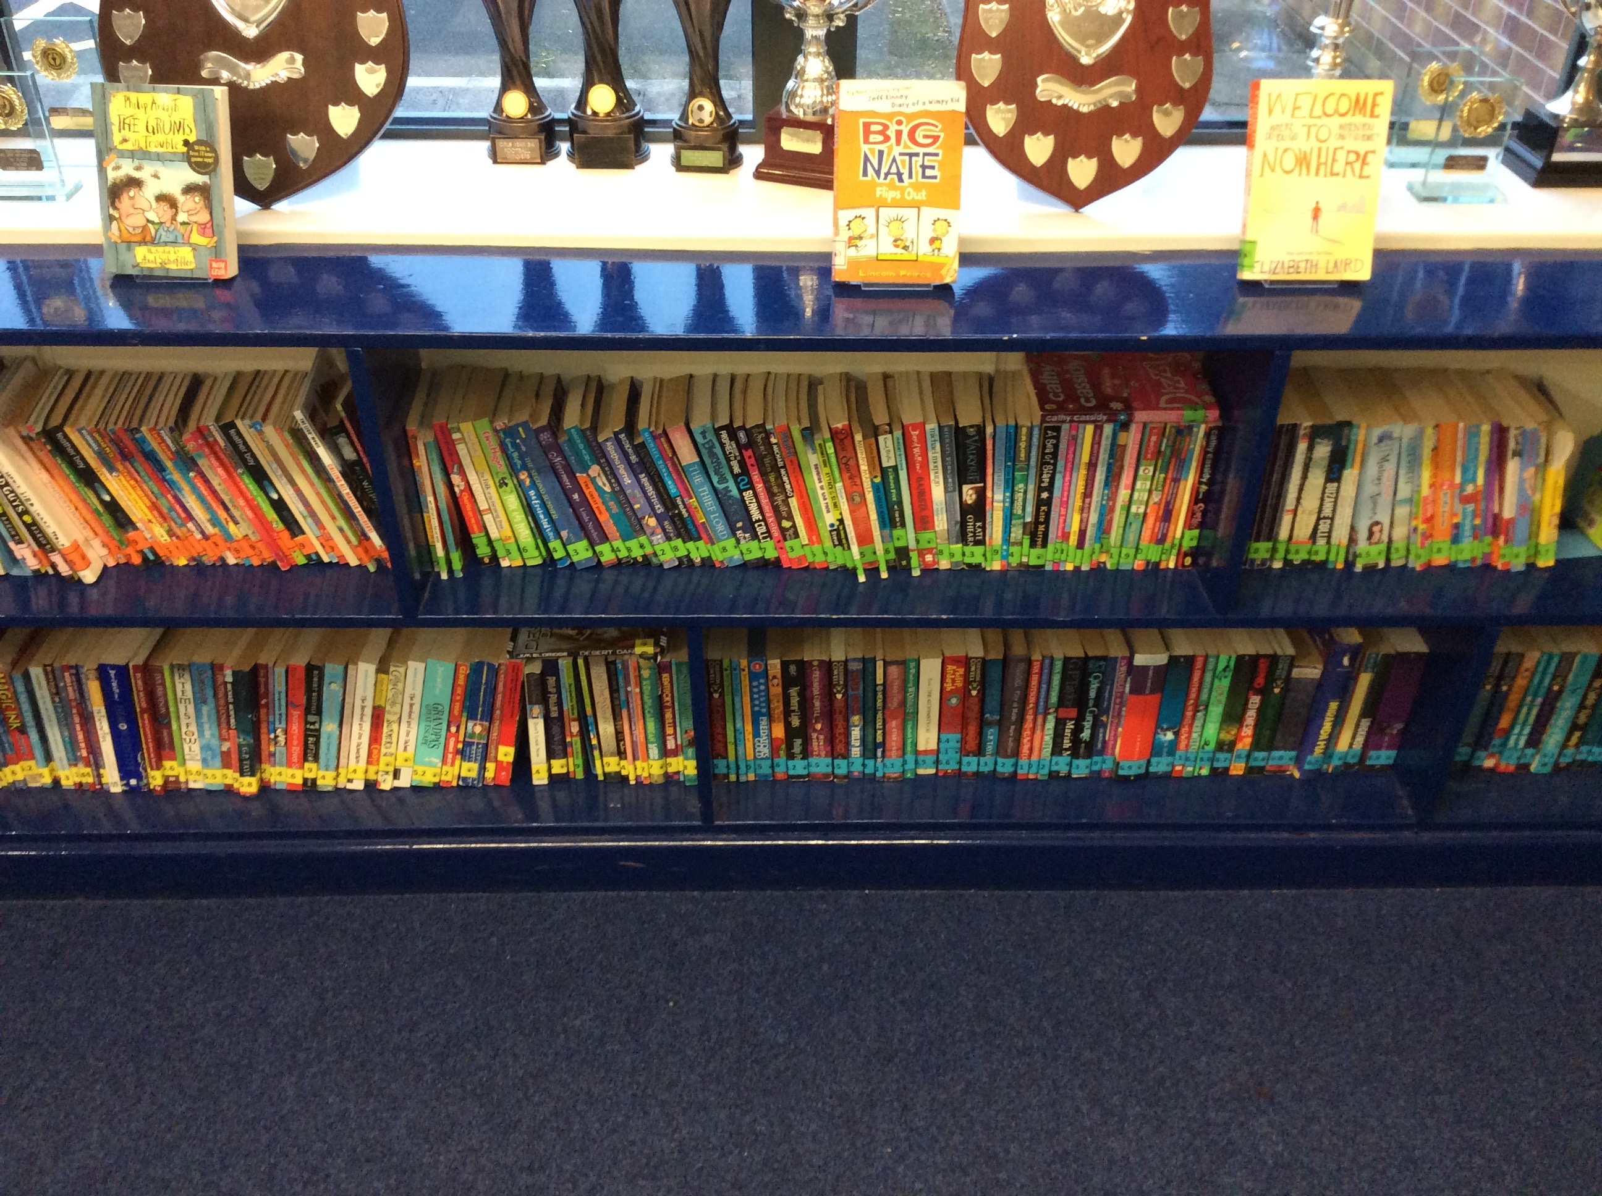
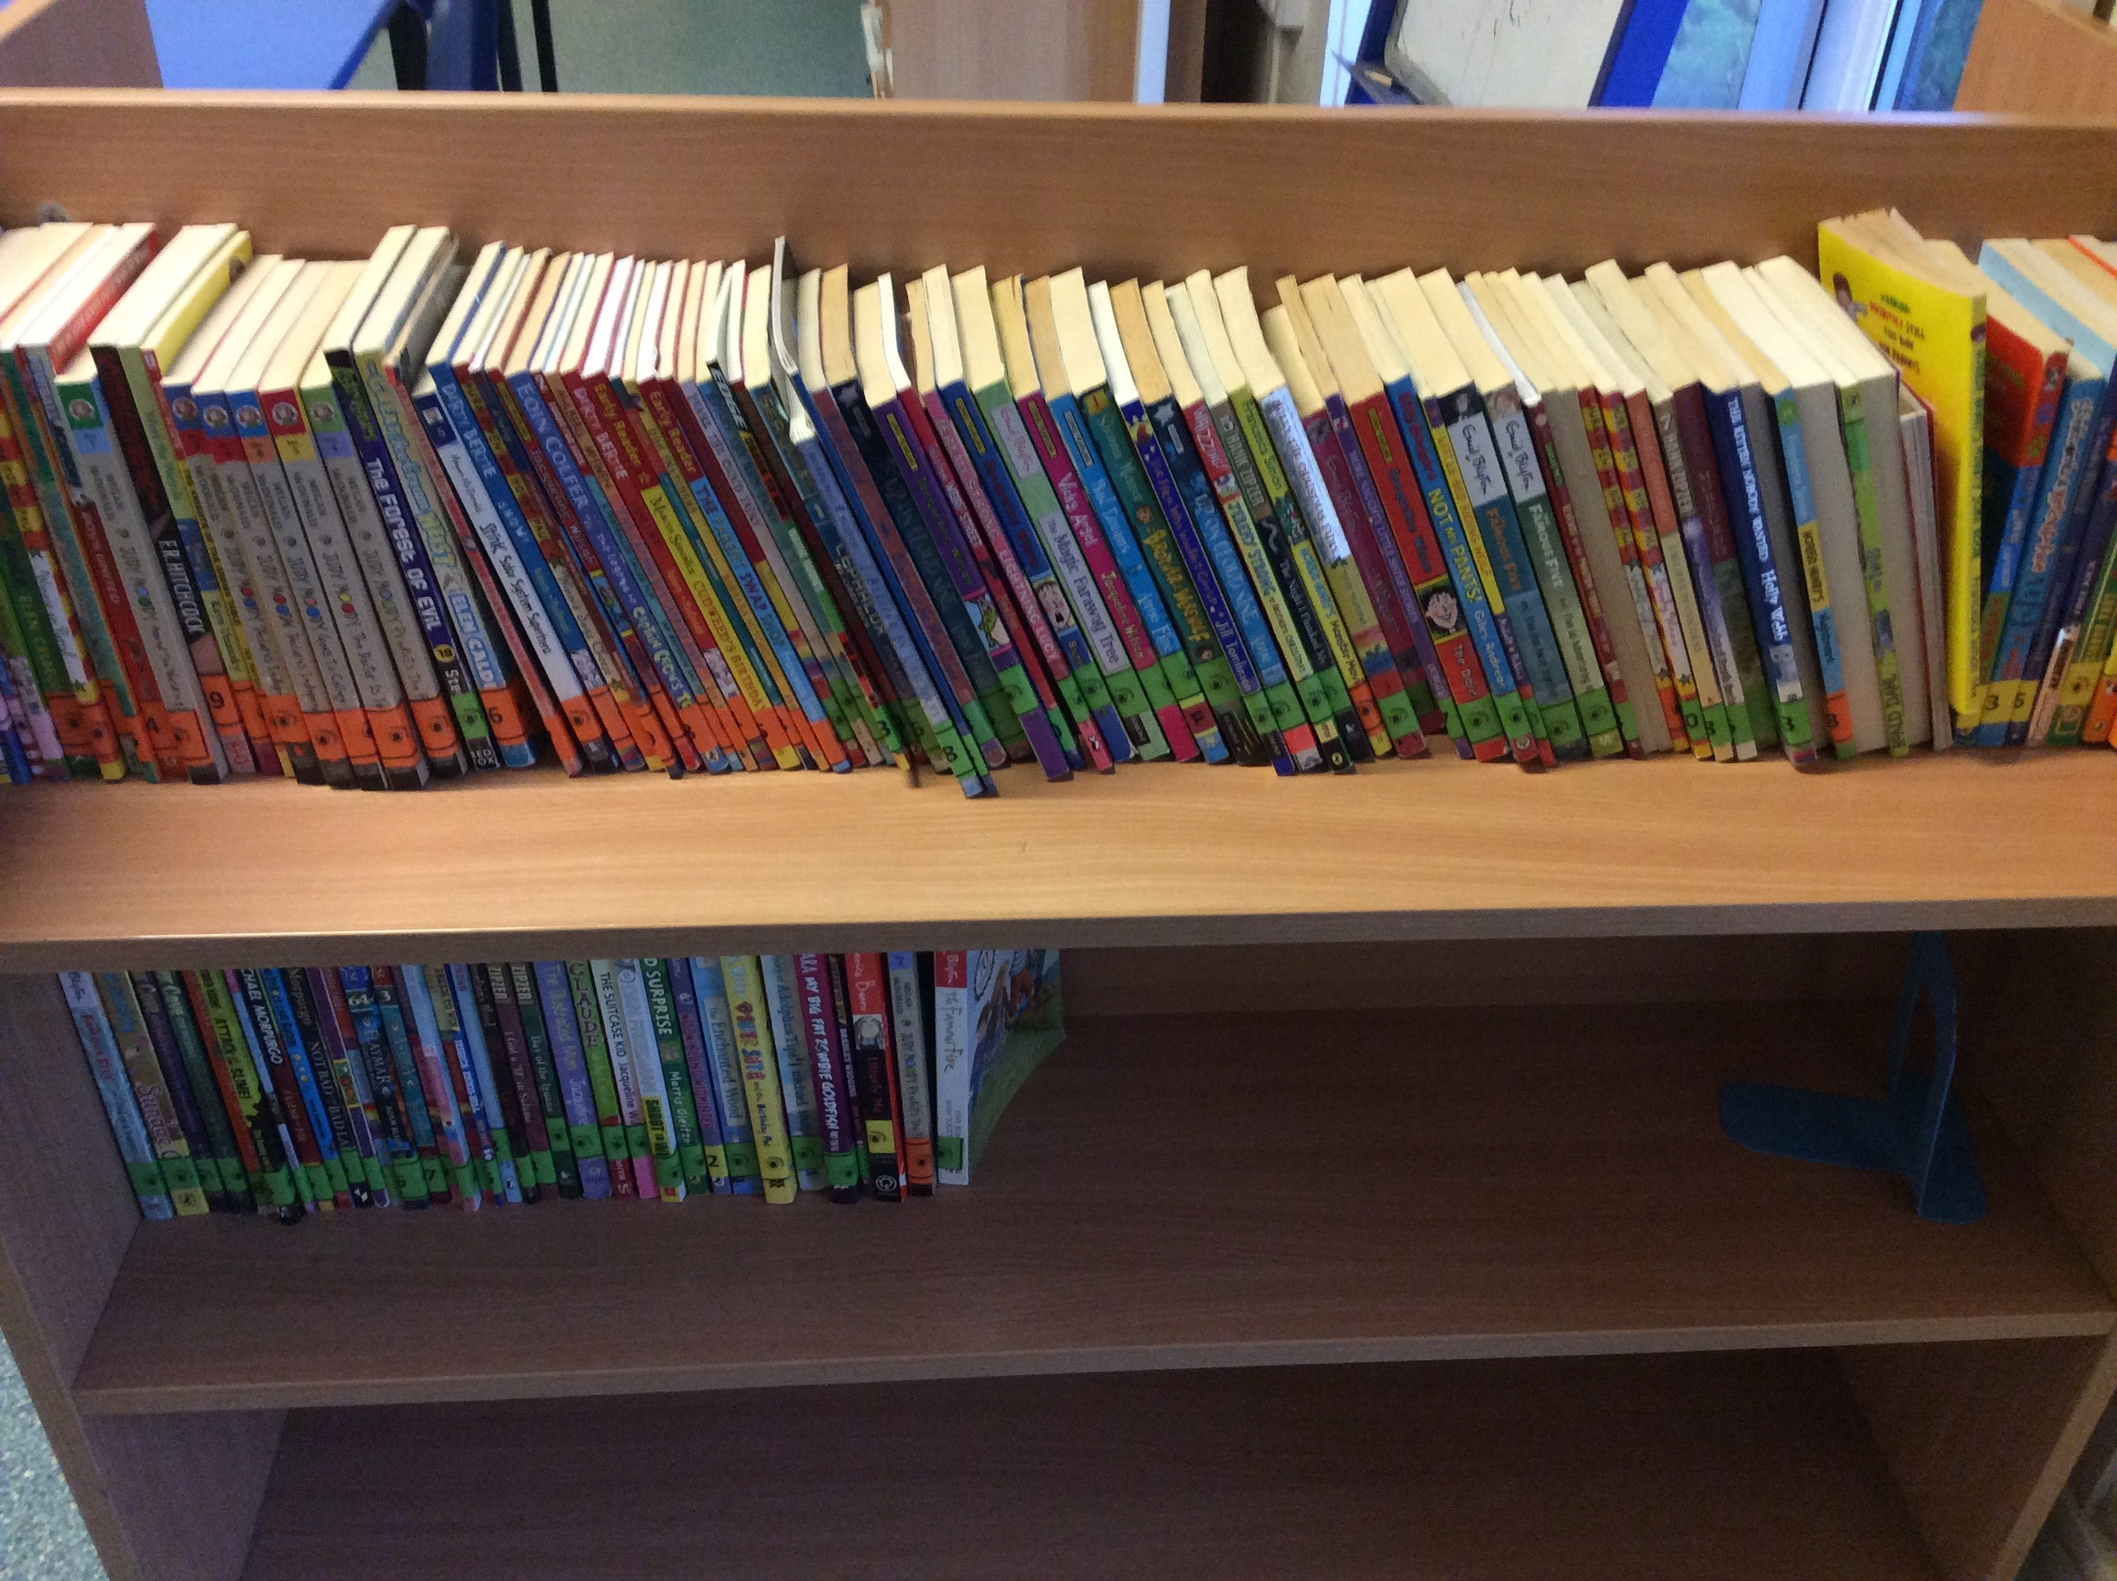
Beautiful book cases

Slide 3

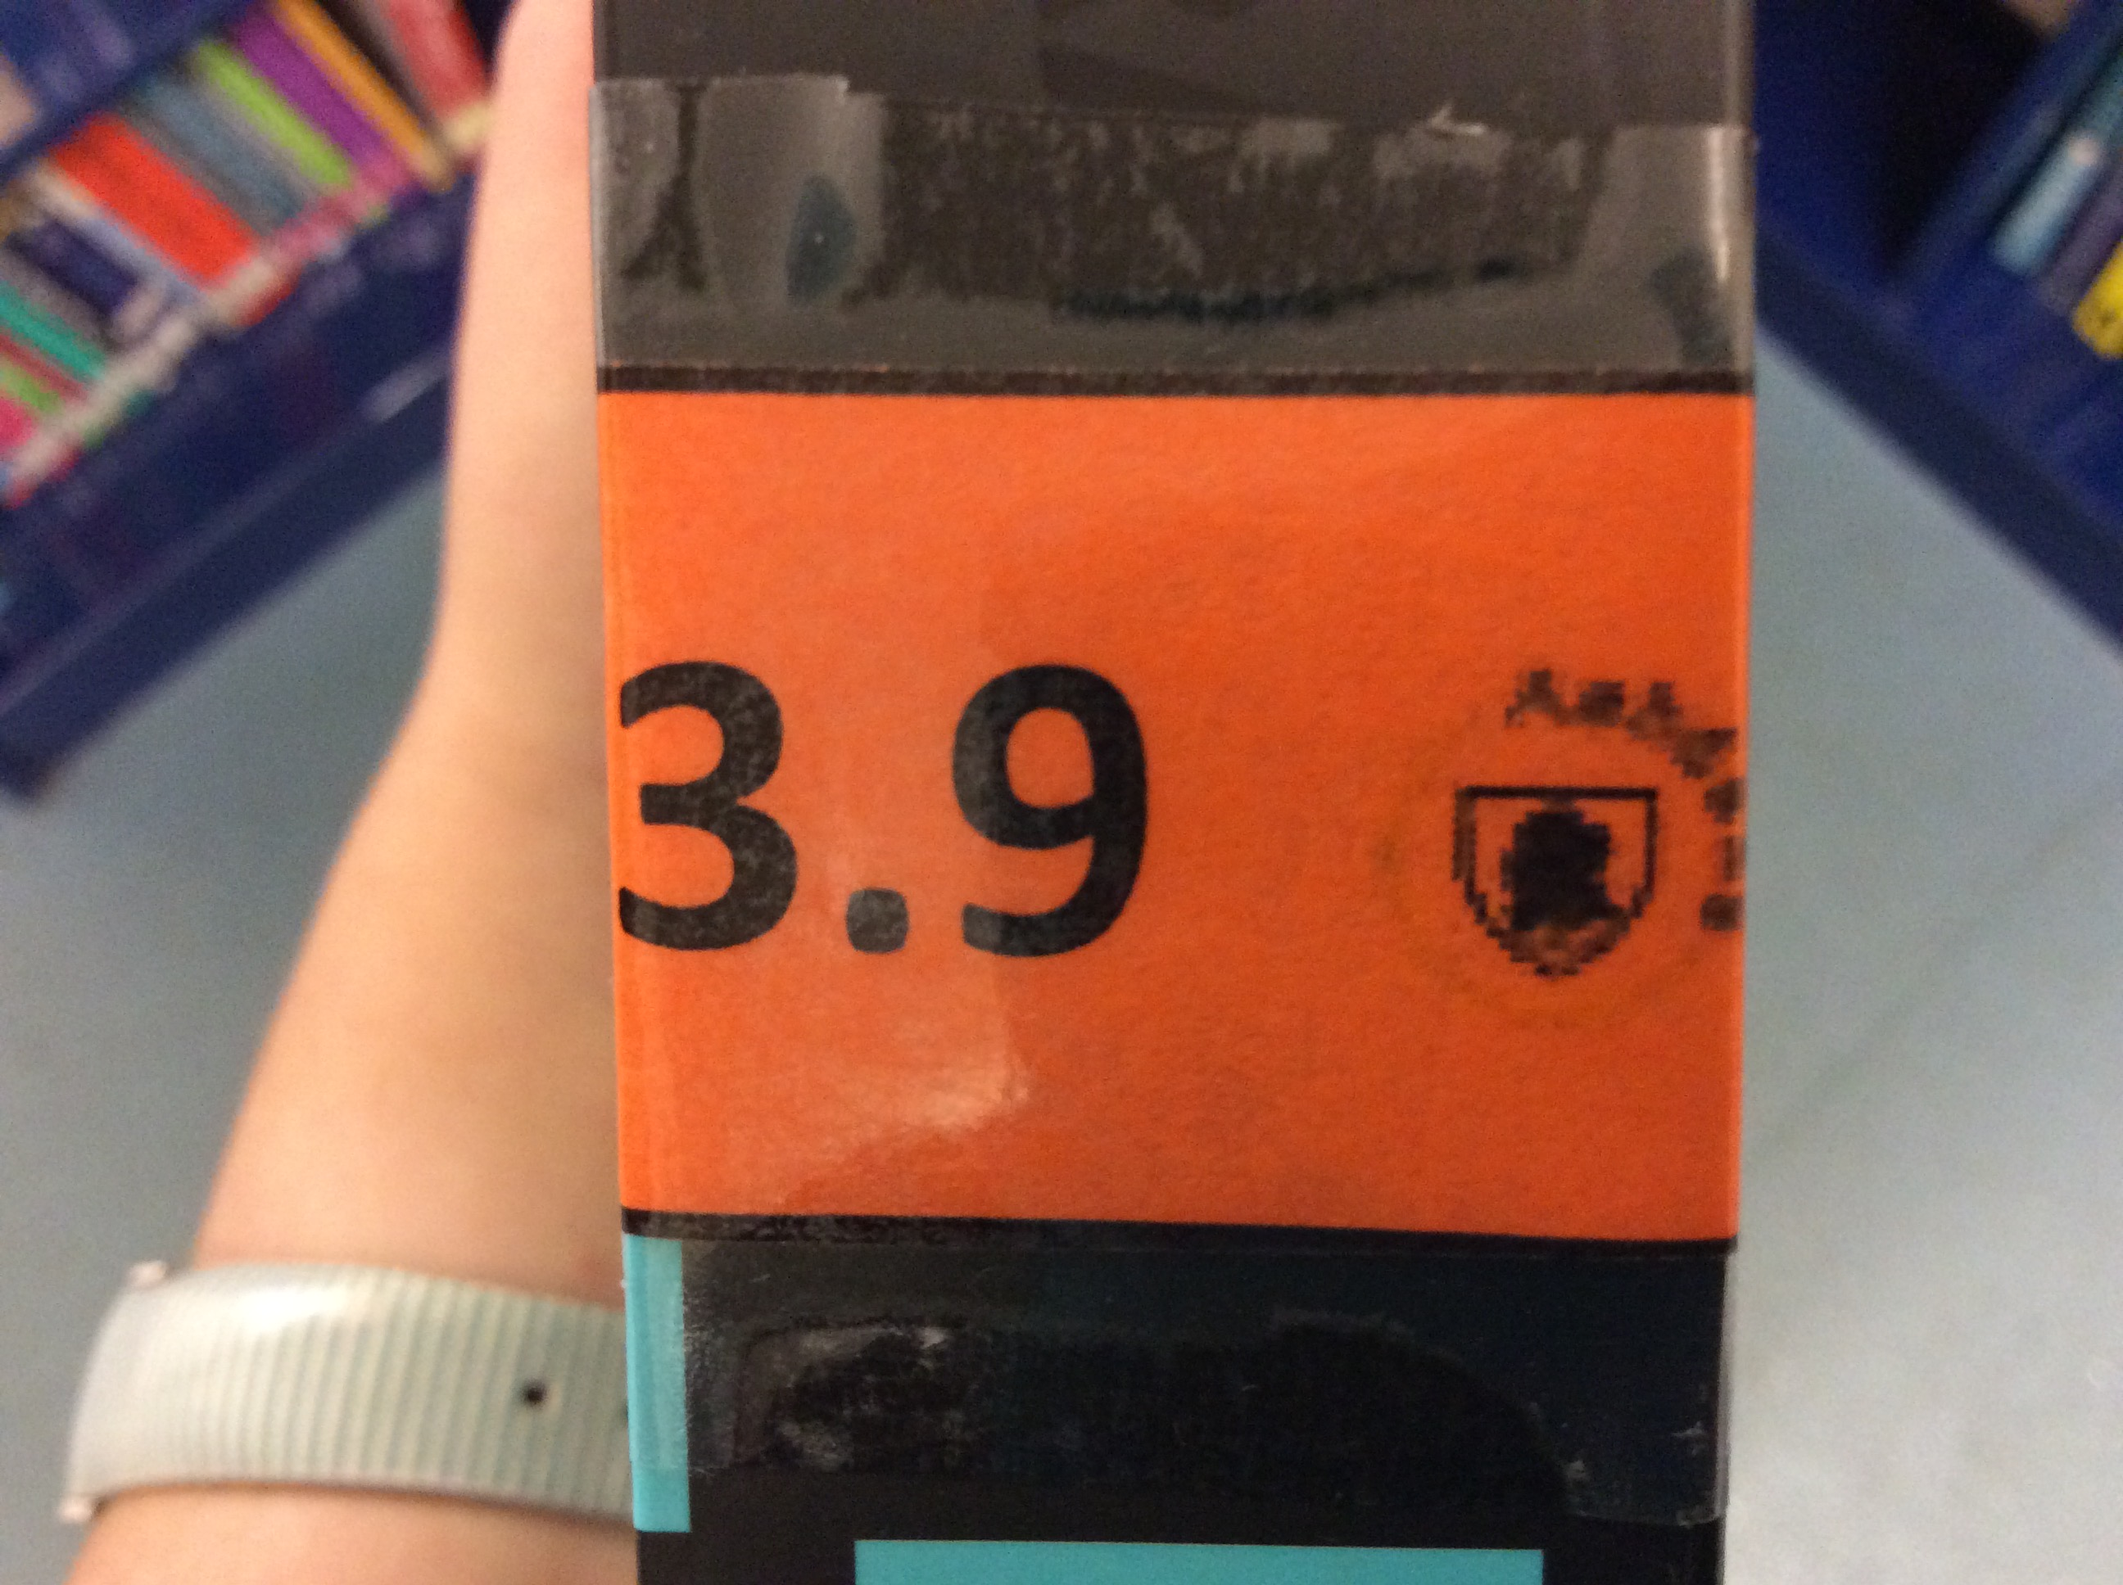
Helping you choose
Each book has a coloured label on the side
01
Your ZPD tells you which books you should read. E.g. 2.3-3.7
02
Still plenty of choice! We will make sure each number has plenty
03
You WILL be able to understand the words and the story
04
You still get to choose the book YOU WANT TO READ!
05

Slide 4

Once you’ve chosen a book
Read
Read it!
Keep
Keep it in your school bag
Home
Take it home to read at night and on weekends and bring it to school each day
Share
You can read it independently, with an adult, brother or sister and with your teacher in school
Return
PLEASE look after it and return it in the same condition

Slide 5
I’ve finished my book!
Its quiz time!
Once you have finished your book you will do a short quiz to see how much you can remember about the story and the characters
You earn points for every answer you get right
Prizes (which are detailed later) up for grabs for the biggest points scorer

Slide 6
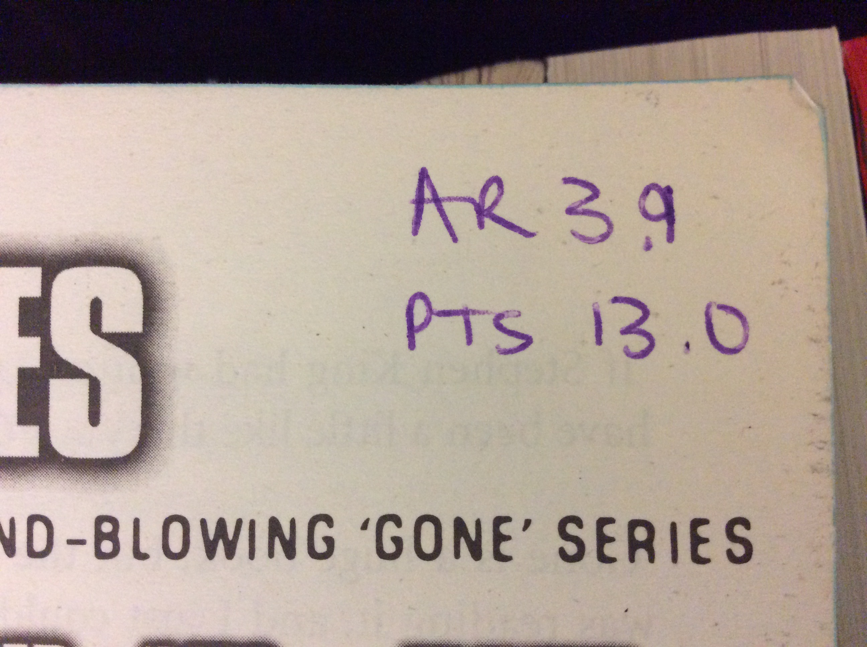
How many points can I score?
Inside the cover of EVERY labelled book is a code.
AR = the ZPD code for that book.
E.g. 3.9
PTs= points available from the quiz.
E.g. 13pts
The bigger the book; the more points available in the quiz

Slide 7
when do I quiz?
As soon as possible once you’ve finished your book!
On an i-pad from your classroom
In Guided Reading OR straight after lunch
You can only quiz whilst you’re in school

Slide 8
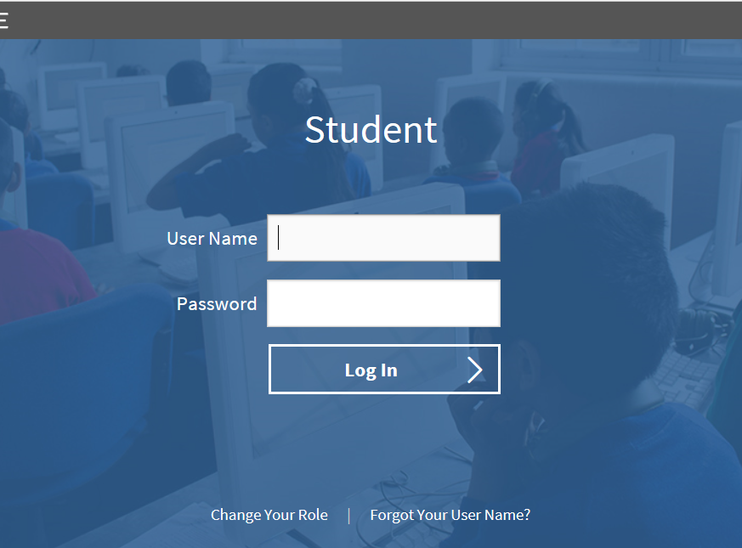
How do I quiz?
Log in to our special website

Slide 9
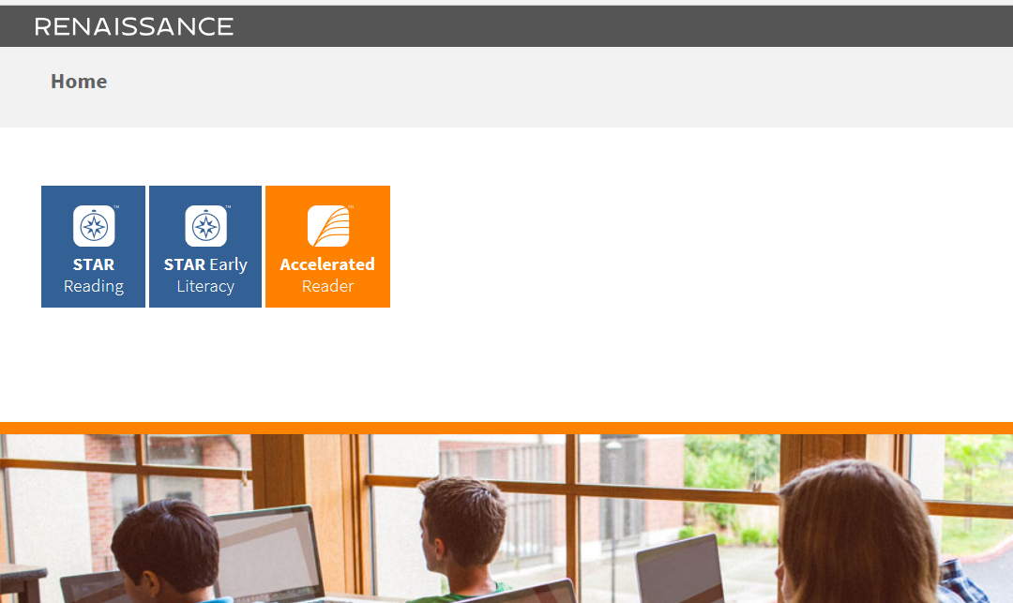
Click on ‘Accelerated Reader’

Slide 10
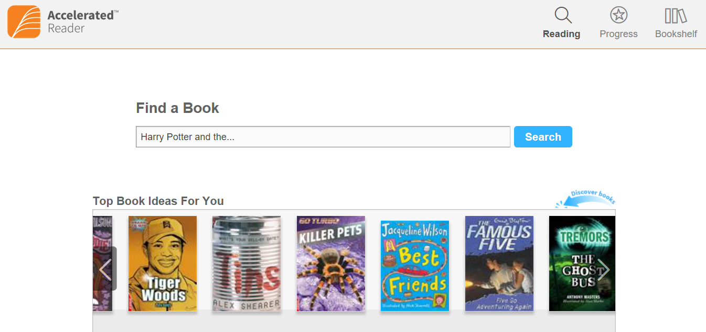
Type in the title of your book and search

Slide 11
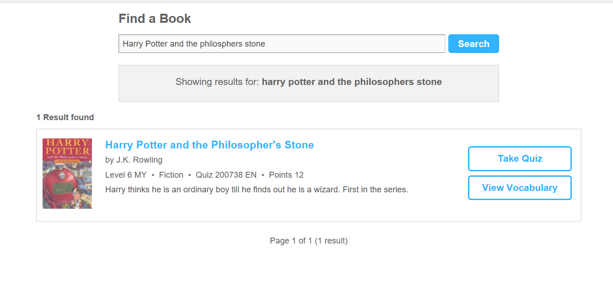
Take quiz!
This one is worth 12 points

Slide 12

Competition time!
Weekly class top 10 (most points scored)

Slide 13


Competition time!
At Christmas (9 weeks away) the top 10 highest scorers from every class will
Receive Christmas treats!
2) Be in with a chance of winning Amazon vouchers!

Slide 14

Competition time!
The child in each class who has improved the most with their reading will also receive a special prize

Slide 15
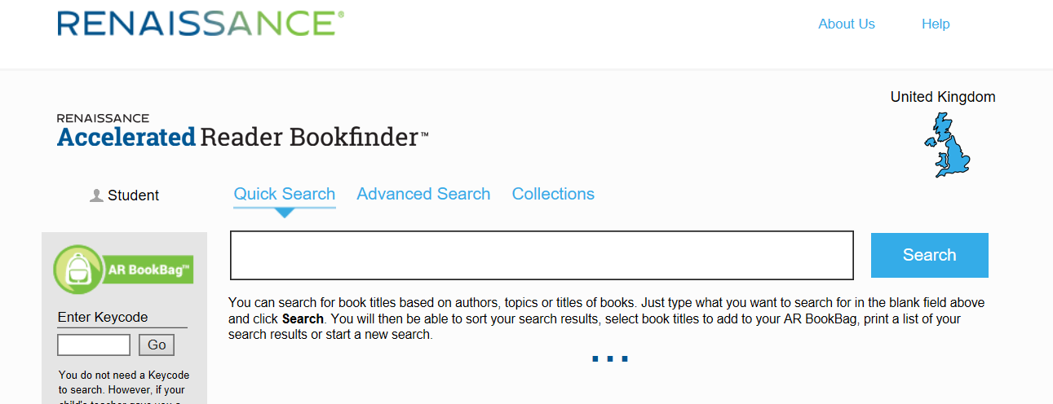
Buying a book for yourself?
Use www.arbookfind.co.uk to see what ZPD code it is.
Search for a specific book
Search for books in your ZPD

