Slide 1
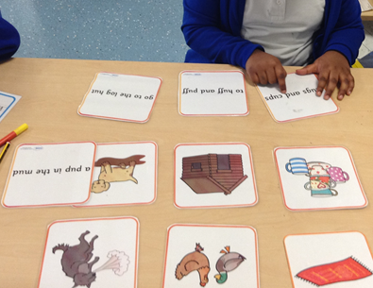
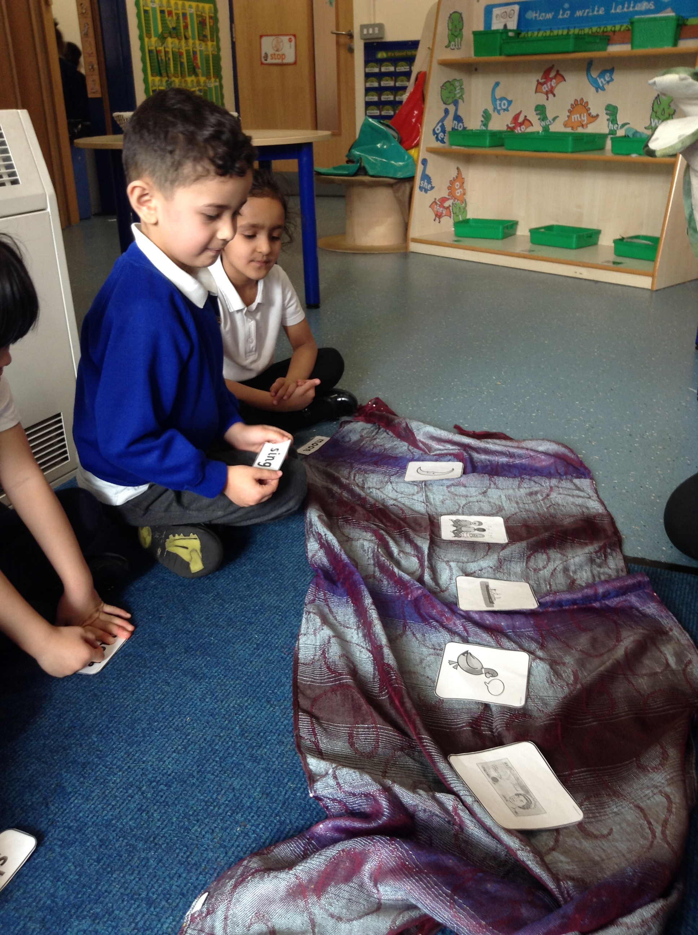
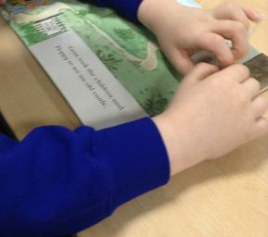
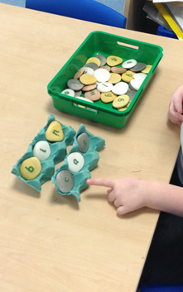
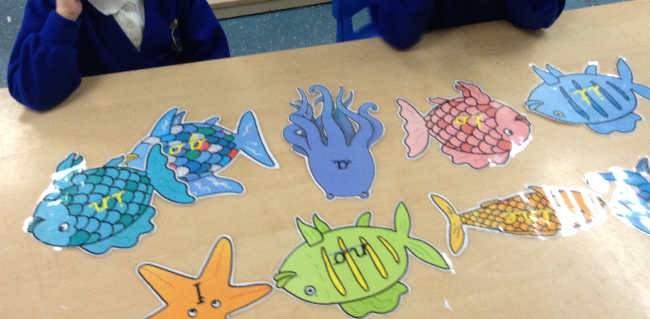
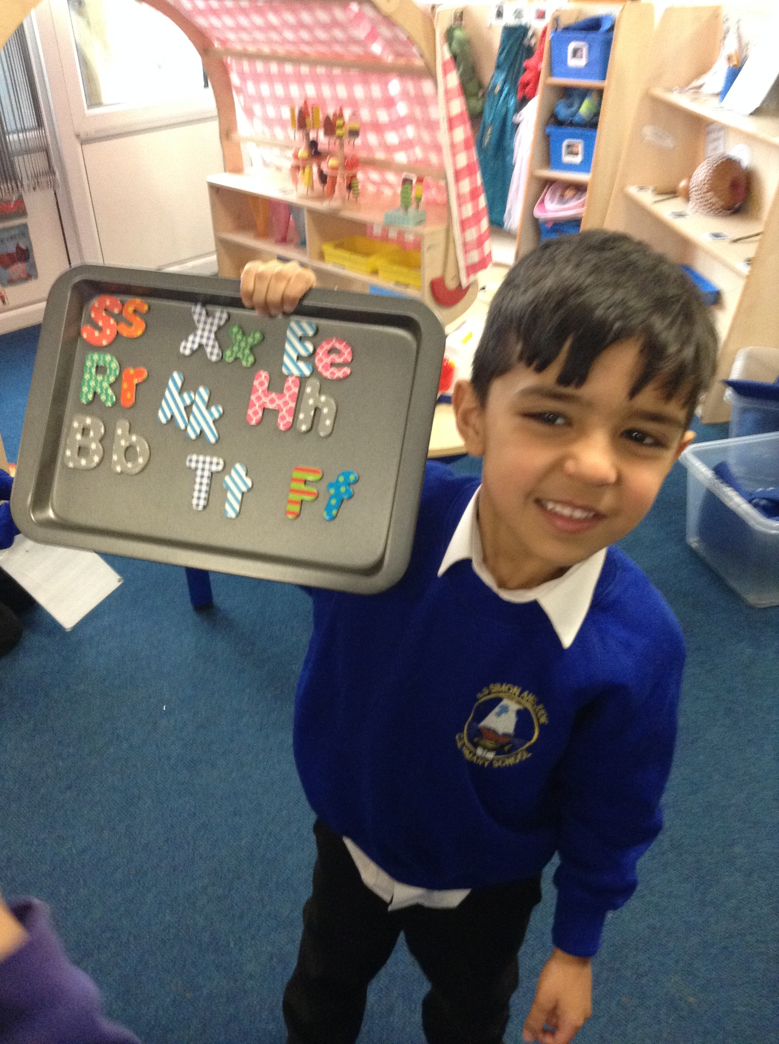

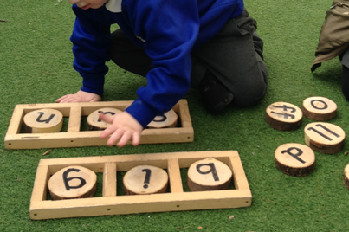
Phonics At home
A parent friendly guide

Slide 2
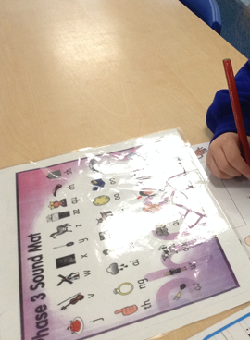
Why are we here?
To :
Help you understand what phonics is and why it is so important.
Learn new words that your children use and what they mean.
Support your children at home with their learning.

Slide 3
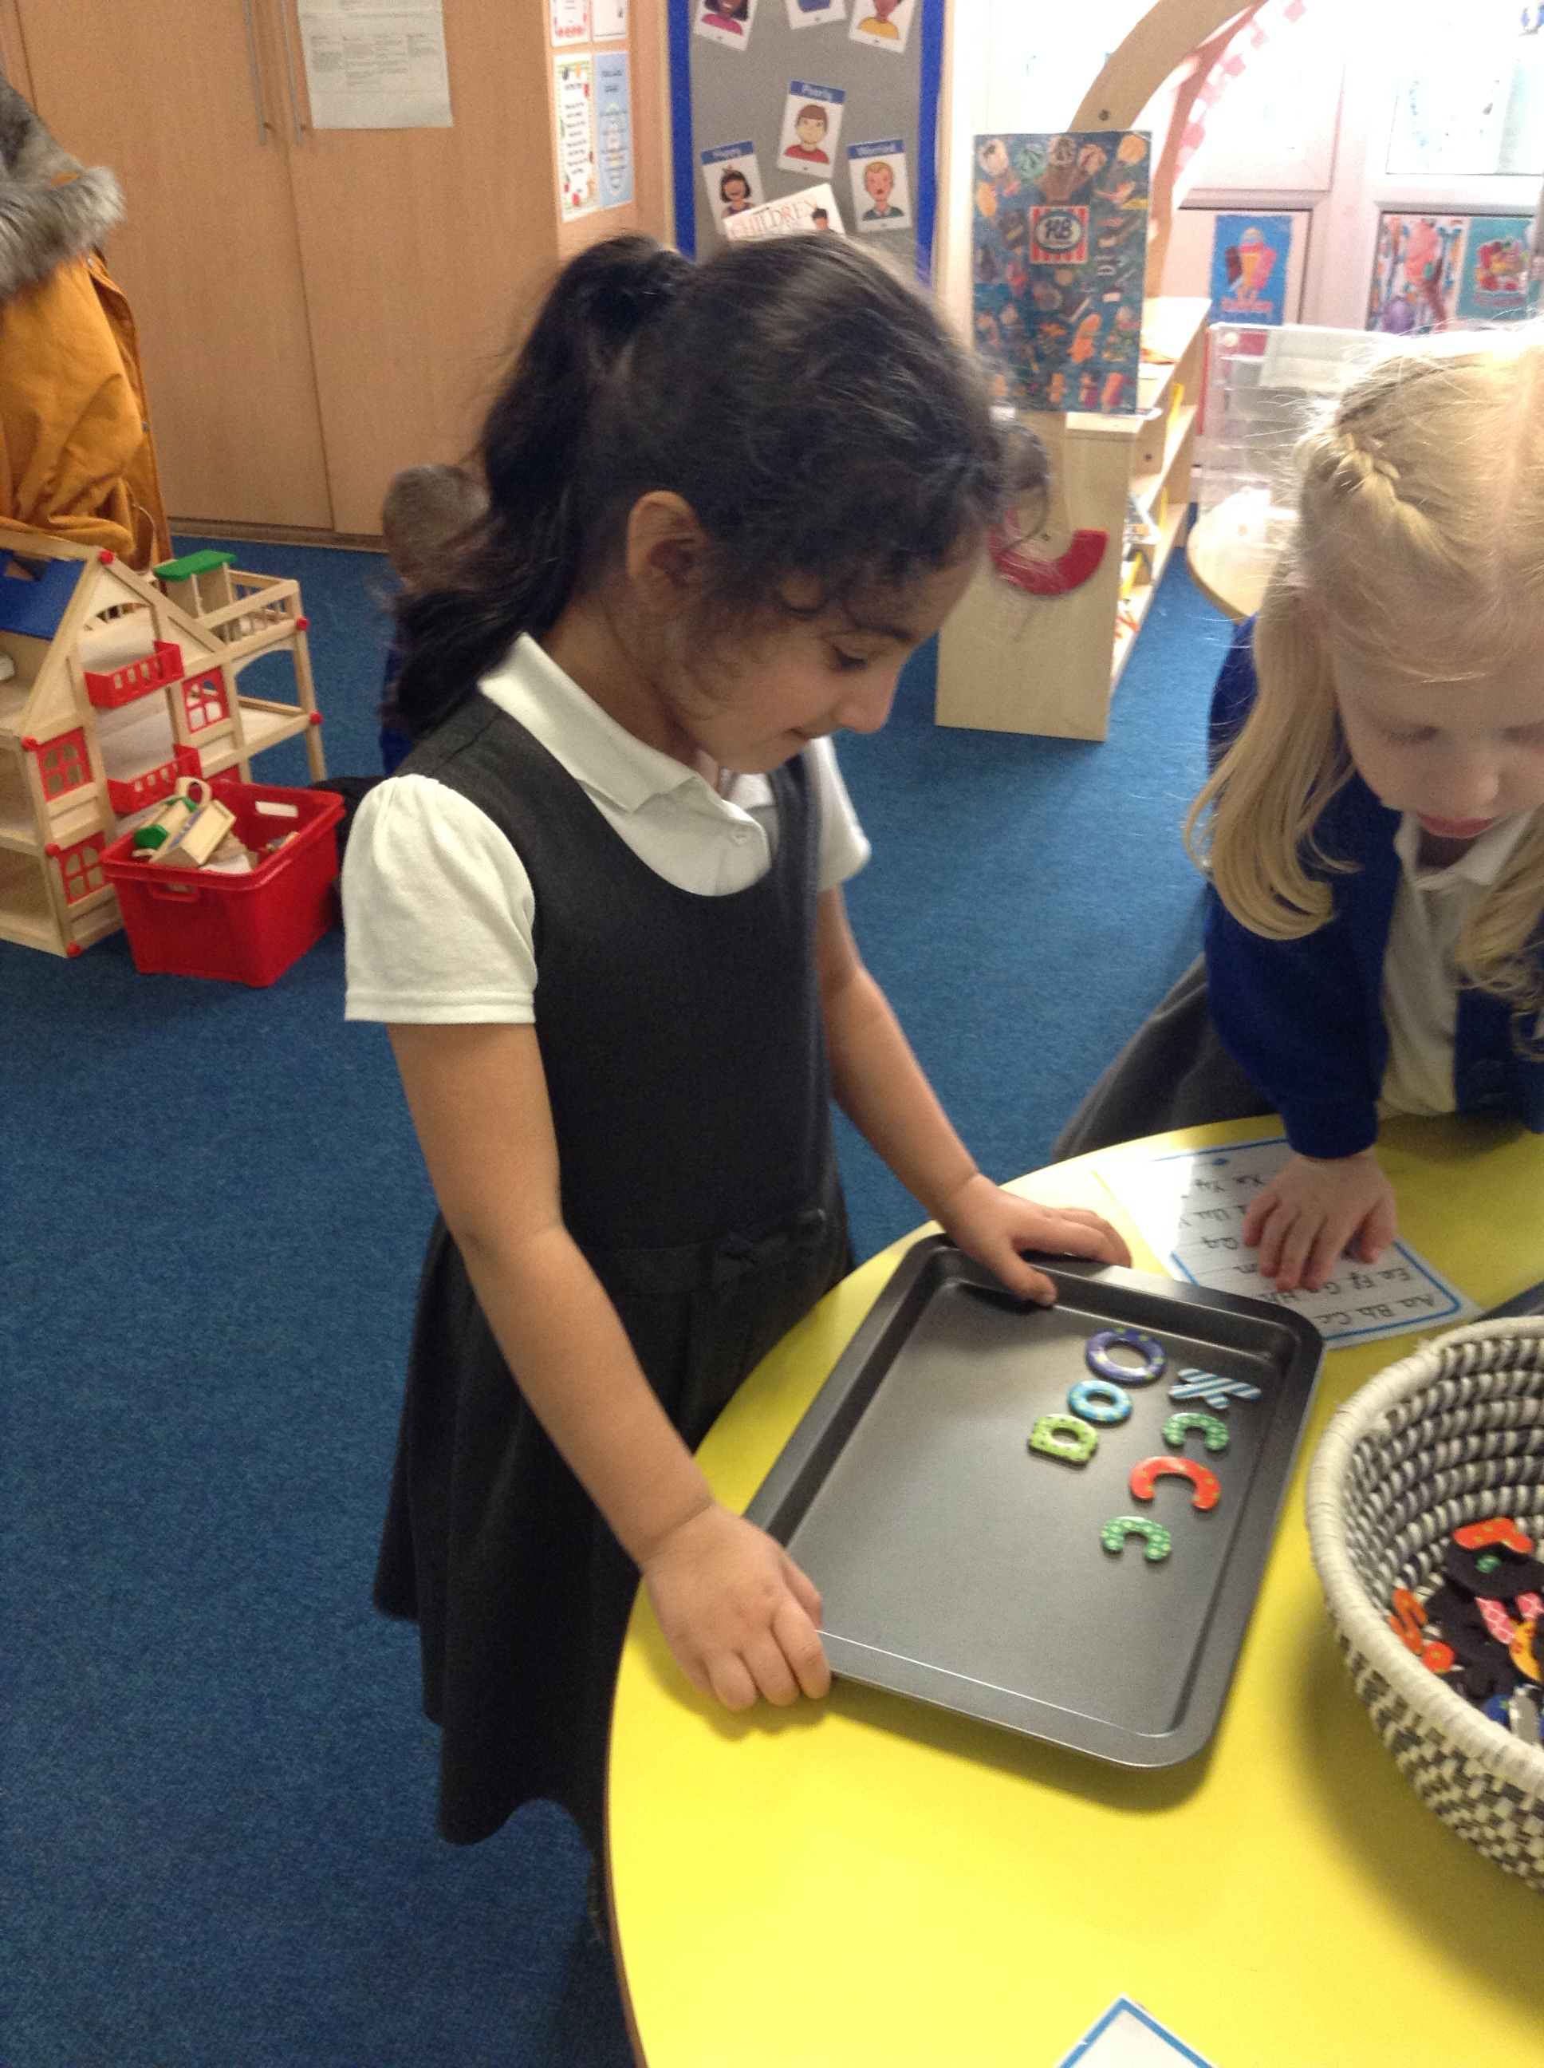
What is phonics?
Knowledge of the alphabetic code
(26 letters, 44 phonemes, 140 different letter combinations)
AND
Understanding of the skills of segmenting and blending

Slide 4

How we teach phonics
We follow the Letters and Sounds ‘Principles and Practice of High Quality Phonics’ document. Phonics is supported by using elements from Read Write Inc and Jolly Phonics amongst other resources to support the effective delivery of phonics lessons in order to cater for all pupils’ needs.
Letters and Sounds begins in EYFS and moves through to Year 2. In KS2, interventions are planned in order to meet each pupils’ specific needs.
Phonics lessons are systematic, following a clear structure and accurate, modelling the use of pure sounds.

Slide 5
Terminology
We use the correct phonic terminology with children right from the beginning. It might sound complex but it actually makes it easier.

Slide 6
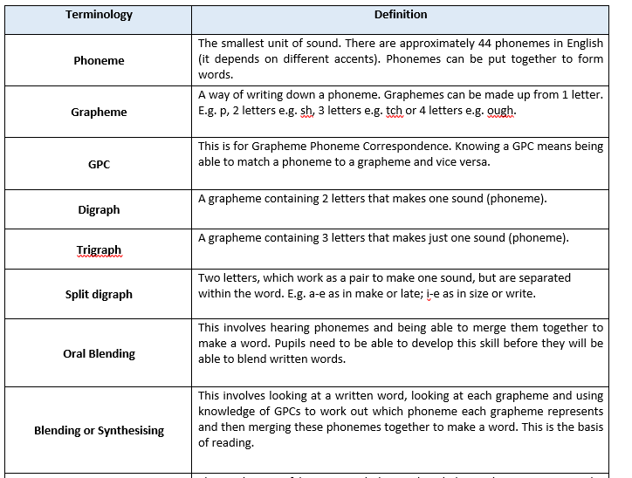
Terminology

Slide 7
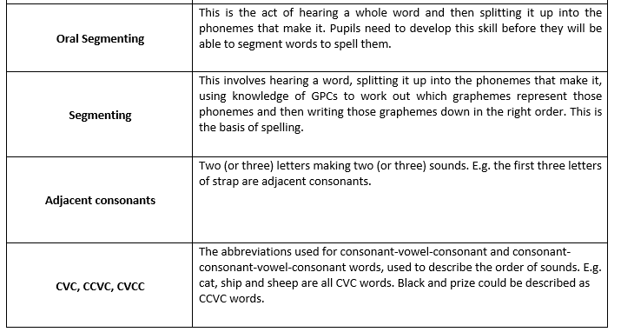
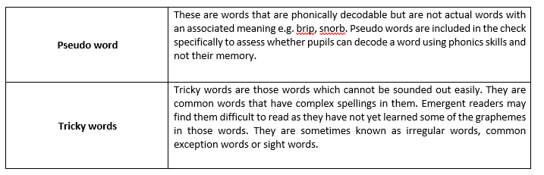

Slide 8
Tricky words
Common Exception Words
Pupils are taught high frequency words that do not conform completely to grapheme-phoneme correspondence rules. We call these ‘tricky’ words. Pupils are specifically taught the ‘tricky’ part of the word and strategies to remember this. They are taught to apply their knowledge of these words in reading and writing. The words are taken from phases 2 to 5 of Letters and Sounds in addition to those listed in the English Appendix 1: Spelling to the National Curriculum.
Phonically Decodable Texts
Pupils are not expected to read texts which they cannot decode for themselves until they are reaching fluency. We have a choice of phonically decodable books for both guided reading and home reading, which are carefully selected to match the pupil’s developing phonic knowledge, so that every pupil can experience success in their reading by using the skills they have already been taught.

Slide 9
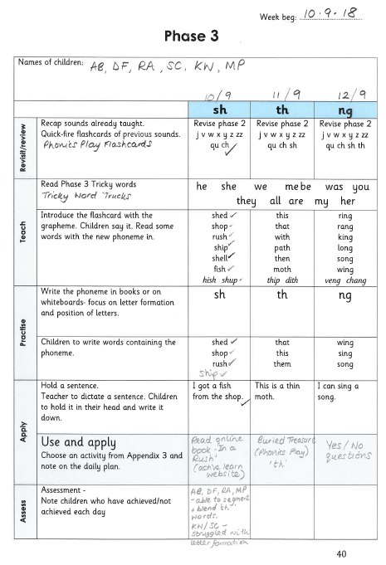
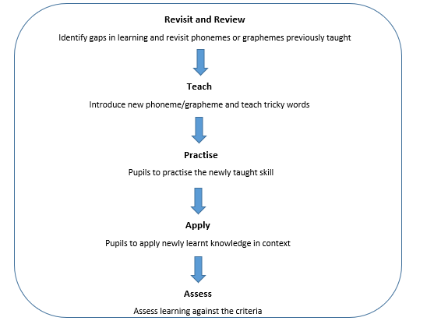
Planning
Phase 2

Slide 10
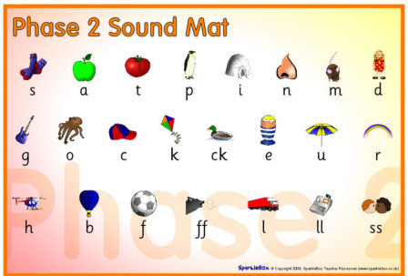

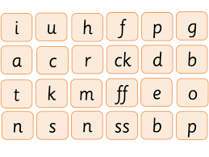
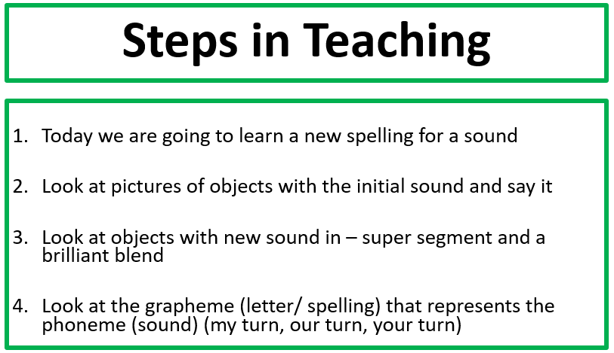
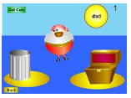
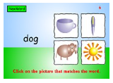
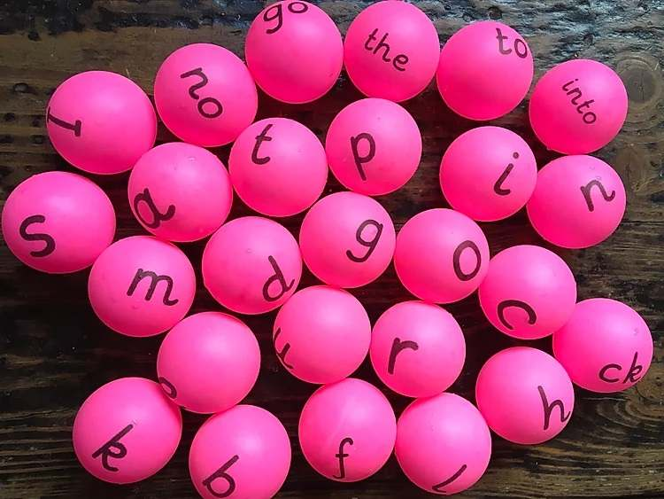

Phase 2
Revisit and review
Teach
Practise
Apply
Build it read it write it
Whiteboards
books
Super segmenting/Brilliant blending
Robot
Hulk
Swimming
Dancing

Slide 11
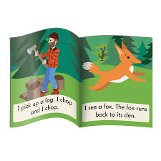
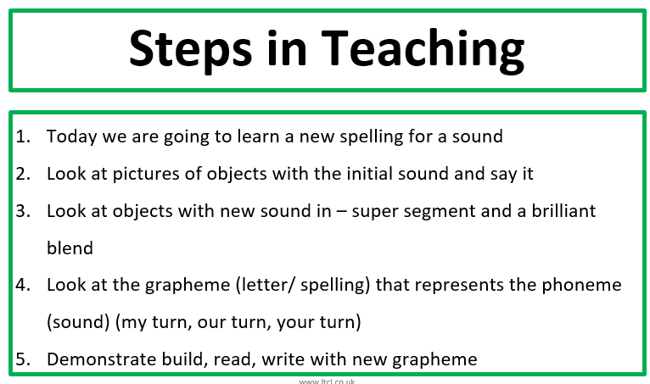
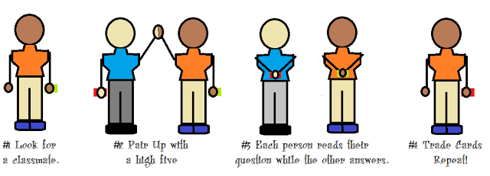
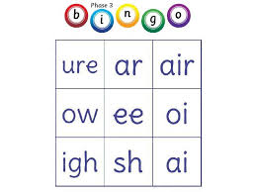
Phase 3
Revisit and review
Teach
Practise
Apply
Build it read it write it (LA)
Whiteboards
Super segmenting/Brilliant blending
Robot
Hulk
Swimming

Slide 12
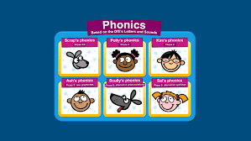
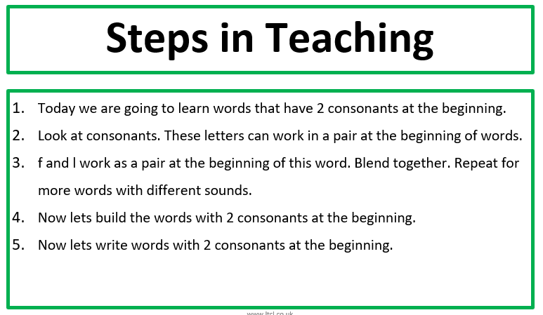
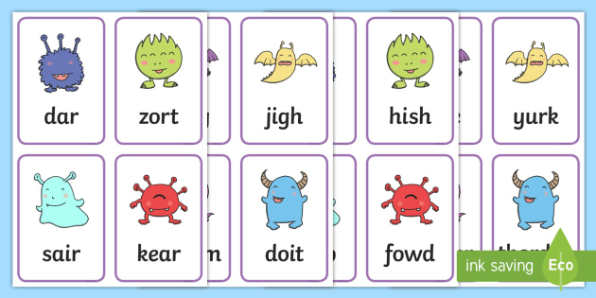

Phase 4
Revisit and review
Teach
Practise
Apply
Magic microphone
Whiteboards
books
Super segmenting/Brilliant blending
Robot
Hulk
Swimming

Slide 13
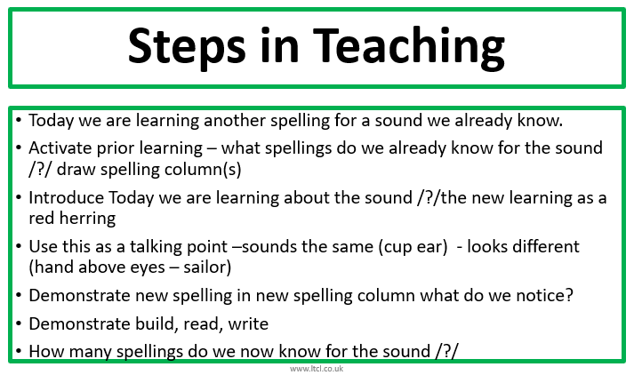
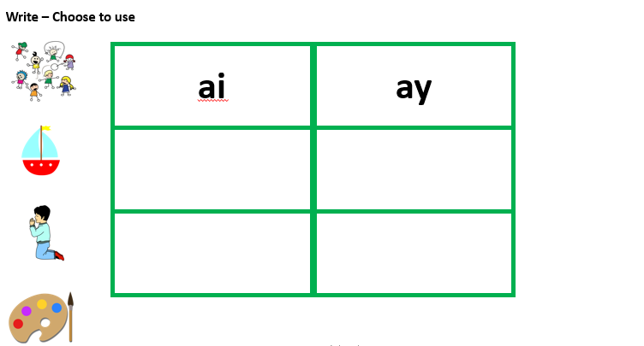
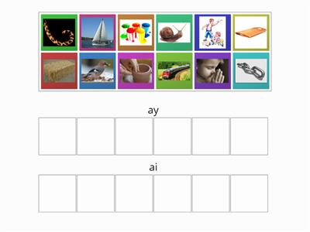
Phase 5a
Revisit and review
Teach
Practise
Apply
Split digraph teach

Slide 14
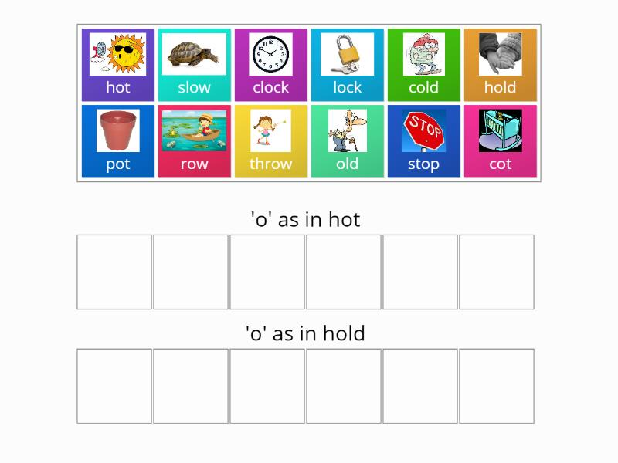
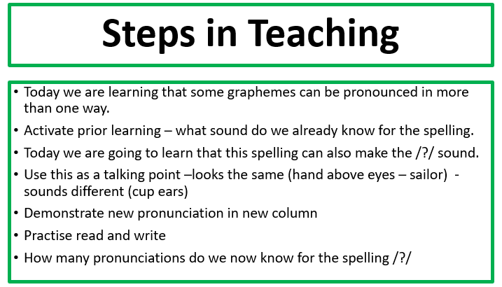
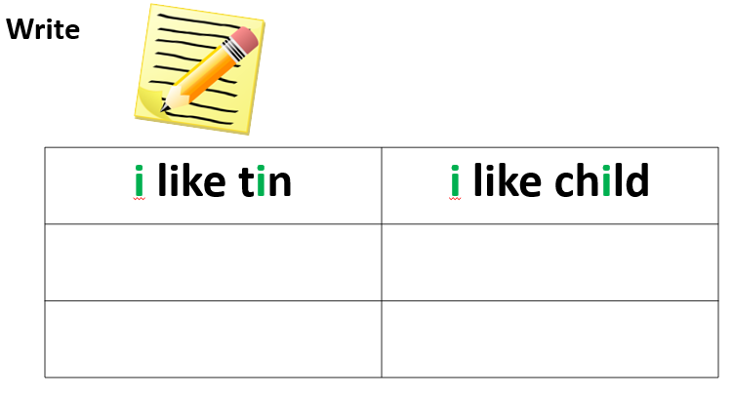
Phase 5B
Revisit and review
Teach
Practise
Apply

Slide 15
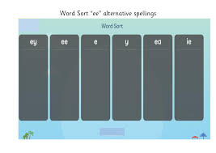
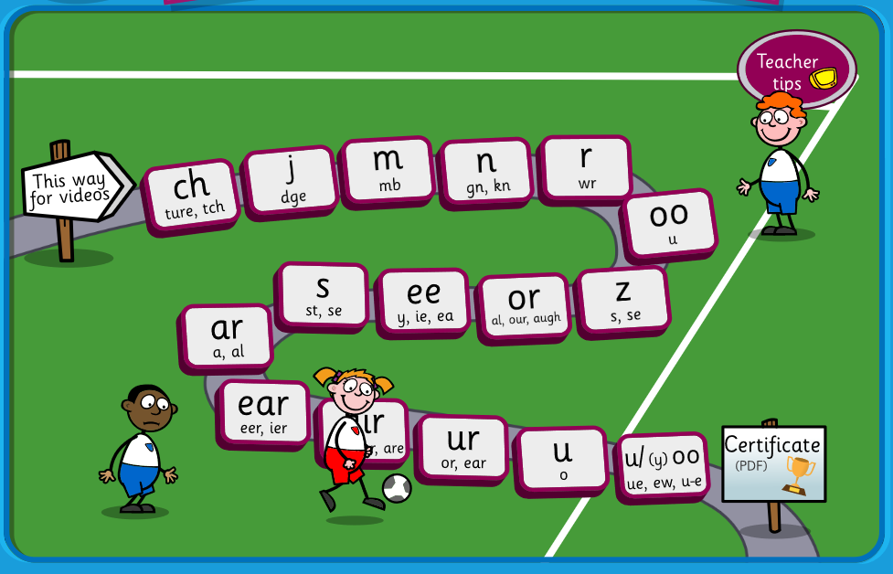
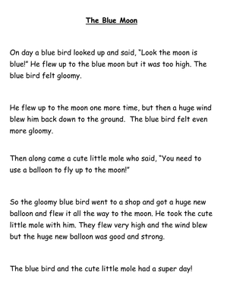
Phase 5c
Revisit and review
Teach
Practise
Apply

Slide 16
ONLINE Resources
Active Learn – www.activelearnprimary.co.uk – decodable texts for application of sound being taught
Phonicsplay – www.phonicsplay.co.uk – range of interactive games and printable resources
Espresso
Letters and Sounds - http://www.letters-and-sounds.com – interactive games, printable resources and application ideas.
Topmarks - www.topmarks.co.uk – links to phonics games. Be careful with sounds and accents!
Teach Your Monster To Read - www.teachyourmonstertoread.com – especially good for progression.
Phonics Bloom - www.phonicsbloom.com - range of interactive games.
Twinkl Phonics Suite – App
SpellingPlay www.spellingplay.co.uk

