Slide 1
Teach reading: change lives
Parent workshop: Foundations for a Love of Reading
Notes:
Suggested resources:
Print out the Foundations for Love of Reading handout for parents to take home.
A selection of picture books on display for parents to look at.
Choose one book that you can read aloud for Slide 8 – make sure it has some dialogue so you can model reading a character's voice with expression.
Suggested script:
Welcome to this parent information session all about how we use Little Wandle Foundations in our Nursery to support your child to develop a love of reading.

Slide 2
Children are made readers on the laps of their parents.
Emilie Buchwald
Notes:
Suggested script:
This quote from Emilie Buchwald, (an author, poet and teacher) is a good place for us to start.
We know that you are the people who can make the biggest difference to your children's reading.
When you read with your child, you are laying the best possible foundations for their future reading.
Today we will look at why reading aloud with your child is so important.

Slide 3

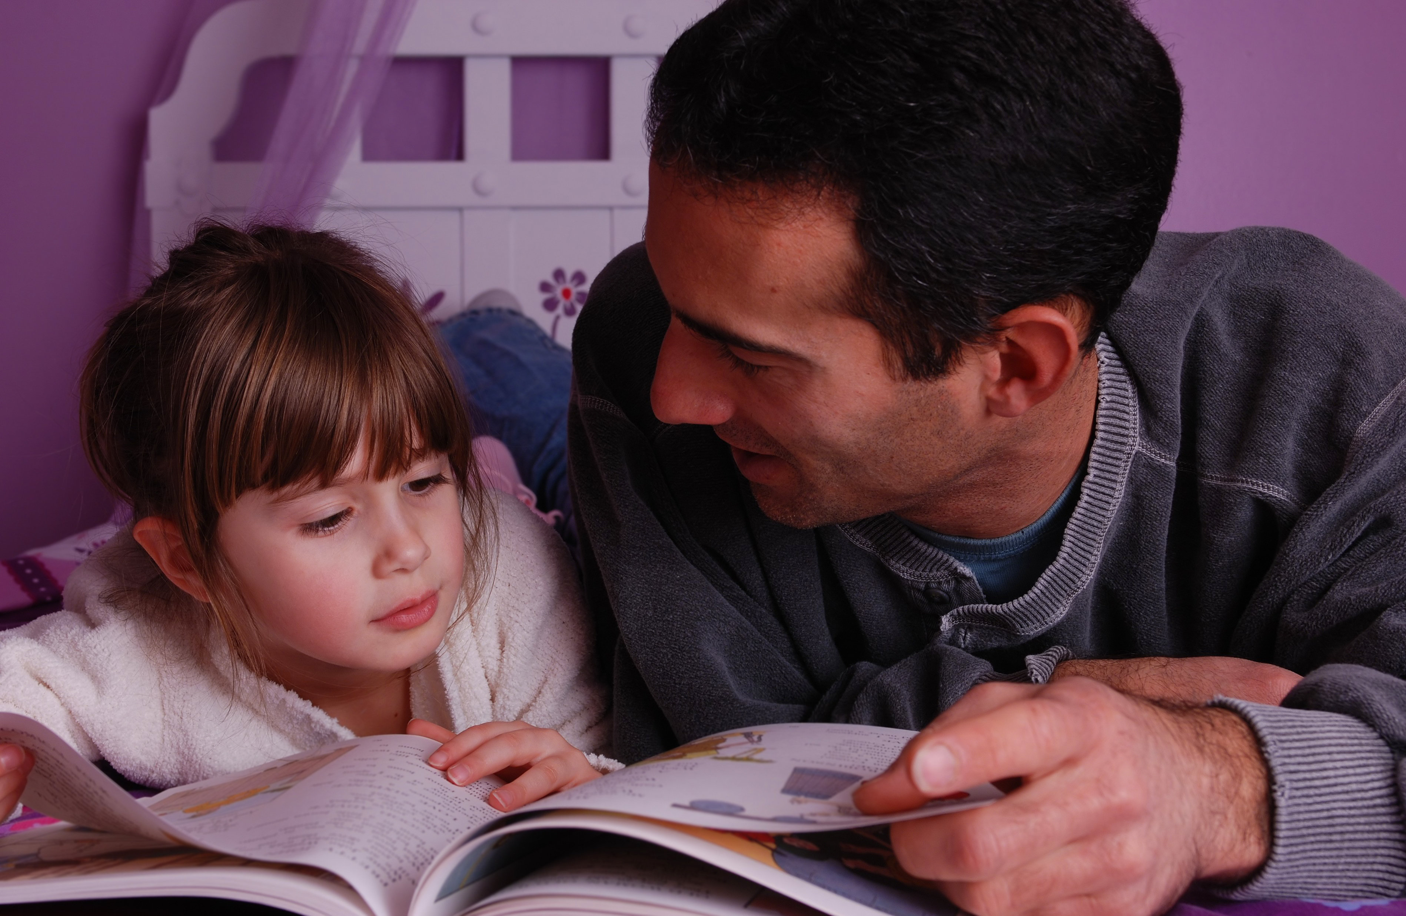
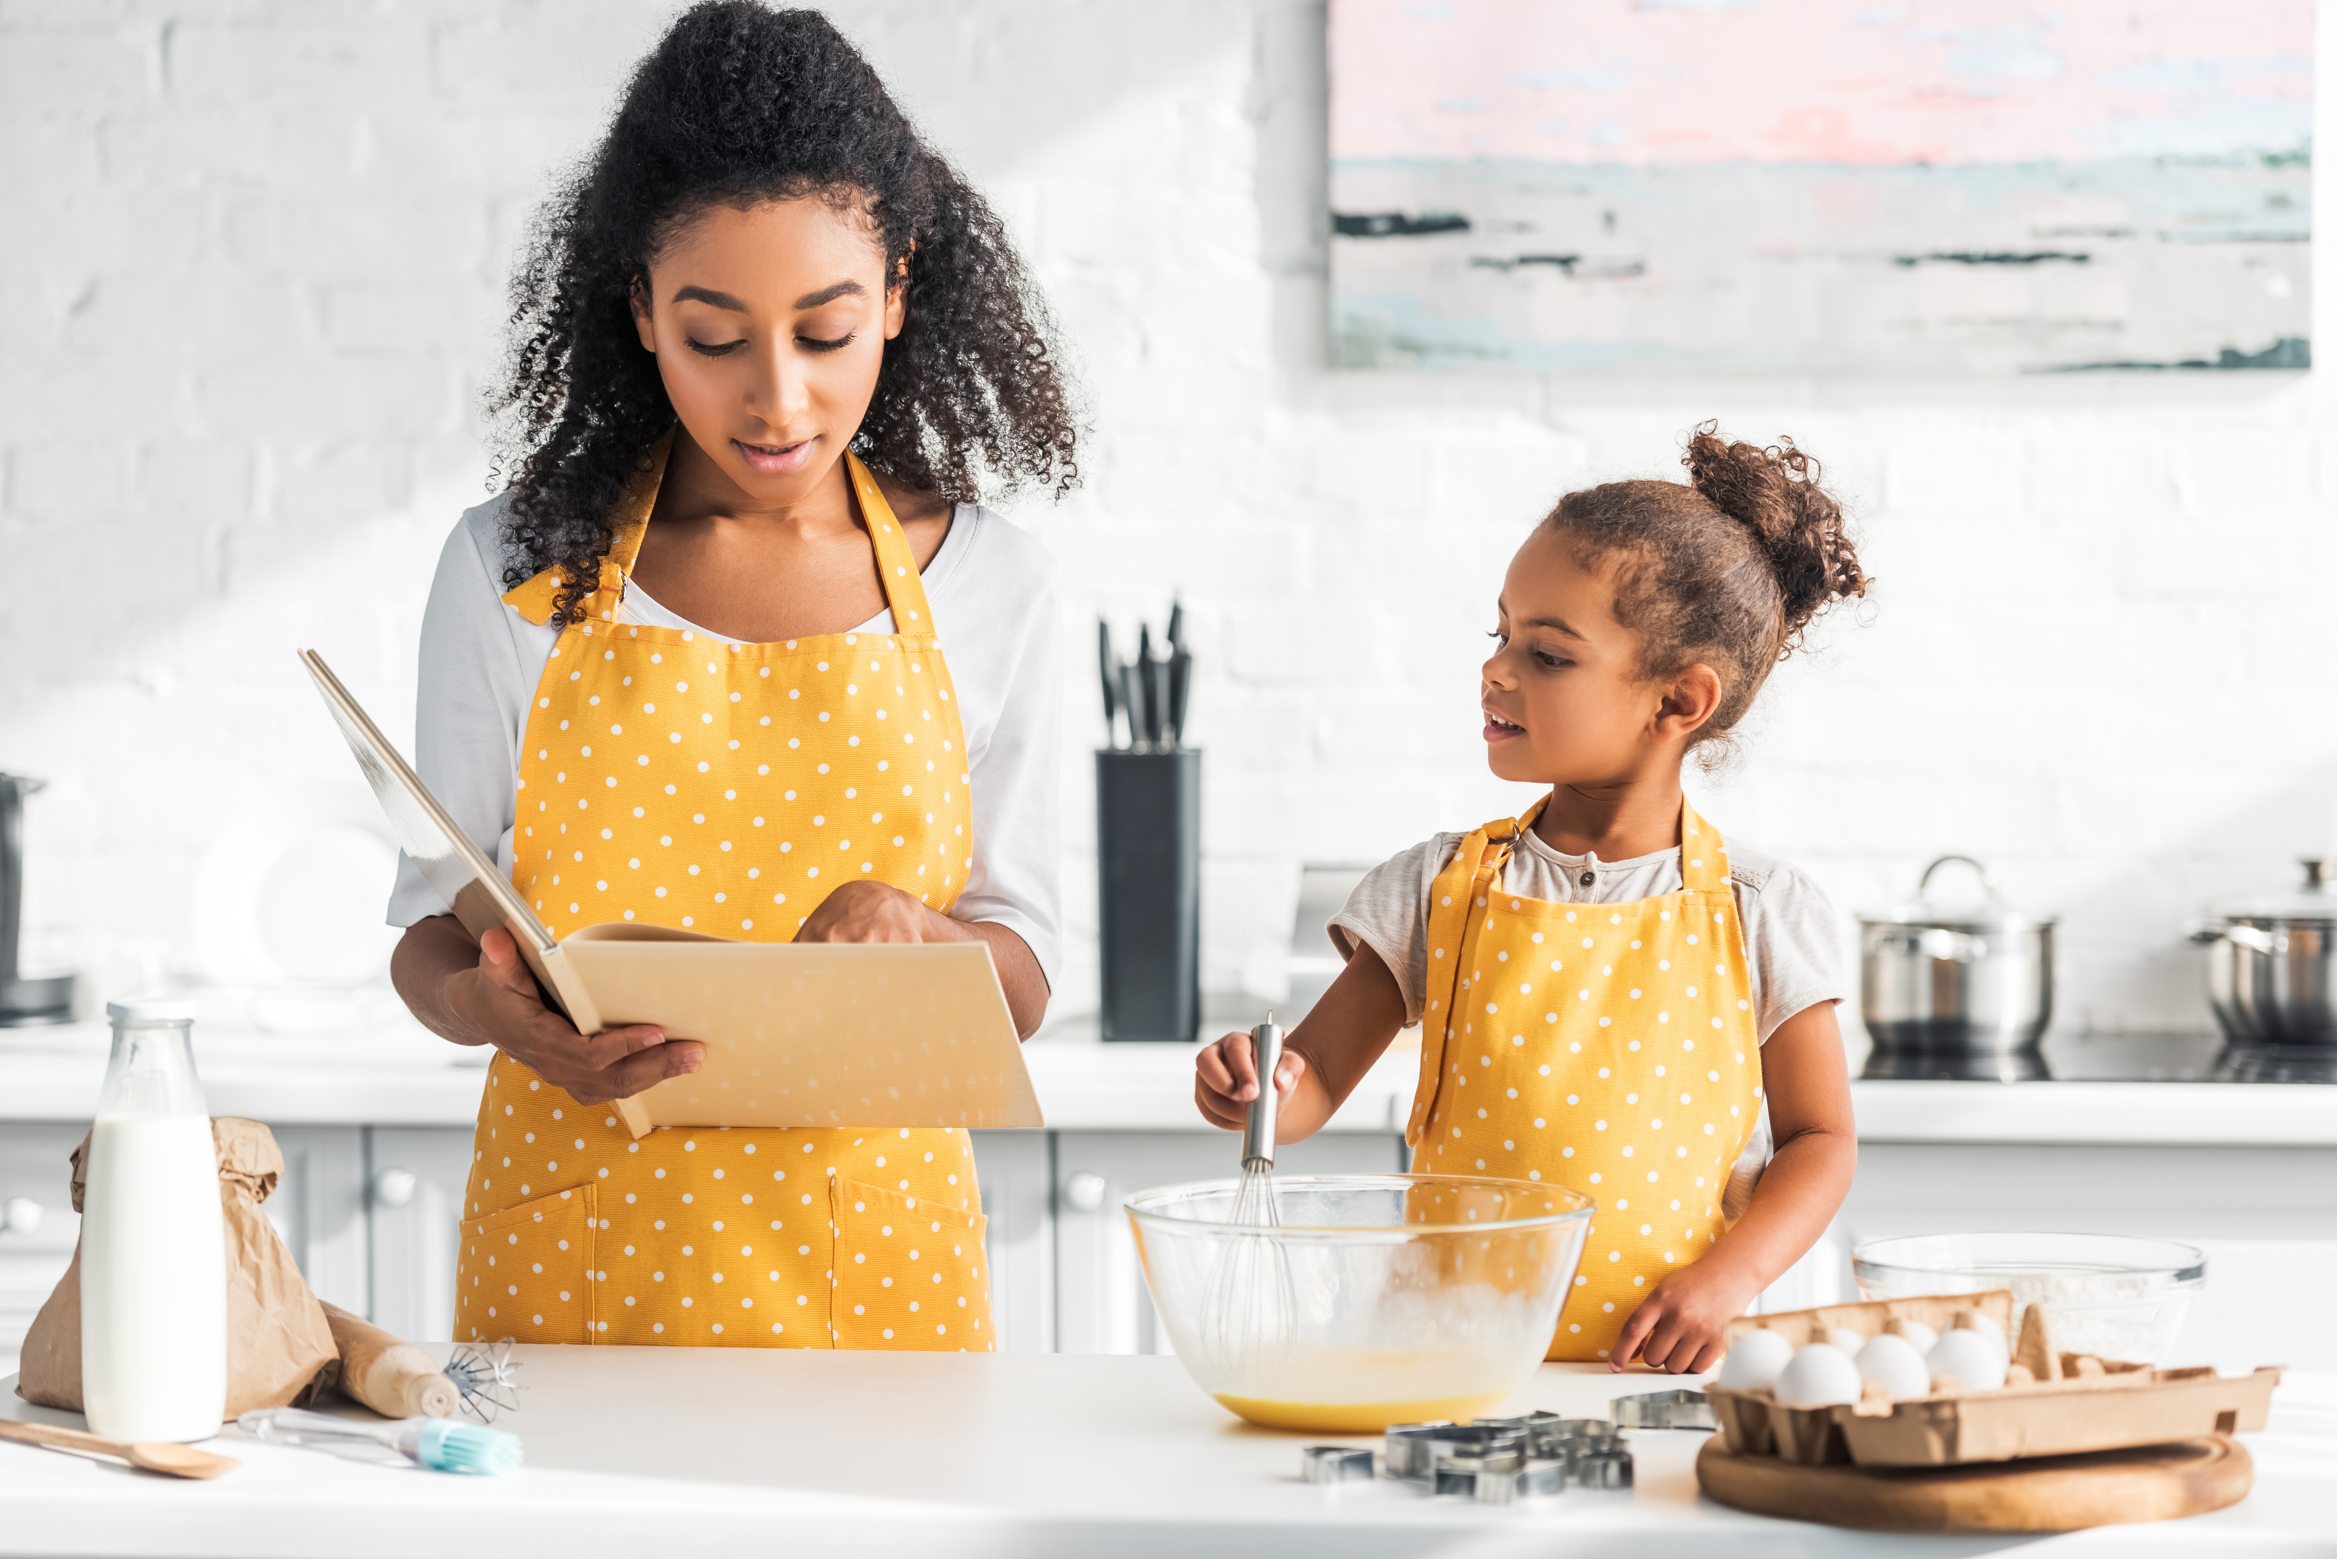
When do you read with your child?
Notes:
Suggested script:
Ask: When did you last read with your child? What did you read with them?
You probably read a lot with your child – every time you read, you are helping your child.

Slide 4
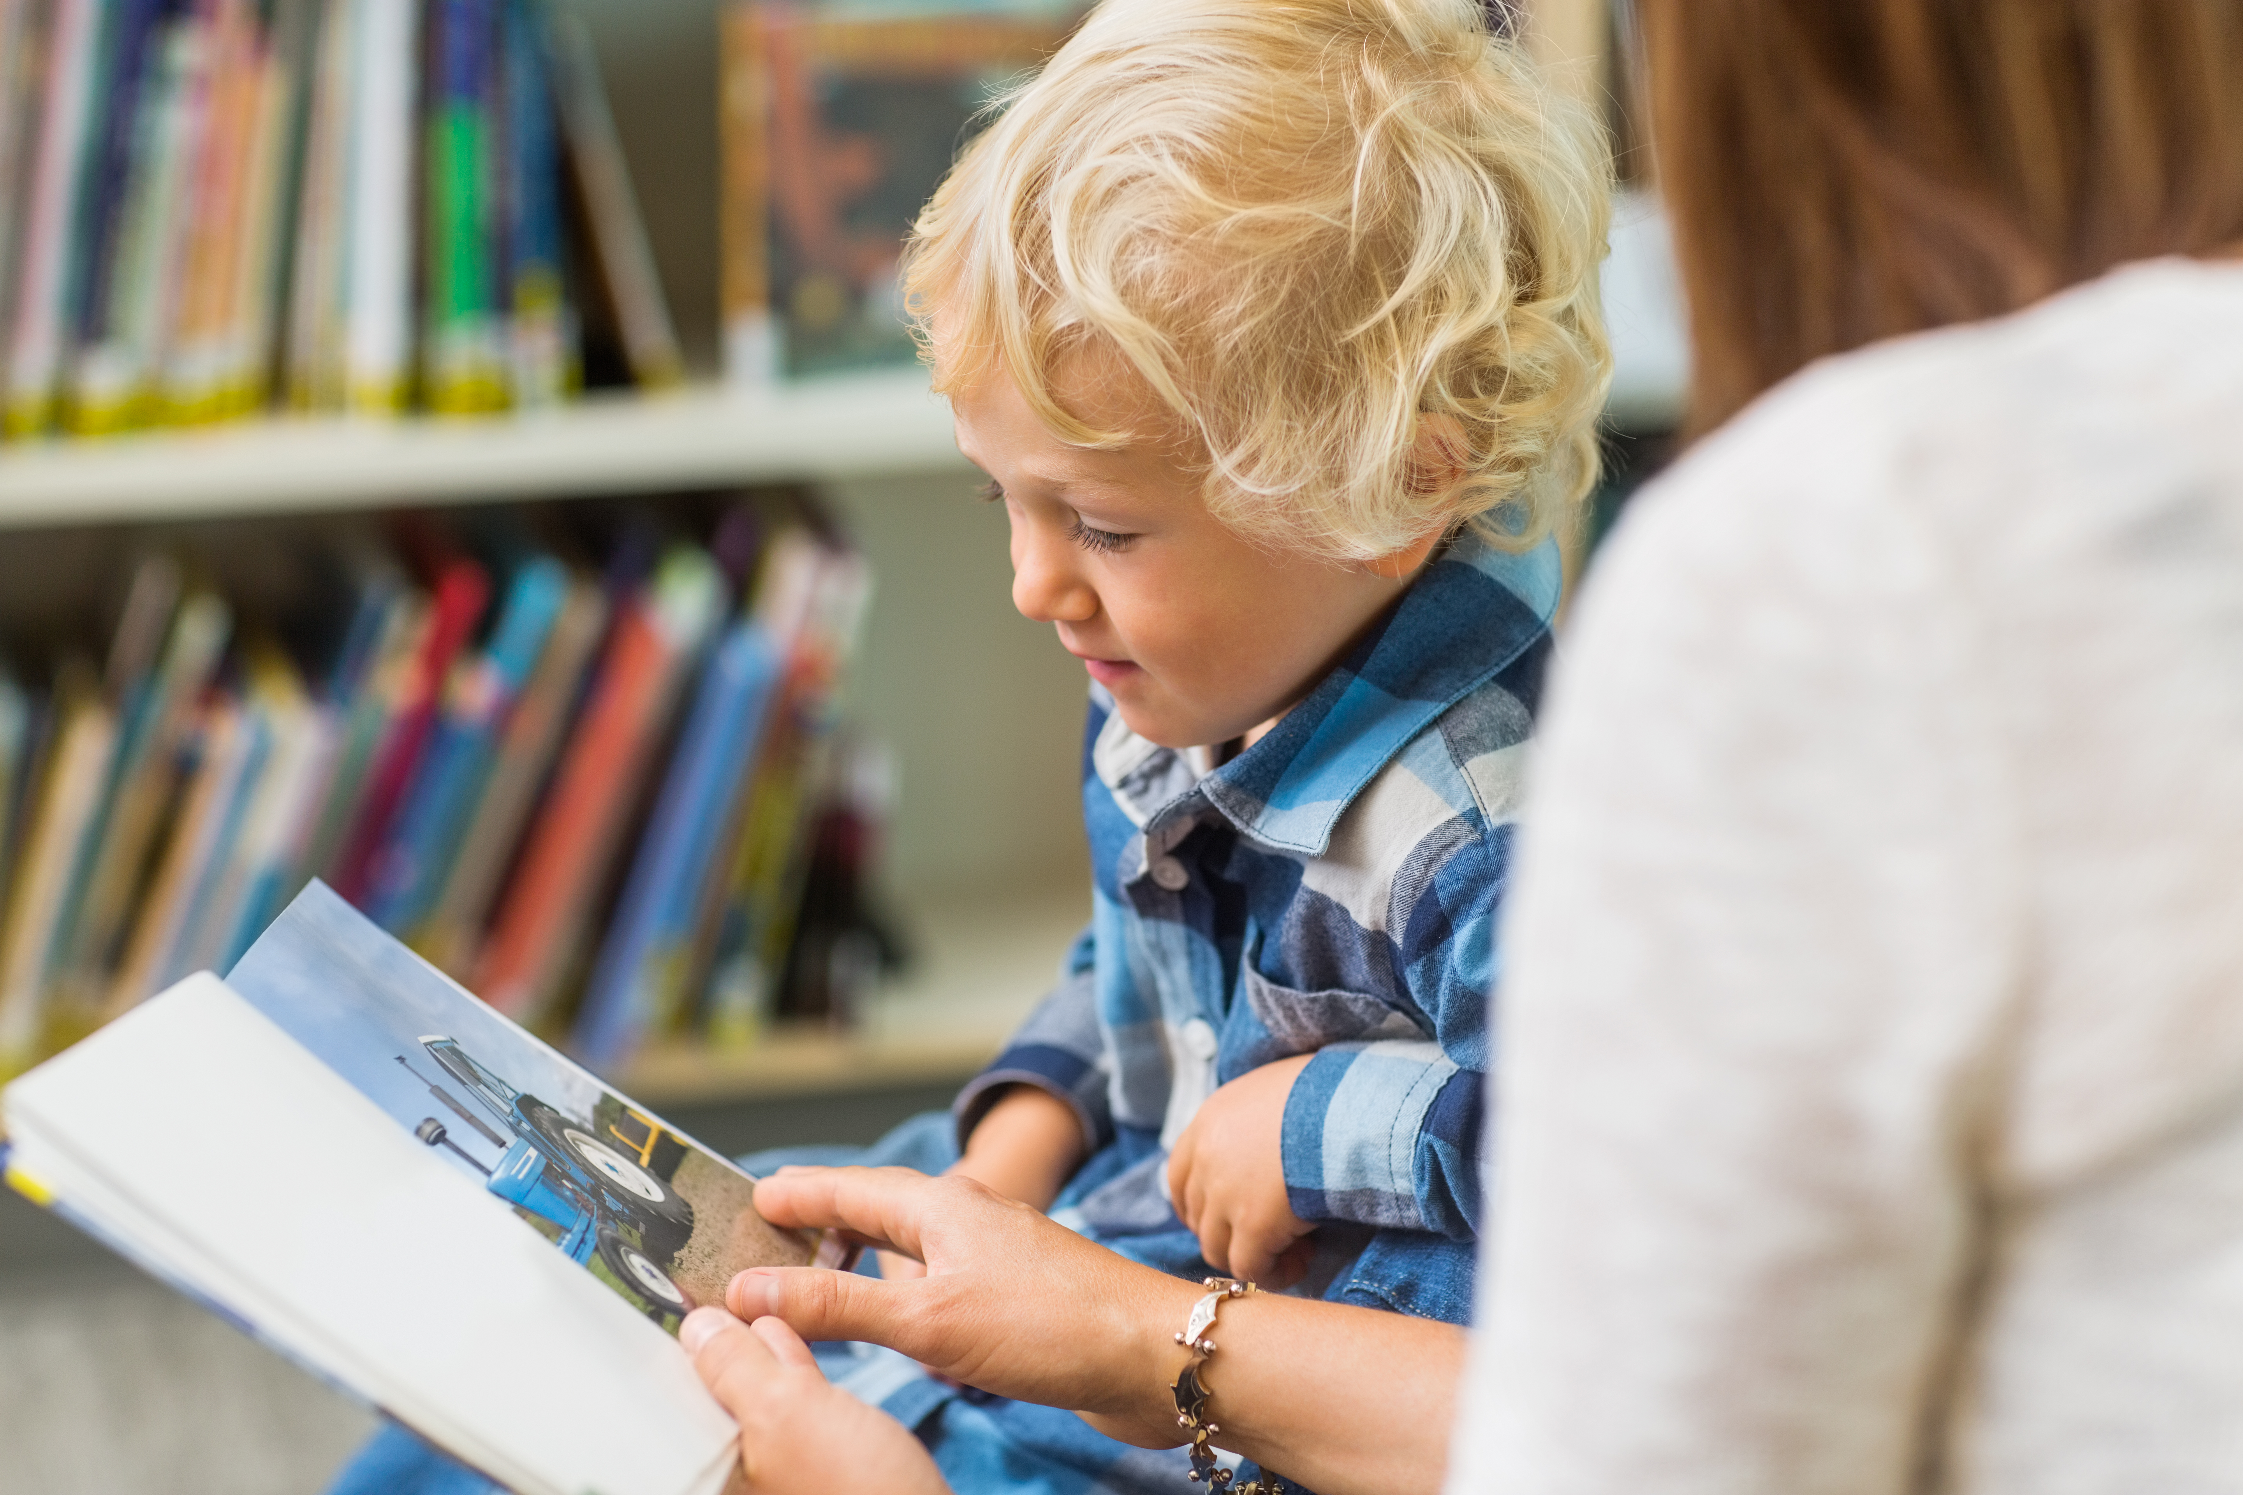
Little Wandle Foundations for a Love of Reading
Our setting has chosen to use the Little Wandle Foundations for a Love of Reading programme to give every child the best possible start to their reading journey.
We use this approach in Nursery, so that children go into Reception loving books.
Notes:
Suggested script:
Read the text on the slide.

Slide 5
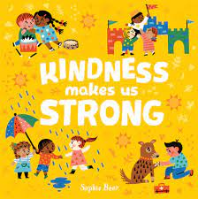
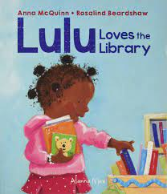
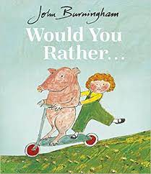
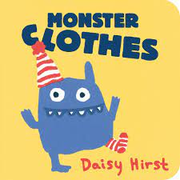
Little Wandle Foundations for a Love of Reading
We plan our provision using the Little Wandle book plans.
These help children by:
re-reading stories to build familiarity
developing vocabulary
reading related poems and rhymes
taking part in role-play linked to the text
providing opportunities for sensory play.
Notes:
Suggested script:
Read the text on the slide.

Slide 6
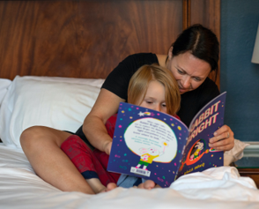
Why read with your child at home?
The number of books your child has encountered by the age of six is a positive predictor of their reading ability two years later.
This benefit comes from:
adults reading to children
children enjoying books simply by looking at them and talking about them.
Parental involvement in the development of children’s reading skill: A five-year longitudinal study (2002) Sénéchal, M. and LeFevre, J.
Notes:
Suggested script:
Read the text on the slide.

Slide 7

Does it matter which language we use?
Use your home language.
It is better for your child to hear expert talk from you in your language.
Many studies tell us that it is the back-and-forth talk between adults and children when they are sharing books that makes the difference to children’s language and comprehension.
This impact will translate to better language and comprehension skills for your child in English.
Notes:
Suggested script:
Read the text on the slide.

Slide 8
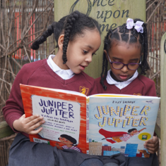
Does it matter how we read with our children?
Studies show that it is the enjoyment and chat that matters!
The more you chat together about the book and the things that interest your child, the more impact it has.
You don’t even have to read the words – talking about the pictures is just as important.
If you can read the words, then use your voice to make them come alive. It will help your child understand the book even better.
Notes:
Suggested script:
Read the text on the slide.
If you can, read aloud a page from a story with a flat monotonous voice, and then again with expression.
Ask: Which version sounded better? What did you notice about how I changed my voice?

Slide 9
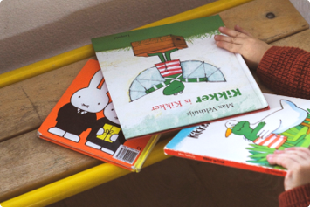
Does the type of book matter?
Let your child be the boss of the books they choose. Their enjoyment is what really matters.
Comics, information books, magazines, story books, picture books, poems and leaflets are all great for sharing.
Catalogues are fun to share and talk about, too.
Notes:
Suggested script:
Read the text on the slide.
If possible, show parents a range of these different reading material types.

Slide 10
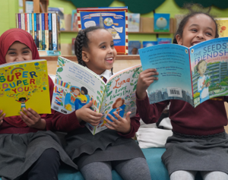
What if they always want to read the same book?
Repeated reading of books is really beneficial for children. It helps them memorise parts of the story, words and phrases, too.
Knowing a book or poem by heart is fun and powerful for children. They can ‘read’ the story with you or join in with individual words or phrases.
If you really want to mix it up, offer another book alongside the much-loved favourite!
Notes:
Suggested script:
Read the text on the slide.
Show the parents some of your class's favourite books at the moment.

Slide 11
Main take-aways
Nursery is where we lay the foundations for a love of books.
Little Wandle Foundations for a Love of Reading ensures that children are read to daily.
You can help at home by:
talking lots to your child
reading aloud to them every day
singing songs and rhymes
playing some of our Tuning into sounds and Rhyme time games.
Notes:
Suggested script:
Read the text on the slide.
Remember to ask us if you have any questions – we will always be happy to help!

Slide 12
A minute spent reading to your kids now will repay itself a million-fold later not only because they love you for reading to them, but also because, years later, when they’re miles away, those quiet evenings when you were tucked in with them, everything quiet but the sound of the page-turns, will seem to you, I promise, sacred.
George Saunders
Notes:
Suggested script:
Let's end with this wonderful quote from the American writer, George Saunders.
We understand how busy life is, but we promise that you will never forget carving time out of your busy days for sharing stories with your child!

